Slide 1
NLP Study – 3주차
Last Week Complementationary Material
발표자: 최희정

Slide 2
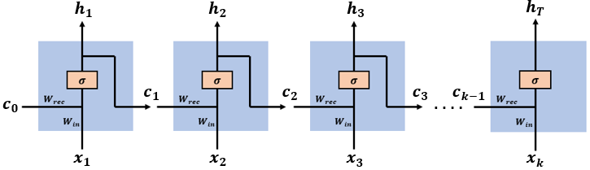
Last Week’s Unanswered Question
NLP Study – 3주차
Why do RNN networks suffer from vanishing gradients?
Input = sequence of vectors = [x(1), x(2), …, x(k)]
Network state vectors = [c(1), c(2), …, c(k-1)]
∴ time step = t → input vector = [c(t-1), x(t)]
Wrec = c(t-1) 에 적용되는 weight
Win = x(t) 에 적용되는 weight
∴ W = [Wrec, Win]
발표자: 최희정
Reference: https://medium.datadriveninvestor.com/how-do-lstm-networks-solve-the-problem-of-vanishing-gradients-a6784971a577

Slide 3


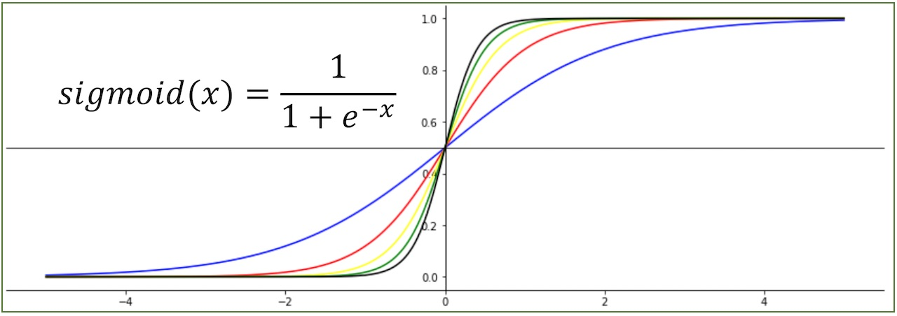
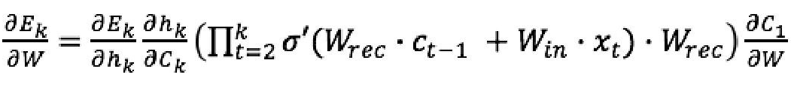
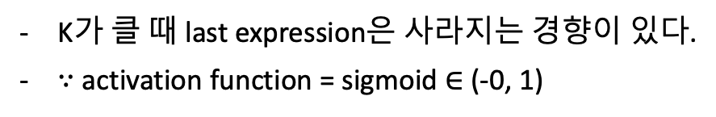
Last Week’s Unanswered Question
NLP Study – 3주차
BPTT (Backpropagation through time)
<Calculate Gradient>
<Update Weights>
- E(k) = prediction error
<Time step = k>
K가 클 때 last expression은 사라지는 경향이 있다.
∵ activation function = sigmoid $∈$ (-0, 1)
발표자: 최희정
Reference: https://medium.datadriveninvestor.com/how-do-lstm-networks-solve-the-problem-of-vanishing-gradients-a6784971a577

Slide 4



Last Week’s Unanswered Question
NLP Study – 3주차
BPTT (Backpropagation through time)
발표자: 최희정
Reference: https://medium.datadriveninvestor.com/how-do-lstm-networks-solve-the-problem-of-vanishing-gradients-a6784971a577

Slide 5
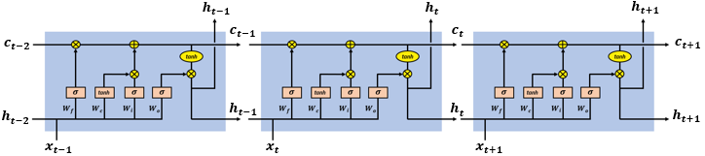
Last Week’s Unanswered Question
NLP Study – 3주차
How LSTM networks solve this?
Time step = t → input = [h(t-1), x(t)]
Forget gate, input gate, output gate
발표자: 최희정
Reference: https://medium.datadriveninvestor.com/how-do-lstm-networks-solve-the-problem-of-vanishing-gradients-a6784971a577

Slide 6
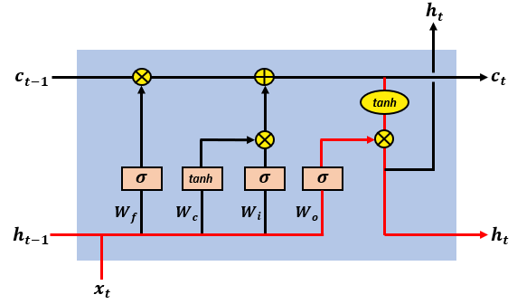

Last Week’s Unanswered Question
NLP Study – 3주차
LSTM cell state
타임 스텝 t 에서의 셀 스테이트
t-1 에서의 셀 스테이트
t 에서의 망각 게이트 출력
t 에서의 셀 스테이트
t 에서의 시퀀스 인풋
발표자: 최희정
Reference: https://medium.datadriveninvestor.com/how-do-lstm-networks-solve-the-problem-of-vanishing-gradients-a6784971a577

Slide 7
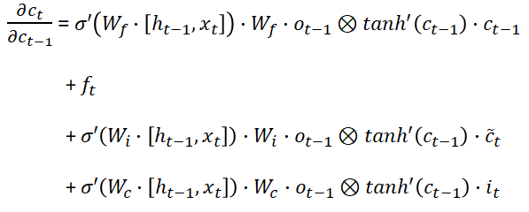

Last Week’s Unanswered Question
NLP Study – 3주차
BPTT (Backpropagation through time)
발표자: 최희정
Reference: https://medium.datadriveninvestor.com/how-do-lstm-networks-solve-the-problem-of-vanishing-gradients-a6784971a577

Slide 8

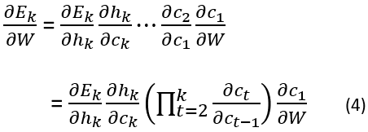


Last Week’s Unanswered Question
NLP Study – 3주차
BPTT (Backpropagation through time)
발표자: 최희정
Reference: https://medium.datadriveninvestor.com/how-do-lstm-networks-solve-the-problem-of-vanishing-gradients-a6784971a577

Slide 9
NLP Study – 3주차
<Paper Review>
Efficient Estimation of Word Representations
in Vector Space
발표자: 최희정
Efficient Estimation of Word Representations in Vector Space, 2013.

Slide 10
NLP Study – 3주차
Introduction – Goals of the Paper
아주 많은 데이터셋을 가지고, high quality word vector를 표현해보자!
단어 사이의 Similarity를 파악하자!
어떻게? Vector Offset 연산으로!
a = “debug”, a’ = “debugging”
→ a’ - a = vector offset = “-ing” (suffix)
Vector(“king”) - vector(“man”) + vector(“woman”) = vector(“queen”)
발표자: 최희정
Efficient Estimation of Word Representations in Vector Space, 2013.

Slide 11
NLP Study – 3주차
Model Architectures – Computational Complexity
O = E * T * Q
(E = epoch, T = # training, Q = 모델 아키텍쳐를 따름)
일반적으로, E=[3, 50], T >= 1’000’000’000
발표자: 최희정
Efficient Estimation of Word Representations in Vector Space, 2013.

Slide 12
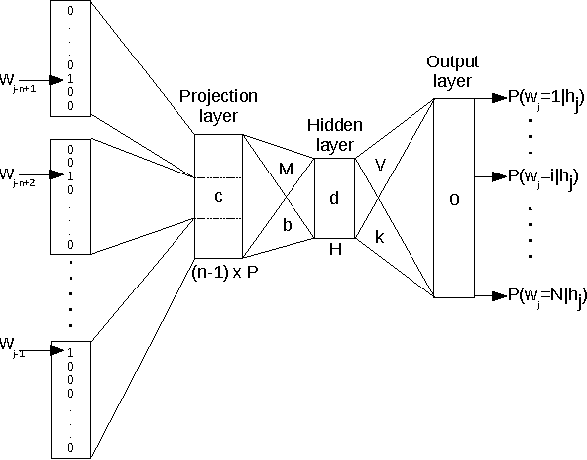
NLP Study – 3주차
Model Architectures – Feedforward Neural Net Language Model (NNLM)
Feedforward Neural Net
Q = N*D + N*D*H + H*V
N = 고려할 이전 단어의 개수
V = vocabulary의 크기
D = 단어 표현
(P = V*D)
H = 은닉층 유닛 개수
발표자: 최희정
Efficient Estimation of Word Representations in Vector Space, 2013.

Slide 13
NLP Study – 3주차
Model Architectures – Feedforward Neural Net Language Model (NNLM)
Proposed Model
Vocabulary가 허프만 이진 트리로 표현되는 계층적 softmax 사용
(허프만 이진 트리: 자주 나오는 단어에 짧은 이진 코드)
→ Q = N*D + N*D*H + H*log2(V)
발표자: 최희정
Efficient Estimation of Word Representations in Vector Space, 2013.

Slide 14
NLP Study – 3주차
Model Architectures – Recurrent Neural Net Language Model (RNNLM)
Recurrent Neural Net
Projection layer가 없음.
Q = H*H + H*V
(단어 표현 D가
Hidden layer의 크기 H와 같아짐)
Proposed Model
Vocabulary가 허프만 이진 트리로 표현되는 계층적 softmax 사용
(허프만 이진 트리: 자주 나오는 단어에 짧은 이진 코드)
→ Q = H*H + H*log2(V)
발표자: 최희정
Efficient Estimation of Word Representations in Vector Space, 2013.

Slide 15
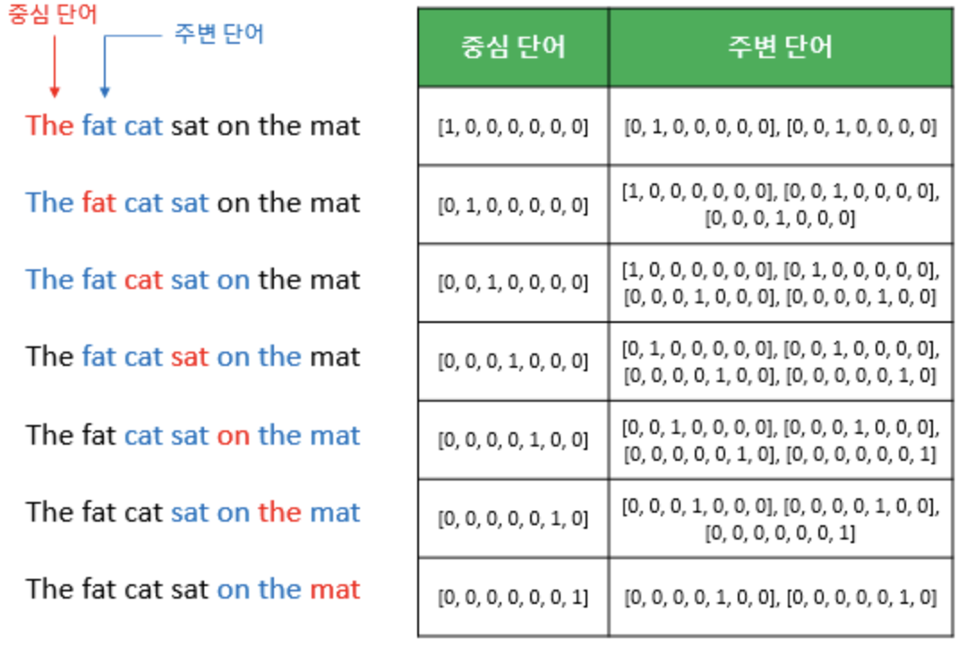
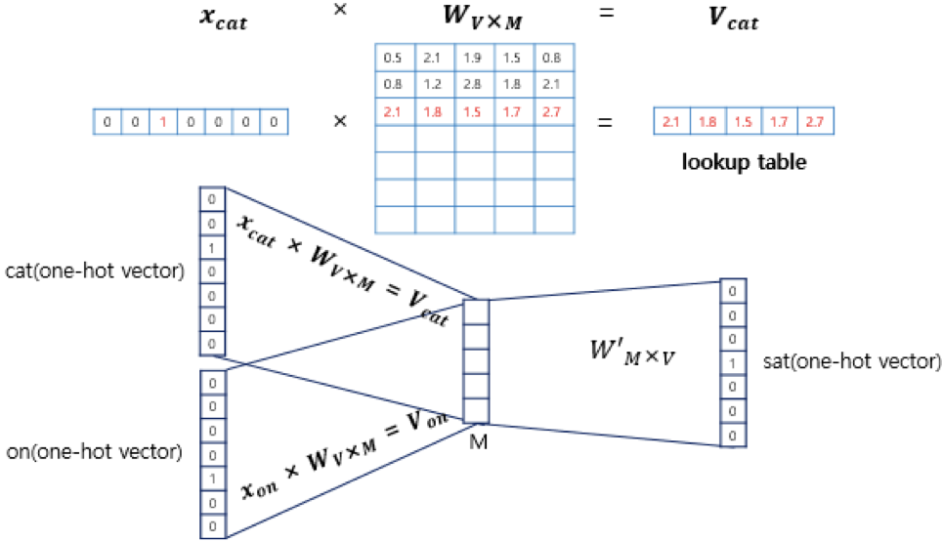
NLP Study – 3주차
New Log-linear Models – Continuous Bag-of-Words Models(CBOW)
CBOW: 주변에 있는 단어(context word)들을 가지고, 중간에 있는 단어(center word)들을 예측하는 방법
→ Q = N*D(=M) + D * log2(V) 히든 레이어가 없음!
발표자: 최희정
Efficient Estimation of Word Representations in Vector Space, 2013.

Slide 16
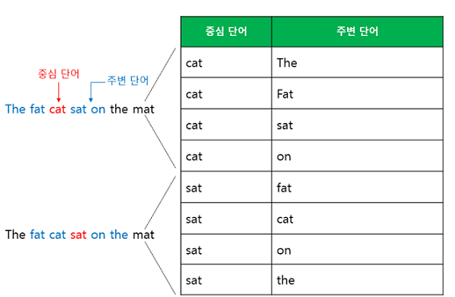
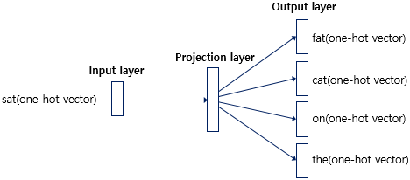
NLP Study – 3주차
New Log-linear Models – Continuous Skip-gram Model
Skip-gram: center word를 가지고 context word를 예측하는 방법
발표자: 최희정
Efficient Estimation of Word Representations in Vector Space, 2013.

