Slide 1
Web Services, WS-*, SOAP, WSDL, etc
Oxford University
Software Engineering Programme
Sep 2015

Slide 2
Contents
Understanding WS-*
SOAP
SOAP examples

Slide 3







WS-* Standards
A set of extensible and composable standards that work together
Providing a common, standard, interoperable base to implement SOA

Slide 4
Composability
The ability to use the various Web services standards together or apart
Some examples from other spaces:
The Spring Framework allows you to choose whether or not to use transactions without rewriting your code
Java Security can be applied to existing code libraries by setting policies
More about composability later

Slide 5
Key Web Services Standards
Orchestration
Business Process Execution Language (BPEL)
SECURE
WS-Security
(encrypt, sign, auth)
WS-SecureConversation
(~SSL)
WS-Trust
(~Kerberos)
RELIABLE
WS-ReliableMessaging
(ExactlyOnce,
InOrder delivery, ~JMS)
TRANSACTIONAL
WS-AtomicTransaction
(2 Phase Commit ~XA)
WS-BusinessActivity
(Long running loosely coupled)
Composable
Quality
of
Service
WS-Policy
WS-MetadataExchange
WS-Addressing
Messaging
SOAP
WSDL
Transport
HTTP, TCP, SMTP, UDP
Wire interaction
Metadata
The Web services platform forms a complete framework for open standards enterprise middleware

Slide 6


Standards Bodies
Pulling it together:
Interoperability
Composability
Profiling
Qualities of Service:
Security, Transactions, Reliability
Resource management
Base standards:
XML, HTTP, SOAP,
WS-Addressing, Policy

Slide 7
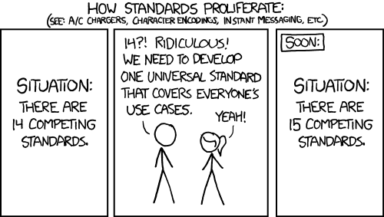

Slide 8
SOAP
SOAP was originally proposed by Microsoft and Developmentor
IBM joined up shortly afterwards
SOAP used to stand for:
Simple Object Access Protocol
BUT they soon realised it isn’t that simple and isn’t an object access protocol!
So now its just SOAP

Slide 9
A Sample SOAP Message
<soap:Envelope xmlns:soap="http://schemas.xmlsoap.org/soap/envelope/">
<soap:Header/>
<soap:Body>
<getProductDetails xmlns="http://warehouse.example.com/ws">
<productID>827635</productID> </getProductDetails>
</soap:Body>
</soap:Envelope>

Slide 10
A Sample SOAP Message (cont)
<soap:Envelope xmlns:soap="http://schemas.xmlsoap.org/soap/envelope/">
<soap:Header/>
<soap:Body>
<getProductDetails xmlns="http://warehouse.example.com/ws">
<productID>827635</productID> </getProductDetails>
</soap:Body>
</soap:Envelope>
The SOAP header provides a space for arbitrary headers to be added to the message`

Slide 11
A Sample SOAP Message (cont)
<soap:Envelope xmlns:soap="http://schemas.xmlsoap.org/soap/envelope/">
<soap:Header/>
<soap:Body>
<getProductDetails xmlns="http://warehouse.example.com/ws">
<productID>827635</productID> </getProductDetails>
</soap:Body>
</soap:Envelope>
The contents of the SOAP body element can be any valid XML that the parties wish to interchange

Slide 12
Main Features of SOAP
<SOAP:Envelope>
This is a simple XML wrapper that holds the message and indicates this is a SOAP message
<SOAP:Header>
An optional element that carries headers
This is how security, reliability, etc are composed
<SOAP:Body>
The business payload of the message
An XML element

Slide 13
Further Aspects of SOAP
Two versions:
SOAP 1.1
The mainly deployed version
Submitted as the proposed spec to the W3C
SOAP 1.2
The standardized version from the W3C

Slide 14
Further Aspects of SOAP Cont…
Major differences
SOAP 1.2 is defined in terms of XML Infoset
This is the LOGICAL structure of an XML document and NOT the actual <> encoding
The namespace changed
Actor → Role (see next page)
Addition of none and UltimateReceiver roles
Different faults and fault model
Abstract binding framework

Slide 15
Roles
A SOAP message may be passed from agent to agent
Known as SOAP intermediaries
Each header can be targeted against a specific role (e.g. a security manager)
A little used aspect of the specification
Specific roles:
None – shouldn’t be processed
Next – must be processed by whoever receives it
UltimateReceiver – the final consumer of the message

Slide 16
mustUnderstand Attribute
Headers can be marked with an attribute:
<wsrm:Sequence mustUnderstand=‘true’/>
This means that the processing agent must either be able to process this header, or send a fault

Slide 17
SOAP- A Simple Enveloping Model
So why use SOAP over POX?
Firstly, you don’t have to
We will see how Axis2 supports both SOAP and POX without any change to your code
POX is a great model for simple lightweight communications
But
SOAP has the “space” in the message to add security, reliability etc when you need it
Almost every enterprise integration model needs extensible headers
SOAP is much less reliant on the transport for headers, routing, etc

Slide 18
Using SOAP Headers
Some simple examples
Add a signature to ensure the message isn’t modified
Add a process identifier to track this message as part of a wider process
Add a userid so that end-to-end security can be guaranteed
Add a message number so messages can be resent if lost

Slide 19

What is a service definition?
Notes:
Discuss first

Slide 20
What is a service definition?
What does it do?
Where is it?
Who owns and runs it?
Is it going to be up on Monday?
What do I have to do to use it?
How much does it cost?

Slide 21
What is a service definition?
What does it do?
Where is it?
Who owns and runs it?
Is it going to be up on Monday?
What do I have to do to use it?
How much does it cost?

Slide 22
Web Services Description Language
WSDL
Currently used version 1.1
Recently 2.0 made available
Focuses on:
What the messages are
Schema
How they flow (in, in-out, etc)
Message Exchange Pattern
Where they are
Endpoint URLs

Slide 23
Abstraction
WSDL splits into:
Interface / PortType
The abstract interface
The Binding
The mapping into SOAP or XML/HTTP (or +++)
The port
The actual endpoint or location

Slide 24
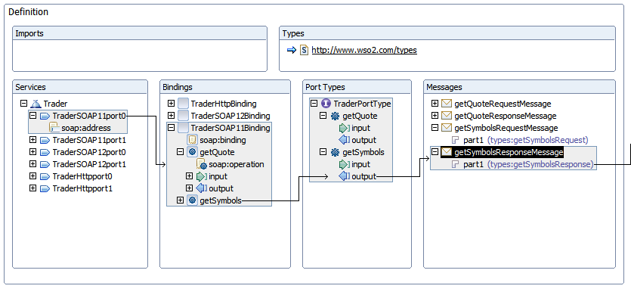
Graphical view of WSDL

Slide 25
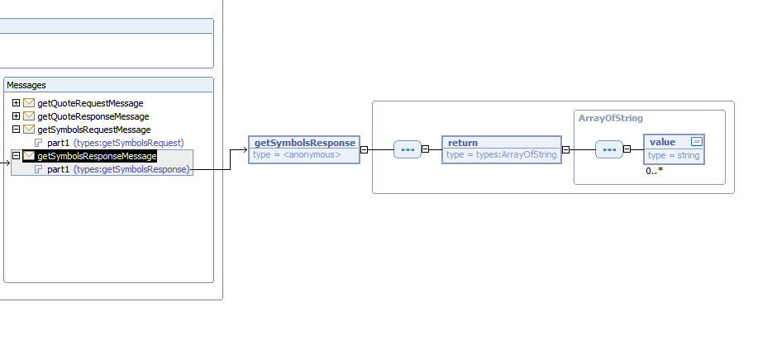
WSDL link to Schema

Slide 26
WSDL type definitions
<wsdl:types>
<schema>
<element name="getQuoteRequest">
…
</element> </schema>
</wsdl:types>

Slide 27
A simple schema
<?xml version="1.0" encoding="UTF-8"?>
<schema>
<complexType name="Person">
<sequence>
<element name="Name" type="string“/>
<element name="Company" type="string”/>
</sequence>
</complexType>
<element name="People" type="tns:Person”/>
</schema>

Slide 28
Schema
Simple types
e.g: integer, decimal, string, short, time, unsignedLong, date, any, hexBinary
ComplexTypes
Named or inline
sequence, choice, all
Multiplicity
0..1,1..1,etc

Slide 29
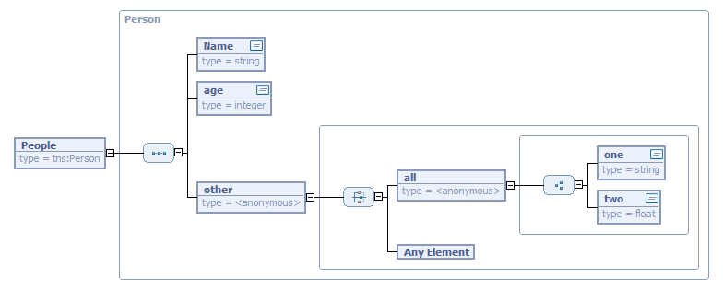
Graphically

Slide 30
Messages
<wsdl:message name="getQuoteRequestMessage">
<wsdl:part
element="types:getQuoteRequest" name="part1" />
</wsdl:message>

Slide 31
PortType
<wsdl:portType name="TraderPortType">
<wsdl:operation name="getQuote">
<wsdl:input message="types:getQuoteRequestMessage" />
<wsdl:output message="types:getQuoteResponseMessage" />
</wsdl:operation>
</wsdl:portType>

Slide 32
Bindings
<wsdl:binding type="types:TraderPortType“
name="TraderSOAP11Binding">
<soap:binding style="document"
transport="http://schemas.xmlsoap.org/soap/http“
/>
<wsdl:operation name="getQuote">
…
</wsdl:operation>
</wsdl:binding>

Slide 33
Service and Ports
<wsdl:service name="Trader">
<wsdl:port
binding="types:TraderSOAP11Binding"
name="TraderSOAP11port0">
<soap:address
location=
"https://localhost:9443/axis2/services/Trader“ />
</wsdl:port>
</wsdl:service>

Slide 34
WSDL styles of SOAP binding
The WSDL portType is a theoretical definition
May have defined the message Parts in terms of Schema types or elements
The SOAP binding says how this relates to the actual SOAP message
Elements => use=literal
Types => use can be literal or encoded, but almost always literal
Literal means that the elements in the SOAP body are examples of the elements defined
Encoded + encodingStyle means that the parts are defined as Types, and a particular concrete encoding is used to make up the SOAP body

Slide 35
WSDL styles continued
Also the body can be defined as document or RPC
In document style, the message parts appear directly in the SOAP body
In RPC style, the first element in the body is a wrapper element, named after the operation

Slide 36
Variations
doc/lit
Usually a single schema element defines the whole SOAP body. The element is not “encoded” in any way
rpc/encoded
The message parts are parameters, defined using schema types
There is a wrapper element named as the op
Each object is mapped into XML using SOAP encoding (possibly pointers)
rpc/literal
There are multiple parts defined as elements
Still a wrapper element
doc/encoded
Never seen this, though probably someone used it once somewhere ☺

Slide 37
SOAP Encoding
Is dead!
SOAP encoding is a model that was initially presented
Allows a graph structure instead of a tree structure, and supports arrays
Pointers within the XML like object references
WS-I Basic Profile bans it
Pure XML is the cleaner approach

Slide 38
Wrapped doc/lit
The “wrapped” style is useful way of mapping an object method to a SOAP operation
doc/lit wrapped emulates this but hides it in the schema
A single element, named the same as the op
The first level of children are the parameters

Slide 39
WS-I Basic Profile
Tried to clarify this mess:
R2705 A wsdl:binding in a DESCRIPTION MUST use either be a rpc-literal binding or a document-literal binding.

Slide 40
Granularity
Fine-grained
Are you exposing services or the internals of your application?
Often the result of taking existing APIs and “service-enabling” them
Coarse grained
Generally considered better
But can be too big
Require too much data passed in every request
Need to be useful in your enterprise

Slide 41
Bottom-up modelling
Take existing code and expose as services
Unlikely to expose re-usable services
Because the existing code was designed to be used within the application
Quick way to get started

Slide 42
Top-down modelling
A major undertaking
Requires a good understanding of the business and business processes
Various methodologies exist:
IBM’s SOMA – Service Oriented Modeling Architecture
Based on a very high level business analysis
Refined down to processes and services
A simpler approach is BPEL process modeling and evolve the service definitions from the processes
If this is a long process it may be counter-productive

Slide 43
Top down design
High level model
(process model, data model)
Required Services
Refinement
Schemas and WSDL
Java Code
(business logic)

Slide 44
Why Contract First?
Advantages
Agree the external interface
Good design principle
How Service Oriented Architecture is meant to be
Focus the mind on what is most important
Improves interoperability
WSDL first design leads to much more interop
Disadvantages
Need to know WSDL and Schema syntax!

Slide 45
Contract First Development
Construct the WSDL
Numerous tools available to make it easier
Generate an empty service class from WSDL
Usually called a “skeleton”
Contains all the framework specific code except the business logic
Fill in the business logic
Deploy the service
Updates the WSDL
Build a client

Slide 46
Contract first development
WSDL
Stub
Skeleton
WSDL
1-1
Stub
Skeleton
WSDL
Stub
Skeleton
1-1
n-m
n-m
n-m
Schema
Data Object
Schema
1-1
1-1
Data Object
Refinement

Slide 47
Understanding the model
Each WSDL may reference multiple data types from schema(s)
Ideally the data types will be re-used across the set of services
Each data type will be mapped to a Java object
Each service will be mapped to a stub and/or a skeleton
Those stubs and skeletons will use the Java data objects

Slide 48
Complexity of this approach
WSDL was never designed to be written by mere mortals
Complex structure
Lots of pointers that have to be correct
E.g. Service -> port -> binding -> portType
Schema is worse!
Highly complex spec
Element -> ComplexType links
Only solution
Use a tool

Slide 49
Tools to Construct WSDL
Construct WSDL
Eclipse WTP (Web Tools project)
Open Source tool – completely free
XMLSpy
Free version available
Licensed version has a very good WSDL editor
Stylus Studio
Proprietary tool

Slide 50

Eclipse Web Tools Platform
http://www.eclipse.org/webtools/

Slide 51
Another approach
Cheat!!!!!
Write Java interfaces matching your “model”
Run Java2WSDL
Now “throw away” the Java
Your WSDL is now the authoritative model

Slide 52
Iteration
Especially valuable when starting on SOA
Allows quick and simple first steps
Typically update service definitions as new users come on board
Requires the right approach and attitude!
As well as the right infrastructure to support versioning and routing

Slide 53
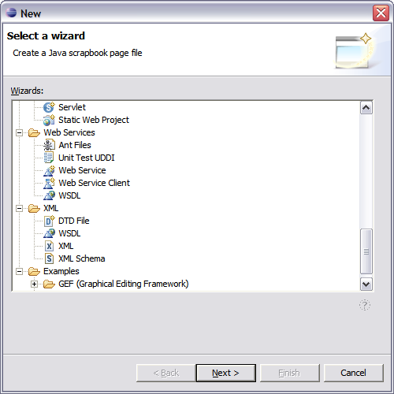
Web Tools-WSDL and Schema

Slide 54
Where do you find WSDLs?
?wsdl
Email, Web page, etc
xmethods.net
wsdlicio.us
Registry

Slide 55
Summary
WSDL is a key technology for Interoperability
A standard XML based interface language
Flexible binding to Schema
Well tooled

