Slide 1
Course Introduction Service Orientated Architecture (SOA)
Oxford University
Software Engineering Programme
Nov 2016

Slide 2
Introduction
Aims
Pre-requisites
Contents
Objectives
Resources
Rules of Engagement
Introductions

Slide 3
Aims

Slide 4
Pre-requisites
Covered by the Pre-Study Guide
Command line tooling and Unix commands
Some Python programming and text editors
Basic Understanding of networking, servers and distributed computing

Slide 5
Format
A mixture of lectures and practical labs
Lectures aim to provide the wider context and background
Independent of specific technologies
Labs are based on specific technologies
Designed to demonstrate the principles

Slide 6
Lab model
Local Virtual Machine
Ubuntu
Pre-installed SOA software

Slide 7
Contents
Introduction and overview of the week
Distributed computing models
SOA Background and evolution
HTTP Basics
SOAP
REST
RESTful coding models

Slide 8
Contents Continued
SOA Case Studies
Microservices
Cloud and SOA
Enterprise Service Bus and Mediation
SOA Security
API Management
Composition and Workflow
Governance

Slide 9
Practicals
Basic HTTP server and client
SOAP server and client
RESTful service
Securing HTTP – encryption, authentication, access control
Integration and mediation
Workflow
API Management
Governance

Slide 10
Specific Objectives
Clear understanding of the aims and properties of SOA systems
Tools and approaches for building, testing and integrating services
Understanding of REST principles and approaches
Ability to architect and design SOA solutions
Microservices architecture and comparison with traditional SOA
Ability to define security, management and governance approaches for SOA

Slide 11
Rules of Engagement
Ask questions as we go along
We will “park” any that are better answered later
Don’t wait till the end to ask or raise concerns
If you don’t ask we can’t help you

Slide 12
First Run since a major update!
This is the first running of this course since it was re-written
Please take that into consideration:
There will be bugs!
Please help out:
Please create new issues on the Github repository
https://github.com/pzfreo/ox-soa2/issues/new

Slide 13
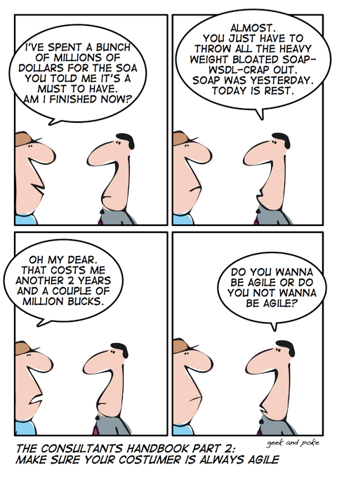

Slide 14
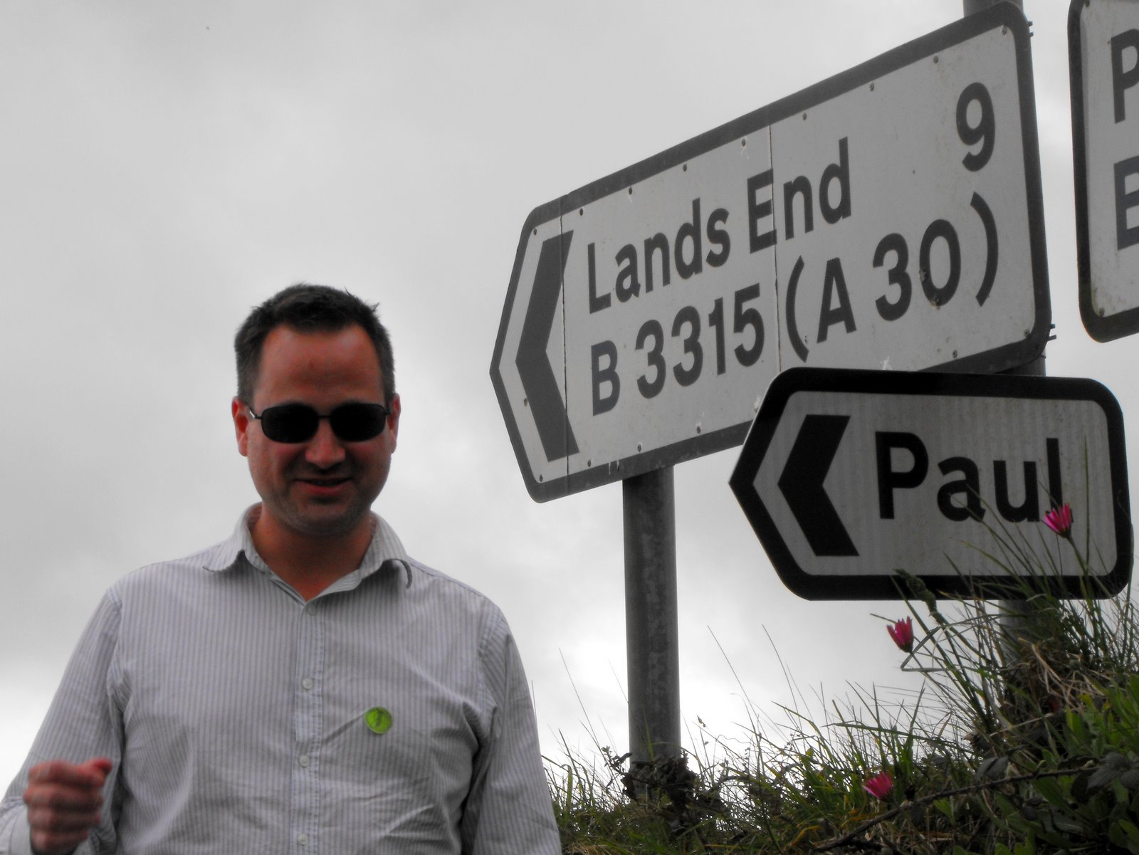
Paul Fremantle
CTO and Co-Founder of WSO2
Currently on study leave
PhD research student
Previously Senior Technical Staff Member, IBM WebSphere architecture
VP, Apache Synapse and Member of ASF
MA in Maths and Philosophy
MSc in Computation (1995)
Also teaches CLO module

Slide 15
You?

Slide 16
Approximate Schedule
Monday | Tuesday | Wednesday | Thursday | Friday
Overall Introductions First Cloud lab exercise | Introduction to Big Data and case studies Hadoop Lab 1 | Spark and SQL SparkSQL Lab | Visualisation Visualisation Lab | Overview and Recap Presentation Group Exercise
Cloud Overview and case studies Elastic Cloud Lab | Hadoop details, Map-Reduce Hadoop Extras | Storage and NoSQL Cassandra Lab | Containers Docker Lab | Final Thoughts and Assignment
Cloud Theory Platform-as-a-Service, scaling Further Cloud Lab | Intro to Spark | Cassandra details Cassandra Lab2 | Realtime Big Data Realtime Lab

Slide 17

Let’s get started

