Slide 1
Course Introduction Service Orientated Architecture (SOA)
Oxford University
Software Engineering Programme
Nov 2016

Slide 2
Introduction
Aims
Pre-requisites
Contents
Objectives
Resources
Rules of Engagement
Introductions

Slide 3
Aims

Slide 4
Pre-requisites
Covered by the Pre-Study Guide
Command line tooling and Unix commands
Some Python programming and text editors
Basic Understanding of networking, servers and distributed computing

Slide 5
Format
A mixture of lectures and practical labs
Lectures aim to provide the wider context and background
Independent of specific technologies
Labs are based on specific technologies
Designed to demonstrate the principles

Slide 6
Lab model
Local Virtual Machine
Ubuntu
Pre-installed SOA software

Slide 7
Contents

Slide 8
Practicals

Slide 9
Specific Objectives

Slide 10
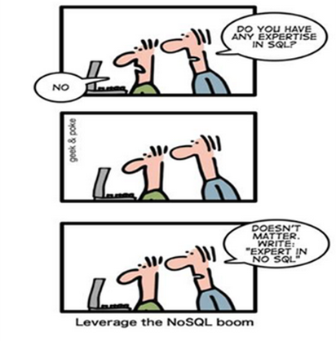
Improve your CV?

Slide 11
Beyond the scope of this course

Slide 12
Rules of Engagement
Ask questions as we go along
We will “park” any that are better answered later
Don’t wait till the end to ask or raise concerns
If you don’t ask we can’t help you

Slide 13
First Run since a major update!
This is the first running of this course since it was re-written
Please take that into consideration:
There will be bugs!
Please help out:
Please create new issues on the Github repository
https://github.com/pzfreo/ox-soa2/issues/new

Slide 14
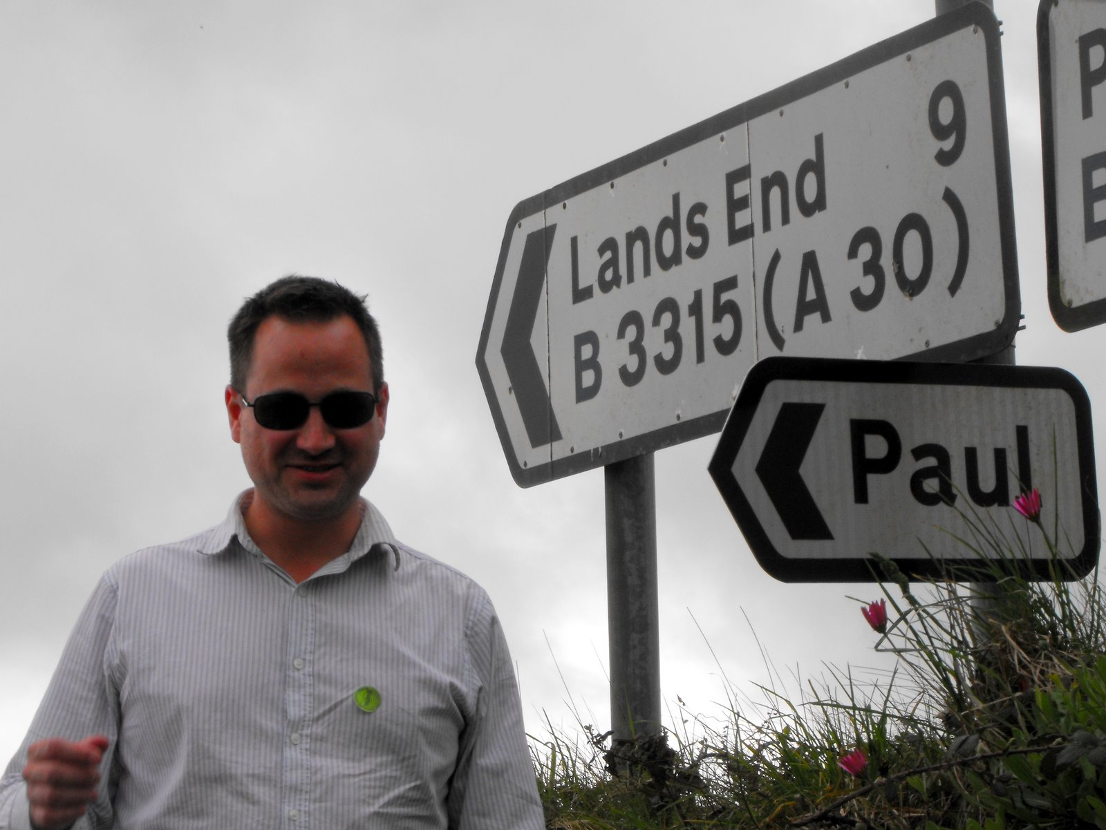
Paul Fremantle
CTO and Co-Founder of WSO2
Currently on study leave
Previously Senior Technical Staff Member, IBM WebSphere architecture
VP, Apache Synapse and Member of ASF
MA in Maths and Philosophy
MSc in Computation (1995)
Teaches SOA module
PhD Research Student

Slide 15
You?

Slide 16
Approximate Schedule
Monday | Tuesday | Wednesday | Thursday | Friday
Overall Introductions First Cloud lab exercise | Introduction to Big Data and case studies Hadoop Lab 1 | Spark and SQL SparkSQL Lab | Visualisation Visualisation Lab | Overview and Recap Presentation Group Exercise
Cloud Overview and case studies Elastic Cloud Lab | Hadoop details, Map-Reduce Hadoop Extras | Storage and NoSQL Cassandra Lab | Containers Docker Lab | Final Thoughts and Assignment
Cloud Theory Platform-as-a-Service, scaling Further Cloud Lab | Intro to Spark | Cassandra details Cassandra Lab2 | Realtime Big Data Realtime Lab

Slide 17

Let’s get started

