Slide 1
Introduction Service Oriented Architecture
Oxford University
Software Engineering Programme
Sep 2016

Slide 2
Introduction
Aims
Pre-requisites
Contents
Connections
Resources
Rules of Engagement
Introductions

Slide 3
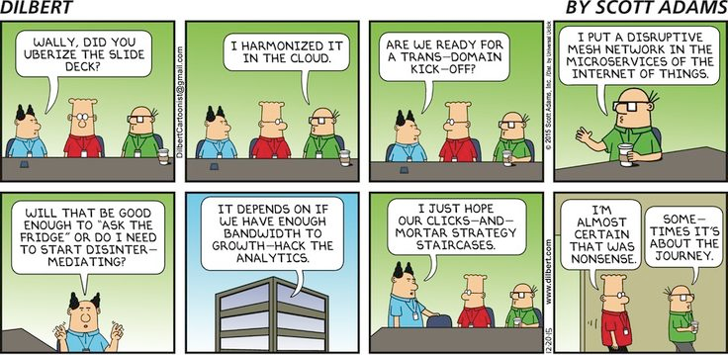

Slide 4
Apologies for the Jargon
There is a lot!
Microservices, SOA, DevOps, REST, SOAP, WSDL, Swagger, JSON, XML, OAuth2, TLS, etc
Please ask if I fail to explain an acronym

Slide 5
Aims
To understand:
Benefits and challenges of SOA
Services, Microservices and APIs
Security models
Mediation, Composition, Governance
Implementation of
SOAP and REST based services
Microservices
ESB and BPMN flows
OAuth2 and SSL secured services
API Gateways and clients

Slide 6
Pre-requisites (Some familiarity required)
Languages: Java, Node, Python
Data formats: JSON and XML
Tools: Unix shell, Eclipse, Text editors

Slide 7
Contents
Overview and course outline
Case studies and motivations
SOAP and WSDL
SOAP Implementation technologies
REST introduction
REST example flows
Advanced REST
Microservices architecture
Deployment, DevOps, containers and cloud-native applications
Integration and ESBs
Security
API and API Management
Orchestration and Choreography
Governance
Overview, futures, recap

Slide 8
Practicals
My aim is to have more practicals than everyone can manage:
Some people finish early, so there are extensions and bonus practicals for them.
You might wish to do more at home?!?
The practicals are quite directive to start with:
This is a complex area with a lot to cover.
Extensions are more freeform.
You need to think and not just do as I say to get the most out of them.
The practicals are mainly re-written from the previous run:
I don’t know how long they will take you
There may be bugs
I may be wrong about #A!

Slide 9
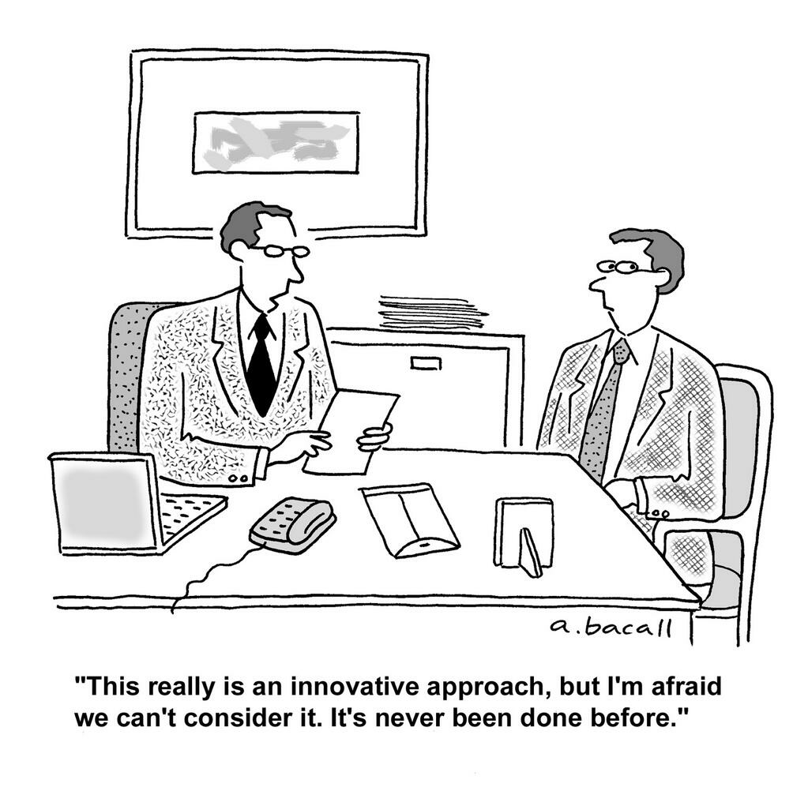

Slide 10
Practicals
Basic HTTP server and client
SOAP server and client
HTTP service in Java
Evolving the Richardson Maturity Model towards a RESTful service
Microservice and Docker deployment
ESB flows
SSL and OAuth2 security
API Management and Analytics
BPMN workflows
Plus some bonus exercises

Slide 11
Resources
Weerawarana et al, Web Services Platform Architecture, (Pearson, 2005)
Erl, SOA (Prentice-Hall, 2005)
Richardson and Ruby, RESTful Web Services (O’Reilly, 2007)
Webber et al, REST in Practice (O’Reilly, 2010)
Fielding, Architectural Styles and the Design of Network-based Software Architectures, (University of California, 2000)
Various W3C, OASIS, IETF, OMG standards

Slide 12
Rules of Engagement
Ask questions as we go along
We will “park” any that are better answered later
Don’t wait till the end to ask or raise concerns
Timings are flexible
Please keep mobile phones silent or better still turned off
If you have improvements or bug reports, please submit issues or pull requests:
https://github.com/pzfreo/ox-soa2/issues/new

Slide 13
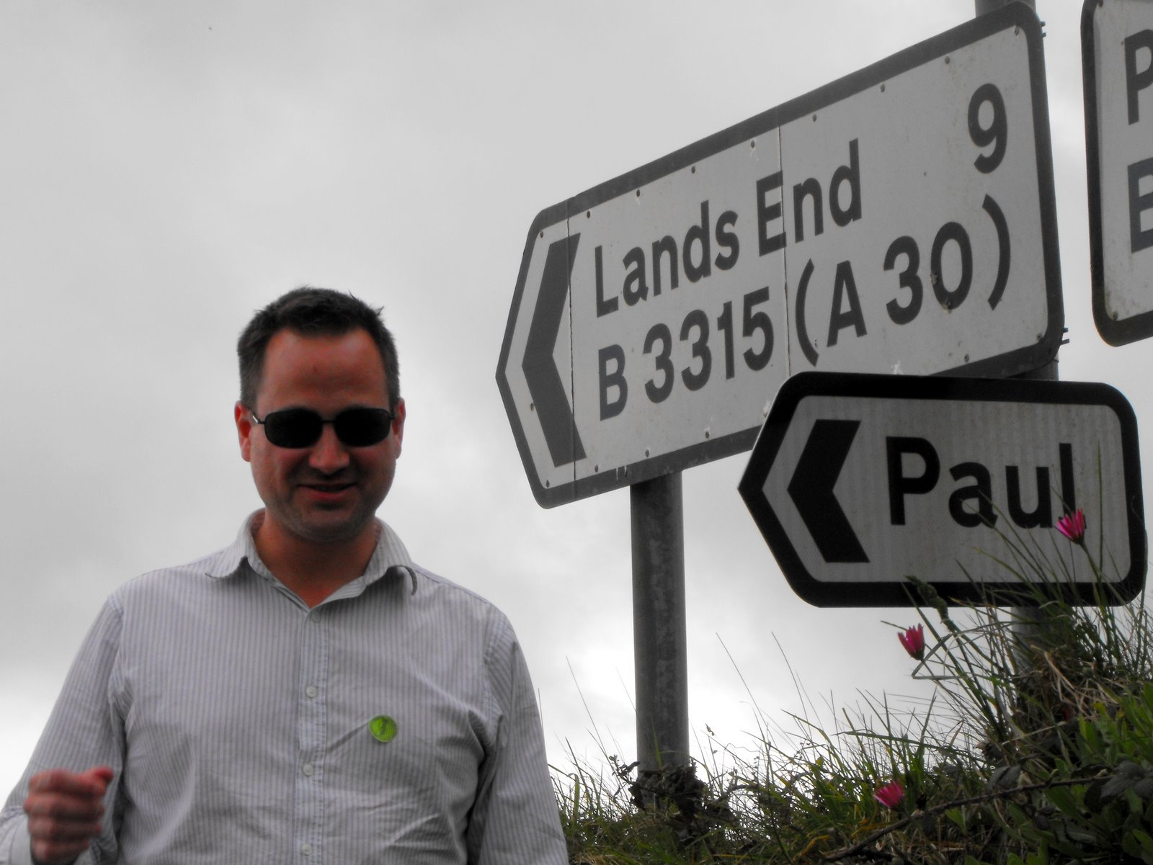
Paul Fremantle
CTO and Co-Founder of WSO2
Previously Senior Technical Staff Member, IBM WebSphere architecture
Co-Chair Web Services Reliable eXchange at OASIS (WSRM)
VP, Apache Synapse and Member of ASF
MA in Maths and Philosophy
MSc in Computation
Studying for a PhD:
Security and privacy in IoT middleware

Slide 14
You?

Slide 15
Approximate Schedule
Monday | Tuesday | Wednesday | Thursday | Friday
Introduction | REST introduction | Microservices | Security | Design Exercise
Case Studies and motivation | REST example flow | Docker Introduction | Governance | History and futures Conclusions
SOAP and WSDL | Evolving REST practicals | DevOps, deployment, management | API Management
SOAP Implementation | Advanced REST | Integration and ESBs | Composition

Slide 16

Let’s get started

