Slide 1
Implementing REST
Oxford University
Software Engineering Programme
June 2016

Slide 2

Just do it?!

Slide 3
A good answer if you already know
HTTP coding
JSON
etc

Slide 4
Why use a framework?
Routing
Separate logic for different verbs, paths, content-types
Cacheing and content negotiation
Data format manipulation
Translation to/from JSON
Readability

Slide 5
REST frameworks Too many to list
Java
JAX-RS, Spring Boot, Dropwizard, Play, WSO2 MSF4J, etc
Node
Express, Restify
.NET Web API
Erlang
Leptus, WebMachine
Python
Eve

Slide 6
Why I propose JAX-RS for Java?
Lots of implementations is good
Pretty decent API
Clean looking code
Fast and effective

Slide 7
Why I use Express in node.js?
Simple
Good routing logic
Works well

Slide 8
ymmv

Slide 9
Introducing JAX-RS Model
JAX-RS uses Java annotations to map an incoming HTTP request to a Java method.
To use JAX-RS you annotate your class with the @Path annotation to indicate the relative URI path.
Then annotate one or more of your class's methods with @GET, @POST, @PUT, @DELETE, or @HEAD to indicate which HTTP method you want dispatched to a particular method.

Slide 10
An Example
@Path("/accounts")
public class AccountEntryService {
@GET
public String getAccounts() {...}
}

Slide 11
Query Parameters
getAccounts() method could return thousands of accounts in our system.
To limit the size of the result set, the client could send a URI query parameter to specify how many results it wanted
http://somewhere.com/accounts?size=50.
To extract this information from the HTTP request, JAX-RS has @QueryParam annotation:

Slide 12
Accessing Query Parameters
@Path("/accounts")
public class AccountEntryService {
@GET
public String getAccounts(
@QueryParam("size")
@DefaultValue("50") int size)
{
... method body ...
}
}

Slide 13
Path Parameters
@Path("/accounts")
public class AccountEntryService {
@GET
@Path("/{id}")
public String getAccount(
@PathParam("id") int accountId) {
... method body ...
}
}

Slide 14
More on Path Parameters
The {id} string represents our path expression.
The @PathParam annotation will pull in the info from the incoming URI and inject it into the accountId parameter.
For example, if our request is http://somewhere.com/accounts/111, accountId would get the value 111 injected into it.
Complex path expressions are also supported. Use Java regular expressions as follows:
@Path("{id: \\d+}")

Slide 15
Handling Content Types
The String passed back from getAccount() could be any mime type: plain text, HTML, XML, JSON, YAML.
You can specify which mime type the method return type provides with the @Produces annotation. For example, let's say getAccounts() method actually returns an XML string.
Also the @Consumes can direct different incoming content types to different methods

Slide 16
Response Content Type
@Path("/accounts")
public class AccountEntryService {
@GET
@Path("{id}")
@Produces("application/xml")
public String getAccount(@PathParm("id") int accountId)
{
...
}
}

Slide 17
Content Negotiation
HTTP clients use the HTTP Accept header to specify a list of mime types they would prefer the server to return to them.
Firefox browser sends this Accept header with every request:
Accept: text/html,application/xhtml+xml,application/xml;q=0.9,*/*;q=0.8
JAX-RS understands the Accept header and will use it when dispatching to JAX-RS annotated methods.

Slide 18
Request Content Type
@Path("/accounts")
public class AccountEntryService {
@GET
@Path("{id}")
@Produces("application/xml")
public String getAccount(@PathParm("id") int accountId) {...}
@GET
@Path("{id}")
@Produces("text/html")
public String getAccountHtml(@PathParm("id") int accountId) {...}
}

Slide 19
The Response Body
return Response.ok().entity(response_body).build();

Slide 20
Content Marshalling
JAX-RS allows you to write HTTP message body readers and writers that know how to marshall a specific Java type to and from a specific mime type.
The JAX-RS specification has some required built-in marshallers. For instance, vendors are required to provide support for marshalling JAXB annotated classes.
The details are beyond this course, but look up @Provider

Slide 21
Response Codes
The HTTP specification defines what HTTP response codes should be on a successful request.
GET should return 200 OK
POST should return 201 Created
You can expect JAX-RS to return the same default response codes.
Sometimes, however, you need to specify your own response codes, or simply to add specific headers or cookies to your HTTP response. JAX-RS provides a Response class for this.

Slide 22
Examples of creating Responses
200 OK:
return Response.ok().build();
201 Created return Response.created( URI.create ("orders/" + uuid)).build();
404 Not Found
return Response.status(Status.NOT_FOUND). build();

Slide 23
Clients

Slide 24
First try it out
Chrome Advanced REST Client is a good start
SOAPUI also provides test capabilities
curl should be your friend too!

Slide 25
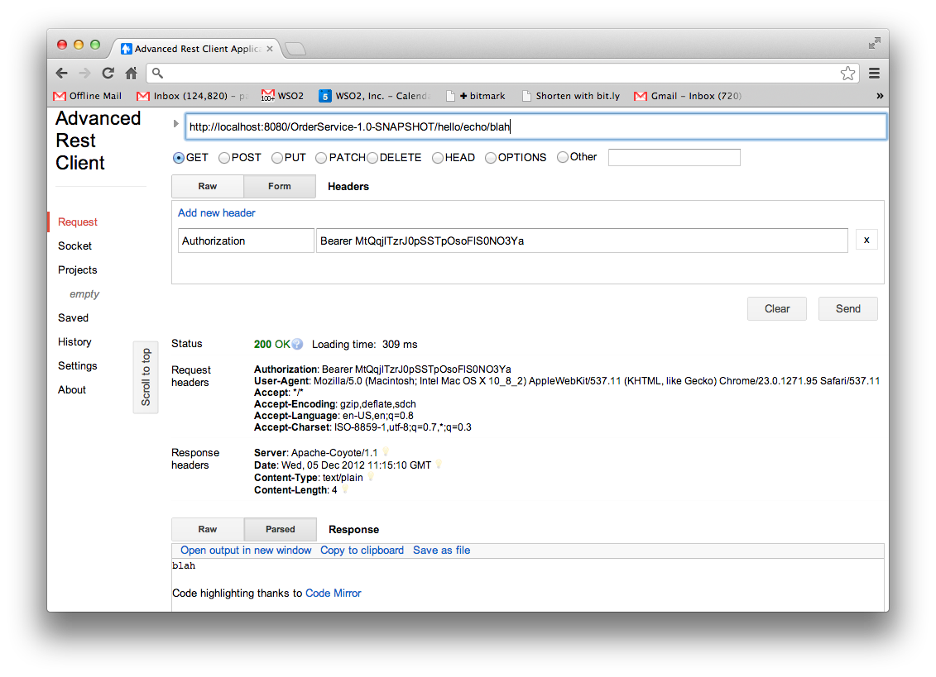

Slide 26
curl
curl -v http://localhost:8080/OrderService-1.0-SNAPSHOT/hello/echo/blah
* About to connect() to localhost port 8080 (#0)
* Trying ::1...
* connected
* Connected to localhost (::1) port 8080 (#0)
> GET /OrderService-1.0-SNAPSHOT/hello/echo/blah HTTP/1.1
> User-Agent: curl/7.24.0 (x86_64-apple-darwin12.0) libcurl/7.24.0 OpenSSL/0.9.8r zlib/1.2.5
> Host: localhost:8080
> Accept: */*
>
< HTTP/1.1 200 OK
< Server: Apache-Coyote/1.1
< Date: Wed, 05 Dec 2012 11:20:17 GMT
< Content-Type: text/plain
< Content-Length: 4
<
* Connection #0 to host localhost left intact
blah* Closing connection #0

Slide 27
JAXRS 2.0 Client API
Similar to CXF client
Aiming to be much higher level than standard HTTP clients
Not a bad idea, but don’t give up on “loose coupling”
The client and the service are independent
Technology choice of one shouldn’t influence the technology choice of the other

Slide 28
Example JAX-RS Client Code
Client client = ClientBuilder.newBuilder().newClient();
WebTarget target = client.target("http://localhost:8080/rs");
target = target.path("service").queryParam("a", "avalue");
Invocation.Builder builder = target.request();
Response response = builder.get();
Book book = builder.get(Book.class);

Slide 29
Example HTTPClient code
HttpClient client = new DefaultHttpClient();
{
HttpGet request = new HttpGet(url);
HttpResponse response = client.execute(request);
System.out.println("Response status:" + response.getStatusLine());
System.out.println("Response data:");
HttpEntity entity = response.getEntity();
if (entity != null) {
BufferedReader br = new BufferedReader(new InputStreamReader(
(entity.getContent())));
String output;
while ((output = br.readLine()) != null) {
System.out.println(output);
}
}
}

Slide 30
Example Python Code
h = httplib2.Http();
resp, content = h.request("http://api.openweathermap.org/data/2.5/weather?q="+city)
try:
response=json.loads(content)
main = response['main']
temp = round(main['temp'] - 273.15,2)
humidity = main['humidity']
pressure = main['pressure']
wind = response['wind']
windspeed = wind['speed']
winddirection = wind['deg']
country = response['sys']['country']
city = response['name']

Slide 31
Example Node code
var post_req = http.request(post_options, function(r) {
var body = "”
r.on('data', function (chunk) {
body += chunk;
});
r.on('end', function() {
try {
console.log(body);
var response = JSON.parse(body);
} catch (e) {}
if (response) {
callback(response);
}
else
{
callback(null);
}
});
});

Slide 32
Questions?

