Slide 1
Web Services, WS-*, SOAP, WSDL, etc
Oxford University
Software Engineering Programme
June 2016

Slide 2
Contents
Understanding WS-*
SOAP
SOAP examples

Slide 3







WS-* Standards
A set of extensible and composable standards that work together
Providing a common, standard, interoperable base to implement SOA

Slide 4
Key Web Services Standards
Orchestration
Business Process Execution Language (BPEL)
SECURE
WS-Security
(encrypt, sign, auth)
WS-SecureConversation
(~SSL)
WS-Trust
(~Kerberos)
RELIABLE
WS-ReliableMessaging
(ExactlyOnce,
InOrder delivery, ~JMS)
TRANSACTIONAL
WS-AtomicTransaction
(2 Phase Commit ~XA)
WS-BusinessActivity
(Long running loosely coupled)
Composable
Quality
of
Service
WS-Policy
WS-MetadataExchange
WS-Addressing
Messaging
SOAP
WSDL
Transport
HTTP, TCP, SMTP, UDP
Wire interaction
Metadata
The Web services platform forms a complete framework for open standards enterprise middleware

Slide 5
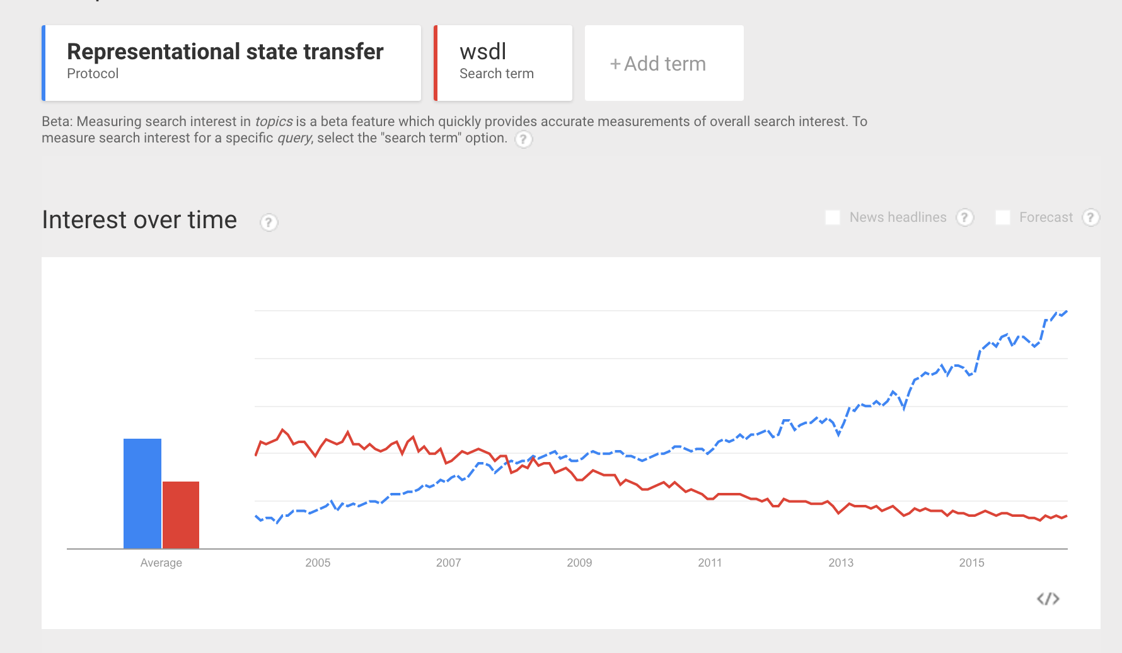

Slide 6
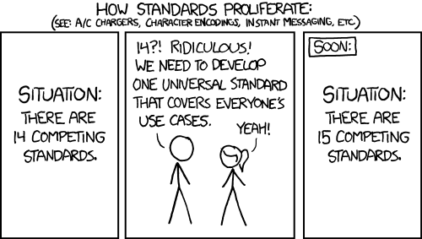

Slide 7
A Sample SOAP Message
<soap:Envelope xmlns:soap="http://schemas.xmlsoap.org/soap/envelope/">
<soap:Header/>
<soap:Body>
<getProductDetails xmlns="http://warehouse.example.com/ws">
<productID>827635</productID> </getProductDetails>
</soap:Body>
</soap:Envelope>

Slide 8
A Sample SOAP Message (cont)
<soap:Envelope xmlns:soap="http://schemas.xmlsoap.org/soap/envelope/">
<soap:Header/>
<soap:Body>
<getProductDetails xmlns="http://warehouse.example.com/ws">
<productID>827635</productID> </getProductDetails>
</soap:Body>
</soap:Envelope>
The SOAP header provides a space for arbitrary headers to be added to the message`

Slide 9
A Sample SOAP Message (cont)
<soap:Envelope xmlns:soap="http://schemas.xmlsoap.org/soap/envelope/">
<soap:Header/>
<soap:Body>
<getProductDetails xmlns="http://warehouse.example.com/ws">
<productID>827635</productID> </getProductDetails>
</soap:Body>
</soap:Envelope>
The contents of the SOAP body element can be any valid XML that the parties wish to interchange

Slide 10
Using SOAP Headers
Some simple examples
Add a signature to ensure the message isn’t modified
Add a process identifier to track this message as part of a wider process
Add a userid so that end-to-end security can be guaranteed
Add a message number so messages can be resent if lost

Slide 11

What is a service definition?
Notes:
Discuss first

Slide 12
What is a service definition?
What does it do?
Where is it?
Who owns and runs it?
Is it going to be up on Monday?
What do I have to do to use it?
How much does it cost?

Slide 13
What is a service definition?
What does it do?
Where is it?
Who owns and runs it?
Is it going to be up on Monday?
What do I have to do to use it?
How much does it cost?

Slide 14
Abstraction
WSDL splits into:
Interface / PortType
The abstract interface
The Binding
The mapping into SOAP or XML/HTTP (or +++)
The port
The actual endpoint or location

Slide 15
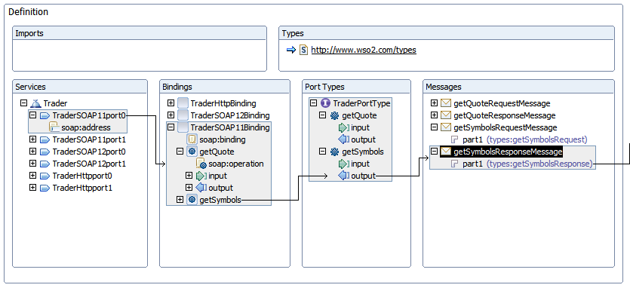
Graphical view of WSDL

Slide 16
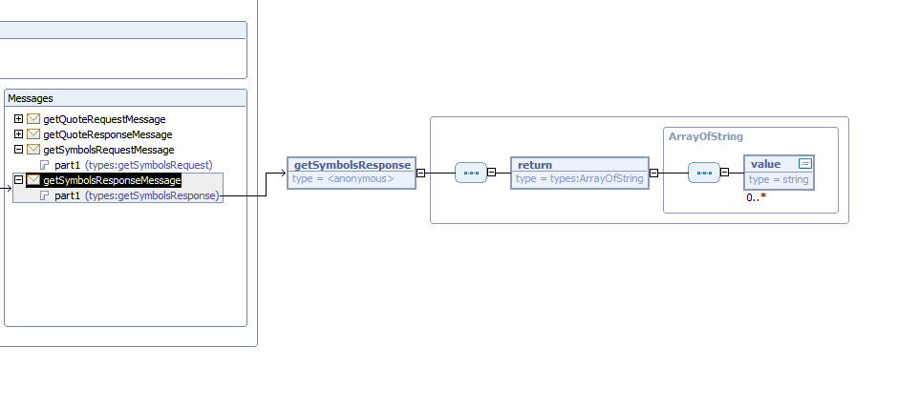
WSDL link to Schema

Slide 17
WSDL type definitions
<wsdl:types>
<schema>
<element name="getQuoteRequest">
…
</element> </schema>
</wsdl:types>

Slide 18
A simple schema
<?xml version="1.0" encoding="UTF-8"?>
<schema>
<complexType name="Person">
<sequence>
<element name="Name" type="string“/>
<element name="Company" type="string”/>
</sequence>
</complexType>
<element name="People" type="tns:Person”/>
</schema>

Slide 19
Schema
Simple types
e.g: integer, decimal, string, short, time, unsignedLong, date, any, hexBinary
ComplexTypes
Named or inline
sequence, choice, all
Multiplicity
0..1,1..1,etc

Slide 20
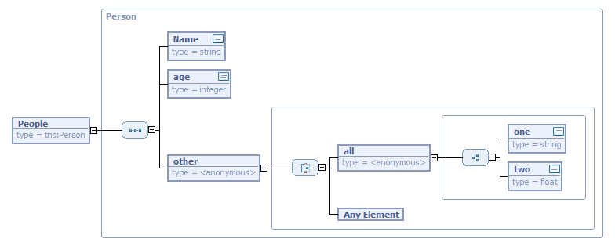
Graphically

Slide 21
Granularity
Fine-grained
Are you exposing services or the internals of your application?
Often the result of taking existing APIs and “service-enabling” them
Coarse grained
Generally considered better
But can be too big
Require too much data passed in every request
Need to be useful in your enterprise

Slide 22
Bottom-up modelling
Take existing code and expose as services
Unlikely to expose re-usable services
Because the existing code was designed to be used within the application
Quick way to get started

Slide 23
Top-down modelling
A major undertaking
Requires a good understanding of the business and business processes
Various methodologies exist:
IBM’s SOMA – Service Oriented Modeling Architecture
Based on a very high level business analysis
Refined down to processes and services
A simpler approach is BPEL process modeling and evolve the service definitions from the processes
If this is a long process it may be counter-productive

Slide 24
Top down design
High level model
(process model, data model)
Required Services
Refinement
Schemas and WSDL
Java Code
(business logic)

Slide 25
Why Contract First?
Advantages
Agree the external interface
Good design principle
How Service Oriented Architecture is meant to be
Focus the mind on what is most important
Improves interoperability
WSDL first design leads to much more interop
Disadvantages
Need to know WSDL and Schema syntax!

Slide 26
Summary
SOAP was designed to be a simpler alternative to CORBA
SOAP has good descriptions and tooling
However, RESTful approaches rapidly disrupting the market

