Slide 1
Understanding HTTP and REST
Oxford University
Software Engineering Programme
Sep 2015

Slide 2

World Wide Web
navigating document collections
multimedia documents
hypertext cross-references
hypertext markup language
(HTML)
hypertext transfer protocol
(HTTP)
Tim Berners-Lee at CERN, 1989–1992

Slide 3
HTTP
two-way transmission of requests and responses
layered over TCP
essentially stateless (but. . . )
standard extensions for security

Slide 4
HTTP “Verbs”
GET uri
read a document; should be “safe”
PUT uri, data
create or modify a resource; should be idempotent
POST uri, data
create a subordinate resource
DELETE uri
delete a resource; should be idempotent
(also HEAD, TRACE, OPTIONS, CONNECT and now PATCH)

Slide 5
URIs, URNs, URLs
uniform resource identifier (URI)
uniform resource locator (URL)
uniform resource name (URN)
http://fremantle.org/hello
Is it a URI? URL? URN?

Slide 6
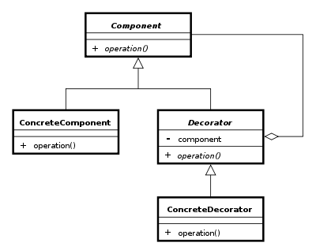
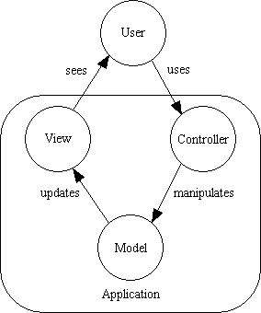
Examples of Design Patterns

Slide 7
REST is a design pattern
Also characterized as an Architectural Style (aka an architecture design pattern)

Slide 8
Resource Oriented Architecture
Resource-oriented architecture
after Richardson & Ruby, RESTful WS
action identified in HTTP method, not in payload
scoping information in URI

Slide 9
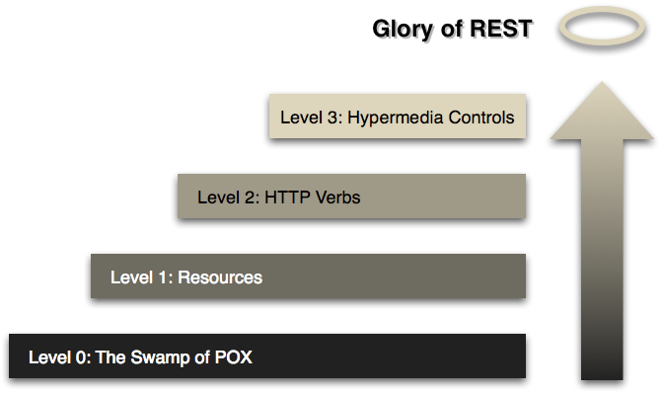
Richardson’s Maturity Model

Slide 10
HTTP good bad and ugly
Good
GET reports/open-bugs HTTP/1.1
in contrast to RPC-style interaction
Bad
POST /rpc HTTP/1.1 Host: www.upcdatabase.com <?xml version="1.0”> <methodCall> <methodName>lookupUPC</methodName> … </methodCall>
Ugly
http://www.flickr.com/services/rest?method=search&tags=cat

Slide 11
PUT vs POST
PUT vs POST
creation by either PUT to new URI or POST to existing URI
typically, create a subordinate resource with a POST to its parent
use PUT when client chooses URI; use POST when server chooses
successful POST returns code 201 ‘Created’ with Location header
(POST also sometimes used for form submission, but this can be non-uniform)

Slide 12
Resource Representations and States
Interact with services using representations of resources.
An XML representation
A JSON representation
An object referenced by one URI can have different formats available. Different platforms need different formats.
A mobile application may need JSON
A Java application may need XML.
Utilize the Content-Type header
And the Accept: header
Communicate in a stateless manner
Stateless applications are far more scaleable

Slide 13
Hypertext as the Engine of Application State
Resources are identified by URIs
↓
Clients communicate with resources via requests using a
standard set of methods
↓
Requests and responses contain resource representations
in formats identified by media types
↓
Responses contain URIs that link to further resources
↓
Beginning

Slide 14
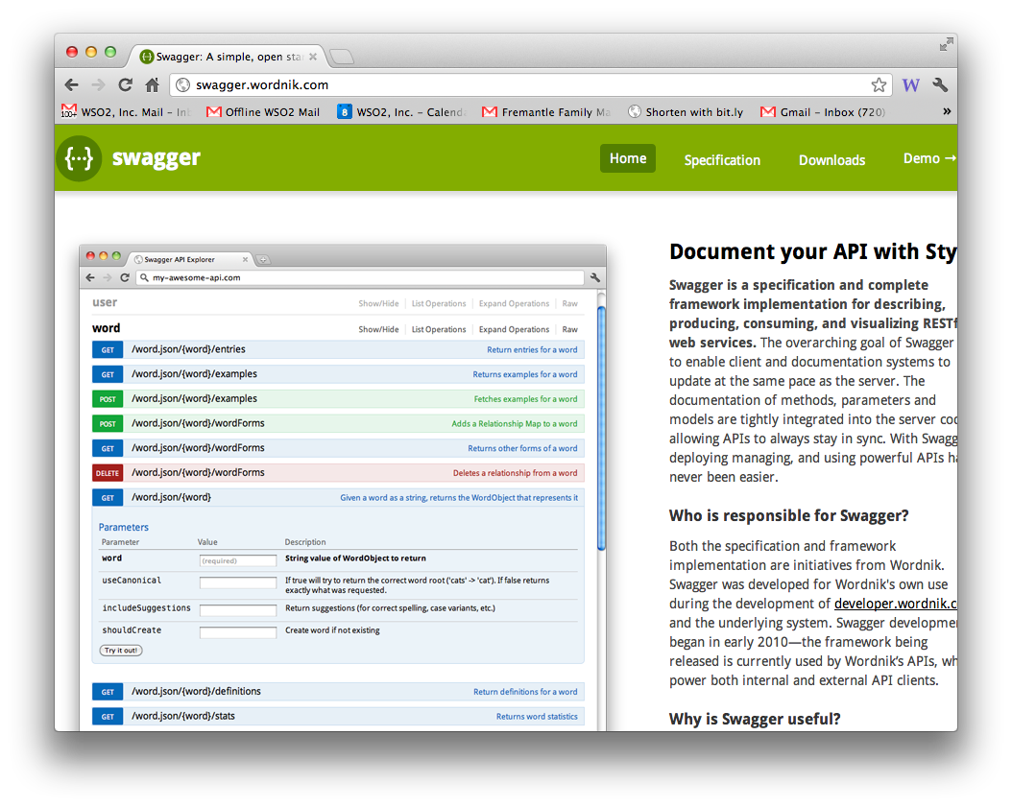
REST description

Slide 15
JSON
A simple notation that originated in JavaScript
var x = {a:1, b:2, c:3}
equivalent to:
x.a = 1; x.b = 2; x.c = 3
Can be done “dynamically”
var x = “{a:1, b:2, c:3}”
// imagine this actually
// comes from a webserver
var z = eval(‘(‘+x+’)’)
assert(z.a == 1)

Slide 16
Our sample Purchase service

Slide 17
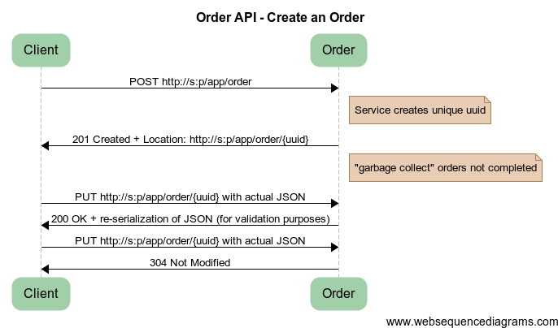
Create an Order
Notes:
title Order API - Create an Order
Client -> Order: POST http://s:p/app/order
note right of Order: Service creates unique uuid
Order -> Client: 201 Created + Location: http://s:p/app/order/{uuid}
note right of Order: "garbage collect" orders not completed
Client -> Order: PUT http://s:p/app/order/{uuid} with actual JSON
Order -> Client: 200 OK + re-serialization of JSON (for validation purposes)
Client -> Order: PUT http://s:p/app/order/{uuid} with actual JSON
Order -> Client: 304 Not Modified

Slide 18
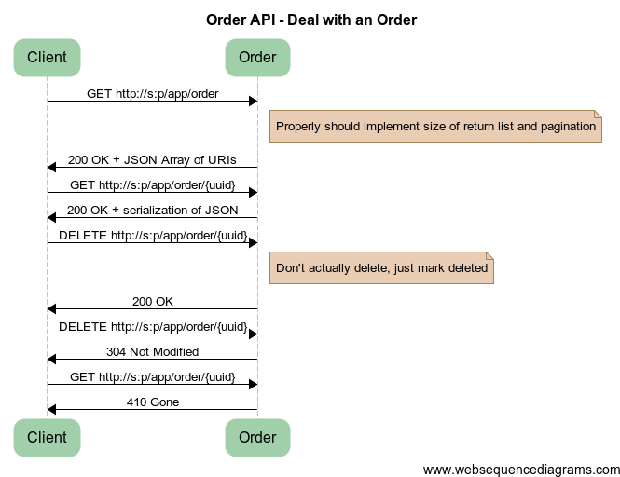
Notes:
title Order API - Deal with an Order
Client -> Order: GET http://s:p/app/order
note right of Order: Properly should implement size of return list and pagination
Order -> Client: 200 OK + JSON Array of URIs
Client -> Order: GET http://s:p/app/order/{uuid}
Order -> Client: 200 OK + serialization of JSON
Client -> Order: DELETE http://s:p/app/order/{uuid}
note right of Order: Don't actually delete, just mark deleted
Order -> Client: 200 OK
Client -> Order: DELETE http://s:p/app/order/{uuid}
Order -> Client: 304 Not Modified
Client -> Order: GET http://s:p/app/order/{uuid}
Order -> Client: 410 Gone

Slide 19
Questions?

