Slide 1
Queued Transaction Processing
System A
Queue
Transaction 1:
Add entry to DB1
Enqueue Message
Transaction 2:
Add entry to DB2
Dequeue Message
DB1
DB2
System
B

Slide 2
AMQP Advanced Message Queuing Protocol
Emerged out of JP Morgan
Wanted an open source/open standard alternative to proprietary (e.g. MQSeries)
Standardized at OASIS
Multiple Open Source implementations
RabbitMQ, Apache Qpid, WSO2 Message Broker, Apache Apollo, Apache ActiveMQ, etc
Used widely e.g. in OpenStack

Slide 3
MQTT Message Queuing Telemetry Transport
Very lightweight messaging pub/sub system
Built for SCADA, M2M, IoT
Being standardised at OASIS MQTT TC
Close to being done
No wire changes from 3.1
Big effort in the Eclipse Paho / M2M project

Slide 4
SOA failures
One consumer per service

Slide 5
SOA failures
“Just buy an ESB from me”

Slide 6
SOA failures
Vendor Driven Architecture

Slide 7



“soa” successes

Slide 8
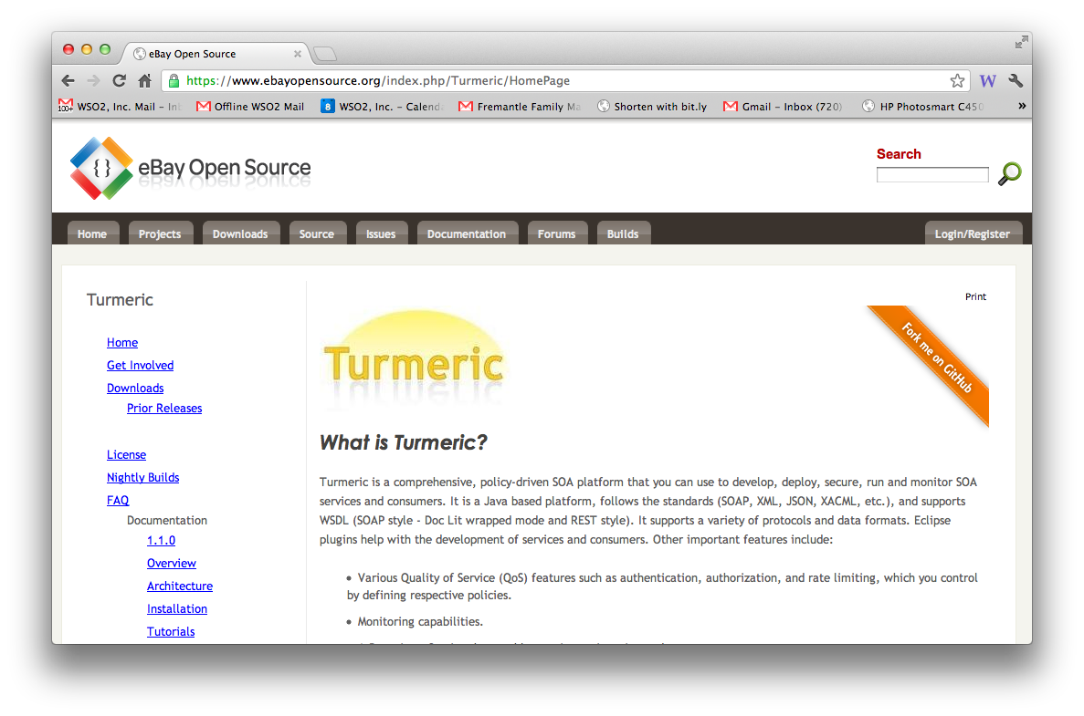

Slide 9
Why ESB/SOA model isn’t just EAI
Policy based
XACML, Throttling Policy, etc
eBay’s Internal Service Router
Independent management
Loose coupling of configuration
Hot deploy / re-deploy / continuous delivery
Governance
Lifecycle and Dependency management
Analysis and reporting on the meta-model
Non-blocking asynchronous routing
Distributed architecture

Slide 10
Key API technologies
json / rest
OAuth / OAuth2 keys
SLA management
API portal / API Store
Catalogue, subscription/purchase
Monetization
Forum, Ratings, Social
Analytics

Slide 11


Slide 12
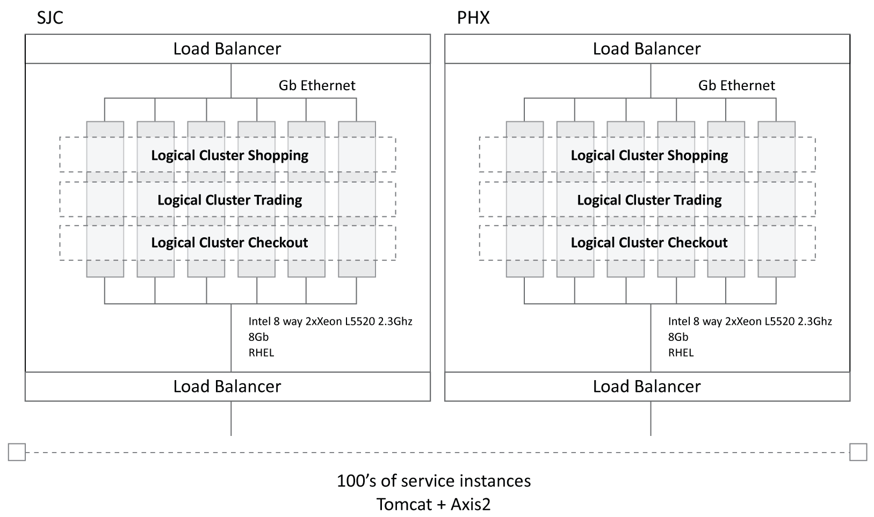
High volume integration @ eBay

Slide 13
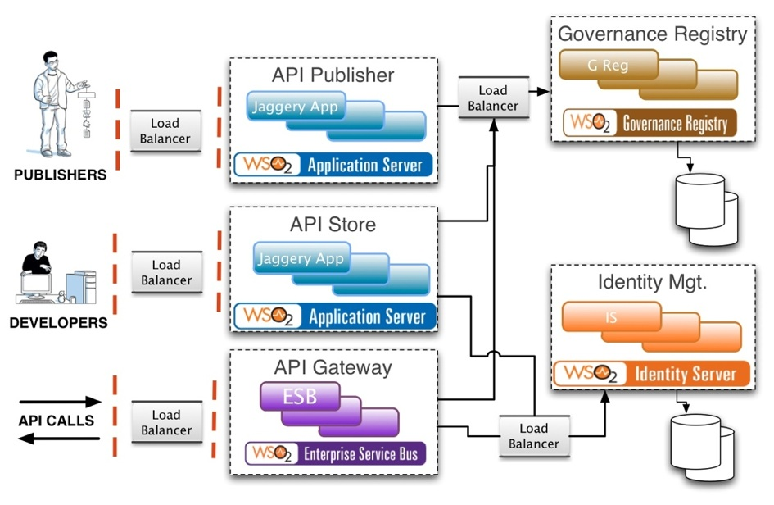
API management
Notes:
API Publisher may actually be purely inside the firewall – if publishing is an internal-only process.
“Load Balancer” can be WSO2 Load Balancer or some other one.
This picture does not show how all activity events are pushed into BAM for analysis, analytics and visualization (using Cassandra and Hadoop).

Slide 14

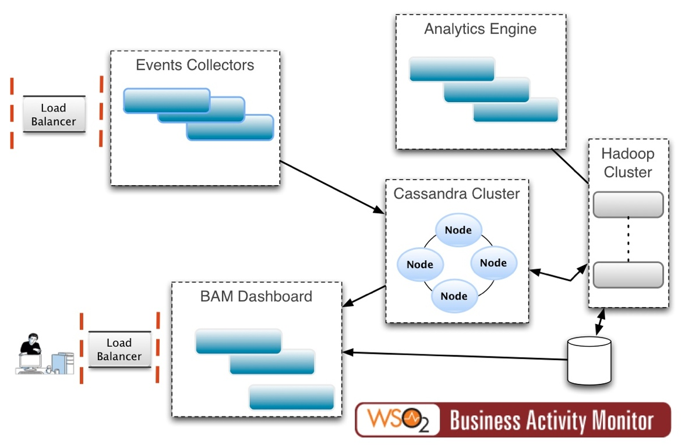
Scalable analytics

Slide 15



Cloud integration
Cloud Service Gateway
Database
ESB-as-a-Service
SAP

