Slide 1

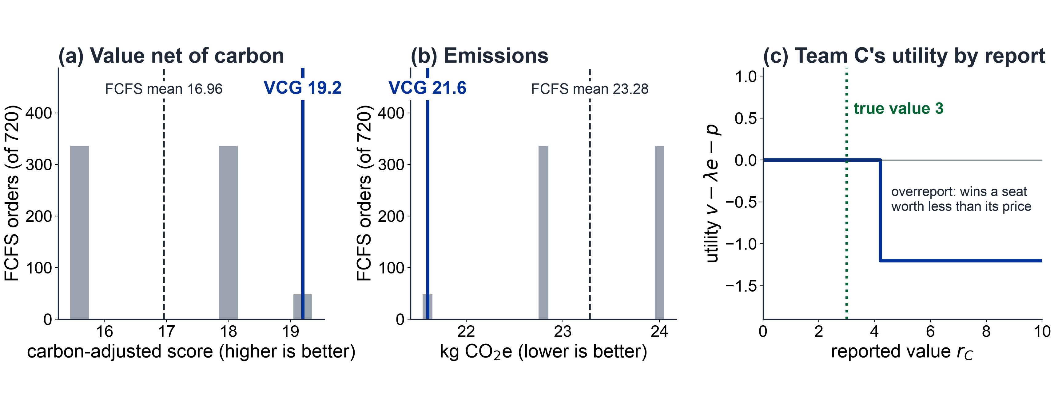


COMSCI / ECON 206 | PS2 RESEARCH SYMPOSIUM | FALL 2026
Can a carbon-aware VCG rule allocate shared
GPU-hours better than first come, first served?
Mustafa Ayub Khan, Temur Akhtamjonov, Gihun Lee | Team FP5
Course instructor: Professor Luyao Zhang
FINAL v2 · OCT 2026
KEY MESSAGE
A published, carbon-aware VCG rule beats or ties all 720 FCFS arrival orders on value net of carbon (19.2 vs. 16.96 mean),
cuts emissions per unit of value (0.72 vs. 0.81 kg), and keeps truthful reporting optimal at every carbon weight tested, but serves fewer teams (4 vs. 4.93).
01 Question & model
02 Design & evidence
03 Impact & dialogue
Setting & verified gap
Q1 Economics
How should scarce GPU-hours be allocated for value net of carbon when teams can misreport their private value?
Q2 Computation
Can an exactly solved multi-team VCG beat first come, first served and stay auditable?
Q3 Behavior
Do people report truthfully and understand the rule?
Practical impact: a real-world case
Setting: AI demand outpaces compute; queues ignore both value and carbon.
Gap: FAIR-Compute [5] shows that value-blind scheduling loses about a third of scientific value, but it does not quantify carbon and leaves truthful-reporting mechanisms to future work. We build that piece at an exactly solvable scale.
Case: a university's shared GPU cluster replaces queue order with a published, re-runnable rule and a carbon weight λ set by the institution; no adoption yet.
Benefits / risks: compute goes to value net of carbon and every allocation is auditable; fewer teams are served, and a heavy λ penalizes compute-heavy research.
Who needs what: academia, a transparent pilot; industry, robustness at hundreds of teams; public institutions, a re-runnable audit.
Correction: rule, inputs, and code are public, so any team can re-run and challenge an allocation.
Strategic model
A · 25 h
B · 20 h
C · 15 h
capacity K = 100 GPU-h
120 GPU-h requested:
who is left out?
D · 25 h
E · 20 h
F · 15 h
Players: six teams A–F; each privately knows vᵢ ∈ {3, 6, 9} and sends one sealed report rᵢ (static game, incomplete information).
Public: request dᵢ, emissions eᵢ = 0.24 dᵢ kg CO₂e, capacity K = 100, λ = 0.5.
Rule: pick the feasible group S* maximizing Σ(rᵢ − λeᵢ) over all 64 groups; each winner pays the score the other teams lose because it is selected.
Payoff: uᵢ = vᵢ − λeᵢ − pᵢ if selected, else 0.
Solution: truthful rᵢ = vᵢ is dominant (DSIC) [1–4]: the price never depends on a team's own report.
Analogy stops: credits are not money; values are never verified.
Block width = public request dᵢ. Shade = private value vᵢ (dark 9, medium 6, light 3). Emissions eᵢ = 0.24 dᵢ kg CO₂e; λ = 0.5.
Figure 1. Research questions and setting. Six teams request 120 GPU-hours from a pool of 100. Values are private; requests and emissions are public. Q1 and Q2 are answered by the model and its exact computation, Q3 by play in the Hugging Face Space.
Behavioral evidence: five self-plays (exploratory)
Measure | Benchmark | Observed
Truthful reports (r = v) | 5 / 5 | 2 / 5
Overreports | 0 | 3
Selection predicted correctly | — | 3 / 5
Plays where a misreport raised utility | 0 | 0
Reduced payoff matrix: Team C vs. Team E
Agreement: no misreport paid off; one overreport bought a seat for 36 credits and ended at u = −3.6.
Gap: three of five players overreported. Stated reasons: wanting to be selected, and misunderstanding the rule.
Integration: the Space's what-if curve exposed that utility vᵢ − pᵢ rewards overreporting; each team now bears its own carbon.
(u_C, u_E) | E truthful (r = 6) | E underreports (r = 4)
C truthful (r = 3) | (0, 1.2) | (0.8, 0)
C overreports (r = 4.5) | (−1.2, 0) | (0.8, 0)
Simplification: only C and E choose; A, B, D, F report truthfully. Truth is weakly dominant for both, and C's overreport pushes the truthful E out.
Three lenses
Peer review, limits & next test
Game theory: truthful reporting is each team's best strategy, whatever others report.
Social choice: value net of carbon under capacity; the cost is fewer teams served (4 vs. 4.93).
Mechanism design: a published score rule with VCG prices replaces the queue; λ moves prices, not the winners or the best strategy.
Figure 2. FCFS outcomes across all 720 arrival orders vs. VCG (a, b), and Team C's utility for every report (c).
Result: VCG picks A, B, D, E (value 30, 21.6 kg CO₂e); no FCFS order beats it, but FCFS serves more teams on average.
Parameter change: for λ from 0.1 to 1 the same group wins, the price per winner falls from 5.28 to 0, and truth stays optimal. With two GPU types (H100, A100) the same teams win and emissions fall from 21.6 to 16.6 kg.
Verification: python colab/run_simulation.py reproduces the outputs; 7 unit tests pass; notebook 9/9 checks PASS; commit 8a656a4.
Why λ = 0.5? Sweep 0 to 1: prices change, the best strategy does not.
One GPU type? Two-pool extension: same winners, emissions −23%.
No play data? Five recorded self-plays by the authors.
One instance? Truth also holds on 100 random instances; the FCFS comparison over random draws is next.
Limits: λ and 0.24 kg/GPU-h are assumptions; true values cannot be verified; authors played against simulated rivals.
Acknowledgments
Selected references
OPEN MATERIALS
QR codes: left Hugging Face Space, right GitHub repository.
Instructor: Professor Luyao Zhang. Symposium reviewers: Y. Wu, Z. Zhou, Z. Wang, X. Sun, Y. Liu, A. Wang, M. Chen. Software: Python, Jupyter and Google Colab, matplotlib, Hugging Face Spaces. AI: Claude Code (Claude Opus 5.5) assisted the Space, notebook, tests, figures, and revision drafts; the authors are responsible for all content.
[1] Vickrey, W. (1961). Counterspeculation, auctions, and competitive sealed tenders. J. Finance 16(1), 8–37. doi:10.1111/j.1540-6261.1961.tb02789.x
[2] Clarke, E. H. (1971). Multipart pricing of public goods. Public Choice 11, 17–33. doi:10.1007/BF01726210
[3] Groves, T. (1973). Incentives in teams. Econometrica 41(4), 617–631. doi:10.2307/1914085
[4] Harsanyi, J. C. (1968). Games with incomplete information played by Bayesian players, II. Mgmt. Sci. 14(5), 320–334. doi:10.1287/mnsc.14.5.320
[5] Zachariadis, K. E., et al. (2026). FAIR-Compute: A roadmap for fair and efficient allocation of federated digital research infrastructure. arXiv:2607.28290
Hugging Face: https://huggingface.co/spaces/dku-comsci-econ206-2026/PS2_Team_A
GitHub: https://github.com/dku-comsci-econ206-Autumn2026/FP05-PS2-Team-A (commit 8a656a4)
Colab: https://colab.research.google.com/drive/14eo8a2HWUbbBtv-m-ia4xRiL4V6Iwtun
Notes:
COMSCI/ECON 206 PS2 clean A0 poster template.
Brand guide: https://dku-web-admissions.s3.cn-north-1.amazonaws.com.cn/dkumain/wp-content/uploads/mainsite/2022/05/brand-guide-compressed_2021.pdf, linked from https://www.dukekunshan.edu.cn/media/. Guide pp. 5, 6, 12, 14, and 15 establish logo clear space/proportions, unchanged logo artwork, application colors #003399 and #006633 plus white, and Calibri as the office system font when InterstatePlus cannot be used. Official logo asset: https://www.dukekunshan.edu.cn/wp-content/uploads/2021/08/large_dku-Logo.png.
Calibri is specified in the editable PowerPoint. The exported PDF uses Carlito, a metric-compatible open-source substitute because Calibri is unavailable in the export environment. Re-export from PowerPoint with Calibri for institution-font-exact output.
Clean and annotated versions share all element positions. Keep A0 landscape 1189 x 841 mm, 100% print scale. Text and figure/QR placeholders are editable; preserve the embedded logo unchanged and keep at least half its height as clear space. Instructor belongs below authors, not in the author list. Replace all placeholders with actual work; distinguish observed results, inferences, and planned tests. QR codes are optional but full public URLs and tested access are required. References must be full and traceable; acknowledgments must name actual contributions and AI assistance. Sep 28: symposium, peer evaluation and real-world case impacts. Sep 30: final update. The PS1-style paper, LaTeX, and learning pathway are unchanged.

