Slide 1

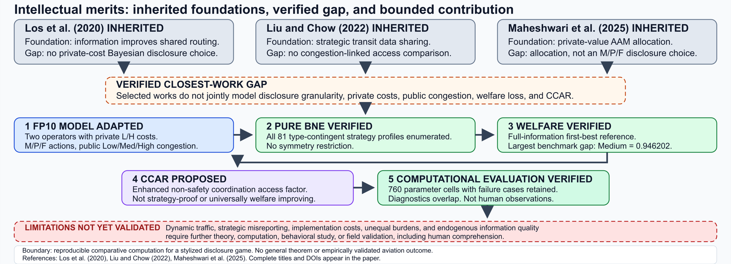
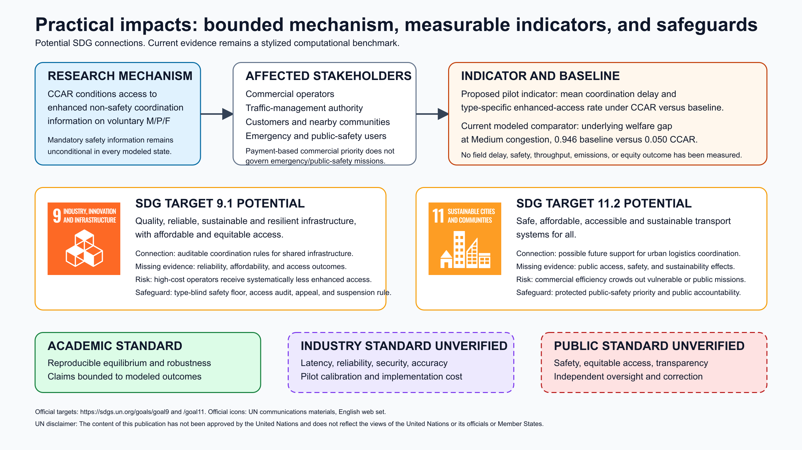
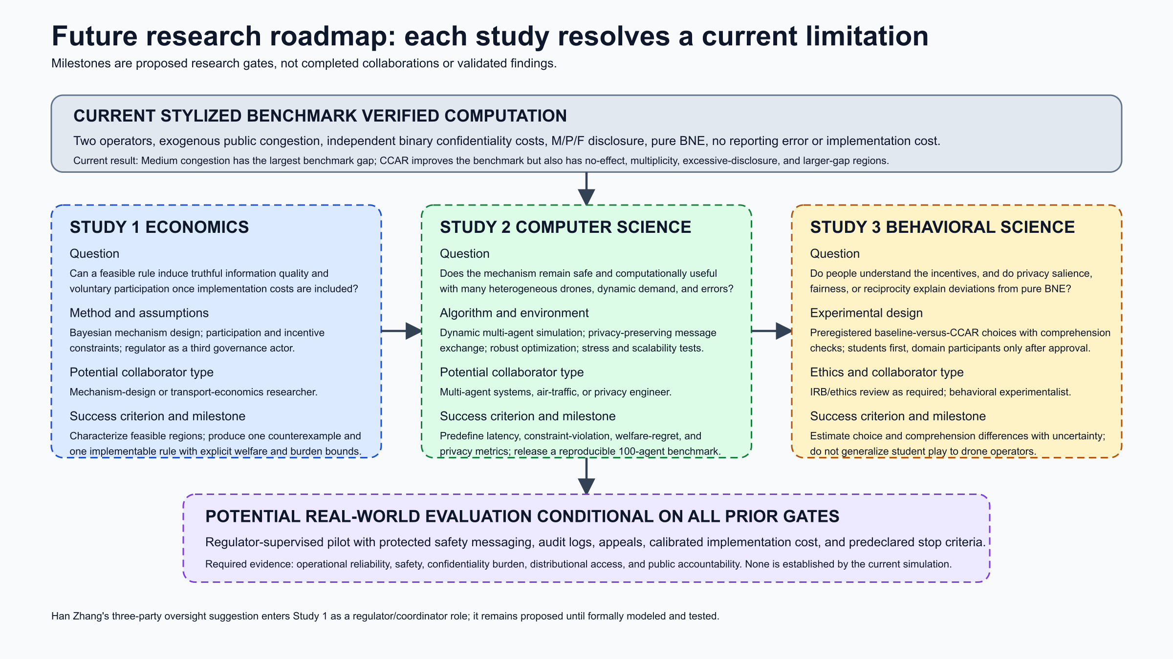
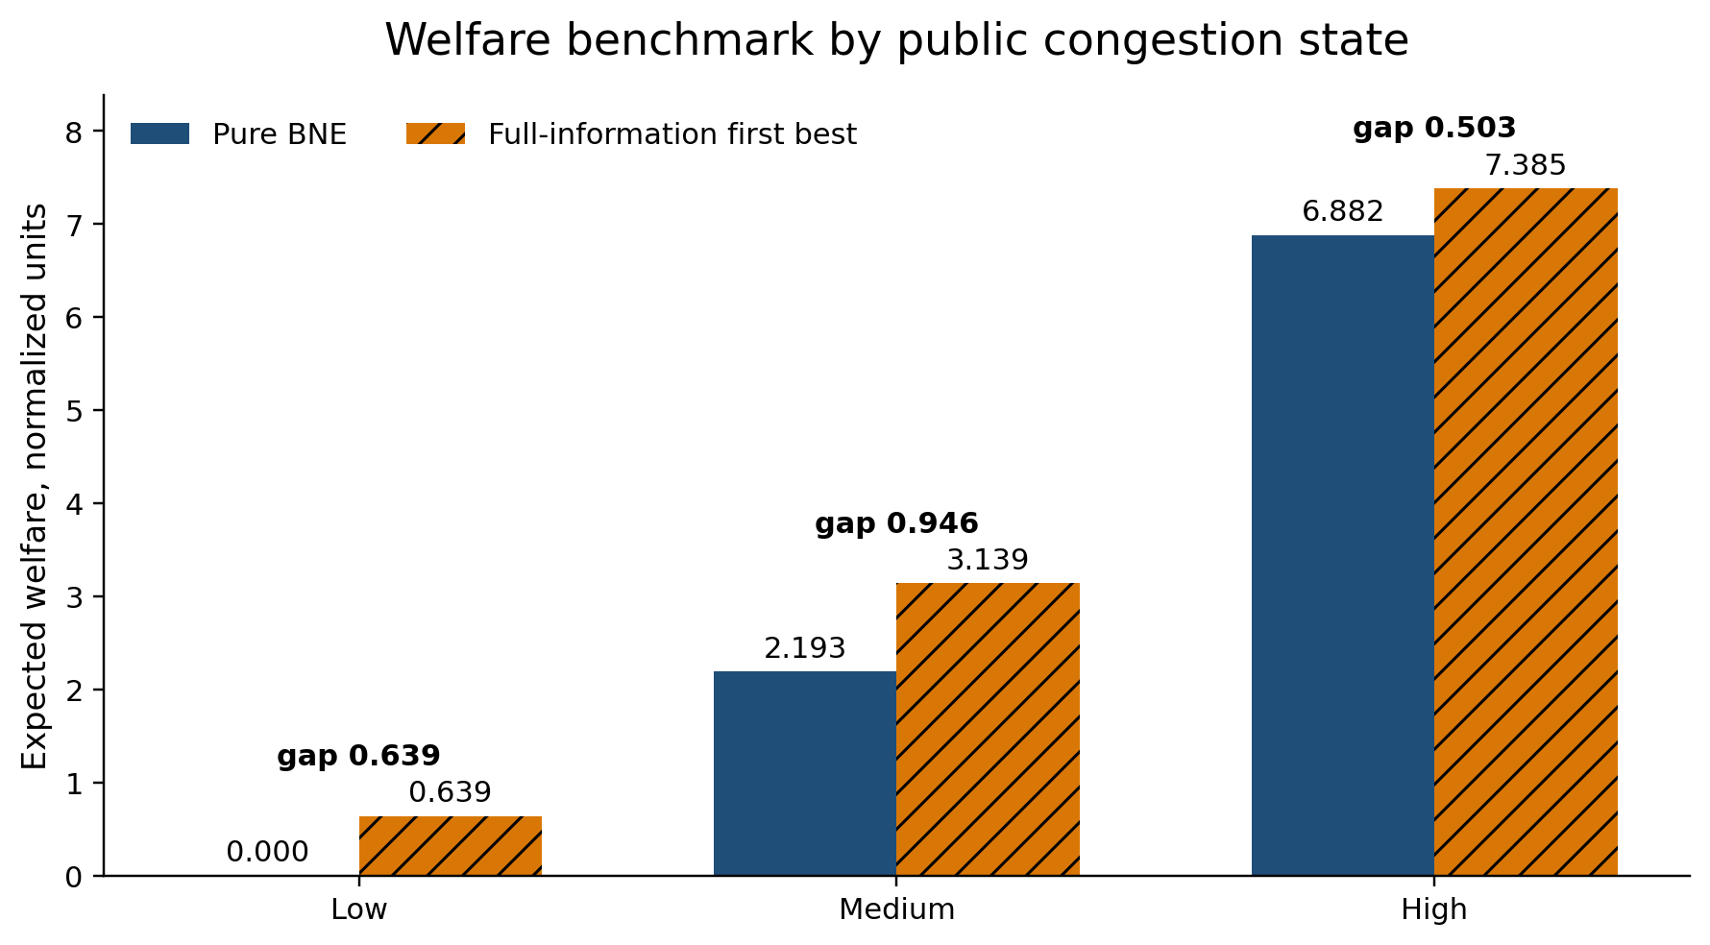


COMSCI / ECON 206 | FINAL RESEARCH PROJECT | AUTUMN 2026
Share or Hide? Strategic Disclosure
in Congested Low-Altitude Drone Traffic
Yiqiao Liu | Team FP10
Course instructor: Professor Luyao Zhang
A0 landscape 1189 × 841 mm. Submit PPTX + PDF. Commit poster PDF/preview to GitHub and embed in ROOT README.md.
FINAL PROJECT v2026.10.15
KEY MESSAGE
The Medium-congestion welfare gap falls from 0.946 to 0.050 in the benchmark CCAR example, but the rule also has no-effect and adverse parameter regions.
01 Question and foundations
02 Model and verified evidence
03 Practical impacts and roadmap
Research question & verified gap
Practical Impacts diagram with SDG targets
When do private confidentiality costs and public congestion make voluntary M/P/F disclosure inefficient, and when does CCAR improve welfare?
Closest work: Los et al. (2020); Liu & Chow (2022); Maheshwari et al. (2025).
Contribution: a reproducible stylized comparison with failure regions, not a theorem or aviation field result.
Strategic model and Intellectual Merits
PRIVATE TYPE Low or High confidentiality cost
ACTION Minimum / Partial / Full
Future Research Roadmap new diagram
BNE Best response to rival's type strategy
CCAR Minimum access factor αM at Medium/High
Figure 1. Closest foundations lead to an endogenous-disclosure Bayesian model, verified BNE and welfare, proposed CCAR, computation, and explicit limitations.
Three complementary lenses
Robustness and verification
Game theory predicts complete type-contingent pure BNE.
Social choice compares operator utility with total welfare and an infeasible type-observing reference.
Mechanism design tests a congestion-contingent rule for enhanced, non-safety access.
760 deterministic grid cells
401 no-effect
334 robust improvements
18 excessive-disclosure flags
3 larger-gap
66 multiple CCAR BNE
Diagnostics overlap.
Exhaustive 81-profile search
Evidence: stylized computation
Source: outputs/final/
Auction or allocation comparison
Integration and updated named contributions
One residual commercial priority slot. FCFS: first eligible request, zero payment. Second-price auction: highest bid wins, pays second bid.
Seed-206 simulation: mean efficiency 0.622 vs 1.000. Emergency and public-safety missions remain outside payment-based access.
Economics defines incentives and welfare; computation exposes failure regions; those failures narrow the practical claim and motivate comprehension/fairness tests.
Yiqiao Liu: model boundary, code, experiments, interface, paper and poster; 65 baseline tests and fresh artifact verification.
Limits: two operators/types, exogenous congestion, pure strategies, no calibration, report-quality or implementation-cost model.
Figure 2. Expected normalized welfare
Low: 0.000 / 0.639
Medium: 2.193 / 3.089 / 3.139
High: 6.882 / 6.882 / 7.385
(BNE / CCAR / first best).
OCT 12 / OCT 14 historical activity records: author confirmation pending
OCT 21 Final submission at 23:00 Shanghai
Full acknowledgments
Selected references
OPEN MATERIALS
Prof. Luyao Zhang: course design and official templates. Prof. Kenneth S. (Ken) Rogerson: documented course-workshop context; no direct FP10 review claimed. Han Zhang: proposed three-party oversight extension. Xinrong Sun: novelty, domain, congestion-benefit and CCAR-externality challenges (author-supplied summaries; source records pending). Tencent Shanghai office; Shanghai Science and Technology Museum; COMSCI/ECON 206 classroom community. UN SDG assets; Python/NumPy/Matplotlib/nbclient/Gradio/Playwright/ACM template; OpenAI Codex assistance. Yiqiao Liu remains responsible.
Los et al. (2020), Transp. Res. E 141, 102011. doi:10.1016/j.tre.2020.102011
Liu & Chow (2022), Transp. Res. B 163, 64–87. doi:10.1016/j.trb.2022.06.013
Maheshwari et al. (2025), ACM JATS 2(4), Art. 19. doi:10.1145/3732290
UN SDG targets 9.1 and 11.2: sdgs.un.org/goals
Hugging Face: hf.co/spaces/dku-comsci-econ206-2026/ps2-share-or-hide-drone-disclosure
GitHub: github.com/dku-comsci-econ206-Autumn2026/PS2-FP10-ShareOrHide-Yiqiao
Final tested commit: pending final verification commit
Notes:
Sources: Los et al. (2020), DOI 10.1016/j.tre.2020.102011; Liu and Chow (2022), DOI 10.1016/j.trb.2022.06.013; Maheshwari et al. (2025), DOI 10.1145/3732290; official UN SDG Goal 9 and Goal 11 pages and communications assets; FP10 outputs/final/release_manifest.json. Evidence is a stylized computational benchmark, not real-world drone traffic evidence. Official course A0 template supplied by COMSCI/ECON 206.

