Slide 1


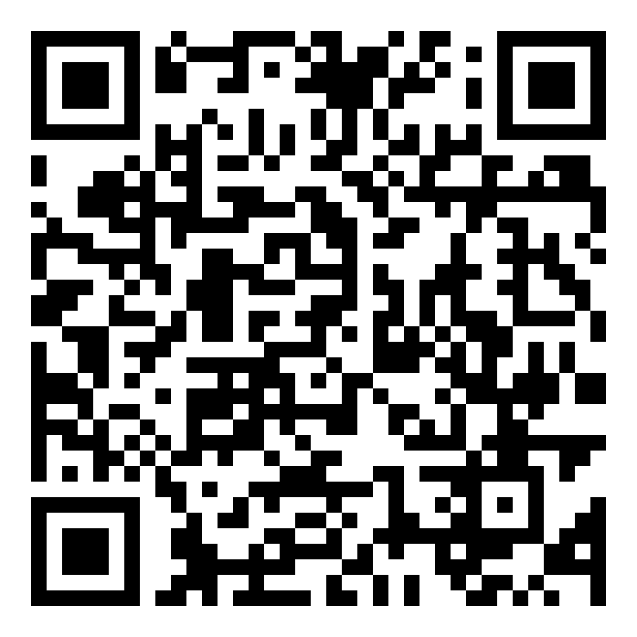
COMSCI / ECON 206 | FINAL PROJECT | FALL 2026
Pay for Training, Not for Openness:
Reward Design for Original and Distilled AI Models
Zhengjun He, Yichen Shen | Team FP4
Course instructor: Professor Luyao Zhang
FINAL · CAPABILITY-TRANSFER OPENNESS
KEY MESSAGE
Private and social rankings are exact reverses: the developer's best move is society's worst. So markets rest on secrecy, or fill with open copies, unless the prize is paid per unit of training compute, not for openness alone.
01 Question & model
02 Design & evidence
03 Merits · Impacts · Roadmap
Research question & verified gap
Figure 1 — the four strategy combinations
Intellectual Merits — three closest papers
Q A developer may imitate (distil) or innovate (train from scratch), and may release the result under secrecy or openness. Which of the four does it choose — and does society want the same?
Gap Rules that reward openness reward it as such (Qiu et al. 2025), and stay silent on whether a model was originally trained or merely imitated. That silence is where the incentive breaks.
Why it matters A prize that pays for openness alone pays the imitator, not the innovator.
Secrecy
Imitate · cheap (C_{d}, E_{d})
Innovate · costly (C_{n}, E_{n})
Qiu et al. (2025) — openness regulation; we inherit openness as a strategic choice but separate original training from distillation.
Xu et al. (2025) — openness, competition, governance; we inherit the subsidy framing but index the reward to compute.
Habibi (2025) — why firms open-source; we inherit the future-share F(m) but compare flat vs. compute-indexed rewards.
Distinct: the four-decision structure, the compute index, the three market states. Evidence: analytical + simulation. Model-based findings, not real-firm effects.
① Secrecy + imitation
Free-rider — takes, gives nothing
π − C_{d}
③ Secrecy + innovation
Monopolist — builds, keeps it
π − C_{n}
Openness
② Openness + imitation
Passer-on — takes and gives back
−C_{d} + kE_{d} − L + βφK·m/(m+m₀)
④ Openness + innovation
Source — builds, and shares
−C_{n} + kE_{n} − L + βφK·m/(m+m₀)
Strategic model & foundations
Players N firms each choose sourcing (imitate or innovate) and release (secrecy or openness).
Payoffs four cells (Figure 1): secrecy keeps the monopoly profit; a release earns a prize on its compute and loses the edge.
Solution concept Nash equilibrium, set against society's ranking.
Assumptions innovation costs more and uses more compute than imitation; the prize rate k is paid per unit of compute E.
Notation C_{d}, E_{d} = cost and compute of imitation · C_{n}, E_{n} = cost and compute of innovation · k = prize per unit of E · L = loss from disclosure · π = monopoly profit kept under secrecy · βφK·m/(m+m₀) = future share an open release buys (β discount · φ ecosystem efficiency · K external contributions · m compatibility share · m₀ internal scale).
Figure 1. The strategy space is a 2 × 2 — sourcing (imitate or innovate) × release (secrecy or openness) — with each cell's payoff. Secrecy plus imitation keeps the monopoly price cheaply, which is why it dominates privately; openness plus innovation is the only cell that creates a reusable source, and it is the most expensive. Cells recomputed in verify_k.py. An open release also keeps the future market share it buys, βφK·m/(m+m₀) — the discounted value of the external contributions an open model attracts.
Practical Impacts — SDG 9.5 · 10.2
Mechanism: tie open-model subsidies to audited training compute.
Stakeholders: labs, smaller developers, users, taxpayers, the agency.
Indicator: original-source releases per unit of public spending.
Baseline (simulated): flat reward → 4% of prize reaches sources (484/source); indexed → 98% (18.6/source).
Payment (k=4): imitator cost C_d=1.44 → reward kE_d=3.94; innovator cost C_n=5.67 → reward kE_n=18.52; total public spending ≈ 354,763.
Risks: misreported compute, duplication, crowding out distillation.
Safeguards: audit, capped pilot, publish results, revise or stop.
Intended benefit, not yet demonstrated.
Figure 2 — private desire vs. social desirability
Combination
Private desire
Social desirability
Conflict
① Secrecy + imitation
← Largest conflict
Three complementary lenses
③ Secrecy + innovation
← Small conflict
② Openness + imitation
← Small conflict
Game theory left alone, the best response is secrecy plus imitation — the cheap way to keep the monopoly price.
Social choice society ranks openness plus innovation best and secrecy plus imitation worst; the two orders are exact reverses.
Mechanism design a prize paid for openness alone rewards the imitator more than the innovator, who paid more to get there; paid per unit of compute it separates them.
④ Openness + innovation
← Largest conflict
Dark red = private desire · green = social desirability (more squares = more wanted).
Three market states — the prize rate k decides which cell wins
Market state
Prize rate
Composition of the market
Outcome
State ① all secrecy
too small for disclosure
① dominates if βφK is small
monopoly price; no source
Future Research Roadmap
Implemented payment rule & auction analogy
State ② all imitation
disclosure, not innovation
② dominates — nobody innovates
no source is ever built
Limitation: illustrative parameters, simulated firms, manipulable compute.
Economics: which reward raises sources/$? — preregistered policy pilot.
Computer science: can original compute be verified? — provenance logs + adversarial benchmarks.
Behavioral: how do firms adapt over rounds? — repeated-choice experiments.
First task: an auditable training measure.
Implemented rule: proportional kE subsidy — each open release is paid k per unit of audited training compute E.
Flat and capped rewards are counterfactual designs, not this institution.
All-pay reading (Baye et al. 1996) is an analogy only: every firm pays its sunk training cost.
State ③ healthy
pays for both
④ wins; some secrecy survives
fair price and a live source
Figure 2. The private order (①> ③> ②> ④) and the social order (④> ②> ③> ①) are exact mirror images: the developer's favourite is society's least wanted. The private order holds while π + L − βφK > C_{n} − C_{d}, i.e. while the future-share motive is weak; with a strong motive openness wins even at k = 0 (panel b).
Interpretation. A prize too small buys no disclosure; one that pays for openness but not for cost buys copies, not capability; only a prize covering both keeps a live source.
Verification. Cells and states are recomputed from scratch in the checker, independently of the symbolic derivation; an interactive page lets a reader move the parameters and watch the winning cell flip.
Runs. Paying for openness alone fills the market with imitation and dries up the sources; paying per unit of compute turns it back to original release (sources: 0.04 → 0.95); capping the prize undoes that, and with the future-share motive opening pays only for m ∈ (0.101, 1.519). Fresh run: seed 206. Copying a copy adds no capability, so mutual imitation burns compute while capability decays — yet some imitation is still efficient, because it stops every firm from re-deriving the same result. Parameters are illustrative, not estimated.
OCT 12 duet defense · OCT 14 roundtable · OCT 21 final
reward rule | (a) no motive, βφK = 0 | (b) motive on, βφK = 19.98
none, k = 0 | .96/.00/.04/.00 ① | .28/.68/.01/.03 ②
openness, R = 20 | .11/.85/.00/.04 ② | .01/.95/.00/.04 ②
indexed, k = 4 | .35/.00/.01/.64 ③ | .03/.02/.00/.95 ③
indexed, capped, k = 12 | .42/.54/.02/.03 ② | .03/.93/.00/.05 ②
Acknowledgments & contributions
Selected references
OPEN MATERIALS
Thanks to Prof. Luyao Zhang; Prof. Kenneth S. (Ken) Rogerson (Sept 7, 2026 workshop discussant); Han Zhang; reviewers Mustafa Ayub Khan, Jiayang Sun, Temur Akhtamjonov, Xuantong Fu, Feiyu Li; Tencent's Shanghai office; the Shanghai Science and Technology Museum; and the COMSCI/ECON 206 community.
Zhengjun He: compute-indexed reward idea, market-competition model, simulation and verification. Yichen Shen: three-question framing, Hugging Face Space, paper/poster consistency. AI assistance disclosed in the paper.
[1] Qiu, T., Laufer, B., Kleinberg, J. & Heidari, H. (2025). Modeling the Economic Impacts of AI Openness Regulation. NeurIPS 2025. arXiv:2507.14193 · doi:10.52202/085713-1246
[2] Xu, F., Wang, X., Chen, W. & Xie, K. (2025). The Economics of AI Foundation Models. arXiv:2510.15200 · doi:10.2139/ssrn.4999355
[3] Habibi, M. (2025). Open Sourcing GPTs. arXiv:2501.11581
Hugging Face: huggingface.co/spaces/dku-comsci-econ206-2026/FP4_PS2
GitHub: github.com/dku-comsci-econ206-Autumn2026/PS2-FP4-CapabilityTransfer
Commit [FINAL-COMMIT] · MIT licence
A0 landscape · editable PPTX + PDF · commit poster/final-poster.png and final-poster.pdf to GitHub root README
Notes:
COMSCI/ECON 206 PS2 clean A0 poster template.
Brand guide: https://dku-web-admissions.s3.cn-north-1.amazonaws.com.cn/dkumain/wp-content/uploads/mainsite/2022/05/brand-guide-compressed_2021.pdf, linked from https://www.dukekunshan.edu.cn/media/. Guide pp. 5, 6, 12, 14, and 15 establish logo clear space/proportions, unchanged logo artwork, application colors #003399 and #006633 plus white, and Calibri as the office system font when InterstatePlus cannot be used. Official logo asset: https://www.dukekunshan.edu.cn/wp-content/uploads/2021/08/large_dku-Logo.png.
Calibri is specified in the editable PowerPoint. The exported PDF uses Carlito, a metric-compatible open-source substitute because Calibri is unavailable in the export environment. Re-export from PowerPoint with Calibri for institution-font-exact output.
Clean and annotated versions share all element positions. Keep A0 landscape 1189 x 841 mm, 100% print scale. Text and figure/QR placeholders are editable; preserve the embedded logo unchanged and keep at least half its height as clear space. Instructor belongs below authors, not in the author list. Replace all placeholders with actual work; distinguish observed results, inferences, and planned tests. QR codes are optional but full public URLs and tested access are required. References must be full and traceable; acknowledgments must name actual contributions and AI assistance. Sep 28: symposium, peer evaluation and real-world case impacts. Sep 30: final update. The PS1-style paper, LaTeX, and learning pathway are unchanged.

