Slide 1

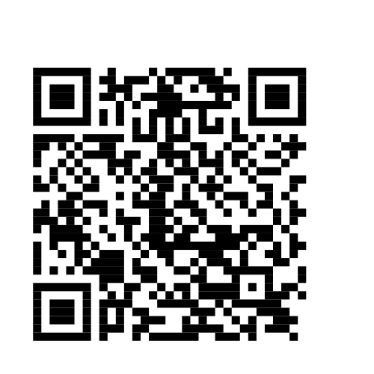
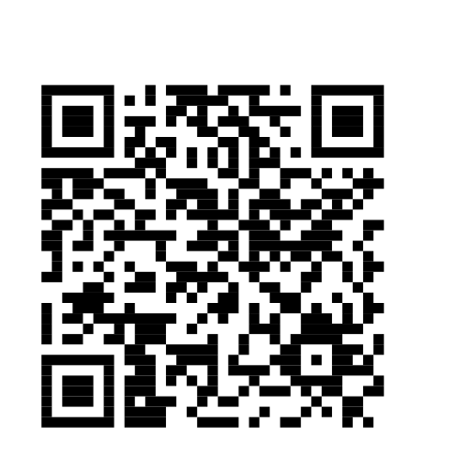
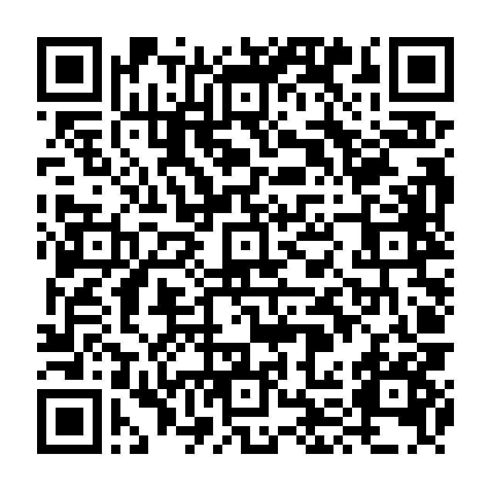
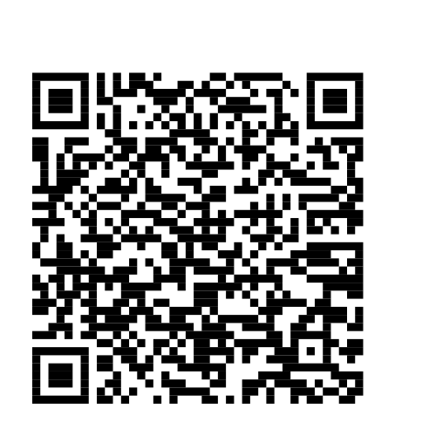
COMSCI / ECON 206 | PS2 RESEARCH SYMPOSIUM | FALL 2026
Governing the DAO Treasury: Token-Weighted vs. Square-Root Voting
under Whale Concentration and Sybil Splitting
Zimu Zhou | Team FP11 (solo) | Duke Kunshan University
Course instructor: Professor Luyao Zhang
01 Question & model
02 Design & evidence
03 Impact & dialogue
Research question & verified gap
Integrated research design
Practical case: Uniswap governance
Shared question: When does SRV improve welfare and non-whale representation over TWV, and when does wallet splitting remove the gains?
Connected questions: Economics evaluates incentives and welfare. Computation tests wallet splitting at fixed concentration. Behavior asks whether fairness and Sybil awareness change rule preferences.
Verified gap: Fritsch et al. [4] measure actual DAO voting concentration. QV theory [2] prices votes, while Sybil research [3,5] already establishes identity risks. Our contribution is a bounded, reproducible comparison of these established mechanisms.
Economic model | Computational evidence | Behavioral evidence
Unequal token holdings TWV versus SRV Holder/stake welfare | 60% whale; 3 voting conditions 1,000 shared value profiles Sincere ballots; seed 206 | Browser self-play Rule preference and fairness Sybil-salience reflection
Prediction: less power for one unsplit whale. | Test: fixed stake, one versus eight whale wallets. | Revision: separate fairness from attack resistance.
Context: UNI holders govern treasury spending [6]. We examine requirements for an SRV grant-voting pilot, without estimating actual Uniswap outcomes.
Pilot test: Hold proposals fixed. Require representation gains to survive plausible splitting attacks and disclose identity safeguards’ access costs.
Risks: Identity checks may exclude legitimate users and impose privacy and implementation costs.
Correction: Publish results, allow wallet-classification appeals, rerun disputed cases, and revise or suspend a pilot whose identity assumptions fail.
Figure 1. One shared question links splitting incentives, reproducible voting outcomes and a bounded behavioral reflection. Cost and salience experiments remain planned.
Voting model & foundations
Key message at 60% whale ownership
Behavior & interdisciplinary integration
Players: Eight actors vote A, B or C for one fixed grant. The whale owns c = 0.60. Seven holders each own 0.40/7. Whale wallets vote as a bloc.
Utility and values: Values vᵢⱼ are iid Uniform[0,1). Winner j* gives uᵢ = vᵢⱼ*. The simulator observes all values to evaluate welfare.
Timing and behavior: Set the rule and wallet count m, then each actor votes sincerely for their highest-valued proposal. This is a one-shot voting baseline; strategic deviations are not simulated.
Scoring: TWV uses wᵢ = sᵢ. SRV uses wᵢ = √sᵢ. Highest total score wins, with A/B/C tie priority. This is square-root weighting, not full QV.
In this benchmark, SRV improves representation at m = 1. Eight-wallet splitting removes that advantage.
Self-play, n = 1: The author voted A twice. TWV selected C and SRV selected A. After considering Sybil splitting, preference switched from SRV to TWV.
Reflection: Fairness mattered, yet the author would split a 60% whale stake into eight costless wallets. Fairness can conflict with incentives.
Alternative explanation: Personal outcomes may drive preference. One self-play record establishes neither causality nor a population pattern.
Integration: GitHub/Colab quantify synthetic voting outcomes. HF uses separate self-play scenarios to record fairness, rule preference and splitting intentions. These are distinct evidence sources.
Next test: Fix values and outcomes. Vary Sybil salience and splitting cost. Compare preferences and splitting intentions.
Three complementary lenses
Figure 2. Sincere-voting means, seed 206, 1,000 shared profiles per condition. Probabilities and efficiency ratios use the same 0–1 scale.
Game theory: Splitting c into m wallets raises SRV whale weight from √c to √(mc); TWV stays c. At c = 0.6, m > 4.67 gives the whale a voting majority under SRV. The simulation fixes m.
Social choice: Holder welfare W(j) = Σᵢvᵢⱼ counts actors equally. Stake welfare Σᵢsᵢvᵢⱼ weights ownership. Better representation can reduce stake efficiency.
Mechanism design: Hold values fixed across TWV (m = 1), SRV (m = 1) and split SRV (m = 8).
Outcome (sincere voting) | TWV, m=1 | SRV, m=1 | SRV, m=8
Holder efficiency | 0.899065 | 0.927781 | 0.899065
Stake-weighted efficiency | 0.991097 | 0.977076 | 0.991097
Whale-preferred winner | 100.0% | 89.6% | 100.0%
Non-whale representation | 32.1% | 41.7% | 32.1%
Payments / DAO revenue | 0 / 0 | 0 / 0 | 0 / 0
Limitations & next computational test
Scope: Synthetic iid values, sincere ballots and a 60% whale. Only the whale splits; splitting is exogenous, costless and coordinated.
Evidence boundary: Three conditions and one seed-206 sample. No equilibrium, uncertainty interval, real-DAO outcome or causal behavioral effect is established.
Next test: Add strategic voting and test Nash equilibria [1]. Vary concentration, splitting costs, identity constraints, seeds and valuation distributions.
Week 5: treasury allocation comparison
Metrics: Efficiency divides realized welfare by its feasible maximum. Representation is the probability that the winner maximizes the seven non-whales’ summed values. It is not a headcount-majority measure.
Whale success is the fraction where the whale’s favorite wins. Welfare counts the whale once, regardless of wallet count.
Resource and reports: One indivisible grant goes to one of three proposals. Holders report ballots based on individual valuations, not monetary bids.
Rules and outcomes: The highest score receives the grant. Voting has zero payments and zero DAO revenue. Utility is the value of the selected proposal.
Boundary: This is collective allocation. It has no seller, auction price, truthful-bidding theorem or revenue objective.
Contribution, leadership & dialogue
Reproducibility & verification
Value: Academic stress tests, an auditable industry pilot, and accessible education with a public challenge route. SDG 4 learning impact is untested.
2056 aspiration: Accountable governance under unequal ownership and manipulable identities.
Question: Which safeguards limit splitting without excluding users?
Python random.Random(206); c = 0.60; 1,000 shared profiles × 3 conditions = 3,000 rows. Committed CSV/JSON outputs agree with the executed notebook. Reruns are deterministic; TWV and split SRV match profile by profile.
Acknowledgments & responsibility
Selected references
Open materials & exact version
Zimu Zhou completed the model, code, self-play, paper and poster as a solo team. Professor Luyao Zhang provided course guidance. The poster adapts the supplied course template.
Tools: Python standard library, GitHub, Colab and Hugging Face. ChatGPT/Codex assisted drafting, debugging and layout. The author retains responsibility for assumptions, checks and claims.
[1] Nash, J. F. 1950. “Equilibrium Points in n-Person Games.” PNAS 36(1): 48–49. https://doi.org/10.1073/pnas.36.1.48
[2] Lalley, S. P., and E. G. Weyl. 2018. “Quadratic Voting: How Mechanism Design Can Radicalize Democracy.” AEA Papers and Proceedings 108: 33–37. https://doi.org/10.1257/pandp.20181002
[3] Douceur, J. R. 2002. “The Sybil Attack.” IPTPS, 251–260. https://doi.org/10.1007/3-540-45748-8_24
[4] Fritsch, R., M. Müller, and R. Wattenhofer. 2024. “Analyzing Voting Power in Decentralized Governance: Who Controls DAOs?” Blockchain: Research and Applications 5(3): 100208. https://doi.org/10.1016/j.bcra.2024.100208
[5] Bennett, A., P. Vander Vos, D. V. Le, and M. Belenkiy. 2026. “Concave is the New Linear: The Impossibility of Anti-Plutocratic DAO Governance.” arXiv:2605.18990. https://doi.org/10.48550/arXiv.2605.18990
[6] Uniswap. “Governance Overview.” Accessed 27 Sep 2026. https://developers.uniswap.org/docs/ecosystem/governance/overview
Hugging Face: https://huggingface.co/spaces/dku-comsci-econ206-2026/DAO_Treasury
GitHub: https://github.com/dku-comsci-econ206-Autumn2026/PS2_Zimu
Commit: 4e96644c9962f7d1441e7d6c36063d4b2facf3de
Colab: https://colab.research.google.com/github/dku-comsci-econ206-Autumn2026/PS2_Zimu/blob/main/dao_treasury_simulation.ipynb
Hugging Face
GitHub
Colab
Notes:
Revised 6 October 2026 to match computational artifact commit 4e96644c9962f7d1441e7d6c36063d4b2facf3de.
Sources: README.md, VERIFICATION.md, src/simulation.py, outputs/summary.json at that commit.
The reported results are a sincere-voting baseline with 1,000 shared profiles, three conditions, and fixed whale stake 0.60. The chart and table use the exact committed summary values, rounded only for display. Original best-response/Nash audit claims and unexported mean utility values have been removed.
Colab notebook: https://colab.research.google.com/github/dku-comsci-econ206-Autumn2026/PS2_Zimu/blob/main/dao_treasury_simulation.ipynb
Self-play remains a single author reflection from separate behavioral scenarios.

