Slide 1

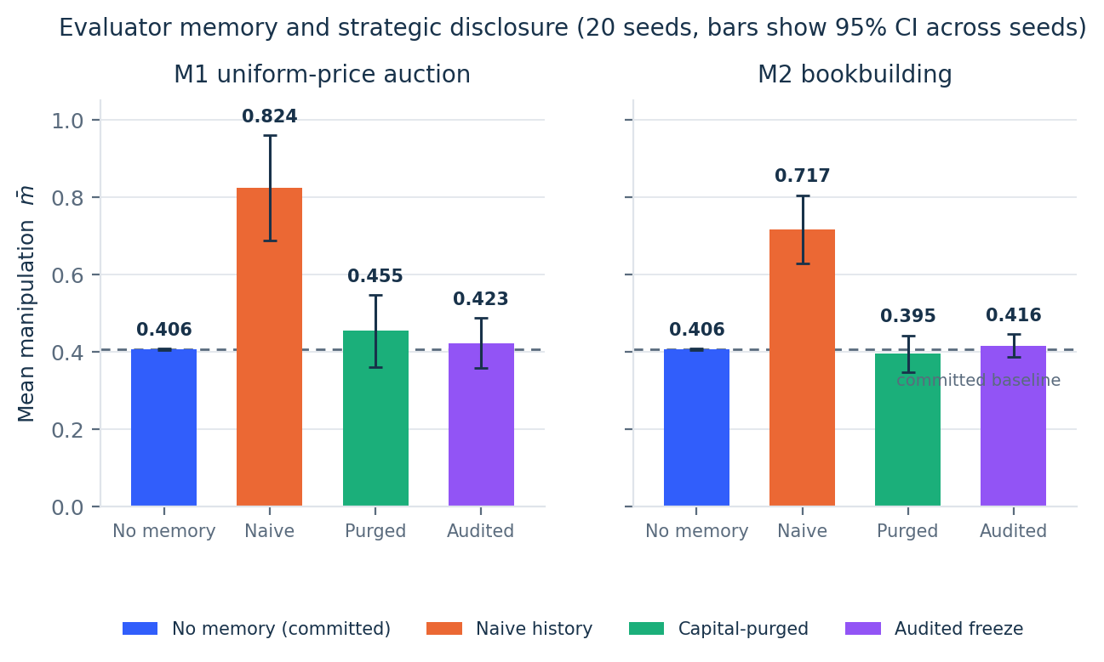
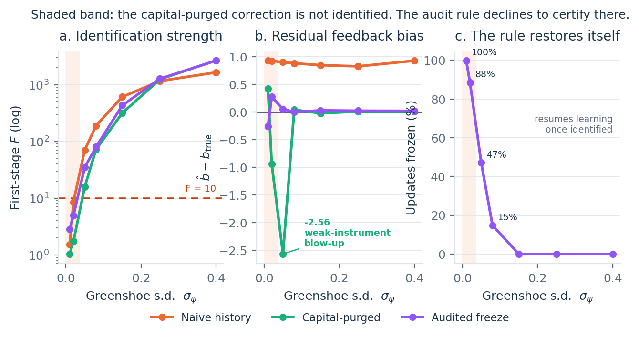
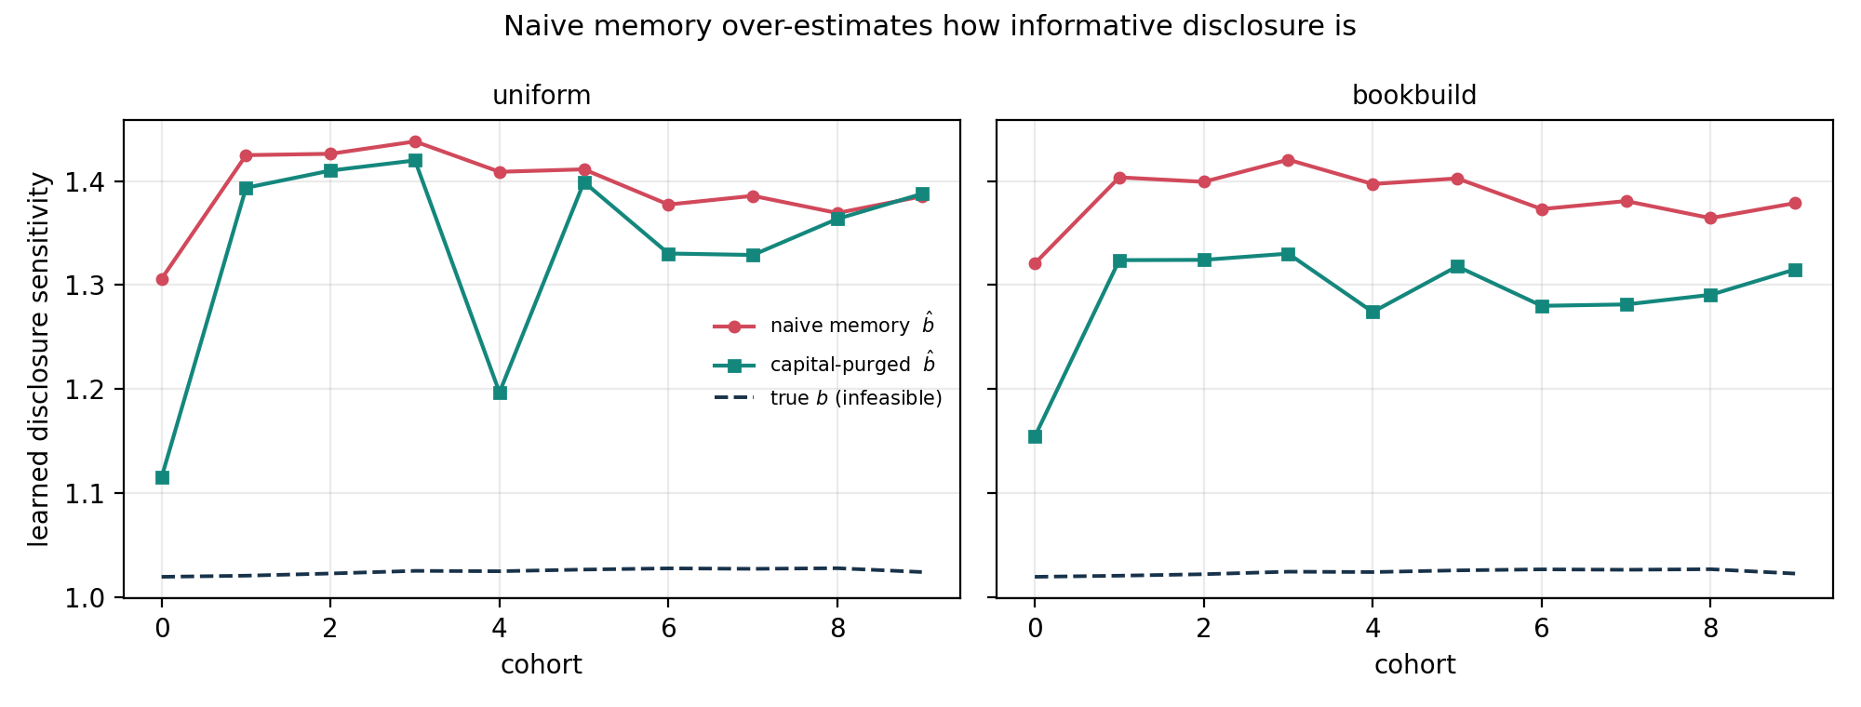
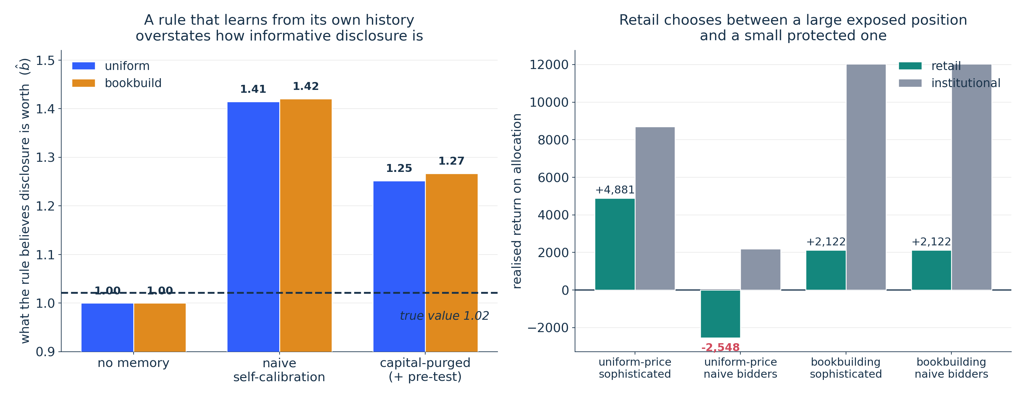
COMSCI / ECON 206 | FINAL PROJECT | AUTUMN 2026 | SYMPOSIUM C
Learning from Its Own Footprint
When may an AI valuation rule revise itself?
Feiyu Li · Xuantong Fu | Team FP3
Course instructor: Professor Luyao Zhang
v1.0-final · 20 seeds · frozen run · all results simulated
KEY MESSAGE
An evaluator that learns from outcomes it caused roughly DOUBLES strategic disclosure: mean manipulation 0.824 vs 0.406 under a committed rule (M1, 20 seeds).
The fix is not accountability in general but IDENTIFICATION: gate revision on a first-stage F ≥ 10 and worst-case bias falls from 2.563 to 0.275.
But the safeguard is NOT free: it costs retail investors 13.1 of 35 places and gains institutions 4.2 of 15. An integrity gain with a distributional price.
01 Question & model
02 Design & evidence
03 Impact & dialogue
Research question & verified gap
Practical design question
Under what condition may an AI valuation rule safely revise itself from outcomes it helped cause — and does the allocation mechanism decide whether that condition can hold?
Gap: costly-disclosure and performative-prediction work never let the SAME rule both set allocation and retrain on it, so no checkable condition exists.
Mechanism: require any valuation rule that also influences allocation to publish its calibration path, allocation footprint and first-stage F, and to freeze updates when F < 10, restoring the last audited rule.
Indicator: share of published updates carrying F ≥ 10. Baseline: no venue discloses this today. SDG 16.6, 16.10, 9.3.
Evidence status: INTENDED BENEFIT, SIMULATED ONLY. Risk: a published threshold is gameable — suppress allocation variation and the rule stays frozen on a favourable parameter. Safeguard: exchange-set shock, third-party audit log.
Strategic model & foundations
Issuer discloses d = θ + m at cost m²/2γ. The rule posts a public score s = (1−β)μ₀ + β[a + b̂(d+η)]; investors bid; the mechanism sets price P and proceeds k; outcome y = θ + ρk + ε re-enters the rule's history.
Best response m* ∝ λβb̂ — every revision of the rule moves every later issuer's report. PBE with beliefs and sequential rationality in Appendix A.0.
Fig 1. Evaluator memory and strategic disclosure. 20 seeds, 95% CI across seeds. Naive history roughly doubles manipulation; the correction and the audit rule return it to the committed baseline.
Interdisciplinary evidence
Economics — the allocation rule, not the estimator, decides whether the evaluator's own footprint is identifiable.
Computer science — GitHub runs the whole grid in one command; 11 assertions verify each claim, including two defects we found in our own PS2 code: a first-stage F mis-normalised by a factor of n−2 (reported 0.136, actually 5.47) and a purge that read b_true when forming its target.
Social choice — challenged by Team FP4 (Oct 12 duet) with Milli et al. 2019 on the social cost of strategic classification, we measured who pays for our own safeguard. Versus the unsafeguarded rule the audited evaluator serves 13.1 fewer of 35 retail investors (99.9%→62.5%) and 4.2 more of 15 institutions (36.7%→64.8%). The allocation and equilibrium claims survived that challenge; the welfare claim did not, and is now narrowed.
Behavioral — the Hugging Face Space records whether players strip predictable inflation out of the public signal. EXPLORATORY: completed n and matched treatment outputs are not established; no population claim is made.
Three complementary lenses
Game theory — revising the rule is itself a strategic act: m* rises with the rule's PERCEIVED sensitivity, so the cost is waste, not deception.
Social choice — pricing accuracy, allocative efficiency and retail access conflict; later issuers inherit a calibration they never influenced.
Mechanism design — only the allocation rule supplies variation in k orthogonal to d, so it decides whether learning is admissible at all.
Limitations & next test
Auction or allocation comparison
Instrument exogeneity is imposed by construction — the central open limitation. ρ is exogenous and unobserved, so allocative efficiency on ρ stays ≈0 in every cell (reported as a negative result). Flat demand curves. One evaluator. Equilibrium is of the stage game, not the full dynamic game.
NEXT TEST, stated in advance: 2SLS on SEC EDGAR S-1 text × realised greenshoe exercise, 2015–2025. If the real first stage returns F < 10, an audited evaluator can never certify in practice and we ABANDON this design in favour of commitment.
100 shares; 15 institutions (≤6 units) and 35 retail (≤2 units) — 160 units of demand, coverage 1.6×, so bids EXCLUDE: 16 of 50 investors get zero.
M1 uniform-price: rank bids, fill, pro-rate the margin, pay the lowest accepted bid. M2 bookbuilding: 85% reserved to institutions at an 8% discount.
The PS2 fixed-share rule is retained as a labelled arm. Boundary: flat demand curves (no demand reduction); no certification or relationship effects.
Fig 2. The discriminating test. Shaded band = the correction is NOT identified. (a) stronger exchange-set greenshoe variation buys identification; (b) below F = 10 the purged estimator is not merely biased but unstable, swinging to −2.563, while the audited rule's worst case is 0.275; (c) the rule restores itself, unfreezing 100% → 0% as identification arrives.
Placebo: setting ρ = 0 removes the effect entirely (+0.328 → −0.019), so it is the capital channel, not the synthetic setup. Sign holds in 27/27 settings.
NAMED CONTRIBUTIONS — Feiyu Li: decided the allocation rule governs whether learning is admissible; built the excludable mechanism (src/auction.py) and the allocation assertions; verified 16/50 excluded and that the PS2 arm still serves all 50. Xuantong Fu: decided the first-stage F should govern the audit rule; built the 2SLS estimator, the audited-freeze rule and the robustness suite; found and verified the F mis-normalisation and the b_true leak. Each author independently re-ran and confirmed a consequential component of the other's work.
Acknowledgments
Selected references
OPEN MATERIALS
Duet partner Team FP4 — Zhengjun He and Yichen Shen — whose selection of Milli et al. (2019) forced us to narrow a claim rather than defend it (see Social choice, left). Prof. Luyao Zhang — incubated this research; her 14 Oct 2026 feedback (fixed-share allocation, the missing sequential-rationality argument, the poster/headline mismatch) produced the largest change in this work. Prof. Kenneth S. (Ken) Rogerson — Program Discussant, 2056 Nobel and Turing Laureate Program Launch Workshop, 7 Sep 2026, who asked what makes our AI better than the AI before it; this paper is the corrected answer. Han Zhang (Liberata; Duke PhD candidate) — explicit correction routes, which became the audited-freeze rule. Formal reviewers: Aaron Wang (FP8), Zhenning Wang — who independently converged on the same open question, whether the footprint survives real issuance data, now the roadmap's first study. Individual self-challenges posted 14 Oct by Feiyu Li (artifact risk) and Xuantong Fu (weak identification); each ran their own test and replied to FP4 separately. Tencent Shanghai office; Shanghai Science and Technology Museum; and the whole COMSCI/ECON 206 classroom community. Software: Python, NumPy, pandas, Matplotlib, Gradio. SDG icons and target text © United Nations. AI-Assisted — disclosed in Appendix A.1. If you reviewed this project and are not named, tell us and we will correct both artifacts.
Perdomo, Zrnic, Mendler-Dünner & Hardt 2020, ICML (performative prediction). Benveniste & Spindt 1989, JFE 24(2) 343, doi:10.1016/0304-405X(89)90051-2. Cao, Jiang, Yang & Zhang 2023, RFS 36(9) 3603, doi:10.1093/rfs/hhad021. Staiger & Stock 1997, Econometrica 65(3) 557, doi:10.2307/2171753. Milli, Miller, Dragan & Hardt 2019, FAT* 230, doi:10.1145/3287560.3287576. Lucas 1976, Carnegie-Rochester 1, 19. Nobel Prize in Economic Sciences 2026 (Hall & Woodford) and 2025 (Mokyr, Aghion & Howitt), nobelprize.org. Full reference list in the paper.
GitHub: github.com/dku-comsci-econ206-Autumn2026/ps2-fp3 (poster embedded in root README)
Colab: colab.research.google.com/drive/1o-t9W3shjHubzSBcB8QK6KYFumrJmEbh
HF Space: huggingface.co/spaces/dku-comsci-econ206-2026/strategic-disclosure-game
Notes:
COMSCI/ECON 206 PS2 clean A0 poster template.
Brand guide: https://dku-web-admissions.s3.cn-north-1.amazonaws.com.cn/dkumain/wp-content/uploads/mainsite/2022/05/brand-guide-compressed_2021.pdf, linked from https://www.dukekunshan.edu.cn/media/. Guide pp. 5, 6, 12, 14, and 15 establish logo clear space/proportions, unchanged logo artwork, application colors #003399 and #006633 plus white, and Calibri as the office system font when InterstatePlus cannot be used. Official logo asset: https://www.dukekunshan.edu.cn/wp-content/uploads/2021/08/large_dku-Logo.png.
Calibri is specified in the editable PowerPoint. The exported PDF uses Carlito, a metric-compatible open-source substitute because Calibri is unavailable in the export environment. Re-export from PowerPoint with Calibri for institution-font-exact output.
Clean and annotated versions share all element positions. Keep A0 landscape 1189 x 841 mm, 100% print scale. Text and figure/QR placeholders are editable; preserve the embedded logo unchanged and keep at least half its height as clear space. Instructor belongs below authors, not in the author list. Replace all placeholders with actual work; distinguish observed results, inferences, and planned tests. QR codes are optional but full public URLs and tested access are required. References must be full and traceable; acknowledgments must name actual contributions and AI assistance. Sep 28: symposium, peer evaluation and real-world case impacts. Sep 30: final update. The PS1-style paper, LaTeX, and learning pathway are unchanged.

