Slide 1

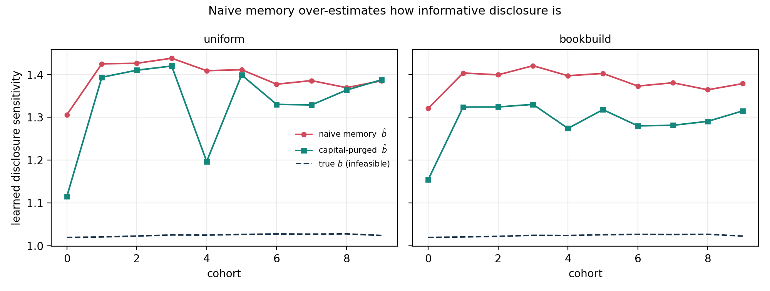
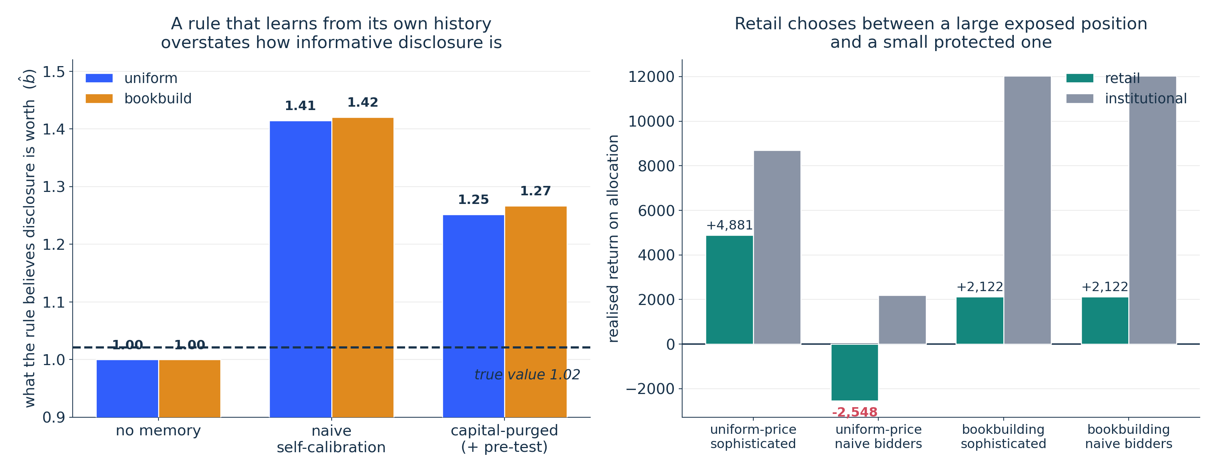
COMSCI / ECON 206 | PS2 RESEARCH SYMPOSIUM | FALL 2026
Learning from Its Own Footprint
Strategic Disclosure, Capital Feedback, and the Design of AI Valuation Rules in IPO Allocation
Feiyu Li · Xuantong Fu | Team FP3
Course instructor: Professor Luyao Zhang
KEY MESSAGE
In the model, outcomes can be high partly BECAUSE the rule priced issuers highly.
Naive history learns b ≈ 6.36 vs. true 1.02 (feedback bias 5.344) and raises mean manipulation 0.408 → 1.367 (+235%) under uniform-price allocation. Capital-purged history reduces bias, but does not remove it.
01 Question & model
02 Design & evidence
03 Impact & dialogue
Research question & verified gap
Practical design question
How should an AI valuation rule be calibrated when the issuer manages its input and the rule's own pricing changes what it later learns from?
Application setting: AI-assisted IPO/equity valuation with auction-based capital allocation.
Gap: costly-disclosure models hold the rule fixed; IPO work treats signals as exogenous; performativity work does not jointly model allocation and later learning.
Question: when can a valuation rule safely learn from outcomes it helped create?
Potential benefit: an auditable criterion for separating genuine performance from evaluator-induced outcomes.
Risk: a naive self-calibrated model can look strong on backtests because its errors track its own past allocations.
Proposed correction: publish calibration sensitivity, the memory-update log, and identification diagnostics for outside audit.
Strategic model & foundations
Issuer discloses d = θ + m at cost m²/2γ. The rule posts a public score; investors bid; allocation determines proceeds k; the outcome y = θ + ρk + ε then enters later calibration.
Issuer types differ in fundamental quality θ, private value of capital v, and social marginal product ρ. Under quadratic cost and single crossing, the PBE benchmark gives manipulation increasing in perceived evaluator sensitivity.
Fig 1. What the rule learns, cohort by cohort, against the infeasible truth.
Interdisciplinary evidence
Behavioral — Hugging Face
Exploratory test: players bid against a public AI valuation while the issuer can move the disclosed input. The planned analysis recovers each player's implied weight on the public signal.
Algorithm appreciation and anchoring make competing predictions about how that weight changes when calibration status is disclosed. No completed sample or treatment estimate is claimed here; this is an exploratory direction check.
Computational — GitHub
200 synthetic issuers, 5 seeds, 3 evaluator designs × 2 allocation mechanisms. One command regenerates the reported numbers plus a run record.
Three complementary lenses
Game theory: strategic disclosure increases with the evaluator's perceived sensitivity; equilibrium can anticipate average inflation, so the cost can appear as resources spent optimizing for the machine.
Social choice: pricing accuracy, allocative efficiency, and retail access can conflict; later issuers inherit the calibration externality.
Mechanism design: the allocation rule affects whether the evaluator's feedback footprint can be identified.
Limitations & next test
Auction or allocation comparison
Capital productivity is exogenous. The AI is a rule, not a player. One AI, no competition. All data synthetic.
Load-bearing: exogeneity of the allocation shock. True by construction here; in real data rationing may track unobserved demand. Our identification is a PROPOSAL.
Next test: robustness to allocation-shock assumptions, then pre-registered replication on real issuance data.
100 IPO shares; 15 institutional and 35 retail investors. Investors observe the public AI signal and private signals.
M1 uniform-price: bids sorted until shares are exhausted; winners pay the lowest accepted price.
M2 bookbuilding: underwriter discretion; the model assigns 85% to institutions and applies an 8% pricing discount.
Boundary: memory is cross-firm; the model abstracts from seasoned repeat issuance.
Fig 2. 200 issuers, seeds 42–46, two-cohort burn-in. Actual simulation output.
Naive memory raises mean manipulation from 0.408 to 1.367 (uniform-price) and 0.921 (bookbuilding). Under uniform-price, manipulation cost rises 14.305 → 243.230 (17×); under bookbuilding, 14.305 → 91.928 (6.4×). Capital purging reduces feedback bias under uniform-price (5.344 → 4.894; F = 0.136) but not under bookbuilding (2.012 → 2.527; F = 0.900). With no purge, price RMSE rises 0.551 → 30.328 under uniform-price.
Unresolved: a residual remains because ρ is heterogeneous and the allocation-shock first stage is weak.
SEP 28 Symposium, peer evaluation & case impact
SEP 30 Final update
Acknowledgments
Selected references
OPEN MATERIALS
Course instructor: Professor Luyao Zhang. We thank Prof. Ken Rogerson and Han Zhang (Liberata); our peer reviewers Aaron Wang and Zhenning Wang; and our discussant.
Software: Python, NumPy, pandas, Matplotlib, Gradio; ACM acmart and the course A0 template, as provided. Data synthetic. AI use disclosed in Appendix A.1.
Cao, Jiang, Yang & Zhang 2023, RFS 36(9) 3603. doi:10.1093/rfs/hhad021
Lacker & Weinberg 1989, JPE 97(6) 1345. doi:10.1086/261657
Sherman 2005, JFE 78(3) 615. doi:10.1016/j.jfineco.2004.09.005
Staiger & Stock 1997, Econometrica 65(3) 557. doi:10.2307/2171753
HF: https://huggingface.co/spaces/dku-comsci-econ206-2026/strategic-disclosure-game
GitHub: https://github.com/dku-comsci-econ206-Autumn2026/ps2-fp3
Notes:
COMSCI/ECON 206 PS2 clean A0 poster template.
Brand guide: https://dku-web-admissions.s3.cn-north-1.amazonaws.com.cn/dkumain/wp-content/uploads/mainsite/2022/05/brand-guide-compressed_2021.pdf, linked from https://www.dukekunshan.edu.cn/media/. Guide pp. 5, 6, 12, 14, and 15 establish logo clear space/proportions, unchanged logo artwork, application colors #003399 and #006633 plus white, and Calibri as the office system font when InterstatePlus cannot be used. Official logo asset: https://www.dukekunshan.edu.cn/wp-content/uploads/2021/08/large_dku-Logo.png.
Calibri is specified in the editable PowerPoint. The exported PDF uses Carlito, a metric-compatible open-source substitute because Calibri is unavailable in the export environment. Re-export from PowerPoint with Calibri for institution-font-exact output.
Clean and annotated versions share all element positions. Keep A0 landscape 1189 x 841 mm, 100% print scale. Text and figure/QR placeholders are editable; preserve the embedded logo unchanged and keep at least half its height as clear space. Instructor belongs below authors, not in the author list. Replace all placeholders with actual work; distinguish observed results, inferences, and planned tests. QR codes are optional but full public URLs and tested access are required. References must be full and traceable; acknowledgments must name actual contributions and AI assistance. Sep 28: symposium, peer evaluation and real-world case impacts. Sep 30: final update. The PS1-style paper, LaTeX, and learning pathway are unchanged.

