Slide 1
EAS-017 APACHE SPARK FUNDAMENTALS
SPARK STREAMING

Slide 2
Section 1: STREAMING OVERVIEW

Slide 3

Scalable, fault-tolerant stream processing system
High-level API
joins, windows, …
often 5x less code
Fault-tolerant
Exactly-once semantics, even for stateful ops
Integration
Integrate with MLlib, SQL, DataFrames, GraphX
Kafka
Flume
File systems
HDFS
Databases
Kinesis
Dashboards
Twitter

Slide 4




HIGH-LEVEL STRUCTURE: RECEIVERS AND BATCHES
Receivers chop up data streams into batches of few seconds
Spark processing engine processes each batch and pushes out the results to external data stores
Receivers
data streams
batches as RDDs
results as RDDs

Slide 5
STREAMING PROGRAMMING MODEL
Discretized Stream (DStream)
Represents a stream of data
Implemented as a infinite sequence of RDDs
DStreams API is very similar to:
RDD API (Spark 1.6)
DataSet API (Spark 2+)
Functional APIs in Scala/Java/Python/R
Create input DStreams from Kafka, Flume, Kinesis, HDFS, …
Apply transformations

Slide 6
Streaming context and DSTREAM
StreamingContext creates and manages DStreams
DStream is continuous analog of RDD unlimited stream of small RDDs (batches)
DStream contract: compute function: generates RDD for batch slide duration dependencies (other DStreams) zeroTime: intialize(zeroTime) generatedRDDs: collection of (time, RDD) kept for rememberInterval checkpointing: checkpoint(interval), ssc.checkpoint(“directory”)

Slide 7
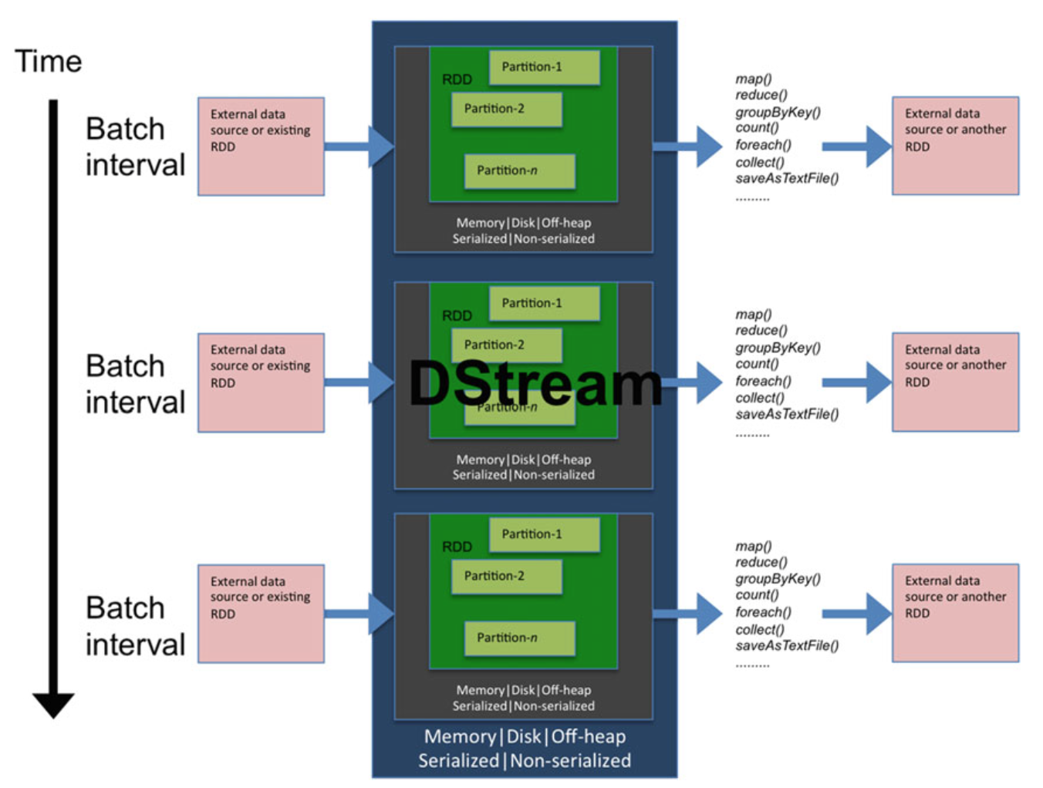

Slide 8
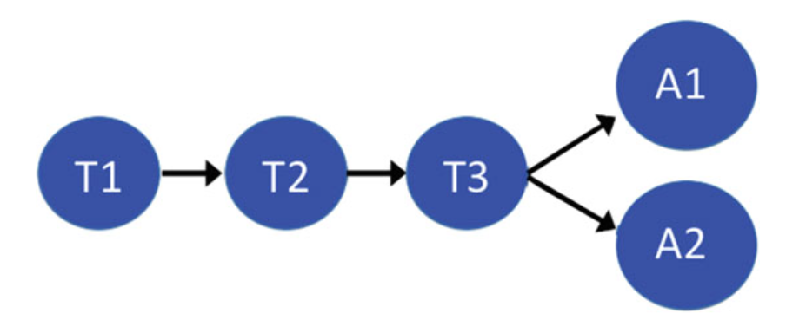
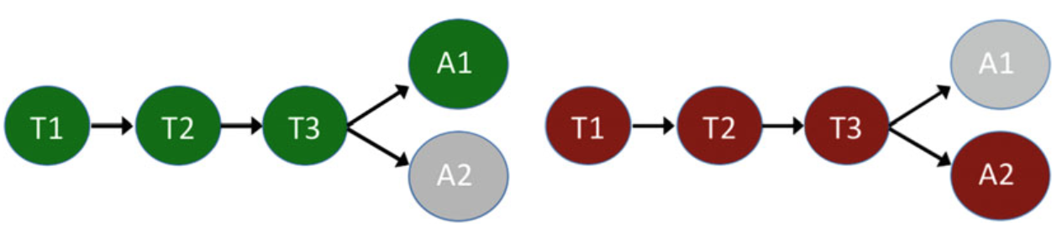
DSTREAM EXECUTION

Slide 9
Dstream types
FilteredDStream – result of DStream filtering
MappedDStream – result of DStream mapping
InputDStream – base class for external sources
FileInputDStream – monitors folder, returns UnionRDD for all new files in folder
SocketInputDStream – reads data from socket (listening on worker)
StateDStream – result of applying a stateful operation to RDDs in DStream
ForEachDStream – RDDs with side effects
WindowedDStream – all RDDs in a running window

Slide 10
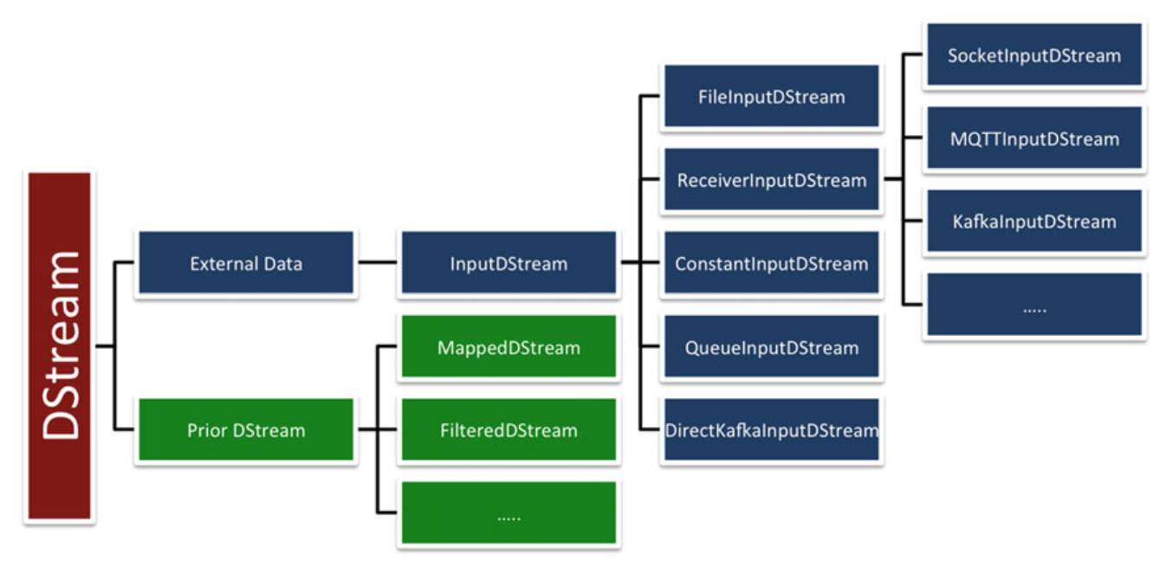

Slide 11
Dstream transformations: MAP
map (function(T))
apllies the user-provided function to each element in DStream
val sdf = new SimpleDateFormat("yyyy-MM-dd")
val tsKey = "created_utc"
val secs = 1000L
val keyedByDay = comments.map(rec => {
val ts = (parse(rec) \ tsKey).values
(sdf.format(new Date(ts.toString.toLong * secs)), rec)
})

Slide 12
Dstream transformations: MAPPARTITIONS
mapPartitions (function(iterator))
apllies the user-provided function to each partition in Dstream
val keyedByDay = comments.mapPartitions(iter => {
var ret = List[(String, String)]()
while (iter.hasNext) {
val rec = iter.next
val ts = (parse(rec) \ tsKey).values
(sdf.format(new Date(ts.toString.toLong * secs)), rec) :: ret
}
ret.iterator
})

Slide 13
Dstream transformations: FLATMAP
flatMap (function(T))
apllies the user-provided function to each element in Dstream and flattens out the content
val wordTokens = comments.flatMap(rec => { ((parse(rec) \ "body")).values.toString.split(" ") })

Slide 14
Dstream transformations: FILTER
filter (predicate(T))
uses the user-provided predicate to filter elements from Dstream
val filterSubreddit = comments.filter(rec =>
(parse(rec) \ "subreddit").values.toString .equals("AskReddit"))

Slide 15
Dstream transformations: TRANSFORM
transform (function(rdd))
apllies the user-provided function to each RDD in DStream
val sortedByAuthor = comments.transform(rdd =>
(rdd.sortBy(rec => (parse(rec) \ "author").values .toString)))

Slide 16
DSTREAM TRANSFORMATIONS: GLOM
glom()
treats each partition in RDDs in Dstream as an array
val rddMin = comments.glom().map(arr =>
arr.minBy(rec => ((parse(rec) \ "created_utc").values.toString.toInt)))

Slide 17
DSTREAM AGGREGATIONS
count() counts the number of elements
countByValue() counts the frequency of each distinct element
reduce(function(tuple,tuple)) aggregates all values into single value

Slide 18
DSTREAM KEY-VALUE AGGREGATIONS: groupbykey
groupByKey()
val topAuthors = comments.map(rec => ((parse(rec) \ "author").values.toString, 1)) .groupByKey() .map(r => (r._2.sum, r._1)) .transform(rdd => rdd.sortByKey(ascending = false))

Slide 19
DSTREAM KEY-VALUE AGGREGATIONS: reducebykey
reduceByKey(function(T,T))
val topAuthors = comments.map(rec => ((parse(rec) \ "author").values.toString, 1)) .reduceByKey(_ + _) .map(r => (r._2, r._1)) .transform(rdd => rdd.sortByKey(ascending = false))

Slide 20
DSTREAM KEY-VALUE AGGREGATIONS: COMBINEBYKEY
combineByKey(createcombiner(acc), mergevalue(acc,val), mergecombiner(acc,acc),partitioner)
val topAuthorsByAvgContent = comments.map(rec => ((parse(rec) \ "author").values.toString, (parse(rec) \ "body").values.toString.split(" ").length))
.combineByKey(
(v) => (v, 1),
(accValue: (Int, Int), v) => (accValue._1 + v, accValue._2 + 1),
(accCombine1: (Int, Int), accCombine2: (Int, Int)) =>
(accCombine1._1 + accCombine2._1, accCombine1._2 + accCombine2._2),
new HashPartitioner(ssc.sparkContext.defaultParallelism) )
.map({case (k, v) => (k, v._1 / v._2.toFloat)})
.map(r => (r._2, r._1))
.transform(rdd => rdd.sortByKey(ascending = false))

Slide 21
DSTREAM AGGREgATIONS: JOIN
join(otherDStream)
treats each partition in RDDs in Dstream as an array
val keyedBySubreddit = comments.map(rec =>
(((parse(rec)) \ "subreddit").values. toString, rec))
val keyedBySubreddit2 = popular.map(rec => ({
val t = rec.split(",")
(t(1).split("/")(4), t(0))
}))
val commentsWithIndustry = keyedBySubreddit.join(keyedBySubreddit2)

Slide 22
DSTREAM AGGREgATIONS: COGROUP
cogroup(otherDStream)
treats each partition in RDDs in Dstream as an array
val keyedBySubreddit = comments.map(rec =>
(((parse(rec)) \ "subreddit").values. toString, rec))
val keyedBySubreddit2 = popular.map(rec => ({
val t = rec.split(",")
(t(1).split("/")(4), t(0))
}))
val commentsWithIndustry = keyedBySubreddit.cogroup(keyedBySubreddit2)

Slide 23
DSTREAM TRANSFORMATIONS: updatestatebykey
updateStateByKey(function())
treats each partition in RDDs in Dstream as an array
val checkpointPath = .... ssc.checkpoint(checkpointPath)
val updateFunc = (values: Seq[Int], state: Option[Int]) => {
val keyedBySubreddit = comments.map(rec =>
(((parse(rec)) \ "subreddit").values. toString, 1))
val currentCount = values.sum
val previousCount = state.getOrElse(0)
Some(currentCount + previousCount)
}
val globalCount = keyedBySubreddit.updateStateByKey(updateFunc)
.map(r => (r._2, r._1))
.transform(rdd => rdd.sortByKey(ascending = false))

Slide 24
SLICING
slice(interval: Interval) slice(fromTime: Time, toTime: Time)
returns collection of RDDs for a given interval

Slide 25
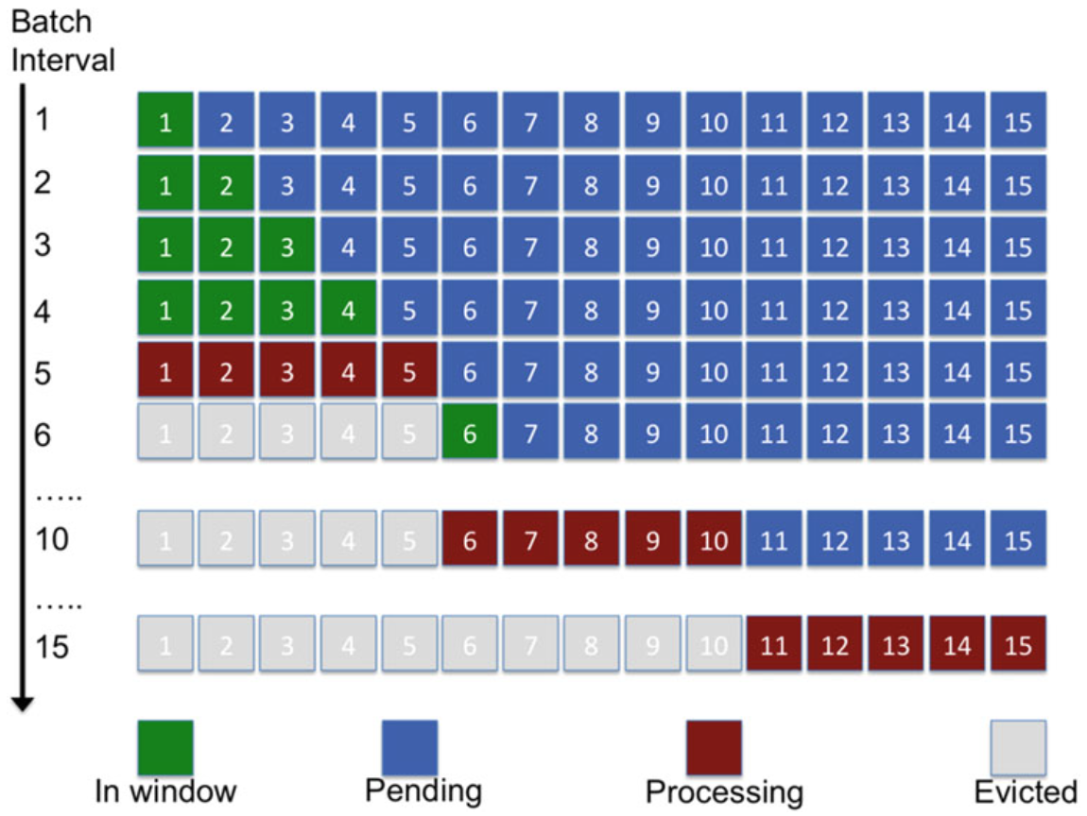
WINDOWING
window(windowDuration: Duration)
window(windowDuration: Duration, slideDuration: Duration)
accumulates values in a sliding window

Slide 26
WINDOWING AGGREGATION
reduceByWindow(function(t,t), windowDuration, slideDuration)

Slide 27
DSTREAM ACTIONS
print()
print(number)
saveAsObjectFiles(prefix, suffix)
saveAsTextFiles(prefix, suffix)
[prefix]-time in ms.[suffix]

Slide 28
DSTREAM ACTIONS
saveAsHadoopFiles(prefix,suffix)
saveAsNewAPIHadoopFiles(prefix,suffix)
globalCount.saveAsHadoopFiles("subreddit", "hadoop", classOf[IntWritable], classOf[Text], classOf[TextOutputFormat[IntWritable, Text]]) globalCount.saveAsNewAPIHadoopFiles("subreddit", "newhadoop", classOf[IntWritable], classOf[Text], classOf[NewTextOutputFormat[IntWritable, Text]])

Slide 29
DSTREAM ACTIONS
foreachRDD(function(RDD))
apply an operation to each RDD
val LOG = LogManager.getLogger(this.getClass) comments.foreachRDD(rdd => {
LOG.info("RDD: %s, Count: %d” .format(rdd.id, rdd.count())) })

