Slide 1
APACHE SPARK FUNDAMENTALS
Module 5: Spark MLLib and Spark ML

Slide 2
Spark MLLIB and SPARK ML
Spark MLlib is a library of Apache Spark to provide distributed machine learning algorithms on top of Spark’s RDD abstraction
Spark ML is a library of Apache Spark to provide distributed machine learning algorithms on top of Spark’s DataFrame abstraction with pipeline building.

Slide 3
MACHINE LEARNING ALGORITHMS IN MLLIB
Classification
Regression
Frequent itemsets
Recommendation
Feature extraction and selection
Clustering
Statistics
Linear Algebra

Slide 4
Terminology
Observations. Items or entities used for learning or evaluation, e.g., emails
Features. Attributes (typically numeric) used to represent an observation, e.g., length, date, presence of keywords
Labels. Values / categories assigned to observations, e.g., spam, not-spam
Training and Test Data. Observations used to train and evaluate a learning algorithm, e.g., a set of emails along with their labels Training data is given to the algorithm for training Test data is withheld at train time

Slide 5
Common Learning Settings
Supervised learning. Learning from labeled observations. Labels ‘teach’ algorithm to learn mapping from observations to labels.
Unsupervised learning. Learning from unlabeled observations. Learning algorithm must find latent structure from features alone.
Can be goal in itself (discover hidden patterns, exploratory data analysis)
Can be a preprocessing for supervised task (semisupervised)
Reinforcement learning. Learning to act in environment on reward-per-action basis.

Slide 6
SUPERVISED LEARNING EXAMPLE CLASSES
Classification. Assign a category to each item, e.g., spam detection Categories are discrete Generally no notion of ‘closeness’ in multi-class setting
Regression. Predict a real value for each item, e.g., stock prices Labels are continuous Can define ‘closeness’ when comparing prediction with lab

Slide 7
UNSUPERVISED LEARNING EXAMPLE CLASSES
Clustering. Partition observations into homogeneous regions, e.g., to identify “communities” within large groups of people in social networks
Dimensionality Reduction. Transform an initial feature representation into a more concise representation, e.g., representing digital images
Notes:
Алгоритмы обучения без учителя как правило используются для подготовки данных для алгоритмов обучения с учителем
<number>

Slide 8
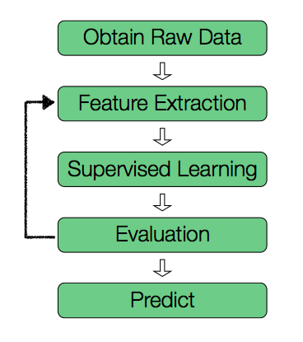
Typical Supervised Learning Workflow

Slide 9
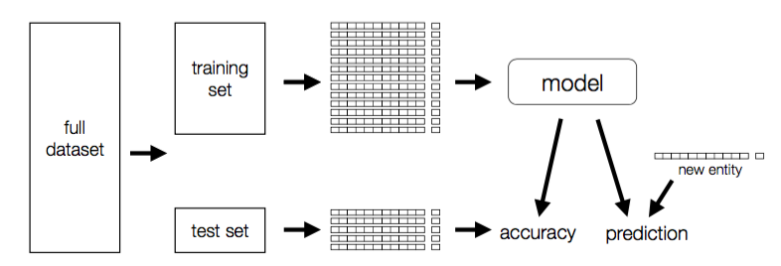
Typical Supervised Learning Workflow

Slide 10
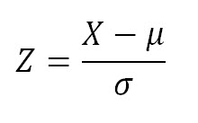
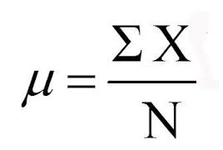

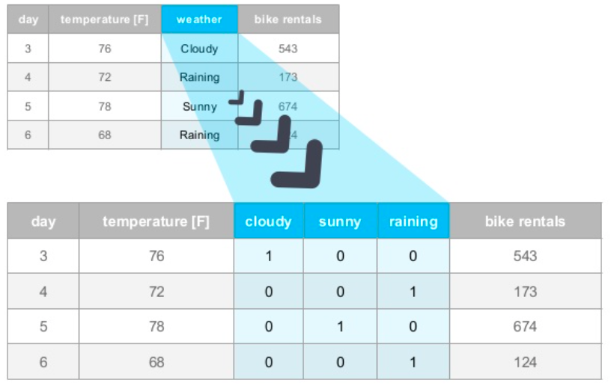
Data manipulation methods
Normalization
Log-transformation
Eliminating outliers
Sampling
Dimensionality reduction
One-hot encoding (one-of-k)

Slide 11
Data manipulation methods: FEATURE ENGINEERING
Feature engineering is the process of using domain knowledge of the data or mathematical techniques to create new features that make machine learning algorithms work better.
Coming up with features is difficult, time-consuming, requires expert knowledge. "Applied machine learning" is basically feature engineering.
— Andrew Ng, Machine Learning and AI via Brain simulations

Slide 12
Model evaluation metrics: MSE and RMSE for regression
MSE (Mean Square Error) = the sum of the squared errors divided by the number of observations. The squared error, in turn, is the square of the difference between real value and predicted value.
Root Mean Squared Error (RMSE) = the square root of the MSE
more interpretable, as it is in the same units as the underlying data

Slide 13
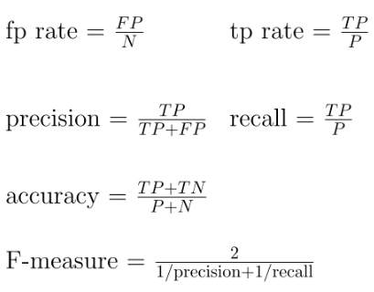
Model evaluation metrics
Confusion matrix for classification

Slide 14
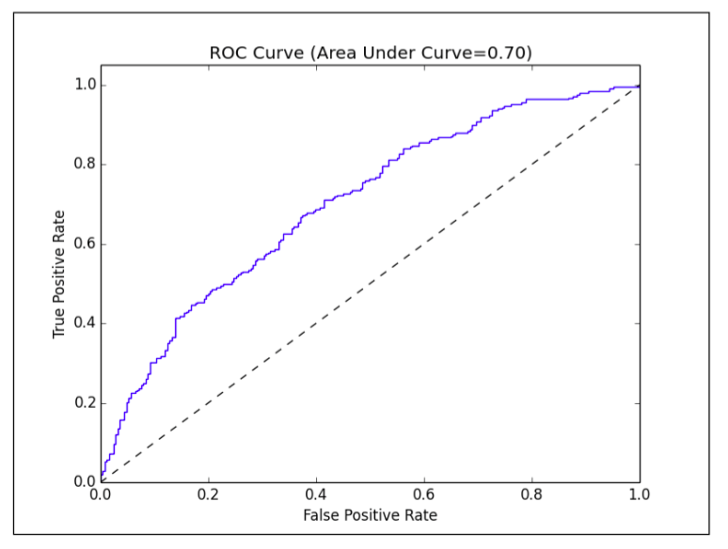
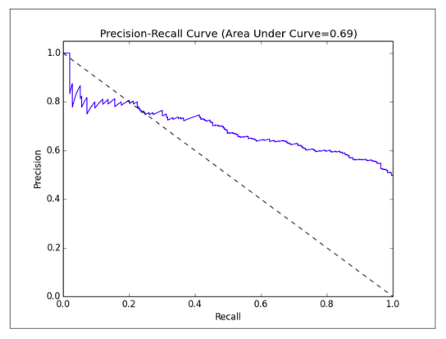
Model evaluation metrics
Area Under ROC and PR Curves for classification
Notes:
for each example
^{x}
^{(in the decreasing order)}
if x is positive, move 1/pos up
if x is negative, move 1/neg right
<number>

Slide 15
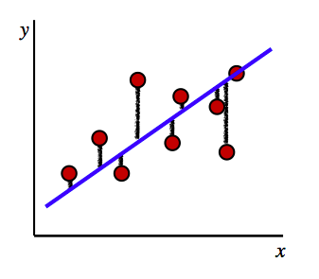

Linear regression
Learn a mapping from observations (features) to continuous labels
Goal: find the line of best fit x coordinate: features y coordinate: labels
Example: Height, Gender, Weight → Shoe Size

Slide 16
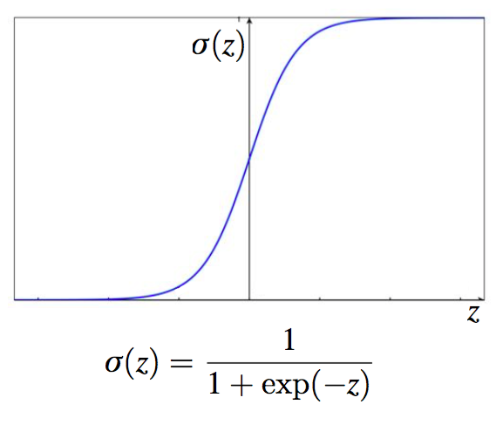
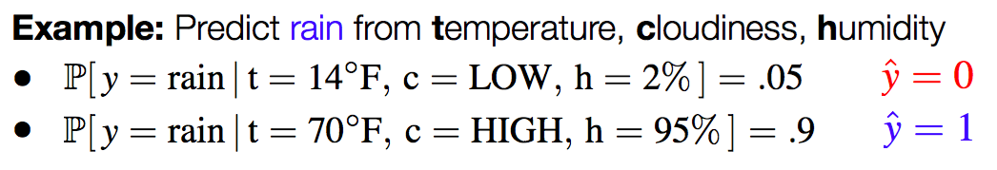
Logistic regression
Learn a mapping from observations to discrete labels
Logistic Function is used to model conditional probability P[y = 1|x] = σ(z) where z is linear combination of features

Slide 17
Naïve Bayes
Naïve Bayes is a probabilistic model that makes predictions by computing the probability of a data point that belongs to a given class. It ‘naively’ assumes conditional independence between features.

Slide 18
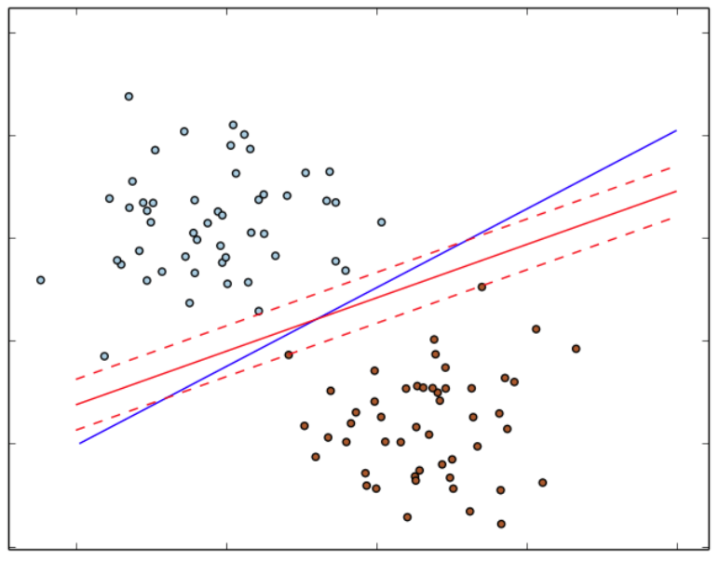
SVM
SVM is a maximum margin classifier—it tries to find a weight vector such that the classes are separated as much as possible. It has been shown to perform well on many classification tasks, and the linear variant can scale to very large datasets.

Slide 19
Decision trees
Decision tree model is a powerful, nonprobabilistic technique that can capture more complex nonlinear patterns and feature interactions. They are relatively easy to understand and interpret, can handle categorical and numerical features, and do not require input data to be scaled or standardized. They are well suited to be included in ensemble methods.
Notes:
"sibsp" is the number of spouses or siblings aboard)
<number>

Slide 20
Ensemble methods
An ensemble method is a learning algorithm which creates a model composed of a set of other base models.
MLLib supports
Random Forests
Gradient-Boosted Trees (GBTs)
One-vs-Rest (a.k.a. One-vs-All)

Slide 21
Ensemble methods
Bagging
Use different (e.g. random) samples of observations and/or predictors (features) of the examples to generate diverse classifiers
Aggregate classifiers: average in regression, majority vote in classification
Boosting
Make examples currently misclassified more important (or less, in some cases)

Slide 22
Clustering algorithms
Clustering is the process of examining a collection of “points,” and grouping the points into “clusters” according to some distance measure.
Hierarchical clustering – produces tree showing how close things are to each other
Agglomerative approach (“bottom up”)
Divisive approach (“top down”)
Nonhierarchical clustering (e.g. k-Means)

Slide 23
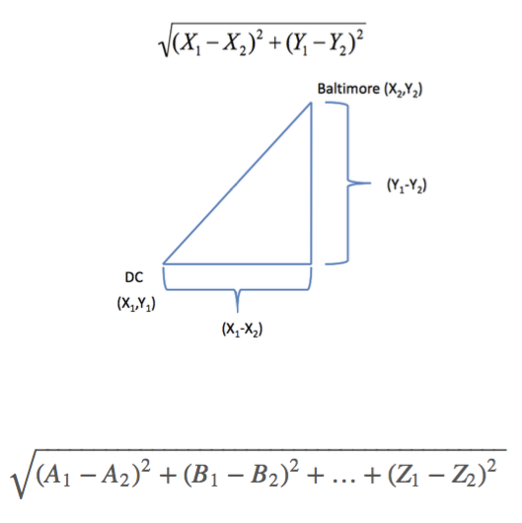
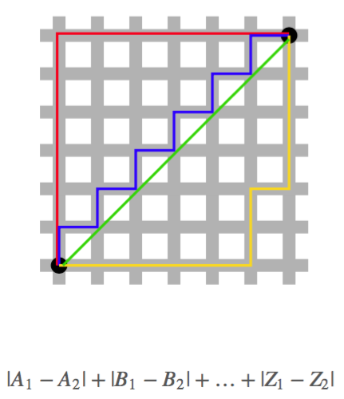
Clustering algorithms: DISTANCES
Euclidian distance
Manhattan distance (works better for high-dimensional data)

Slide 24
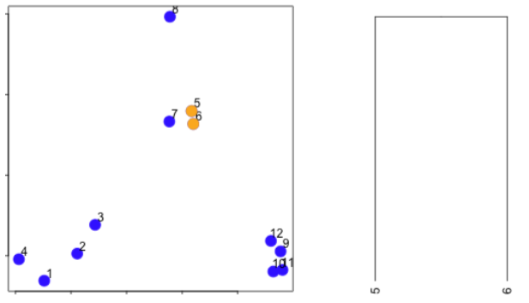
Clustering algorithms: Examples of unsupervised learning
Steps to repeat
Find 2 closest points
Combine them into cluster
From now we consider center of this cluster as one single point

Slide 25
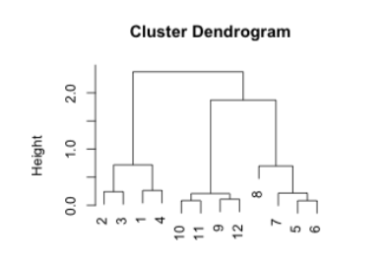
Clustering algorithms: AGGLOMERATIVE

Slide 26
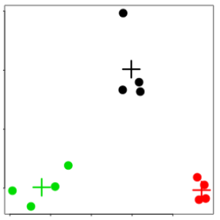
Clustering algorithms: K-MEANS
A partitioning approach
Fix a number of clusters
Get centroids for each cluster
Assign points to the closest centroid
Recalculate centroids
Requires
A defined distance metric
A number of clusters
An initial guess as to cluster centroids
Produces
Final estimate of cluster centroids
An assignment of each point to clusters

Slide 27
MLLIB

Slide 28
MLLIB LOCAL DATATYPES
DenseVector local array of values (Double)
SparseVector local pair of arrays: indexes (Int) and values (Double)
LabelledPoint vector with attached Label (Double)
Matrix local dense matrix with Double values and Int row and column indexes

Slide 29
MLLIB distributed DATATYPES
RowMatrix = RDD[Vector]
each row is a local Vector
IndexedRowMatrix = RDD[IndexedRow] = RDD[(Long,Vector) each row is a local Vector with an index
CoordinateMatrix = RDD[MatrixEntry] = RDD[(Long, Long, Vector)] each cell is a local Vector with two indexes
BlockMatrix = RDD[((Int,Int), Matrix)] collection of submatrixes (MatrixBlock)

Slide 30
Vectors
Vector – dense or sparse indexed array of numeric (Double) values
import org.apache.spark.mllib.linalg.Vectors
val denseVec = Vectors.dense(Array(0.0, 0.4, 0.3, 1.5))
val almostAllZeros = Vectors.dense(Array(0.0, 0.4, 0.3, 1.5, 0.0, 0.0, 0.0, 0.0, 0.0, 0.0))
val sparse = Vectors.sparse(10, Seq((1, 0.4), (2, 0.3), (3, 1.5)))
val fromSparse = sparse.toDense

Slide 31
Basic STATISTICS
dstream.map(f => Vectors.dense(f)).foreachRDD(rdd => {
val stats = Statistics.colStats(rdd)
println("Count: " + stats.count)
println("Max: " + stats.max.toArray.mkString(" "))
println("Min: " + stats.min.toArray.mkString(" "))
println("Mean: " + stats.mean.toArray.mkString(" "))
println("L1-Norm: " + stats.normL1.toArray.mkString(" "))
println("L2-Norm: " + stats.normL2.toArray.mkString(" "))
println("Number of non-zeros: " + stats.numNonzeros.toArray.mkString(" "))
println("Variance: " + stats.variance.toArray.mkString(" "))
})

Slide 32
Basic STATISTICS: CORRELATIONS
dstream.map(f => Vectors.dense(f)).foreachRDD(rdd => {
val corrSpearman = Statistics.corr(rdd, "spearman")
val corrPearson = Statistics.corr(rdd, "pearson")
println("Correlation Spearman: \n" + corrSpearman)
println("Correlation Pearson: \n" + corrPearson)
})

Slide 33
Basic STATISTICS: CHI-SQUARE TEST FOR INDEPENDENCE
dstream.map(f => LabeledPoint(f(0), Vectors.dense(f))) .foreachRDD(rdd => { Statistics.chiSqTest(rdd).zipWithIndex.foreach(v => println("%s, column no. %d". format(v._1, v._2))) })

Slide 34
PREPROCESSING
dstream.map(f => LabeledPoint(f(0), Vectors.dense(f))) .foreachRDD(rdd => { val scalerModel = new StandardScaler().fit(rdd) val scaledRDD = scalerModel.transform(rdd) })

Slide 35
FEATURE SELECTION
dstream.foreachRDD(rdd => { val selector = new ChiSqSelector(5) val model = selector.fit(rdd) val filtered = rdd.map(p => LabeledPoint(p.label, model.transform(p.features)))
})

Slide 36
FEATURE EXTRACTION
datastream.foreachRDD(rdd => { val pca = new PCA(rdd.first().features.size / 2) .fit(rdd.map(_.features)) val testTrain = rdd.randomSplit(Array(0.3, 0.7)) val test = testTrain(0).map(lp => lp.copy(features = pca.transform(lp.features))) val train = testTrain(1).map(lp => lp.copy(features = pca.transform(lp.features))) })

Slide 37
CLASSIFICATION: Logistic regression
val test = ds.transform(rdd => rdd.randomSplit(Array(0.3, 0.7))(0)) val train = ds.transformWith(test, (r1: RDD[LabeledPoint], r2: RDD[LabeledPoint]) => r1.subtract(r2)).cache()
val model = new StreamingLogisticRegressionWithSGD() .setInitialWeights(Vectors.zeros(4)) .setStepSize(0.0001) .setNumIterations(1)
model.trainOn(train) model.predictOnValues(test.map(v => (v.label, v.features))) .foreachRDD(rdd => println("MSE: %f".format(rdd.map(v => math.pow((v._1 - v._2),2)).mean()))
)

Slide 38
CLUSTERING: K-MEANS
val test = ds.transform(rdd => rdd.randomSplit(Array(0.3, 0.7))(0)) val train = ds.transformWith(test, (r1: RDD[LabeledPoint],r2: RDD[LabeledPoint]) => r1.subtract(r2)).cache()
val model = new StreamingKMeans() .setK(3) .setDecayFactor(0) .setRandomCenters(18, 0.0)
model.trainOn(train.map(v => v.features)) val prediction = model.predictOnValues(test.map(v => (v.label,v.features)))

Slide 39
ML PIPELINES

Slide 40
ML workflow
Training Testing/Production
Load data
Load new data
labels + raw data
raw data
Extract features
Extract features
labels + feature vectors
feature vectors
Train model
Predict using model
labels + predictions
predictions
Evaluate
Act on predictions

Slide 41
ML workflow
Datasource 2
Datasource 1
Datasource 3
Extract features
Train model
Evaluate

Slide 42
ML workflow
Datasource 2
Datasource 1
Datasource 3
Train model
Extract features
Extract features
Evaluate
Transform features
Transform features
Transform features

Slide 43
ML workflow
Datasource 2
Datasource 1
Datasource 3
Train model 1
Train model 2
Extract features
Extract features
Ensemble
Transform features
Transform features
Evaluate
Transform features

Slide 44

Pipelines
ML Pipelines provide:
Integration with DataFrames
API based on scikit-learn
Easy workflow inspection
Simple parameter tuning
User-defined Pipeline components: Transformers, Estimators and Evaluators

Slide 45
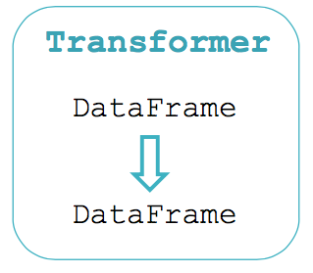
Pipeline abstractions: TRANSFORMER
Transformer implements a method transform(), which converts one DataFrame into another, generally by appending one or more columns.

Slide 46
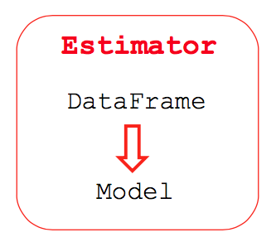
Pipeline abstractions: ESTIMATOR
An Estimator abstracts the concept of a learning algorithm or any algorithm that fits or trains on data. Technically, an Estimator implements a method fit(), which accepts a DataFrame and produces a Model.

Slide 47
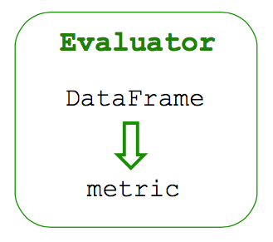
Pipeline abstractions: EVALUATOR
Using labels and predictions from the DataFrame evaluator can produce an evaluation of the model using different metrics, like
accuracy
AUC
MSE

Slide 48
Pipeline abstractions: MODEL
Model is a Transformer which transforms DataFrame with features into a DataFrame with predictions.

Slide 49
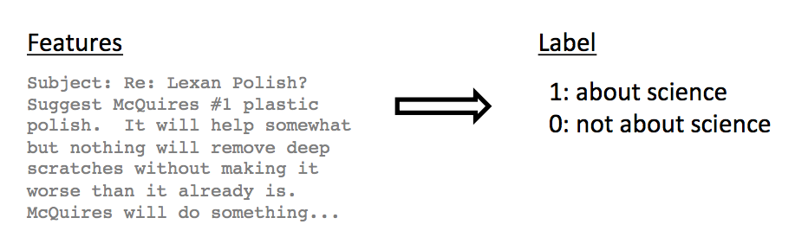
Text classification demo
Goal: Given a text document, predict its topic.
Dataset: “20 Newsgroups” From UCI KDD Archive

Slide 50
Text classification demo
Current data schema
label : Int
text : String
words : Seq[String]
features : Vector
Load data
Tokenizer
Hashed Term Freq.
Train model
Evaluate

Slide 51
Text classification demo
Current data schema
label : Int
text : String
words : Seq[String]
features : Vector
prediction : Int
Load data
Tokenizer
Hashed Term Freq.
Logistic Regression
Evaluate

Slide 52
Text classification demo
Current data schema
label : Int
text : String
words : Seq[String]
features : Vector
prediction : Int
Load data
Tokenizer
Hashed Term Freq.
Logistic Regression
Evaluate

Slide 53
Text classification demo
CrossValidator
Given:
Estimator
Parameter grid
Evaluator
Finds best parameters
Load data
Tokenizer
hashingTf.numFeatures {100, 1000, 10000}
Hashed Term Freq.
lr.regParam {0.01, 0.1, 0.5}
Logistic Regression
Evaluate

Slide 54
Text Classification Code
import org.apache.spark.sql.DataFrame
import org.apache.spark.ml._
val docs = ??? //Training data
def preprocess(df : DataFrame) = df.withColumn("label", col("topic"). like("sci.%").cast("double"))
val training = preprocess(docs)
val labels = training.groupBy("label").agg(col("label"), count("*").as("count"))
val tokenizer = new Tokenizer().setInputCol("text").setOutputCol("words")
val hashingTF = new HashingTF().setNumFeatures(5000). setInputCol(tokenizer.getOutputCol).setOutputCol("features")
val lr = new LogisticRegression().setMaxIter(20).setRegParam(0.01)
val pipeline = new Pipeline().setStages(Array(tokenizer, hashingTF, lr))
val model = pipeline.fit(training)
...

Slide 55
Text Classification Code
...
val predictions = model.transform(training)
val evaluator = new BinaryClassificationEvaluator().setMetricName("areaUnderROC")
def roc(model: Transformer, df: DataFrame) = {
evaluator.evaluate(model.transform(df), ParamMap.empty)
}
roc(model, training)
val test = preprocess(???) //Test data
roc(model, test)
val paramGrid = new ParamGridBuilder(). addGrid(hashingTF.numFeatures, Array(1000, 10000)). addGrid(lr.regParam, Array(0.005, 0.1, 0.2)).build()
val cv = CrossValidator().setEstimator(pipeline).setEvaluator(evaluator). setEstimatorParamMaps(paramGrid).setNumFolds(2)
val cvModel = cv.fit(training)
roc(cvModel, test)

