Slide 1
EAS-017 Apache Spark Fundamentals
Module 1: Introduction

Slide 2

Introduction
Alexander Breyman
Expert, Luxoft Professional Training Center
Ph.D. (1998), Associate Professor (2001), Software Engineering Department, Higher School of Economics
abreiman@luxoft.com

Slide 3
Training Roadmap: OVERVIEW
Spark Architecture
Spark Core
Spark SQL, DataFrames, Datasets
Spark Streaming
Spark ML, MLLib
GraphX
This training covers major aspects of Apache Spark distributed data processing framework.
The goal of this training is to learn about Apache Spark architecture, tools and build-in libraries, and get hands-on experience with Apache Spark.
This training is targeted to developers, architects, team leads.
Pre-requisites:
Application development experience
Basic knowledge of Java or Scala.

Slide 4
TRAINING ROADMAP: STRUCTURE
8 Hour sessions
15-30 mins breaks every 1.5 – 2 hours
Lunches

Slide 5
Introduction – Present yourself
Name
Company and experience
Company
Development experience
Technologies stack
Projects
Why you’re here
Your expectations from the training

Slide 6
Section 1: SPARK PRE-HISTORY: HADOOP

Slide 7
HADOOP
Large-scale batch processing
Multiple write barriers in MapReduce implementation
Multiple jobs for any but the simplest processing tasks
Multiple projects on top of MapReduce
Pig, Cascading, Hive, HBase, Flume, Giraph, Mahout, …
Loose MapReduce analogues for stream processing
Storm, Samza

Slide 8
APACHE SPARK: HISTORY
Written in Scala, with bindings in Java and Python
Developed at UC Berkeley in 2009
Ph.D. project of Matei Zaharia
First paper in 2010
Open-sourced (BSD) in 2010
Commercial support provided by DataBricks since 2013
Became top-level Apache project in February 2014

Slide 9
PROCESSING DISTRIBUTION CLUSTER MANAGEMENT

Slide 10

SPARK CLUSTER
Driver – (1) Master – (*) Workers – (*) Executors – (*) Tasks
Driver
main user code
Master
cluster manager
Worker
Executor: single JVM
Task: single step execution

Slide 11
Cluster managers for spark
Standalone
Mesos
YARN
AWS EC2

Slide 12
SPARK STANDALONE: CLUSTER STARTUP
Manual
sbin/start-master.sh (grab “spark://HOST:PORT” from output)
bin/spark-class org.apache.spark.deploy.master.Master
bin/spark-class org.apache.spark.deploy.worker.Worker spark://HOST:PORT
options: -c CORES, -m MEM (100M, 1G)
Auto
conf/slaves = slave addresses one by line
conf/spark-env.sh = export SPARK_MASTER_OPTS=“-Dspark.deploy…”
sbin/start-all.sh

Slide 13
Standalone cluster manager: JOB SUBMIT
$ ./bin/spark-submit --class MyClass --master spark://hcm-a.luxoft.com:7077 --total-executor-cores ## --executor-cores ##
spark.deploy.spread-out = true (for HDFS) | false (for computations)
client deploy mode only: driver executes on client

Slide 14
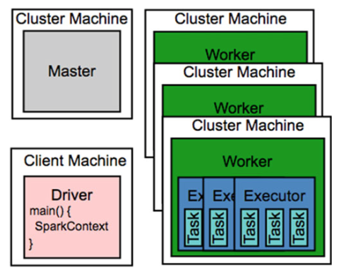
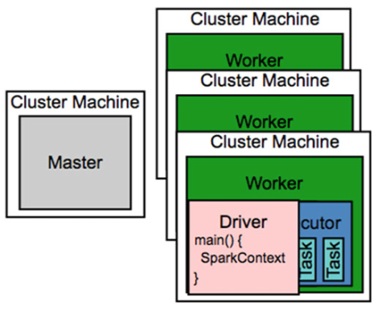
Standalone cluster manager: client vs cluster deploy mode

Slide 15
YARN CLUSTER MANAGER
$ ./bin/spark-submit --class MyClass --master yarn-cluster | yarn-client YARN_CONFIG_DIR
--num-executors 4
--executor-cores 1
--queues default
--driver-memory 4g
--executor-memory 2g

Slide 16
MESOS CLUSTER MANAGER
$ ./bin/spark-submit --class MyClass --master mesos://HOST:5050
spark.executor.uri = htfs://path/to/spark-1.0.1.tar.gz
http, hdfs, s3n
spark.mesos.coarse = false (deprecated: Spark task => Mesos task) | true (one long running Mesos task for Spark to reuse)
client deploy mode only

