Slide 1
EAS-017 Apache Spark Fundamentals
Module 2: Core

Slide 2
MODULE Roadmap
RDD
Transformations
Actions
PairRDD
Data formats
Accumulators
Broadcasting

Slide 3
PROGRAMMING FOR SPARK
User develops a program for execution on Driver node (client or dedicated cluster node), creating datasets (RDDs) and performing operations on datasets in parallel (on many cluster nodes – Workers). Dedicated Master node controls tasks distribution between Workers.

Slide 4
SPARK APPLICATION
import org.apache.spark.{SparkContext, SparkConf}
object SparkApp {
def main(args: Array[String]) {
val conf = new SparkConf()
.setAppName("Spark Application")
.setMaster("local[*]")
val sc = new SparkContext(conf)
val lines = sc.textFile(args(0)).cache()
val c = lines.count()
println(s"There are $c lines in file")
}
}

Slide 5
Section 1: Resilient DISTRIBUTED DATASETS

Slide 6
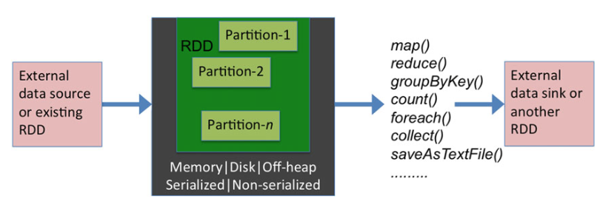
RESILIENT DISTRIBUTED DATASET

Slide 7
RESILIENT DISTRIBUTED DATASET
RDD: Spark “primitive” representing a collection of records
Immutable
Partitioned (the D in RDD)
Transformations operate on an RDD to create another RDD
Coarse-grained manipulations only
RDDs keep track of lineage
Persistence
RDDs can be materialized in memory or on disk
OOM or machine failures: What happens?
Fault tolerance (the R in RDD):
RDDs can always be recomputed from stable storage (disk)

Slide 8
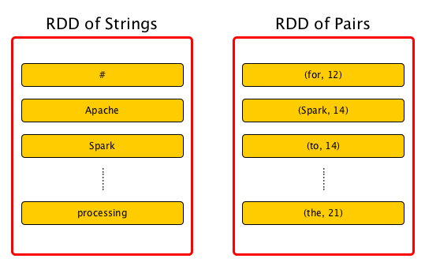
RDDS

Slide 9
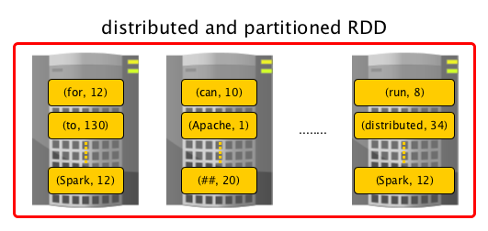
RDDS

Slide 10
HOW TO CREATE RDD
Using SparkContext
from local object: parallelize() or makeRDD()
from storage: textFile() or parquetFile() or hadoopFile() …
By transforming existing RDD
ex.: rdd2 = rdd1.filter(my_function)
By combining existing RDDs
ex.: rdd3 = union(rdd1,rdd2)

Slide 11
RDD: internal representation
Collection of partitions: rdd.partitions()
Collection of RDDs it depends on: rdd.dependencies()
SingleDependency or ShuffleDependency
Function for computing each partition data: iterator(p, parentIterator)
Partitioner (optional): rdd.partitioner()
List of preferred locations (optional): preferredLocations(p)

Slide 12
SOME RDD TYPES
ParallelCollectionRDD – a result of parallelize() or makeRDD()
HadoopRDD – a result of reading a file from HDFS
MapPartitionsRDD – a result of calling operations like map, flatMap, filter, mapPartitions, …
CoalescedRDD – a result of calling operations like repartition and coalesce
ShuffledRDD – a result of shuffling (result of sortByKey, partitionBy)
PairRDD – an RDD of key-value pairs (result of groupByKey and joins)

Slide 13
RDD TRANSFORMATIONS
Return another RDD
Executes on Workers and keeps results there
map, filter, group, sample, sort, distinct, …

Slide 14
Simple transformations
distinct() RDD with each unique value only once
filter(function) RDD of elements for which function evaluates to true
map(function) RDD of results of function applied to each element
flatMap(function) RDD of flattened results of function applied to each element

Slide 15
Set-theoretic TRANSFORMATIONS
union(rdd2)
intersection(rdd2)
subtract(rdd2)
cartesian(rdd2)

Slide 16
GROUPING and sorting
groupBy(function) function return key to group on
sortBy(function, ascending) order RDD by comparator function

Slide 17
SAMPLING TRANSFORMATIONS
sample(withReplacement, fraction, seed)
withReplacement=true - duplicates are possible

Slide 18
Partition-vise transformations
Tuple iterator instead of single tuple as function input
mapPartitions(function(iterator))
mapPartitionsWithIndex(function(index,iterator))
index = partition number
zipPartitions(rdd2)(function(iterator1,iterator2))

Slide 19
PAIRRDD TRANSFORMATIONS
mapValues(function) (k,v) => (k,function(v)): if transformation keeps keys
flatMapValues(function) (k,v) => (k,function(v)) + flatten
sampleByKey(withReplacement, fractionsMap, seed)
aggregateByKey()
groupByKey() group values with the same key
reduceByKey(function) combine values with the same key using function
sortByKey(ascending) sort PairRDD by key values
keys() create RDD of just the keys
values() create RDD of just the values

Slide 20
JOINS
join(rdd2) inner join for PairRDDs using first pair element as key
leftOuterJoin(rdd2)
rightOuterjoin(rdd2)
fullOuterJoin(rdd2)
zip(rdd2)
zipWithIndex()
zipWithUniqueId()

Slide 21
MORE PAIRRDD TRANSFORMATIONS
cogroup(rdd2)
subtractByKey(rdd2) remove records with same key record in rdd2

Slide 22
RDD ACTIONS
Does NOT return an RDD
Executes on Workers and
either return result to Driver
collect, take, takeOrdered, takeSample, reduce, count, first, countByKey
or write result to stable storage
saveAsTextFile, saveAsParquetFile, …
or doesn’t return anything
foreach(function)

Slide 23
SIMPLE COLLECTING ACTIONS
collect() return an array of all RDD elements
take(elementCount) return first # elements from first partition
takeOrdered(elementCount, compareF) return sorted first # elements
takeSample(withReplacement, elementCount)
toArray()
toLocalIterator()

Slide 24
SIMPLE MATH ACTIONS
count() count number of elements
max() return the largest RDD element
min() return the smallest RDD element
sum() return sum of all elements
mean() return mean element
countByValue() return Map (unique value, occurrence count)

Slide 25
APPROXIMATE MATH ACTIONS
countApproxDistinct(relativeStandardDeviation)
meanApprox(timeout, confidence)
sumApprox(timeout, confidence)

Slide 26
REDUCE AND AGGREGATION ACTIONS
reduce(function)
apply commutative function to elements and return single result
fold(zero value)(function)
apply function to each element starting with zero value
aggregate(zero value)(function1, function2)
apply function1 to partitions, then apply function2 to results (using zero)
ex.: rdd.aggregate(0)(max(_,_), _+_)
find max value for each partition and sum them up

Slide 27
MoRE REDUCES
reduceByKeyLocally(function) => Map[k,v]
reduceByKeyToDriver(function) => Map[k,v]

Slide 28
PAIRRDD ACTIONS
countByKey()
groupByKey()
reduceByKey(function)
foldByKey(zero value)(function)
aggregateByKey(zero1, zero2)(function1, function2)

Slide 29
Persisting actions
saveAsTextFile(path)
saveAsSequenceFile(path)
saveAsObjectFile(path)
saveAsHadoopFile(path,keyClass,valueClass,outputFormatClass)
saveAsNewAPIHadoopFile(path,outputFormatClass)

Slide 30
Narrow TRANSFORMATION
Design-time determined dependency on one partition (or a known set of it) – regarless of data values
Can be executed on a subset of data without any information about other data subsets
Ex.: map, flatMap, filter, mapPartitions, union, coalesce

Slide 31
WIDE TRANSFORMATION
Require data to be partitioned in a particular (not arbitrary) way
Process of that partitioning (according to data values) called shuffle
Dependencies cannot be know before parent data is evaluated
Ex.: sort, sortByKey, join, reduceByKey, groupByKey

Slide 32
DATA SERIALIZATION AND STORAGE

Slide 33
DATA Serialization
To transfer data between network nodes it need to be serialized
Serializers built in Spark
Java serialization
slow, flexible
default for shuffling, caching and persisting to disk
Kryo serialization
fast, more compact representation
classes should to be registered or will waste time to resolve them

Slide 34
KRYO Serialization
Configure to use Kryo
config.set(“spark.serializer”,“org.apache.spark.serializer.KryoSerializer”)
config.registerKryoClasses(Array(classOf[MyClass],classOf[MyClass2]))

Slide 35
WORKER MEMORY: RDD STORAGE
Memory for RDD caching: spark.storage.memoryFraction
In-memory deserialized: rdd.persist(MEMORY_ONLY) or rdd.cache()
regular JVM objects, fastest old partitions are deleted when out of memory
In-memory serialized: rdd.persist(MEMORY_ONLY_SER) or
rdd.persist(MEMORY_AND_DISK_SER)
most compact (useful for GBs of data), takes more time, less GC
On disk: rdd.persist(DISK_ONLY) or rdd.persist(MEMORY_AND_DISK)
slowest, to keep hard to recompute partitions

Slide 36
WORKER MEMORY: SHUFFLE BUFFER
Memory for intermediate data: spark.shuffle.memoryFraction
Shuffle, Aggregation intermediate data

Slide 37
Worker MEMORY: DEFAULT SETTING
RDD Storage: 60%
Shuffle Buffers: 20%
User program objects: 20%

Slide 38
LEVEL OF PARALLELISM
Number of RDD partitions
e.g. driven by HDFS block count
Ususally preserved in transformations
Explicit setting: parameter numPartitions for most transformations
rdd2 = rdd1.groupByKey(key, numPartitions = 10)
Automatic partitions redistribution
repartition(#) – common way, shuffling (=coalesce(#, shuffle=true))
coalesce(#) – to reduce number of partitions for smaller RDD, no shuffle

Slide 39
ACCUMULATORS aND BROADCASTING

Slide 40
ACCUMULATORS
Accumulator – variable to be incrementally updated in parallel
Each task has its own value to be summed up
val cnt = sc.longAccumulator(“cnt”)
sc.parallelize(1 to 2).foreach(v=>cnt.add(v))
println(cnt.value)

Slide 41
BROADCASTING
Broadcast variables allow the programmer to keep a read-only variable cached on each machine rather than shipping a copy of it with tasks.
val myMap = Map(…)
val bcMyMap = sc.broadcast(myMap)
myRDD.map(myMap)
myRDD.map(bcMyMap.value)

Slide 42
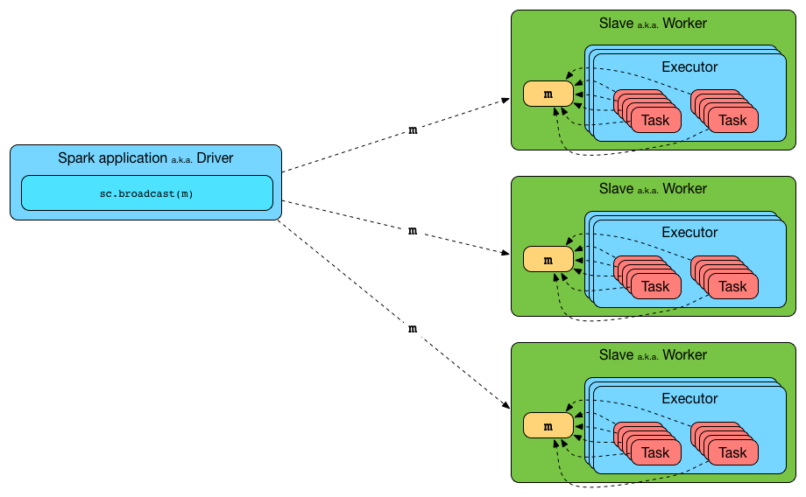
BROADCASTING PROCESS

