Slide 1
Empirical evaluation of RDSA technologies
Gurunath Reddy – A20447076
Deepak Kumar Yadav – A20447332

Slide 2
Introduction
Communication is required in between supercomputers and data centers.
Usage of Remote Direct Storage Access (RDSA)
Performance when compared to message passing interfaces.
Over fabric solutions such as NVMe Over fabric.

Slide 3
NVMe
NVMe is the new protocol and innovative way of accessing high speed storage media.
It is much faster than SSD or HDD.
NVMe over fabric extends benefits of NVMe across data center expanding distance over which NVMe devices can be reached.

Slide 4
PROBLEM STATEMENT
Evaluation of over fabric solution with different workloads for different operations(read and write) using single and multiple drives.

Slide 5
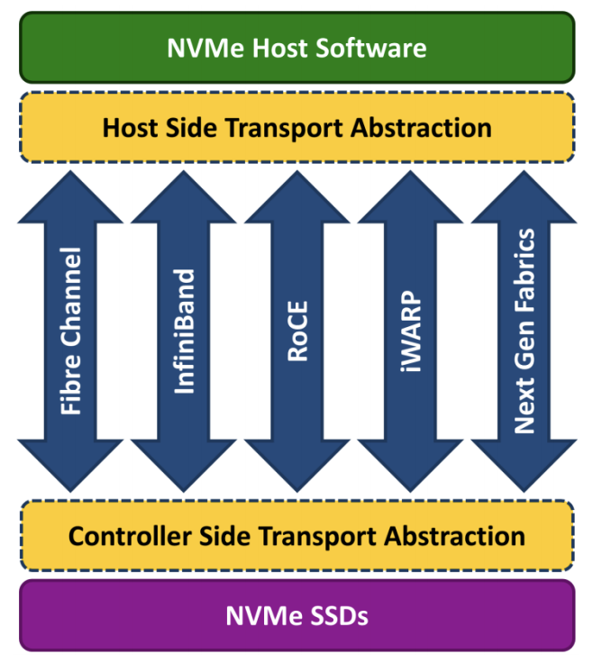
Architecture DESIGN
ARES-COMP-01
Initiator
RoCE
Fabric
RoCE
Target
ARES-COMP-02
ARES-COMP-03
Figure(2) Current setup design
Figure(1) NVMe Architecture with possible fabrics

Slide 6
Evaluations: Test bed
HARDWARE:
ITEM | DESCRIPTION (INITIATOR) | DESCRIPTION (TARGET-1) | DESCRIPTION (TARGET-2)
Server Name | ares-comp-01 | ares-comp-02 | ares-comp-03
CPU | Dual Intel(R) Xeon Scalable Silver 4114 @ 2.20GHz
Memory (GB) | 96
Operating System | Cent OS
Storage | Samsung 960 Evo 250GB NVMe SSD
NIC | 25 Gbps Mellanox ConnectX4

Slide 7
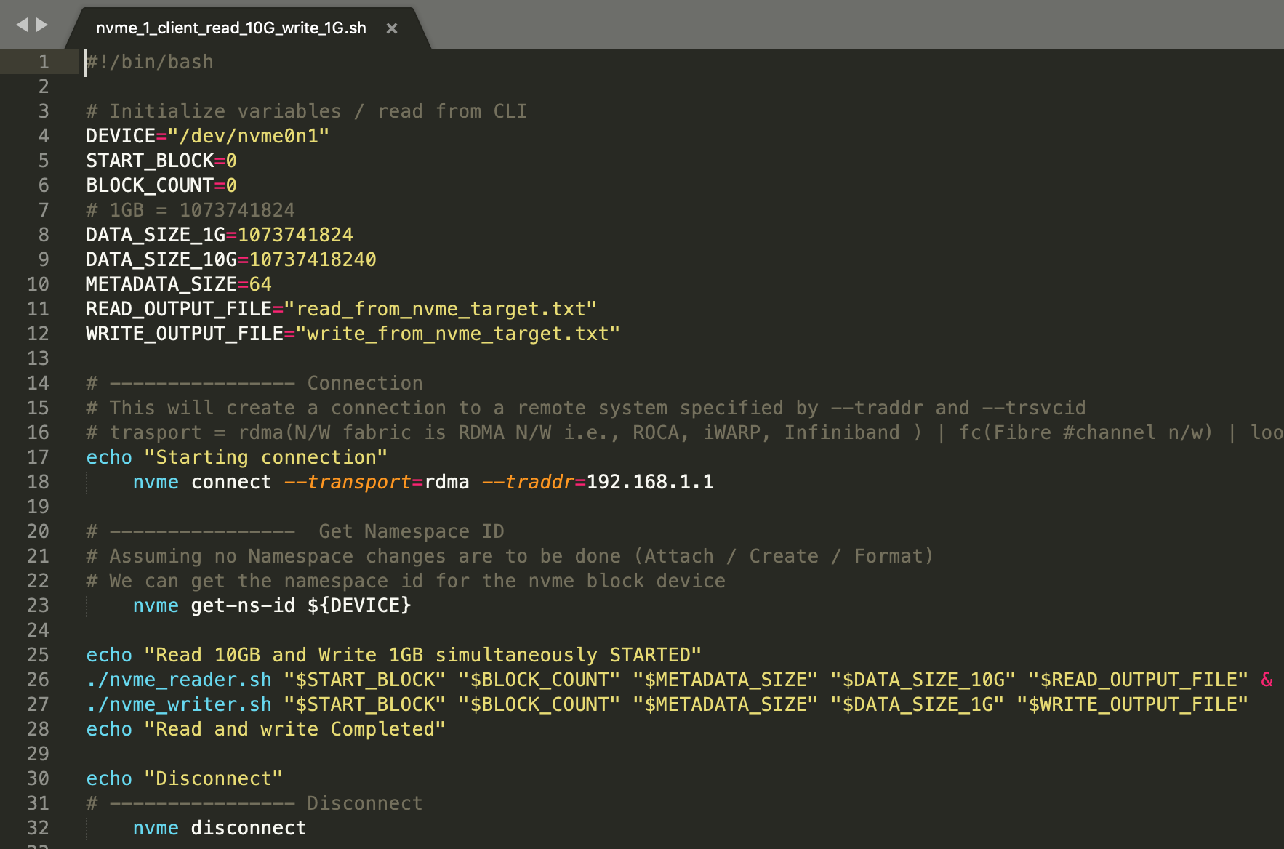
Evaluations: Test bed
SOFTWARE: NVME-CLI commands executed using shell scripts.

Slide 8
Evaluations: Overview
One client trying to read (1GB and 10GB)
One client trying to write (1GB and 10GB)
Multiple clients trying to read 1GB in parallel and 10GB in parallel
Multiple clients trying to write 1GB in parallel and 10GB in parallel.
One client trying to read 1GB and another client trying to write 1GB in parallel.
One client trying to read 10GB and another client trying to write 10GB in parallel.
One client trying to read 1GB and another client trying to write 10GB in parallel.
One client trying to read 10GB and another client trying to write 1GB in parallel.
Read 1GB from 2 drives in parallel and read 10GB from 2 drives in parallel.
Write 1GB from 2 drives in parallel and read 10GB from 2 drives in parallel.
In all the above test cases, our intent is to capture latency for every operation.

Slide 9
Evaluations: Read and Write single NVME drive
R: Read, W: Write

Slide 10
Evaluations: Read and Write single NVME drive
R: Read, W: Write

Slide 11
Evaluations: Read and Write multiple NVME drive
R: Read, W: Write

Slide 12
CONCLUSION:
Write operations faster than read operations for single drive.
Read operations faster than write operations for multiple drive.
Network load influence the latency

Slide 13
Conclusion:

Slide 14
Future work:
Evaluating NVMe over fabric with different kinds of fabric(Example: Fiber channel v/s RoCE).

Slide 15
Questions ?

