Slide 1

Music Genre Classification
https://pixabay.com/vectors/equalizer-beat-music-sound-audio-153212/
Charic Farinango Cuervo
Dmytro Kuzmyk
Jieun Yoo

Slide 2

Problem
We sought to build a music genre classification system.
Motivation
End users find it useful to categorize music based on genre
Manual classification requires a lot of time and expertise
Automatic music recommendation systems require information about music genre
https://pixabay.com/photos/mobile-phone-samsung-music-605422/

Slide 3

Dataset
https://www.kaggle.com/andradaolteanu/gtzan-dataset-music-genre-classification
GTZAN dataset used
1000 audio tracks, each 30 seconds long
10 genres (so 100 tracks per genre)
Genres: Blues, Classical, Country, Disco, Hip hop, Jazz, Metal, Pop, Reggae, Rock
80/20 Train/Test split
https://pixabay.com/photos/plate-record-records-vinyl-music-4725349/

Slide 4






Computational Resources
Language: Python
Libraries
Audio Processing: Librosa
ML: Numpy, Pandas, Scikit-learn, TensorFlow

Slide 5
Audio Processing - Steps
Import and extract audio time series
For upsampled data: split the signal into smaller segments for more data
Extract spectrogram and other features
Take the average of each feature array and save it
Assign the genre of each audio file as a label
Save features in CSV file for posterior use
Before splitting in sets, features are normalized by subtracting mean and dividing by variance
Notes:
Import audio files and extract audio time series as a numpy array with librosa
For upsampled data: split the signal into smaller segments for more data
Extract spectrogram or previously defined hand-crafted features for each audio array.
Take the average of each feature array and save it as representative of the feature for the training example
Assign the genre of each audio file as a label
Save features in CSV file for posterior use
Before splitting in sets, features are normalized by subtracting mean and dividing by variance

Slide 6
Approaches used
Spectrograms: Neural Network
Hand-crafted features extracted for:
k-Nearest Neighbors (k-NN)
Random Forests (RF)
Support Vector Machine (SVM)

Slide 7
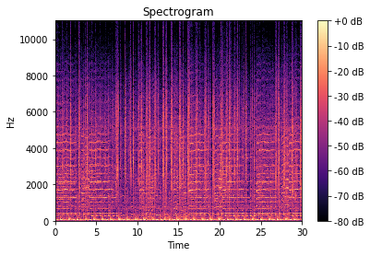
Spectrograms
Librosa loads music files and outputs a signal and frequency, data a machine can read.
A spectrogram:
Signal strength
Frequency in Hz
(Spectrogram of a Reggae music segment)

Slide 8
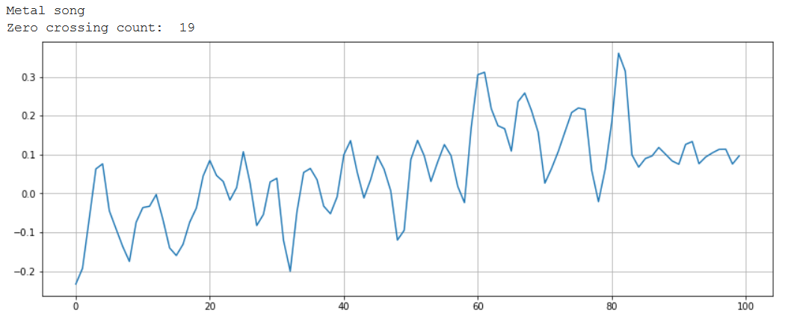
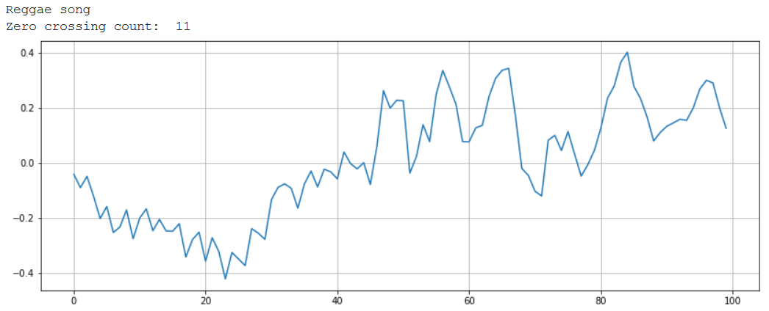
Feature Extraction
Python code was written to extract 26 features
Chroma Frequencies: describes energy of pitch class (there are 12)
Spectral Rolloff: measures skewness of power spectrum (can help distinguish voiced vs. unvoiced music)
Zero Crossing Rate: rate at which signal changes sign from positive to negative in time domain

Slide 9
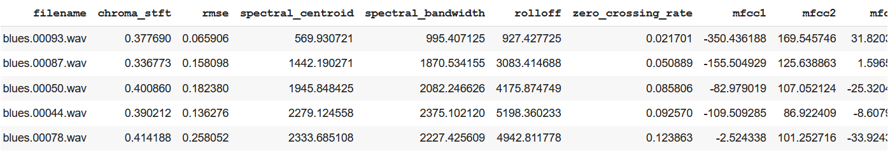
Feature Extraction
Python code was written to extract 26 features
Rmse: measures signal energies in a time window
Spectral Centroid: weighted mean of sound frequencies
Spectral Bandwidth: describes extent of power transfer function around center frequency
Mel-Frequency Cepstral Coefficients (MFCCs) - 20 were extracted: Describe shape of the spectral envelope (coefficients that compose envelope of time power spectrum of sound)

Slide 10
Evaluation Measures
Accuracy
F1 score

Slide 11
Preliminary Results
Neural network
k-NN
Random Forest
Support Vector Machine

Slide 12
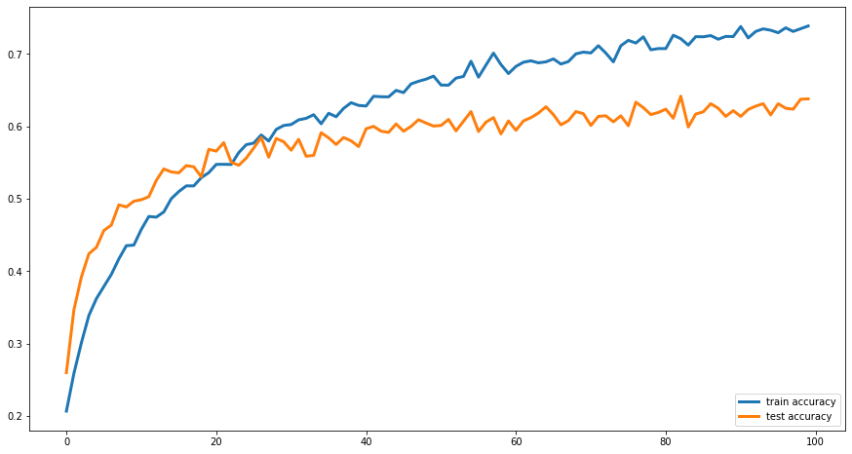
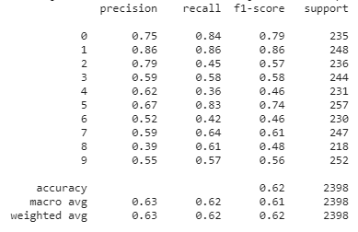
Neural Network
100 Epochs, 128 Batch Size, corrected overfitting.

Slide 13
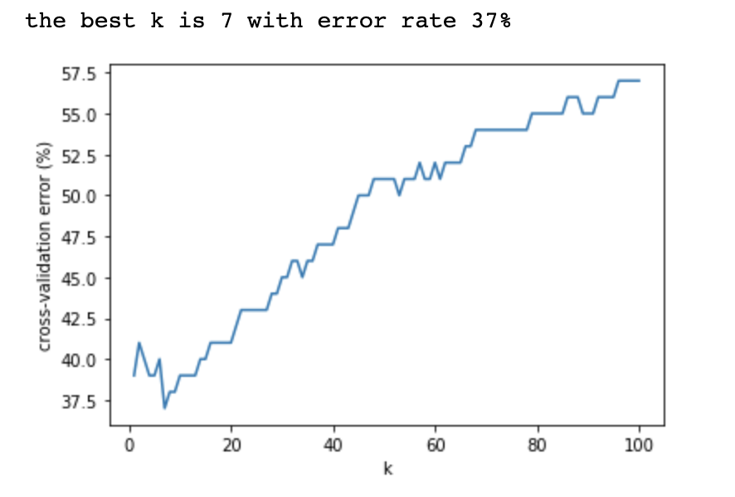
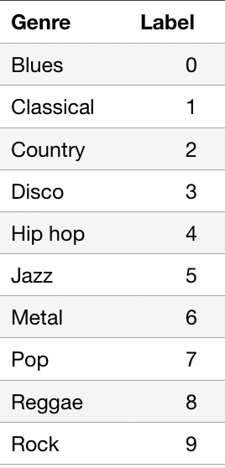
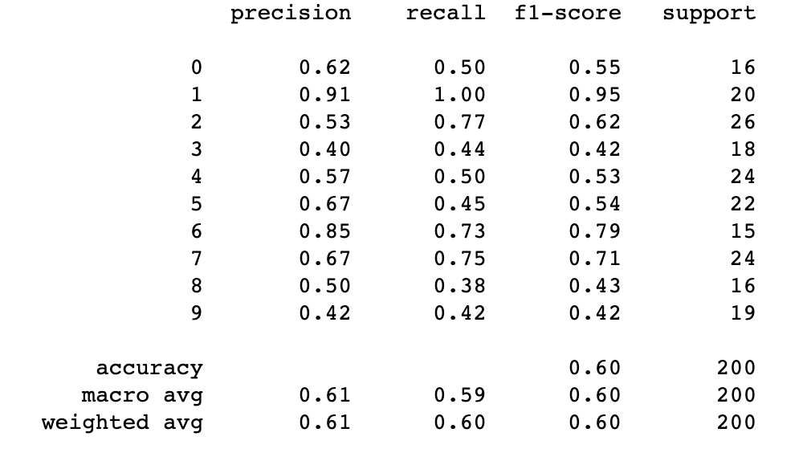
k-NN
Best value for k: 7
F-1 Score: 0.605
k-NN accuracy: 0.60

Slide 14
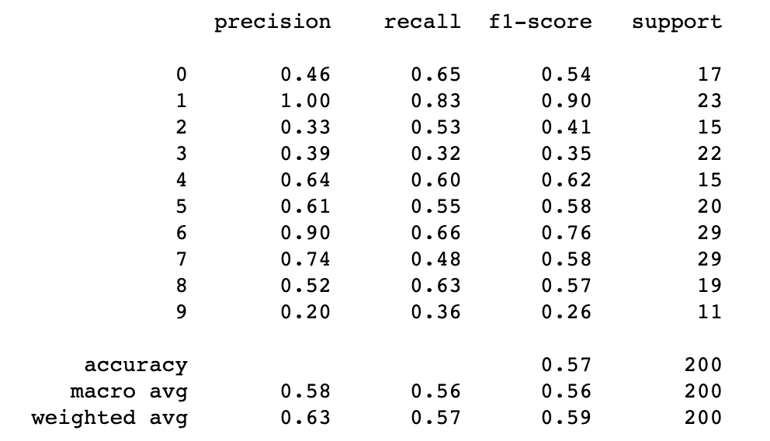
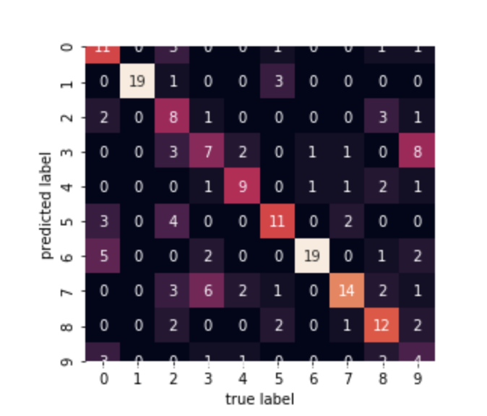
Random Forests
100 trees, with max_depth = 5
f1-score: 0.565

Slide 15
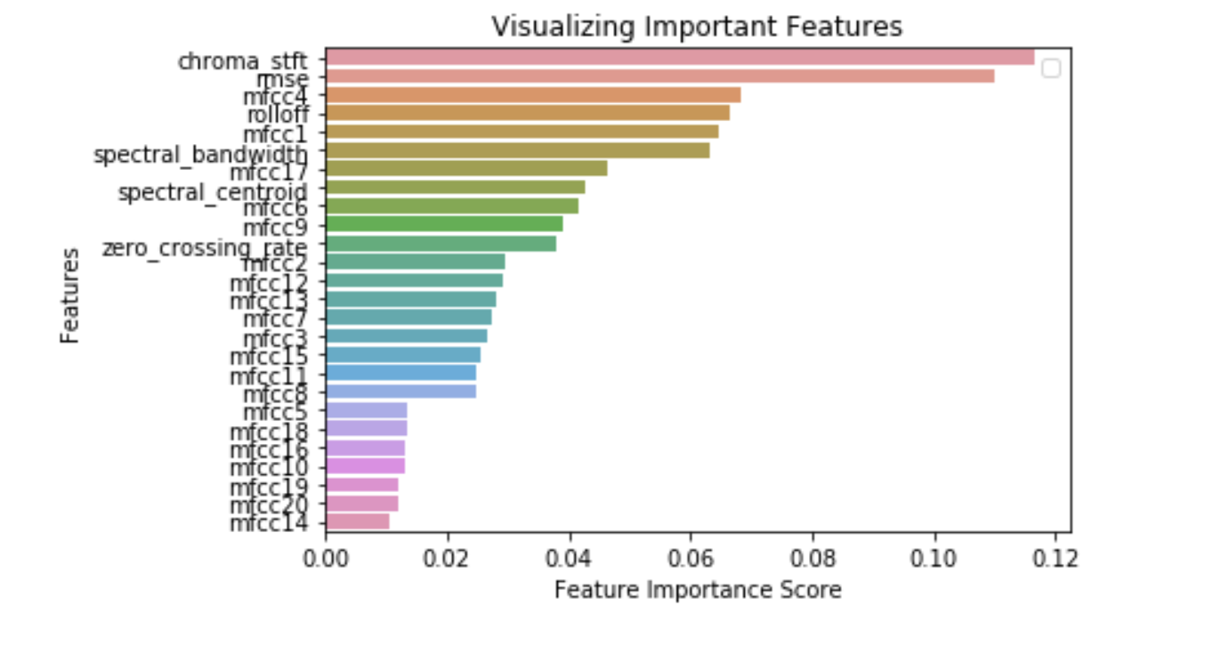
Random Forests

Slide 16
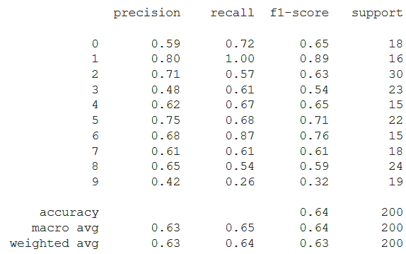
Support Vector Machine
Compare linear vs non-linear kernel and find best hyperparameters using Grid search:

Slide 17
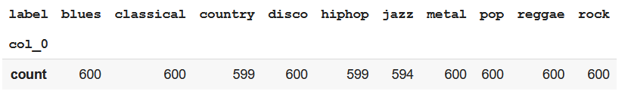
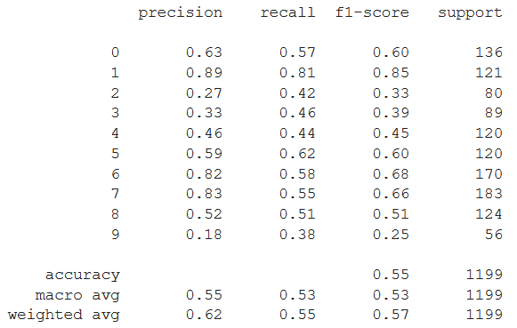
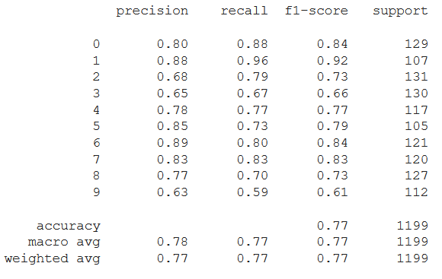
Upsample data - Extended dataset
Random Forest: SVM:

Slide 18
Classification Accuracy across Genres
Algorithm | Accuracy
RF | 0.57
k-NN | 0.60
Neural | 0.62
SVM | 0.64

Slide 19
Lessons learned
Overfitting is a very common problem when having small amount of data. In some cases, upsampling the data set is necessary to generalize better.
Classification performs betters on certain genres.
The genre of music with best f1-score is Classical. This is consistent for K-NN, Random Forest and SVM.
The genre of music with worst f1-score is Rock. This is consistent for K-NN, Random Forest and SVM. A possible reason is that the rock category is very similar to other categories, e.g., country, disco

Slide 20
Lessons learned
One of the advantages of Random Forest is that it is easily interpreted. As such, it helps us to understand what features contribute the most during prediction. In this project the features Chroma Frequencies and Root Mean Square Energy (RMSE) are the most important for genre classification.

