Slide 1
Log Parsing and Graph Plot
Date: 3/7/2019
@qualcomm
Location: Hyderabad
Deepakkumar Gupta
Engineer

Slide 2
Procedure:
Copy log parsing scripts from location:
\\deegup-linux\workspace\Parse_camx_log (or)
\\minnie\UMD\CamX\Parse_camx_log
Use below camx override settings while capturing log for parsing.
For AEC:
adb shell “echo logVerboseMask=0x2000000 >> /vendor/etc/camera/camxoverridesettings.txt”
For AWB:
adb shell “echo logInfoMask=0x4000000 >> /vendor/etc/camera/camxoverridesettings.txt”

Slide 3
Procedure:
The following similar line should be present in log file:
For AEC:
[ VERB][STATS_AEC] camxcaecstatsprocessor.cpp:2826 ReadHALAECParam() ReqId:100,
[ VERB][STATS_AEC] caeccore.cpp:1468: printFrameControl CID:1 FID:2 Mode:PerFrame
For AWB:
[ INFO][STATS_AWB] camxcawbioutil.cpp:2311 PublishFrameControlToMainMetadata() Published PropertyIDAWBFrameControl for reqID: 10

Slide 4
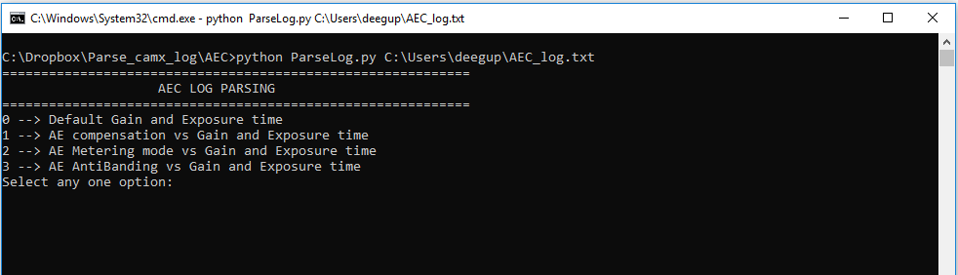
Procedure:
To run AEC log parser, follow below steps
Step1: python ParseLog.py <File name or file path>
Step2: Then choose any one option to plot the graph.

Slide 5
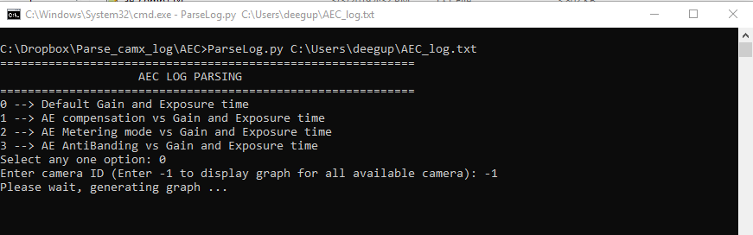
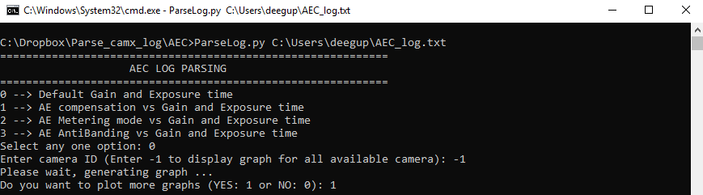
Procedure:
Step3: Enter camera ID (0,1,…, etc. or -1 to show graph for all the available camera ids)
Step4: If you want to plot more graphs then enter 1 else enter 0.

Slide 6
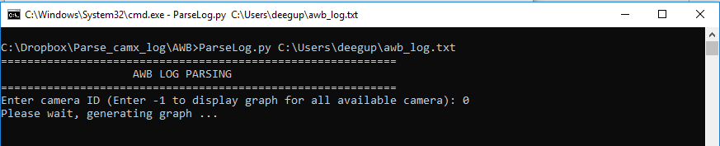
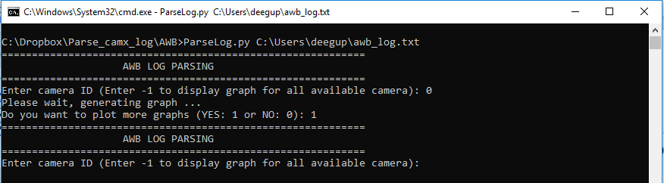
Procedure:
To run AWB log parser, follow below steps
Step1: python ParseLog.py <File name or file path>
Step2: Enter camera ID (0,1,…, etc. or -1 to show graph for all the available camera ids)
Step3: If you want to plot more graphs then enter 1 else enter 0.

Slide 7
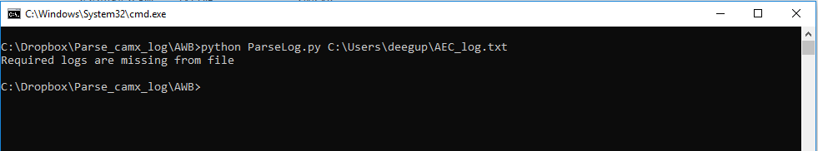
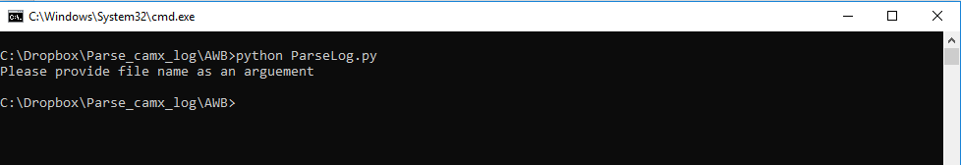
Note:
In case the log file does not have required lines then it will display error message.
In the below snapshot, I passed log but it does not have any AWB logs.
If file name not passed into argument then it will display error message.

Slide 8
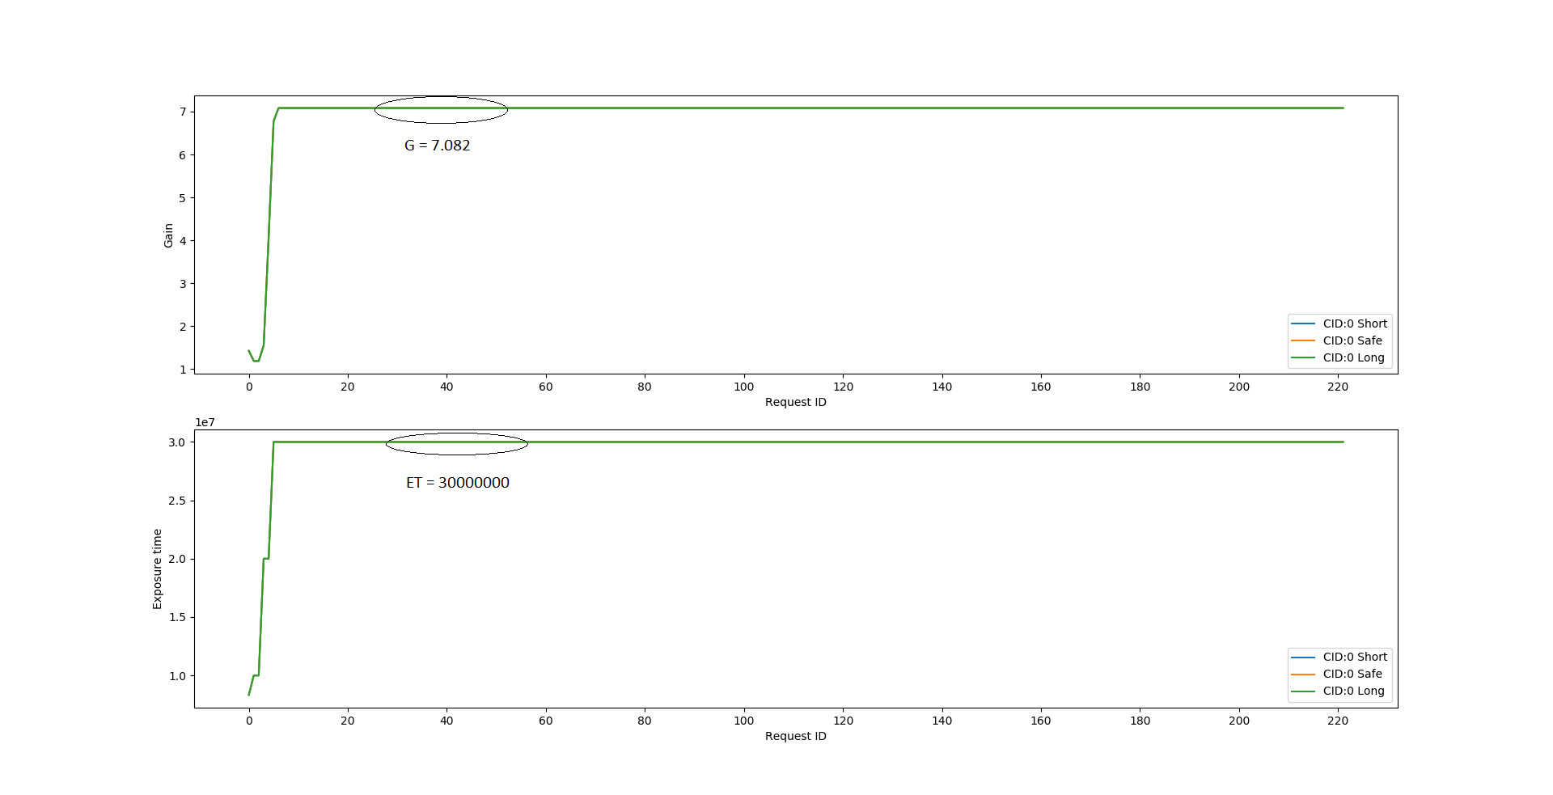
Graph:
AEC: Preview

Slide 9
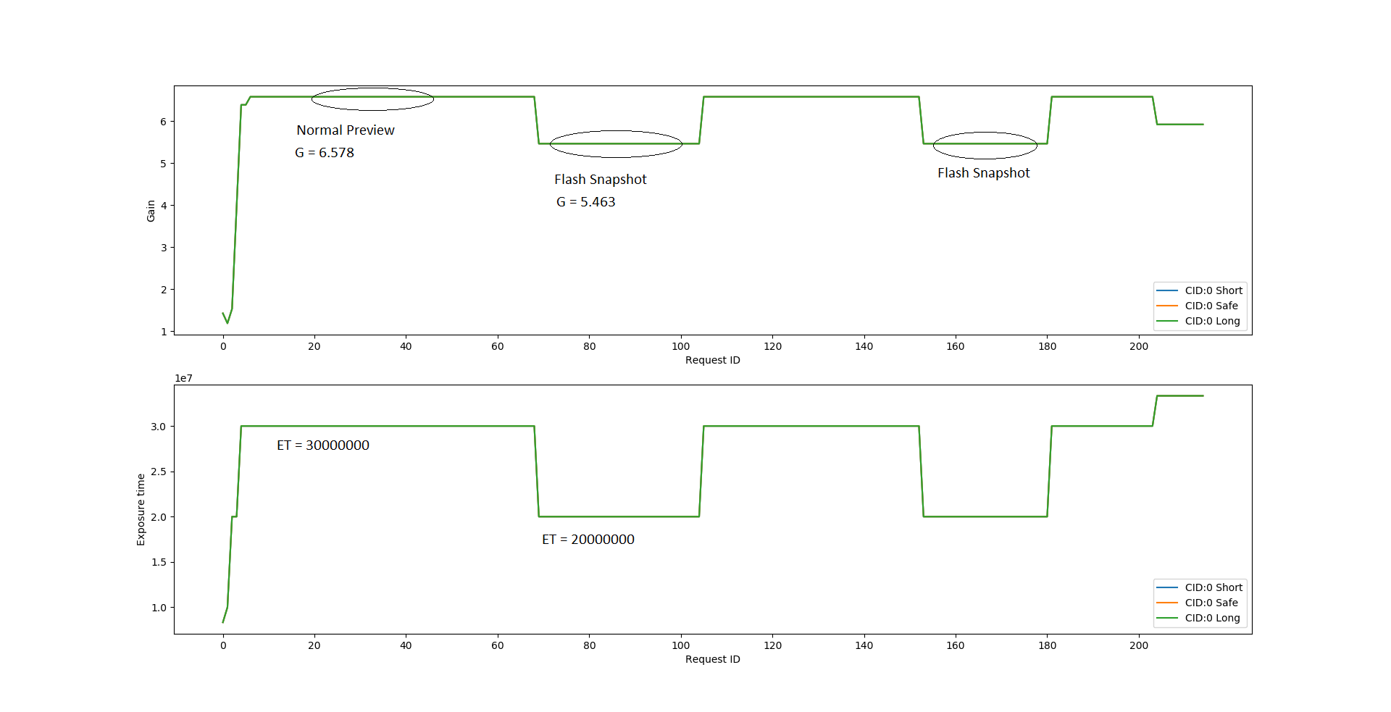
Graph:
AEC: Flash snapshot

Slide 10
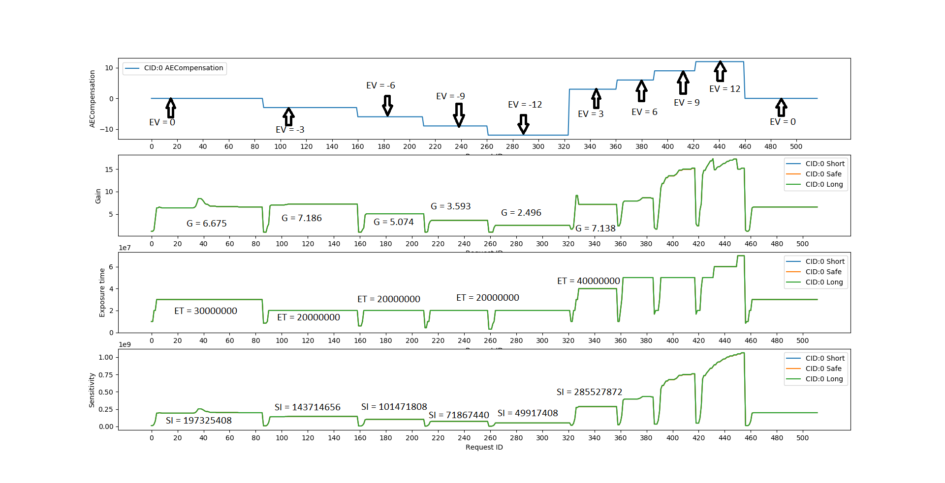
Graph:
AEC: EV vs Gain & Exposure Time & Sensitivity

Slide 11
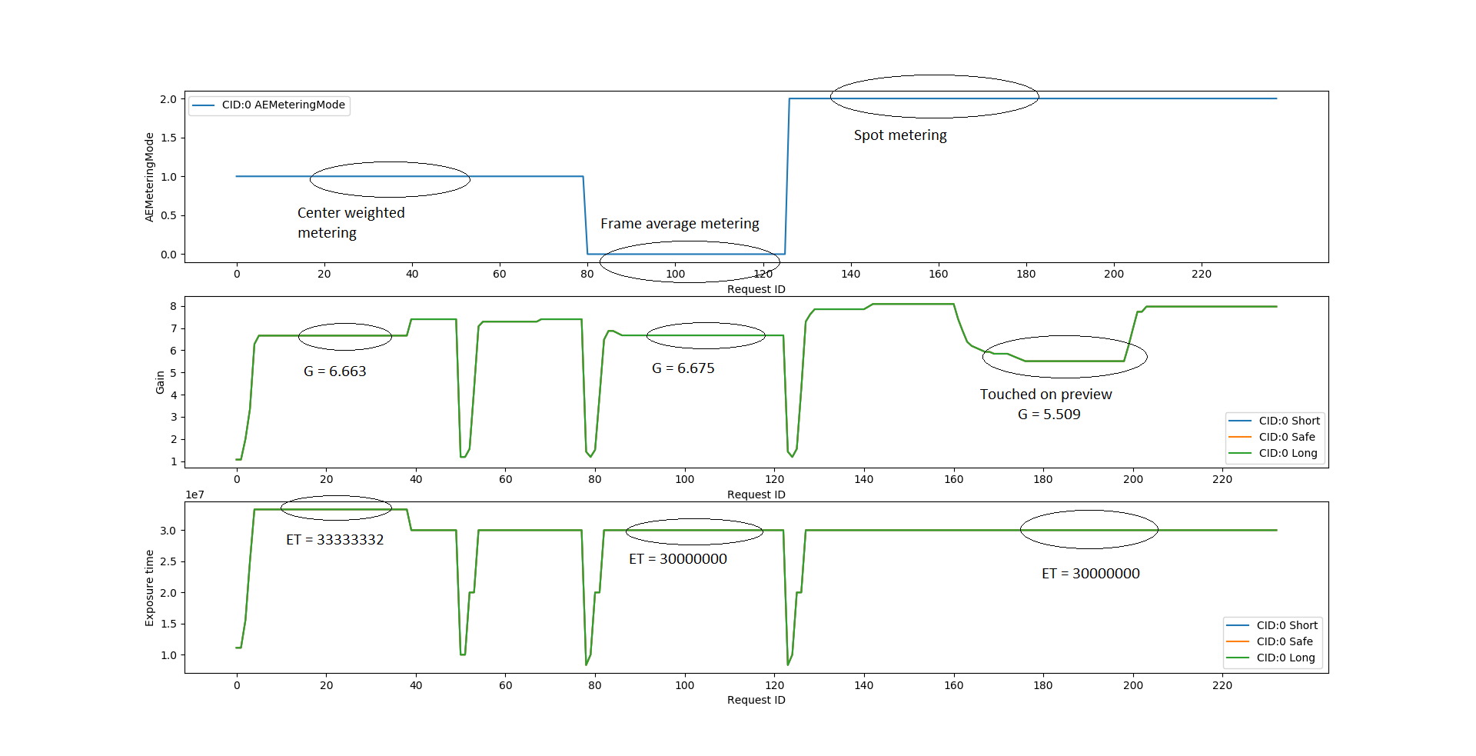
Graph:
AEC: Metering mode vs Gain & Exposure Time

Slide 12
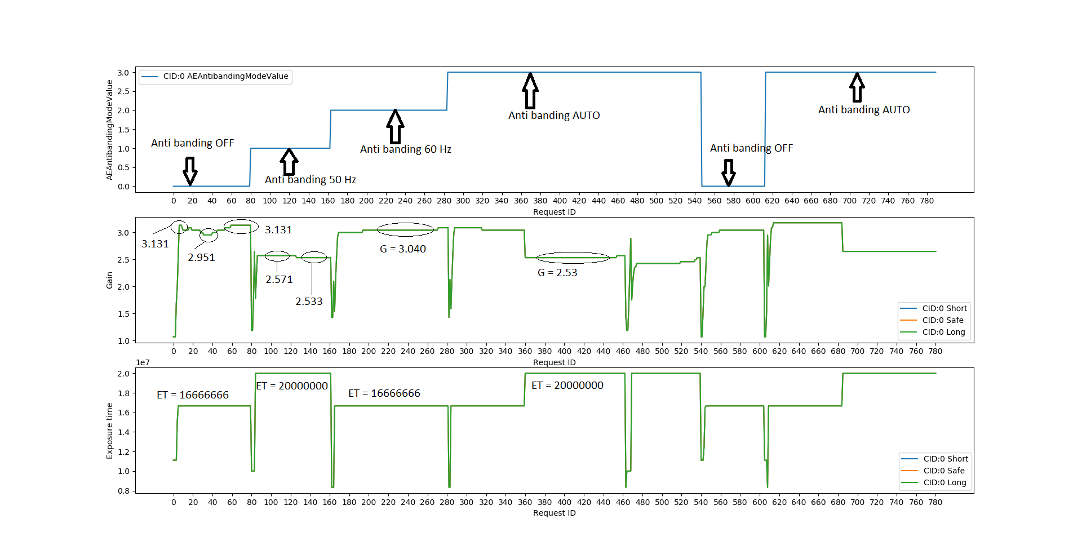
Graph:
AEC: Anti-banding vs Gain & Exposure time

Slide 13
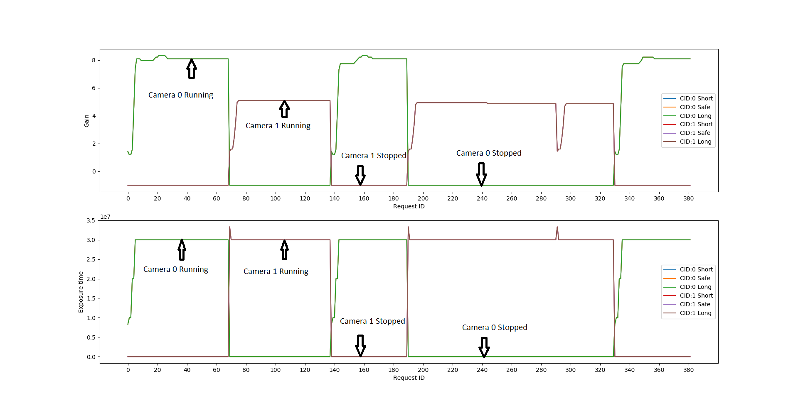
Graph:
AEC: Preview with multiple cameras

Slide 14
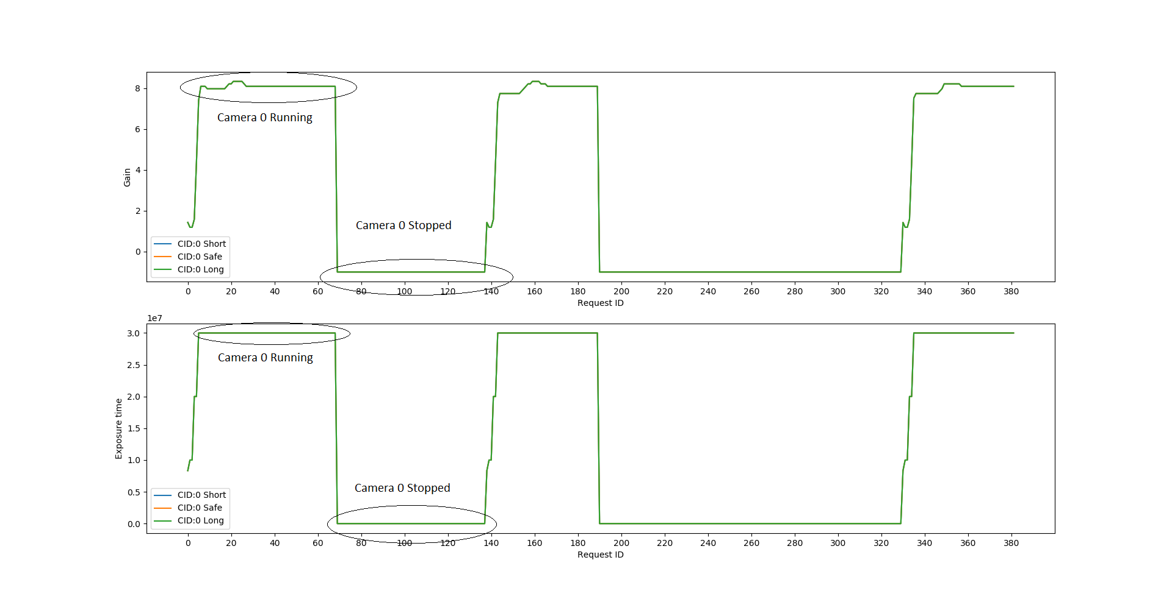
Graph:
AEC: Preview with camera ID 0

Slide 15
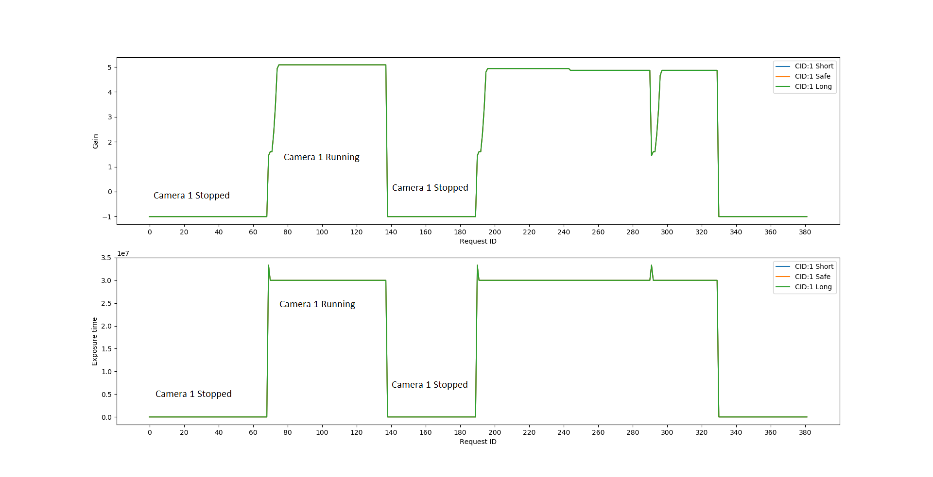
Graph:
AEC: Preview with camera ID 1

Slide 16
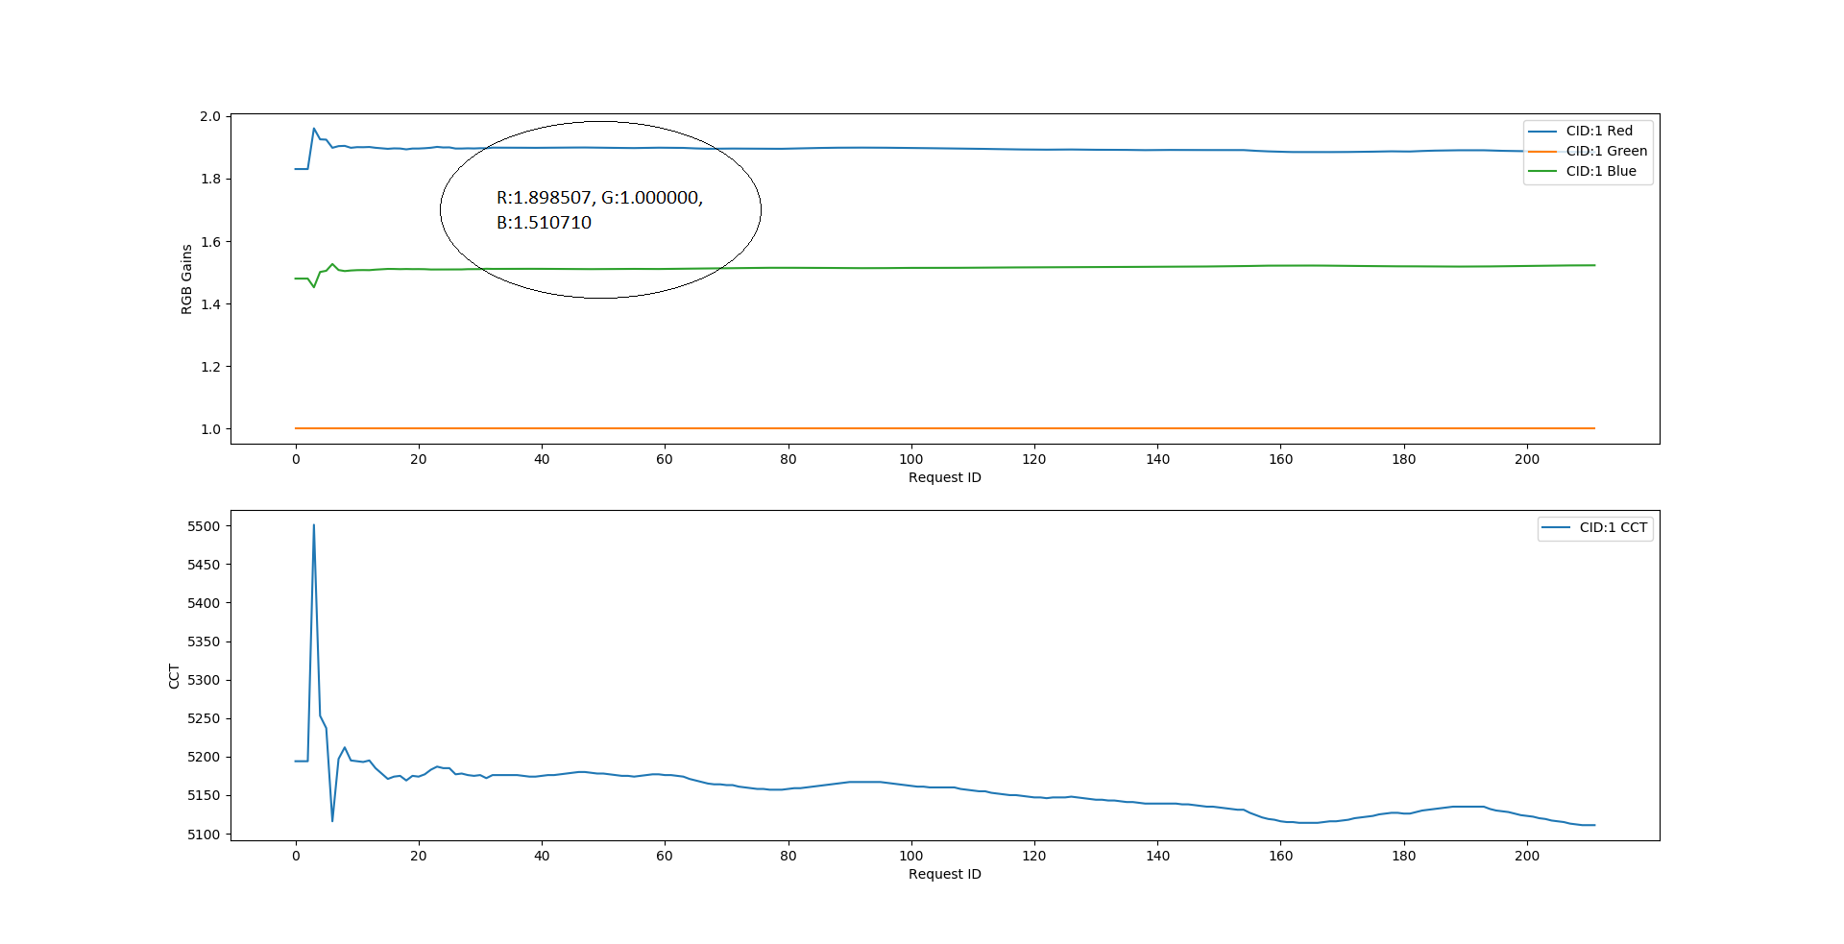
Graph:
AWB: Preview

Slide 17
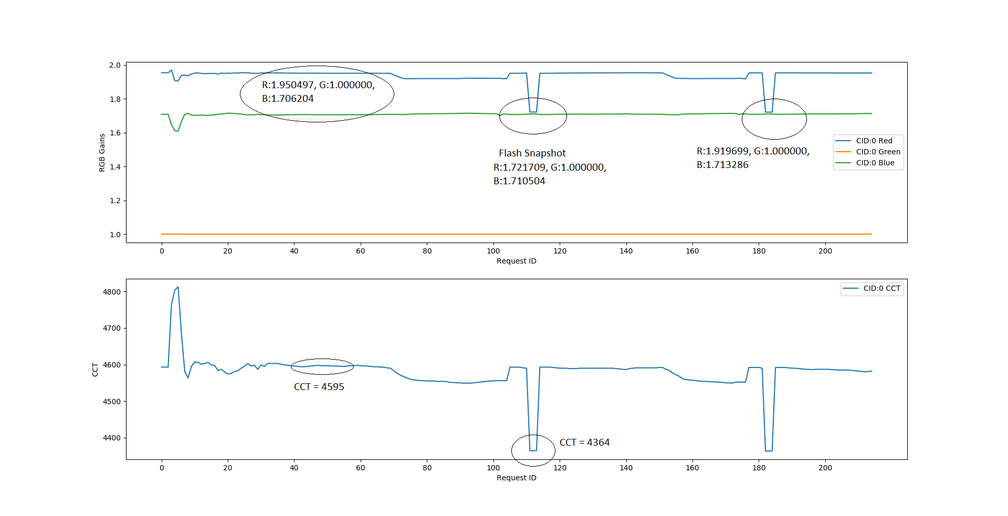
Graph:
AWB: Flash Snapshot

Slide 18
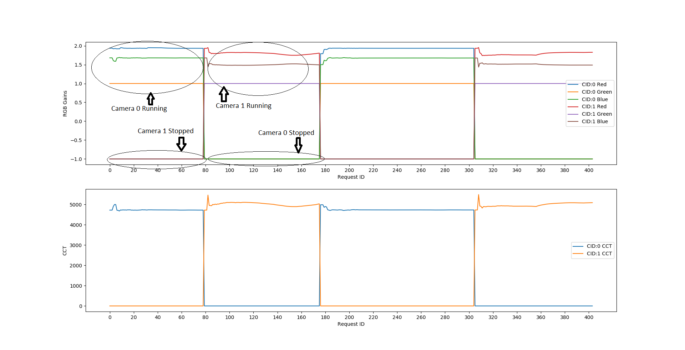
Graph:
AWB: Preview with multiple cameras

Slide 19
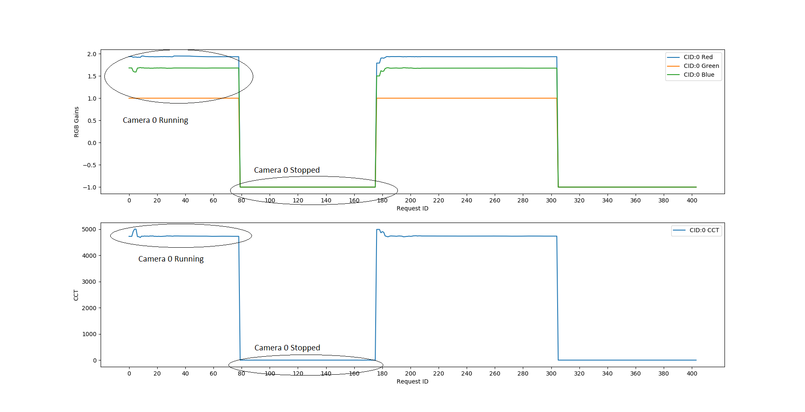
Graph:
AWB: Preview with camera ID 0

Slide 20
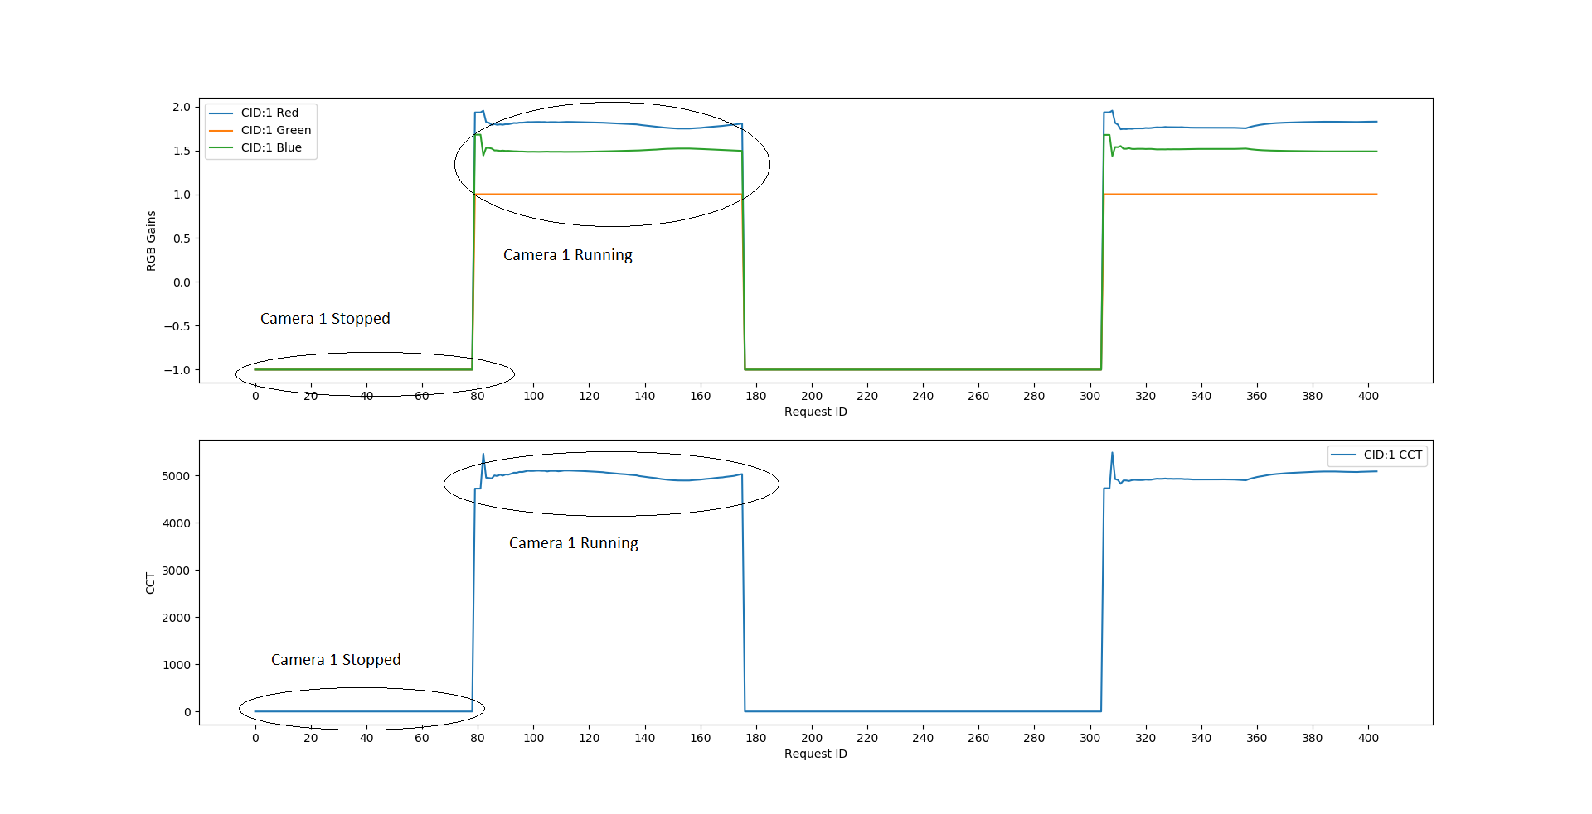
Graph:
AWB: Preview with camera ID 1

