Slide 1

California State University, East Bay College of Business and Economics BAN 673 Time Series Analytics
Introduction to Time Series Analytics and Forecasting Process
Lecture Materials
Dr. Z. Radovilsky
Notes:
1
1
Developed by Dr. Zinovy Radovilsky, Professor of Management
California State University, East Bay
@All rights reserved

Slide 2
Lecture Objectives
Provide examples of time series forecasting in business
Identify science and art of forecasting
Recognize categories and principles of forecasting
Present and explain steps of forecasting process
Use of computer and software in time series forecasting
Notes:
2
2

Slide 3
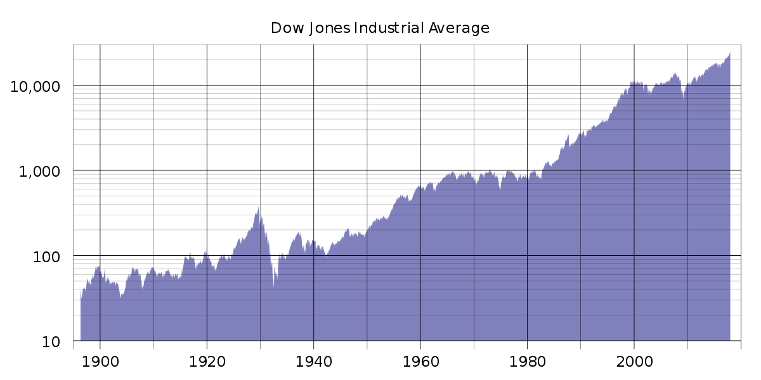
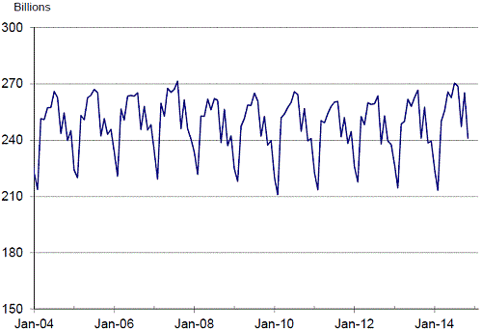
Time Series Analytics
Time series analytics is an important part of predictive analytics dealing with making predictions by applying time series forecasting
Time series is a sequence of data points taken in timely order
Uninterrupted set of successive data observations that have been ordered in time in equally spaced intervals - units of time, e.g., day, month, quarter, etc.
Contrary to time series, cross-sectional data records are collected at the same point of time or without regard to difference in time
U.S. Highway Vehicle-Miles Traveled
(Monthly data, not seasonally adjusted)

Slide 4
Why Time Series Forecasting in Business?
Time series forecast means predicting the future value of a time series data
Nothing happens until somebody forecasts something
Forecasting is a necessary tool to reduce the uncertainty (risk) in decision making
Better decisions come from better forecasts
Forecasting serves as a starting point of major decisions in finance, marketing, operations, purchasing, and other functions

Slide 5
Decisions Requiring Time Series Forecasting
Predicting demands of new and existing products in the following time period
Projecting revenues, profits, expenses, and other financial results into the future
Estimating the rate of quality improvement over a period of time
Predicting stock prices in the next day, month or year
Developing labor requirements over a period of time
Predicting inventory requirements in the next year
Forecasting number of air passengers in the future
Forecasting ridership in U.S. railway in the future

Slide 6
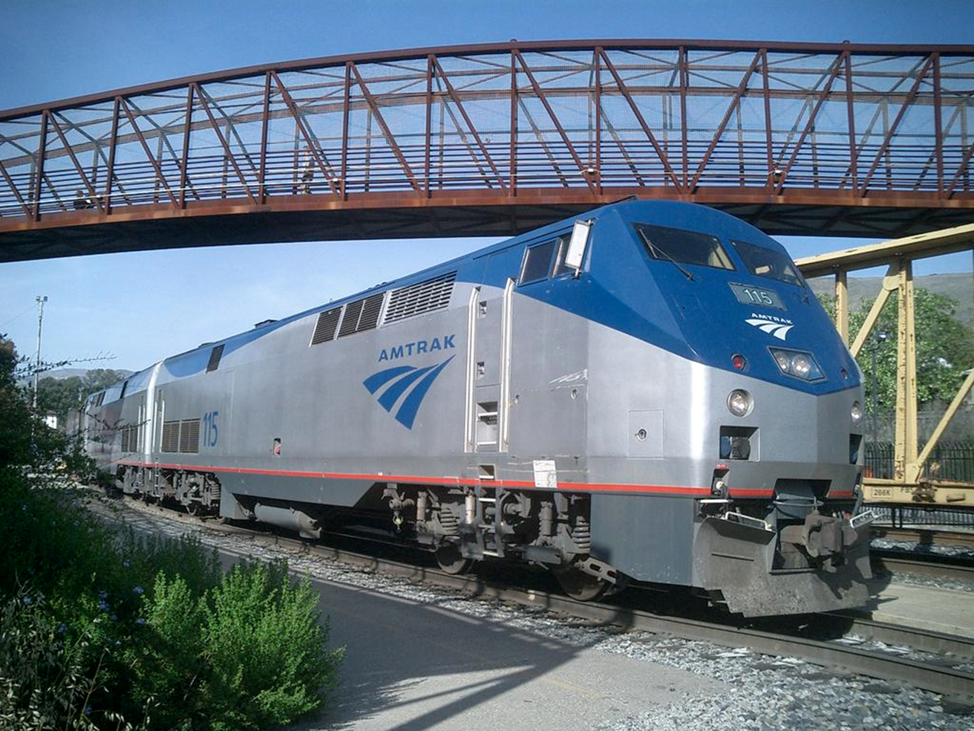
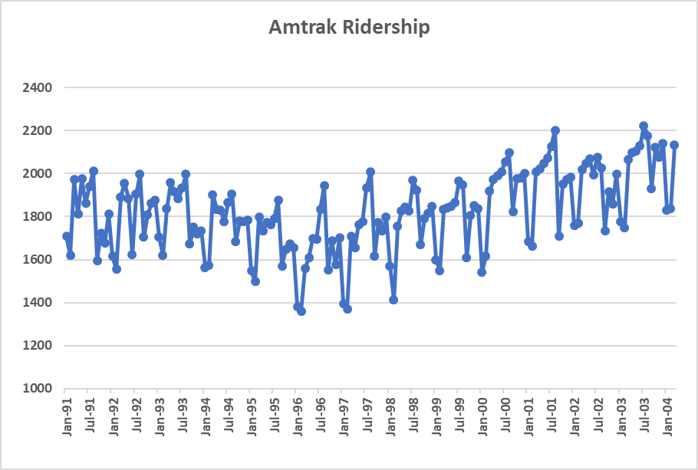

Example: Ridership on Amtrak Trains

Slide 7
Forecasting Equals Science Plus Art
Successful Forecasting = Science + Art
"Science" implies that the body of the forecasting knowledge lies on the solid ground of quantitative forecasting methods and their correct utilization for various business situations
"Art" represents a combination of a decision maker's experience, logic, and intuition to supplement the forecasting quantitative analysis. Management abilities should be involved in forecasting process
Both the science and art of forecasting are essential in developing accurate forecasts
All managers are forecasters
Better forecasts are even more critical today
Cost will be $200 Million!

Slide 8
Basic Notation
t=1,2,3… = time period index
y_{t} (Y_{t} ) = value of the series at time
period t
F_{t+k} = forecast for time period t+k, given data until time t
if k = 1, it will be the forecast for next period (t + 1) after t, F_{t+1}
e_{t} = forecast error for period t,
e_{t} = y_{t} - F_{t}

Slide 9
Forecasting the Future Is Always Difficult...
"Heavier-than-air flying machines are impossible." --President, Royal Society, 1895.
"Everything that can be invented has been invented." --Commissioner, U.S. Office of Patents, 1899.
"Who the hell wants to hear actors talk?" --Warner Brothers, 1927.
"Computers in the future may weigh no more than 1.5 tons." --Popular Mechanics, forecasting the relentless march of science, 1949
"There is no reason anyone would want a computer in their home." --President, Chairman and founder of Digital Equipment Corp., 1977
"Home mortgage rates will never go below 10 percent in this century."
--Many financial experts, 1980

Slide 10
Principles of Time Series Forecasting
Main assumption:
Past pattern repeats itself into the future
Forecasts are rarely perfect
Don't expect forecasts to be exactly equal to the actual data.
The science and art of forecasting try to minimize, but not to eliminate, forecast errors
Forecast errors or residuals mean the difference between actual and forecasted values.
Forecast for a group of products (an aggregated forecast) is usually more accurate than forecasts for individual products
Forecasts for a shorter period tend to be more accurate

Slide 11
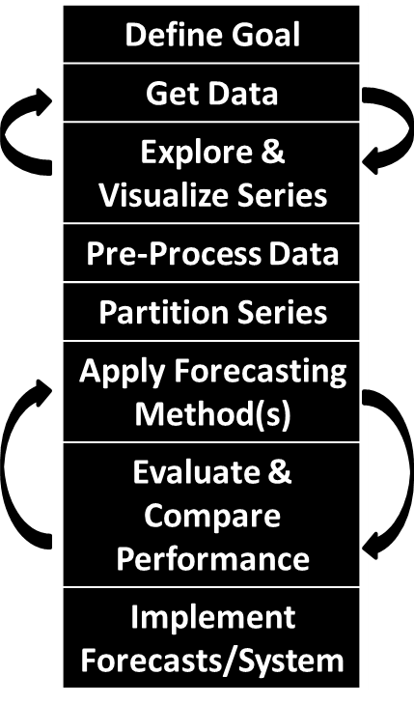
Forecasting Process

Slide 12
Step 1: Define Goal
#1: Descriptive or predictive goal
Descriptive = time series analysis
Mean, median, mode, standard deviation, etc.
Correlation of successive data points - autocorrelation
Time series data patterns: trend, seasonality, etc.
Relationships to external factors
Predictive = time series forecasting
Predict/forecast the future time series points for which the actual time series data is not available
#2: Forecast horizon
How far into the future? (k in F_{t+k})
Long-term vs. short-term forecasting?
Rolling forward or at single time point?
How frequently the model should be examined?

Slide 13
Step 1: Define Goal
#3: Forecast usage
Who are stakeholders and how many?
Should forecast be numerical or binary (event/non-event)?
Will forecast undergo adjustments?
#4: Forecast expertise and automation
In house forecasting or consultants?
How many series and how often will be forecasted?
One-time forecasting or ongoing task?
Which data and software will be available for forecasting?
Implications:
How much data is needed
Choice of forecasting methods
Forecasting software used
Expected levels of accuracy
Model deployment

Slide 14
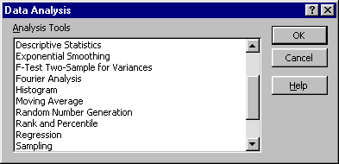
Forecasting Software
Computer and software are critical parts of modern time series forecasting
Excel has capabilities to perform some time-series forecasting methods
Drawbacks of utilizing Excel
No automation of the model construction process
Hard to apply for complicated models
Time-consuming to develop models
General statistical (end-user) software with forecasting modules
JMP, SPSS, Minitab, Stata
Specialized (end-user)forecasting packages for various business functions, e.g.
Forecast Pro – for sales and demand forecasting, operations and inventory management
Amazon Forecast – part of AWS platform
General statistical and programming languages
R, Python, C++
Time series analytics with R
https://cran.r-project.org/web/views/TimeSeries.html

