Slide 1

California State University, East Bay College of Business and Economics BAN 673 Time Series Analytics
Time Series Data and Data Patterns
Lecture Materials
Dr. Z. Radovilsky
Notes:
1
1
Developed by Dr. Zinovy Radovilsky, Professor of Management
California State University, East Bay
@All rights reserved

Slide 2
Lecture Objectives
Define data collection step in time series forecasting
Explain data quality, temporal frequency, series granularity, and domain expertise in time series data
Explore time series data by identifying time series components: trend, seasonality, level and noise
Use R to identify time series components
Apply autocorrelation to identify time series components
Build correlogram (autocorrelation function – Acf) and recognize time series components
Identify time series components using Acf in R
Visualize time series using charts in R
Utilize pre-processing step in time series forecasting
Notes:
2
2

Slide 3
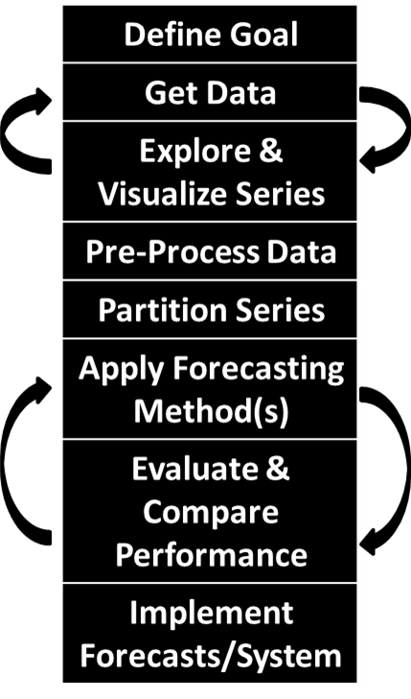
Step 2: Data Collection (Get Data)
Data collection should take into account various aspects of forecasting goal (step 1)
Considerations at the data collection level which can affect the forecasting results:
Data quality
Temporal frequency
Series granularity
Domain expertise

Slide 4
Considerations in Data Collection
Data Quality
Specifically important in time series forecasting, where sample size is relatively small, typically no more than a few hundred values in a series
With multiple sources, data collection may be done from different departments, so compare and choose the best data to apply
For forecasting, additional data may be collected in the future from the same source
External data may be also required to do a more accurate forecasting
Temporal Frequency
Consider frequency of time series the same as the frequency of the required forecast (from the forecast goal)
If the goal to forecast is next day energy usage in a building, then minute-by-minute or hourly day is less useful than daily aggregates of historical data
High frequency data may have more noise, while aggregated data will reduce it
Sometime: use aggregated data, model aggregated forecasts, and then disaggregate the forecasting results

Slide 5
Considerations in Data Collection (continued)
Series Granularity
Granularity refers to the coverage of the data
In terms of geographical area, population, time of operations, etc.
Depending on the forecast goal, series granularity may require different depth, e.g., forecasting general population growth vs. forecast of population of various age groups, states, region, etc.
Level of granularity needs to be aligned with the forecasting goal
Exploring different aggregation and data slicing levels are often needed to obtain appropriate time series
Domain Expertise
Domain expertise (“art of forecasting”) is needed to identify which data to employ (daily vs. hourly, how far back, from which source, etc.)
Help to evaluate practical implications of forecasting results
Requires communication and coordination between business data analysts that perform forecasting and domain experts

Slide 6
Step 3: Explore & Visualize Series
Explore time series step is used to do preliminary time series analysis of the data, and in particular
Identify data patterns (components) of the historical time series data
Use autocorrelation to investigate various data patterns

Slide 7
Time Series Components
Systematic part components
Level (stationary) describes the average value of the series
Trend is the upward or downward change in the series from one period to the next
Seasonality is a short-term cyclical behavior observed several times in a time series
Non-systematic part component
Noise (randomness) – random variations resulting from measurement error or other causes not accounted for
Time series components are commonly considered either additive or multiplicative
Additive components
Y_{t} = Level + Trend + Seasonality + Noise
Multiplicative components
Y_{t} = Level × Trend × Seasonality × Noise
While not all time series have trend and/or seasonality, all series have a level
Forecasting methods attempt to isolate the systematic part and quantify noise (randomness)
Systematic part is used to generate point forecasts
Noise (randomness) helps assess the uncertainty associated with point forecasts

Slide 8
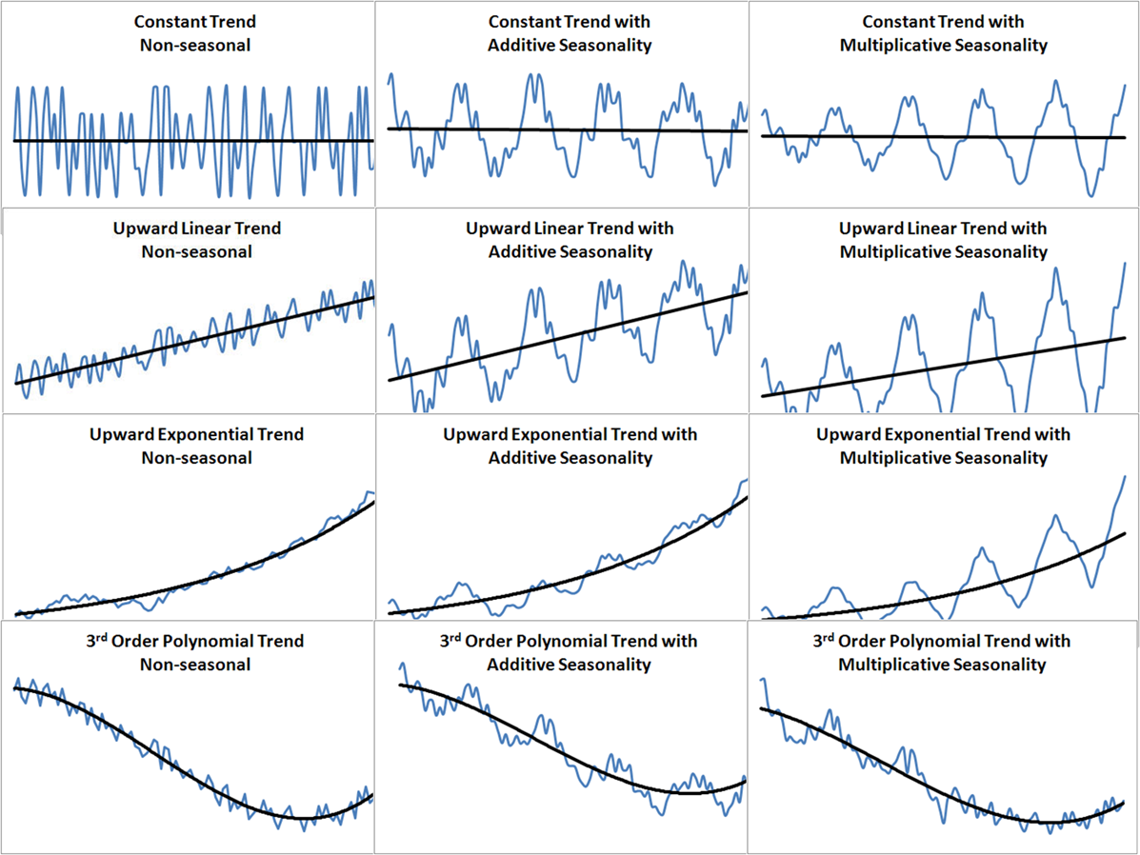
Charts of Time Series Components

Slide 9
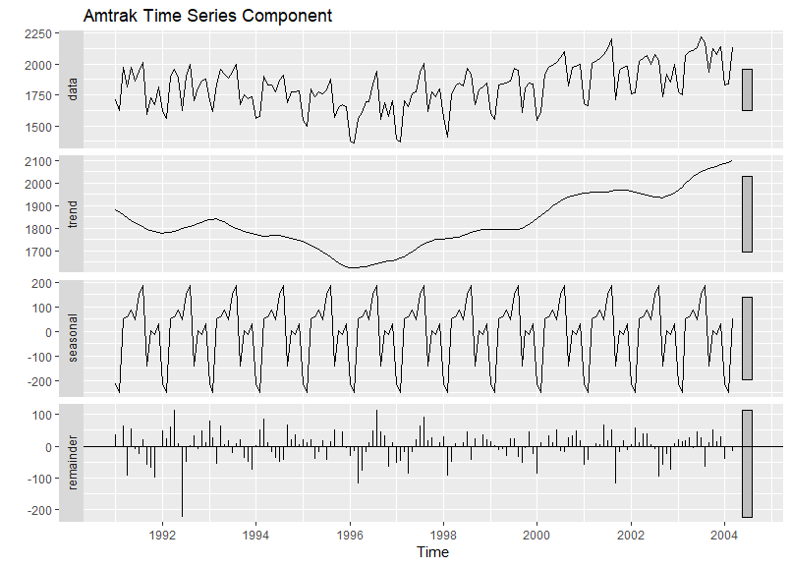
Amtrak Time Series Components Using stl() Function in R

Slide 10
Autocorrelation
Autocorrelation represents the correlation between a random variable (time series data) itself and the same variable lagged one or more periods
Autocorrelation coefficient r_{k} is a measure of autocorrelation between a variable itself and the same variable lagged k periods:
where
r_{k} = autocorrelation coefficient for a lag of k periods (k = 1, 2, 3, …, 12, …)
= mean of the values of the series
Y_{t}= observation in time period t
Y_{t-k} = observation k time periods earlier or at time period t-k
If a time series is random, the autocorrelations for any lag are close to zero
The successive values of a time series are not related to each other

Slide 11
Autocorrelation Coefficients (Excel)

Slide 12
Autocorrelation Function (Acf)
Autocorrelation function (Acf) identifies and plots multiple autocorrelation coefficients for various lags of a time series data
It also calculates and plots interval (horizontal lines) to identify significant autocorrelation
Correlogram – is a plot of autocorrelation (autocorrelation coefficients) for various lags
Correlogram can be used to analyze the autocorrelation coefficients for different time lags and answer the following questions:
Does the time series data have a trend component?
Does the time series data have a seasonal component?
Does the time series data have a level component?
Is the data random?

Slide 13
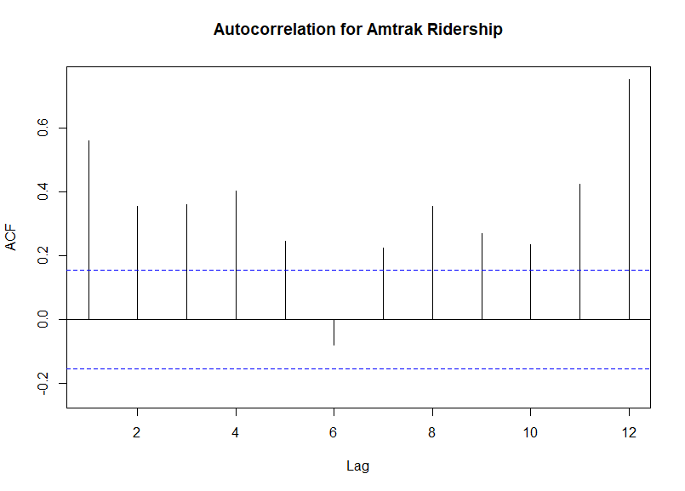
Correlogram Using Acf() Function in R

Slide 14
Analyzing Patterns with Autocorrelation
Series with trends
Positive autocorrelation coefficients are significantly greater from zero for the first lag 1 or first several periods (lag 1, lag 2, etc.) and then gradually drop toward zero
Series with seasonality
Autocorrelation coefficients are significant at the appropriate time lag: lag 4 for quarterly data, lag 12 for monthly data.
In some cases, to distinguish from the trend pattern, the trend should be removed from a non-stationary data first utilizing the differencing method: developing a data set representing differences between the actual data and the one lagged one period (lag 1)
Series with level (stationary) pattern
Autocorrelation coefficients decline to zero fairly rapidly, generally after the second or third time lag.
To distinguish from the trend pattern, the trend should be removed from actual data first utilizing the differencing method

Slide 15
Step 3: Explore & Visualize Series
Visualize series step is used as an effective initial step for characterizing the nature of time series
May detect potential issues with the data
Extreme values
Unequal spacing
Missing values
Time plot is most basic but very informative plot for visualizing a time series
Line chart of the series values (y₁, y₂, …) over time (t = 1, 2, …) with temporal labels (e.g., calendar date) on the horizontal axis

Slide 16
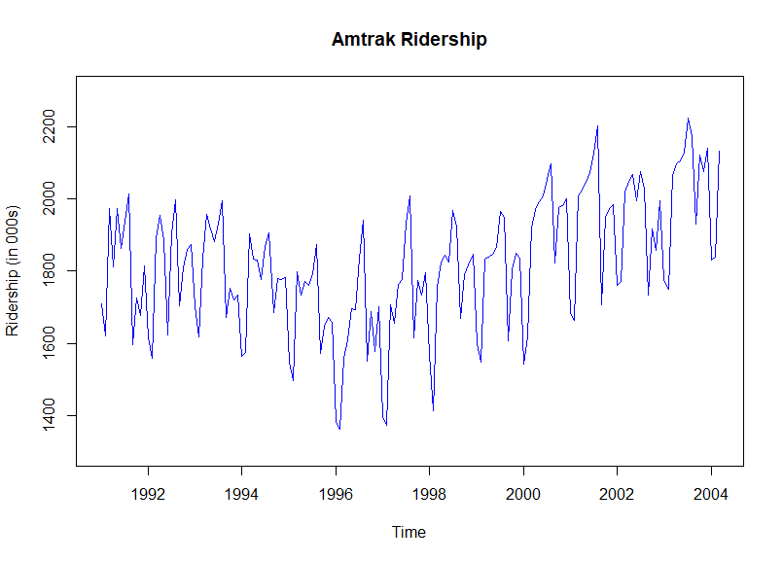
Time Plot for Amtrak Ridership Using plot() Function in R

Slide 17
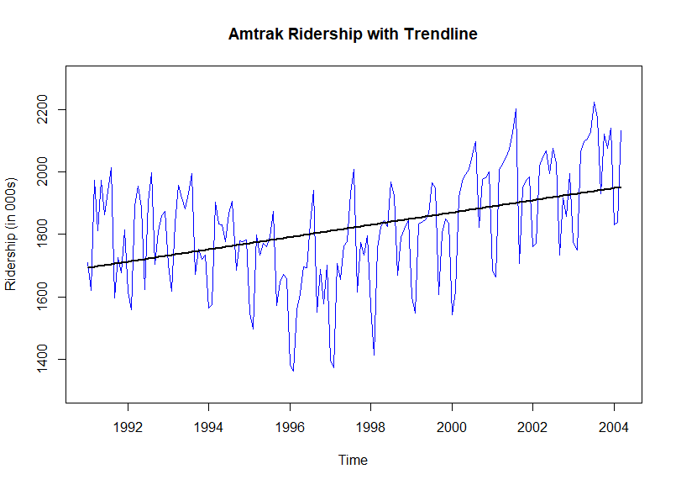
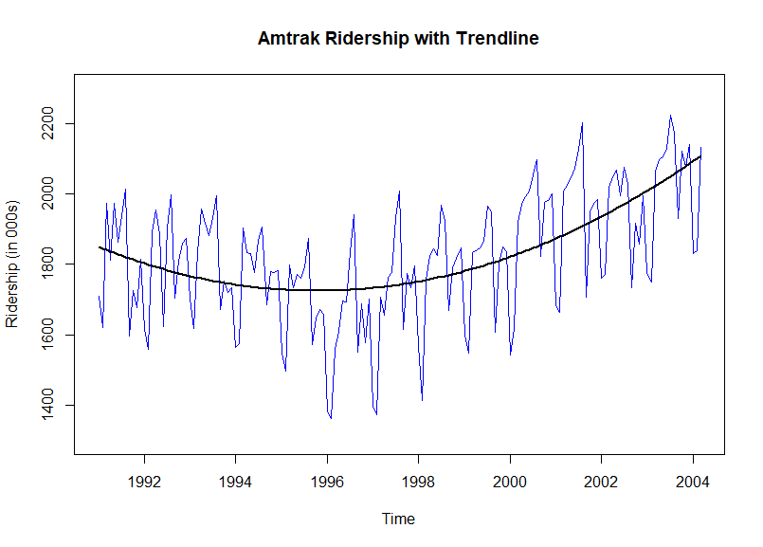
Time Plot with Trendline

Slide 18
Zoom-In Time Plot Using autoplot() Function in R

Slide 19
Step 4: Pre-Process Data
Pre-process data is used to detect potential issues and challenges with data
Extreme values (outliers)
Data entry errors
Missing values
Unequal spacing
Irrelevant periods
Time span (how far back?)
May require data cleaning to remove time series issues

