Slide 1

California State University, East Bay College of Business and Economics BAN 673 Time Series Analytics
Performance Evaluation and Forecasting Methods
Lecture Materials
Dr. Z. Radovilsky
Notes:
1
1
Developed by Dr. Zinovy Radovilsky, Professor of Management
California State University, East Bay
@All rights reserved

Slide 2
Lecture Objectives
Identify principles of time series partitioning
Partition time series data into training and validation data sets
Recognize model-based and data-driven forecasting methods
Explain combination of forecasting methods and ensembles
Identify and explain accuracy measures
Recognize forecast uncertainty and identify prediction intervals
Use R to develop time series partitioning, create naïve forecast, measure forecast accuracy, and prediction intervals
Notes:
2
2

Slide 3
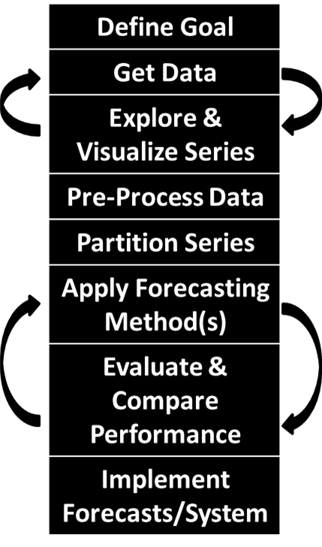
Step 5: Partition Time Series
Partition Series is an important preliminary step before applying any forecasting method
Comes from the need to be able to test how well any selected model performs with the new data not included in the model development
Typically, divide time series data into two partitions: training and validation data sets
Develop a forecasting model based on training data, and test/validate model performance using the validation data
The main reason for partitioning is overfitting
It means that a forecasting model is not only fitting the systematic components of the data (e.g., trend and seasonality), but also the noise
Overfitted model is likely to perform poorly on the new data to be forecasted

Slide 4
Considerations in Data Partitioning
Partitioning of cross-sectional data
Typically, employs two or three data partitions: training set, validation set, and sometimes additional test set
Random selection (in most cases) of data records into training, validation, and test sets
Training set, the largest in records partition, is used to develop various models, which are assessed by validation and, sometimes, test partitions
Time series (temporal) partitioning
The times series is also partitioned into two sets: training period and validation period
Nonrandom selection of partition periods
The earlier period (t = 1, 2, …, n) is designated as the training period, the larger partition (typically, 70-80% of the whole time series data)
The later period (t = n+1, n+2, …N) is designated as the validation period, the smaller partition

Slide 5
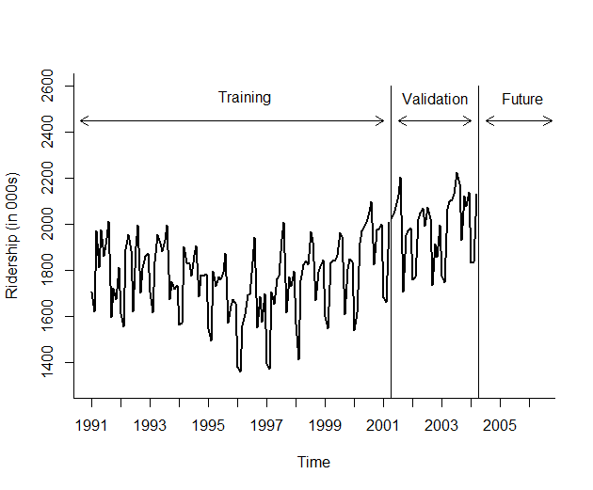
Data Partition Graph For Amtrak

Slide 6
Length of Validation Period and Recombine Partitions for Forecasting
Length of validation period depends on
Data frequency (quarterly, monthly, weekly, etc.) and forecast horizon
If the data needs to be forecasted for next year, choose at least one year of validation period, e.g., 12 months or 4 quarters
Seasonality
For monthly or quarterly seasonality, consider validation period of at least 2 years (24 months or 8 quarter, respectively)
Length of series
The smaller the time series length, the less data will go into validation period
Recombine partitions for forecasting
Before attempting to forecast future values of the series, the training and validation periods must be recombined into one time series, and the chosen model needs to be rerun on the complete data
The validation period, the most recent one, contains the most valuable information for the future period forecasting, and thus needs to be included for model development
With more data for model development, the forecasting model may be estimated more accurately
If only the training period is used for developing forecasts, then it will require forecasting further into the future

Slide 7
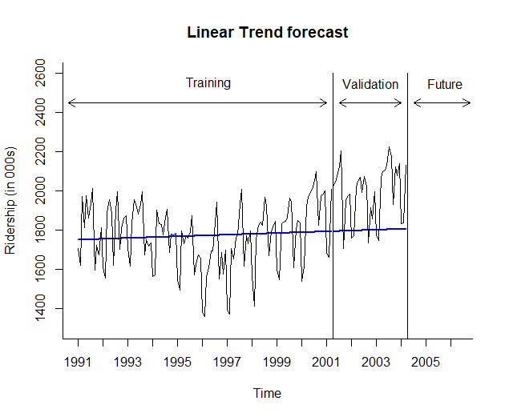
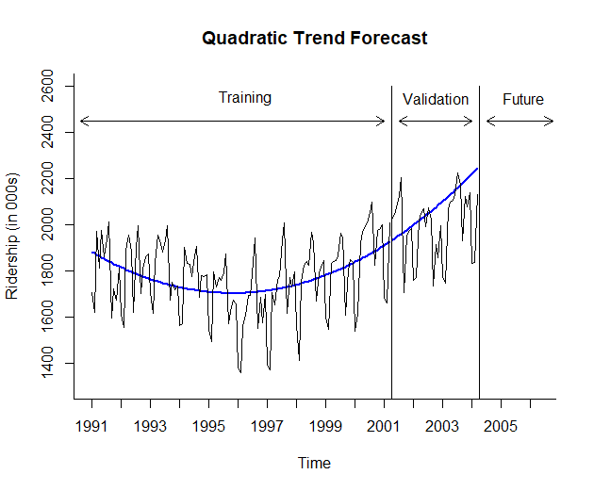
Training and Validation Data with Model Graph

Slide 8
Naïve Forecast
Naïve forecast is a simple forecasting method that uses the most recent value of the time series
If the actual value of time series in period t is y_{t} , the naïve k-step ahead forecast, F_{t+k} is
F_{t+k} = y_{t}
Seasonal naïve forecast for a seasonal time series is the value of the most recent identical season.
For a series with M seasons, seasonal naïve forecast for k-step ahead
F_{t+k} = y_{t-M+k}
For example with monthly time series, the naive forecast for June 2019 will be equal to the actual value in June of 2018
Naïve forecast usage
Being simple and easy to understand, can sometime be actually used to achieve useful accuracy levels
Can be used as a baseline to compare it with some other more advanced forecasting methods

Slide 9
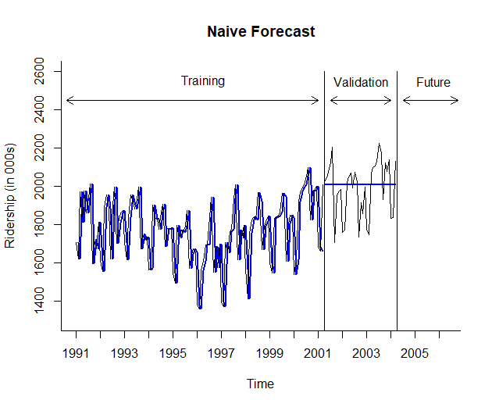
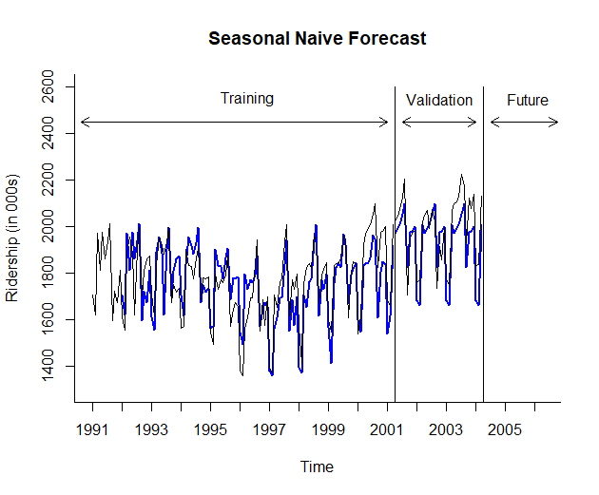
Naïve Forecast for Amtrak Data

Slide 10
Step 6: Apply Forecasting Method(s)
A great variety of forecasting methods
Different methods perform differently depending on the nature of data and forecasting requirements
Simple approach like naïve forecast should be considered as a baseline for performance comparison of more sophisticated methods
Forecasting methods can be roughly divided into model-based and data-driven methods
Model-based methods apply statistical, mathematical, or other scientific model to forecast time series, especially advantageous for time series with small number of records
Simple and multiple linear and non-linear regression
Autoregressive models
ARIMA
Logistic regression
Econometric models

Slide 11

Forecasting Methods and Level of Automation
Data-driven methods are data dependent and “learn” patterns from data
Advantageous when data structure changes over time and require less user input (then model-based models) in model development
Naïve forecasts
Moving average
Exponential smoothing
Neural nets
Manual forecasting
One time forecasting
In-house expertise
Small number of series to forecast
Typically model-based methods
Automated forecasting
Ongoing forecasting
No in-house expertise
Many series to forecast
Typically data-driven methods
Computationally fast

Slide 12

Combine Forecasting Methods and Ensembles
Combine multiple forecasting methods to improve predictive performance
Two-level (multilevel) methods, where the first method uses the original time series to predict future, and the second method uses forecast errors from the first method to generate forecast for errors, and then combine two forecasts together
Ensembles
Multiple methods applied to the same time series, each generates a separate forecast
The resulting forecasts are averaged in some way to produce the final forecast
Can be weighted average, where each forecast has a specific weight proportional to method performance
Example: ensembles played a major role in Netflix competition to develop the most accurate forecast of movie preference by Netflix customers
Advantages of combining forecasting methods and ensembles
More robust forecasts
Higher precision
Disadvantages
Increased cost and time-consuming
More external consulting expertise
Requires predetermined rules for combining forecasts

Slide 13
Step 7: Evaluate & Compare Performance
Performance measures are used in forecasting to evaluate prediction accuracy and compare accuracy of various forecasts to identify the best forecast
Forecast accuracy refers to how close forecasts come to actual data
Accuracy is usually measured in forecasting by the value of its adverse characteristic--forecast error
Forecast error or residual (e_{t}) is the difference between actual (y_{t}) and forecasted (F_{t}) values in the same period
e_{t} = y_{t} - F_{t}
The smaller the forecast error, the more accurate the forecast
Performance measures are typically based on validation period data

Slide 14




Common Accuracy Performance Measures
Consider a validation period with v periods (records), t = 1, 2, …, v, and error e_{t} (difference between actual and forecasted values) in each respective period
Mean/average error (ME or AE) – provides an indication of whether the forecast is over- or under-predicting
Mean absolute error/deviation (MAE or MAD) give the magnitude of the average absolute error:
Mean absolute percentage error (MAPE) gives an absolute percentage score of how forecast deviates (on the average) from actual values; useful for comparing performance across series of data that have different scales:
Root mean squared error (RMSE) has the same units as the time series and sensitive to large errors
$$\text{ME} = \frac{1}{v}\sum_{t=1}^{v}{e_{t}}$$
$$\text{M}\text{A}\text{E}= \frac{1}{v}\sum_{t=1}^{v}{\left|e_{t}\right|}$$
$$\text{M}\text{AP}\text{E}= \frac{100}{v}\sum_{t=1}^{v}{\left|\frac{e_{t}}{\text{y}\text{t}}\right|}$$
$$\text{R}\text{MSE}= \sqrt{\frac{1}{v}\sum_{t=1}^{v}{{e_{t}}^{2}}}$$

Slide 15
Calculation of Accuracy Measures in Excel

Slide 16
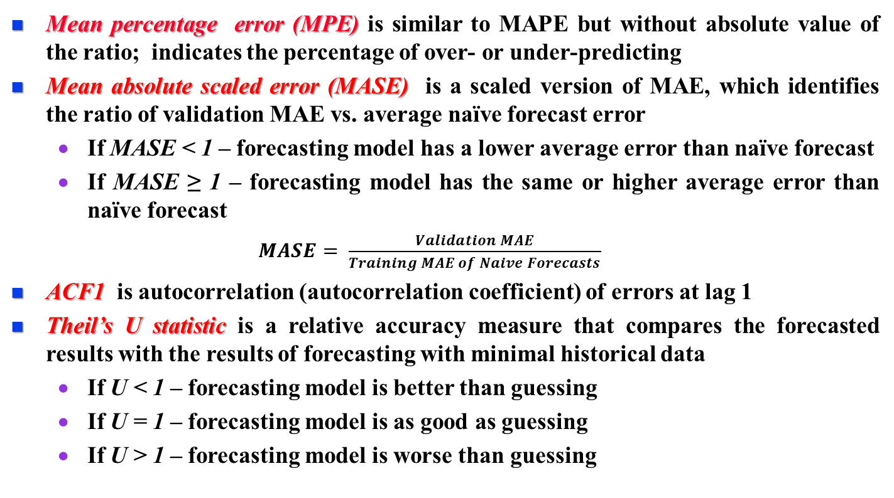
Additional Accuracy Performance Measures
Mean percentage error (MPE) is similar to MAPE but without absolute value of the ratio; indicates the percentage of over- or under-predicting
Mean absolute scaled error (MASE) is a scaled version of MAE, which identifies the ratio of validation MAE vs. average naïve forecast error
If MASE < 1 – forecasting model has a lower average error than naïve forecast
If MASE ≥ 1 – forecasting model has the same or higher average error than naïve forecast
$MASE= \frac{Validation MAE}{Training MAE of Naive Forecasts}$
ACF1 is autocorrelation (autocorrelation coefficient) of errors at lag 1
Theil’s U statistic is a relative accuracy measure that compares the forecasted results with the results of forecasting with minimal historical data
If U < 1 – forecasting model is better than guessing
If U = 1 – forecasting model is as good as guessing
If U > 1 – forecasting model is worse than guessing

Slide 17
Performance Measures Using Accuracy Function in R
Linear Regression Forecast – Validation Data
ME RMSE MAE MPE MAPE MASE ACF1 Theil's U
Test Set 193.132 239.486 209.437 9.210 10.148 2.539 0.273 1.358
Quadratic Regression Forecast – Validation Data
ME RMSE MAE MPE MAPE MASE ACF1 Theil's U
Test Set -83.962 179.849 133.738 -4.725 7.076 1.621 0.417 1.062

Slide 18
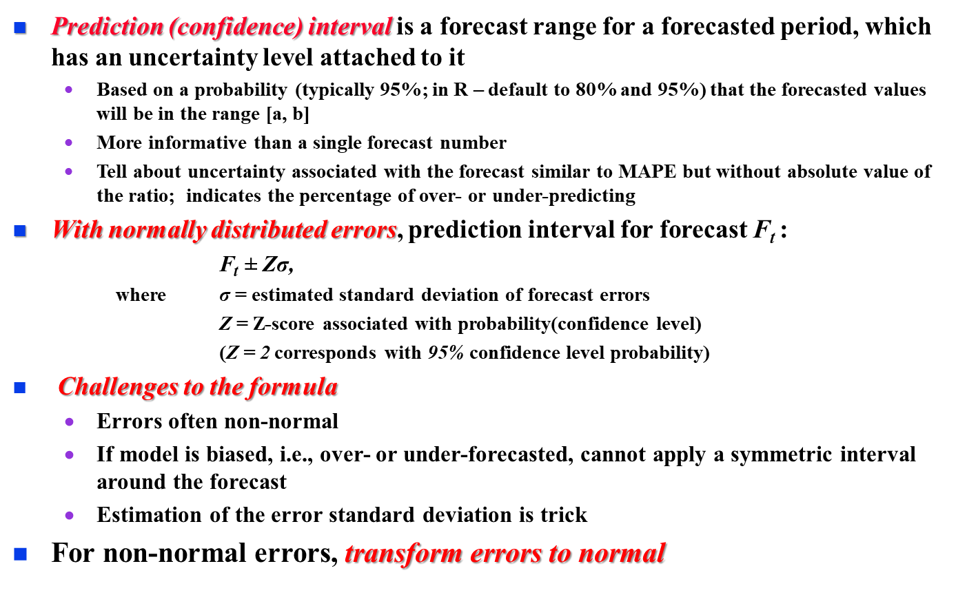
Measure Forecast Uncertainty
Prediction (confidence) interval is a forecast range for a forecasted period, which has an uncertainty level attached to it
Based on a probability (typically 95%; in R – default to 80% and 95%) that the forecasted values will be in the range [a, b]
More informative than a single forecast number
Tell about uncertainty associated with the forecast similar to MAPE but without absolute value of the ratio; indicates the percentage of over- or under-predicting
With normally distributed errors, prediction interval for forecast F_{t} :
F_{t} ± Zσ,
where σ = estimated standard deviation of forecast errors
Z = Z-score associated with probability(confidence level)
(Z = 2 corresponds with 95% confidence level probability)
Challenges to the formula
Errors often non-normal
If model is biased, i.e., over- or under-forecasted, cannot apply a symmetric interval around the forecast
Estimation of the error standard deviation is trick
For non-normal errors, transform errors to normal

Slide 19
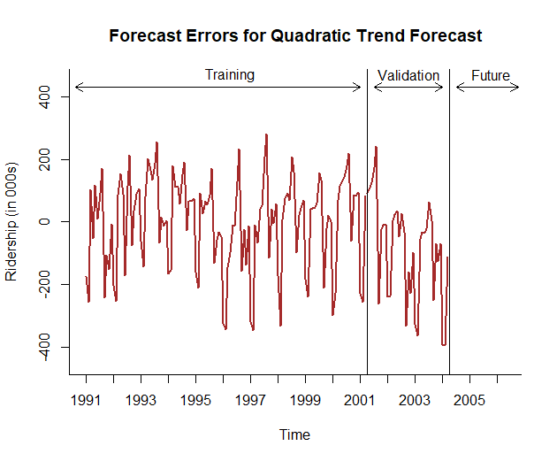
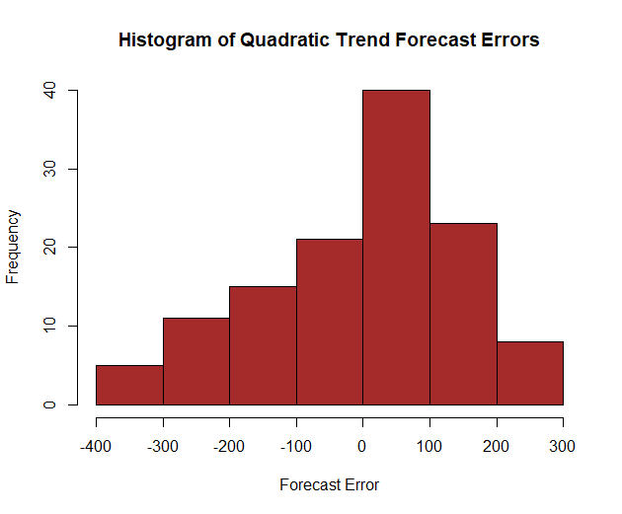
Error Graph and Histogram in R

Slide 20
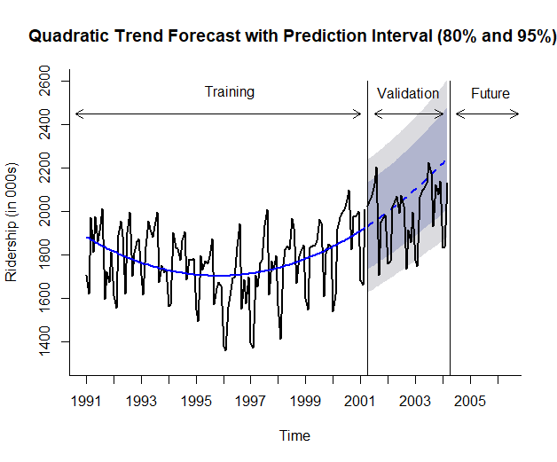
Forecast with Prediction (Confidence) Interval

