Slide 1

California State University, East Bay College of Business and Economics BAN 673 Time Series Analytics
Smoothing Methods: Moving Average
Lecture Materials
Dr. Z. Radovilsky
Notes:
1
1
Developed by Dr. Zinovy Radovilsky, Professor of Management
California State University, East Bay
@All rights reserved

Slide 2
Lecture Objectives
Define smoothing methods and their benefits
Identify moving average approaches
Explain how to apply centered moving average for visualization
Utilize trailing moving average in time series forecasting
Apply weighted moving average in time series forecasting
Use R to develop smoothing methods for time series forecasting and for measuring forecast accuracy
Notes:
2
2

Slide 3
Define Smoothing Methods
Smoothing methods is a family of time series forecasting methods
Data-driven methods – estimate time series components (level, trend, and seasonality) directly from the data without a predetermined structure
Smooth out the noise in a series in order to uncover the data patterns
Average series values over multiple time periods with various types of smoothers, e.g., averaging different time periods or applying smoothing constants
Main smoothing methods
Moving average (MA)
Centered MA, Trailing MA, Weighted MA
Simple exponential smoothing (SES)
Advanced exponential smoothing (AES)
Holt’s model for data with trend
Winter’s (Holt-Winter’s) model for data with trend and seasonality
Smoothing methods are useful for
Data visualization (centered moving average)
Short-term forecasting (with trailing MA, weighted MA, and SES) for the next time period (next day, month, etc.)
Multi-period forecasting with advanced smoothing methods (e.g., Holt-Winter’s model)

Slide 4
Recap: Components of Time Series and Modeling Principles
Time series components
Level (always present)
Trend – steady increase/decrease over time
Seasonality – pattern that repeats itself every season
Random noise (always present)
Time series analysis
Reasonable – selected model(s) should adequately represent historical time series (autocorrelation used)
Parsimony – in general, the simpler the model the better
Goodness of fit – find a model that fits well to the historical time series; the lower the errors (residuals) the better the model
Time series forecasting
Forecast accuracy
Reasonable and parsimony

Slide 5
Moving Average
Moving average (MA) – common method of time series forecasting
Simple smoother
Forecast future points by using an average of several past consecutive points with window (number of points) m defined by user
The term "moving" represents the fact that as each new actual data point becomes available, a revised MA is computed for the next data period requiring forecasting
Two main types of moving averages
Centered moving average
Based on a window centered around time t, for which moving average is identified
Useful to visualize trends, because the averaging operation can suppress seasonality and noise, making the trend more visible
Trailing moving average
Simple and popular
With different weights – weighted moving average

Slide 6
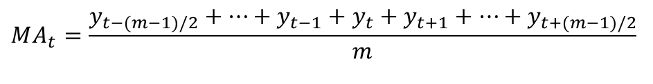
Computing a Centered MA
0
Compute average of values in window (of width m), which is centered at period t
Odd width: center window on time t and average the values in the window
Even width: take the two “almost centered” windows and average the values in them
In seasonal series, the window width w should be equal to the seasonal cycle, e.g., for Amtrak data, m = 12 (monthly seasonality)
$$MA_{t}=\frac{y_{t−(m−1)/2}+…+y_{t−1}+y_{t}+y_{t+1}+⋯+y_{t+(m−1)/2}}{m}$$
m=4
m=4
m=5
t-2 t-1 t t+1 t+2

Slide 7
Centered MA in Excel
Centered MA, k = 4, MA at 3/1991, t=3:
MA₃ = [(1708.917+1620.586+1972.715+1811.665)/4 +(1620.586+1972.715+1811.665+1974.964)/4]/2 = 1811.727
Centered MA, k=5, MA at 3/1991, t=3:
MA₃ = (1708.917+1620.586+1972.715+1811.665+1974.964)/5 = 1817.769

Slide 8
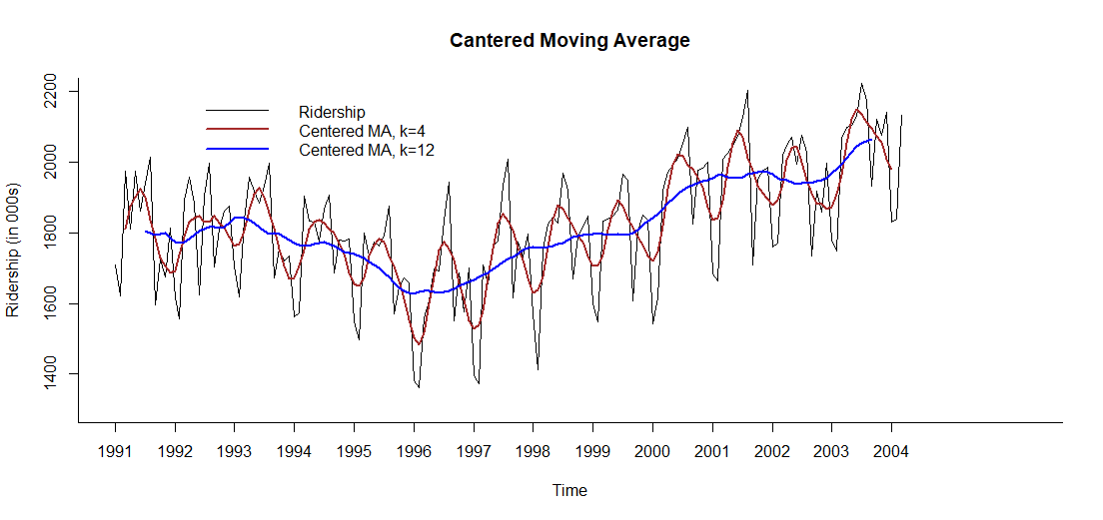
Visualizing Amtrak Ridership Data with Centered MA in R

Slide 9
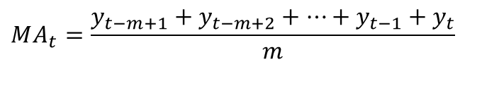
Computing Trailing MA
0
Choose window width (m)
For MA at time t, place window on time points t-m+1, t-m+2, …, t
Compute average of values in the window
m=5
t-4 t-3 t-2 t-1 t
$$MA_{t}=\frac{y_{t−m+1}+y_{t−m+2}+⋯+y_{t−1}+y_{t}}{m}$$

Slide 10
Trailing MA in Excel
Trailing MA, k = 4, MA at 6/1991, t=6:
MA₆ = (1972.715+1811.665+1974.964+1862.356)/4 = 1905.425
Trailing MA, k=5, MA at 6/1991, t=6:
MA₆ = (1620.586+1972.715+1811.665+1974.964+1862.356)/5 = 1848.457

Slide 11
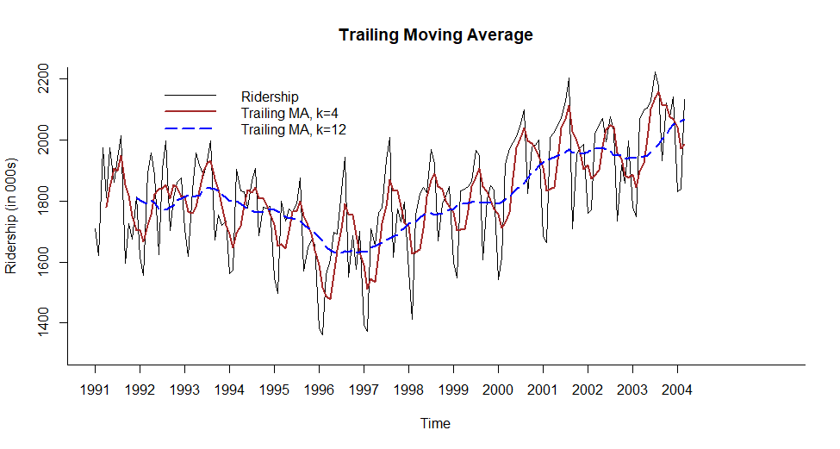
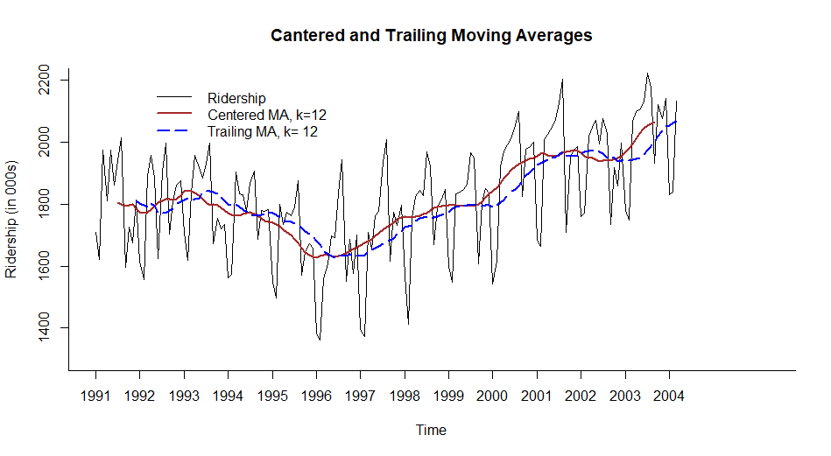
Visualizing Amtrak Ridership Data with Trailing MA and Trailing MA vs. Centered MA

Slide 12
Choosing Window Width (m)
For MA forecasting, user must make a choice of window’s width m, which is the number of records used for averaging
With data-driven methods, the choice of m, which is a smoothing parameter, is a balance between under-smoothing (narrow window, smaller m) and over-smoothing (wider window, larger m)
Wider window with larger m will make forecast more smooth, will expose more global trends
Narrow window with smaller m will reveal local trends
For data with no seasonality, use narrow window (under-smoothing)
For data with seasonality, use m equal to the number of seasons
Experiment with different values of m and compare forecast performance/accuracy based on these values

Slide 13
Performance Measures Using Accuracy Function in R
Trailing MA, k=4
ME RMSE MAE MPE MAPE ACF1 Theil's U
Test Set 1.661 121.413 102.154 -0.361 5.802 0.179 0.706
Trailing MA, k= 5
ME RMSE MAE MPE MAPE ACF1 Theil's U
Test Set 2.236 125.075 106.07 -0.367 6.009 0.286 0.725
Trailing MA, k=12
ME RMSE MAE MPE MAPE ACF1 Theil's U
Test Set 8.561 143.542 118.532 -0.2 6.684 0.338 0.82

Slide 14
Removing Trend and/or Seasonality
0
In general, trailing MA should be used for forecasting in time series that lack seasonality and trend
In order to apply MA in data with trend and/or seasonality, a forecast analyst may want to remove first trend and/or seasonality in time series
Approach 1: Regression
Regression models with trend and/or seasonality can be used to remove trend (de-trending) and/or seasonality (de-seasonalizing) in historical data
Regression residuals (errors) can be forecasted using trailing MA
Approach 2: Differencing
Differencing means taking the difference between two observations
Differencing is a simple and popular operation for removing a trend and/or seasonality
Lag-1 difference: y_{t} – y_{t-1} for removing trend (de-trending)
Lag-M difference: y_{t} – y_{t-M} for removing seasonality with M seasons (de-seasonalizing)
Double-differencing: difference the differenced series, used to remove both trend and seasonality from time series
Instead of two approaches above, may apply advanced smoothing methods
Holt’s model – for series with trend
Winter’s (Holt-Winter’s) model – for series with trend and seasonality

Slide 15
Regression with Quadratic Trend and Seasonality
Call:
tslm(formula = ridership.ts ~ trend + I(trend^2) + season)
Coefficients:
Estimate Std. Error t value Pr(>|t|)
(Intercept) 1.656e+03 2.511e+01 65.968 < 2e-16 ***
trend -4.940e+00 5.064e-01 -9.755 < 2e-16 ***
I(trend^2) 4.127e-02 3.066e-03 13.458 < 2e-16 ***
season2 -3.614e+01 2.746e+01 -1.316 0.1901
season3 2.623e+02 2.746e+01 9.551 < 2e-16 ***
season4 2.715e+02 2.800e+01 9.697 < 2e-16 ***
season5 2.994e+02 2.800e+01 10.695 < 2e-16 ***
season6 2.617e+02 2.800e+01 9.348 < 2e-16 ***
season7 3.638e+02 2.800e+01 12.994 < 2e-16 ***
season8 4.000e+02 2.800e+01 14.286 < 2e-16 ***
season9 7.219e+01 2.800e+01 2.578 0.0109 *
season10 2.138e+02 2.800e+01 7.636 2.78e-12 ***
season11 1.994e+02 2.800e+01 7.119 4.64e-11 ***
season12 2.431e+02 2.800e+01 8.682 7.38e-15 ***
---
Signif. codes: 0 ‘***’ 0.001 ‘**’ 0.01 ‘*’ 0.05 ‘.’ 0.1 ‘ ’ 1
Multiple R-squared: 0.8532, Adjusted R-squared: 0.84
F-statistic: 64.82 on 13 and 145 DF, p-value: < 2.2e-16
y_{t} = 1656 − 4.940 t + 0.04127 t² − 36.14 D₂ + 262.3 D₃ +… + 243.1 D₁₂

Slide 16
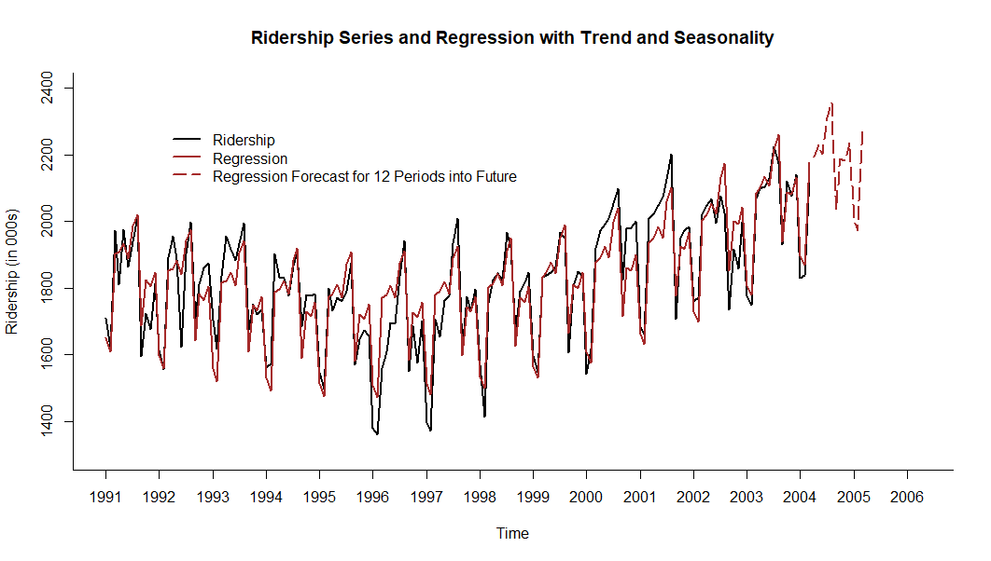
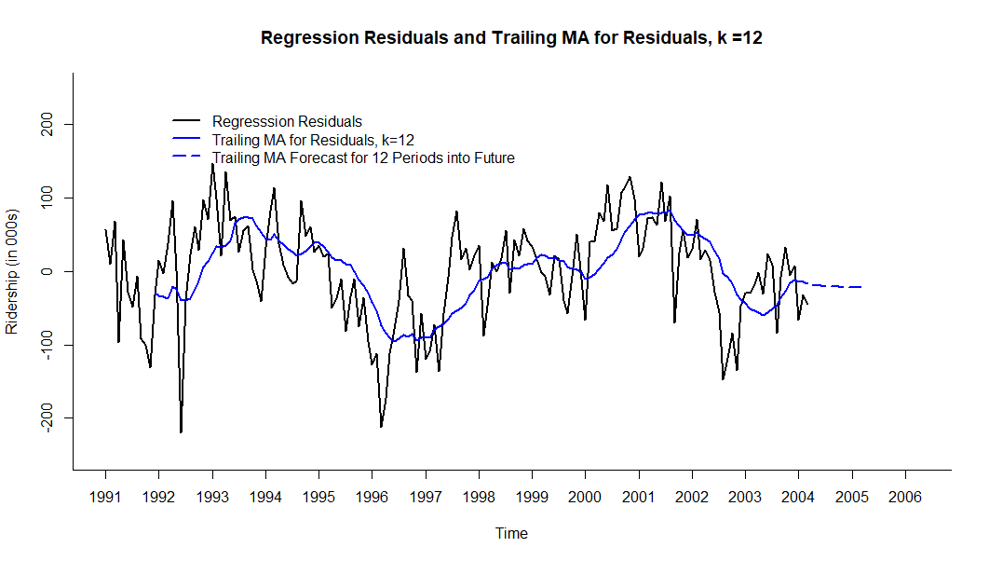
De-Trending and De-Seasonalizing Time Series

Slide 17
Regression with Quadratic Trend and Seasonality + Trailing MA of Residuals Forecast
Forecast period from 1 - April 2004 through 12 - March 2005
Forecast Trailing MA of Total
Period Regression Residuals Forecast
1 2193.895 -17.67663 2176.219
2 2230.128 -18.55946 2211.568
3 2200.795 -19.26572 2181.529
4 2311.354 -19.83073 2291.523
5 2356.100 -20.28274 2335.817
6 2036.934 -20.64435 2016.289
7 2187.264 -20.93363 2166.330
8 2181.622 -21.16506 2160.457
9 2234.274 -21.35021 2212.924
10 2000.112 -21.49832 1978.614
11 1973.018 -21.61682 1951.401
12 2280.547 -21.71161 2258.836

Slide 18
Performance Measures for Regression Forecast vs. Regression and MA Residuals Forecast in R
Regression with Quadratic Trend and Seasonality
ME RMSE MAE MPE MAPE ACF1 Theil's U
Test Set 0.690 69.375 54.761 -0.159 3.089 0.637 0.419
Regression with Quadratic Trend and Seasonality + Trailing MA of Residuals
ME RMSE MAE MPE MAPE ACF1 Theil's U
Test Set 1.235 56.880 45.501 -0.018 2.536 0.543 0.336

Slide 19
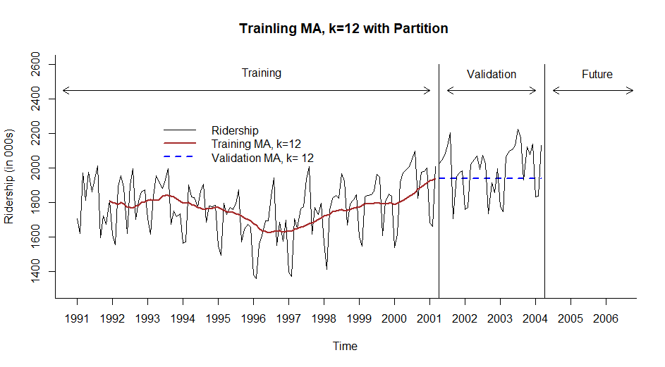
Trailing MA with Partition

Slide 20
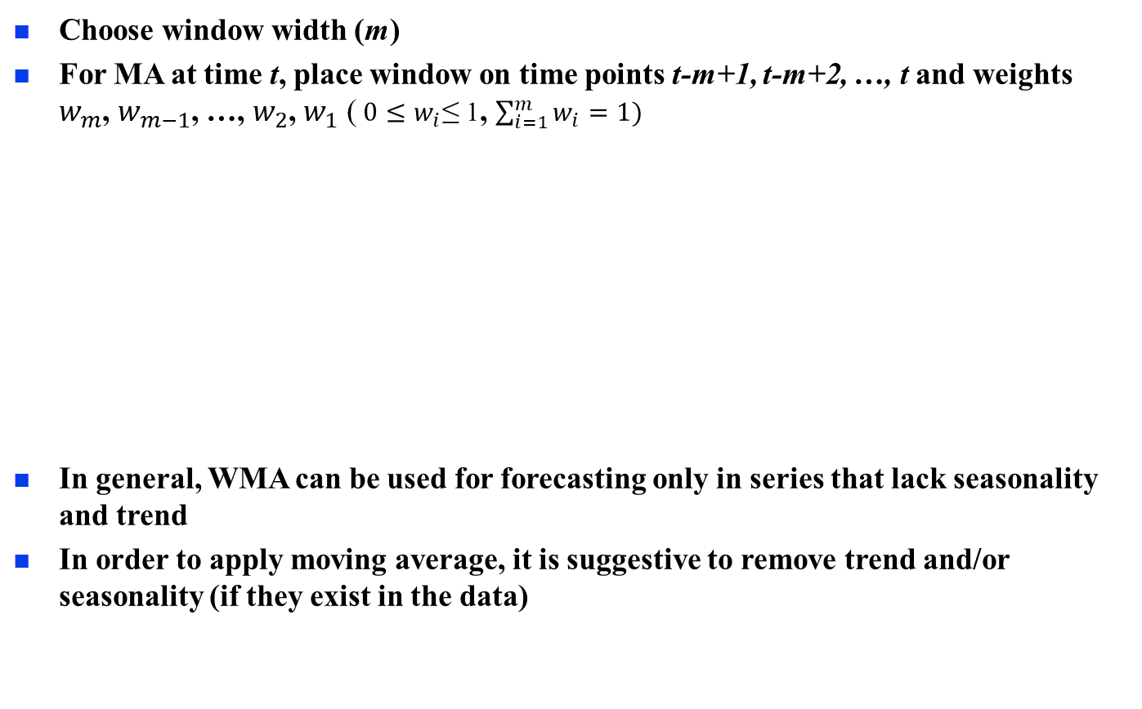
Weighted Moving Average (WMA)
0
Choose window width (m)
For MA at time t, place window on time points t-m+1, t-m+2, …, t and weights $w_{m}$, $w_{m−1}$, …, $w_{2}$, $w_{1}$ ($0≤w_{i}$≤ 1, $\sum_{i=1}^{m}{w_{i}=1)}$
In general, WMA can be used for forecasting only in series that lack seasonality and trend
In order to apply moving average, it is suggestive to remove trend and/or seasonality (if they exist in the data)
m=5
t-4 t-3 t-2 t-1 t
w₅ w₄ w₃ w₂ w₁
$WMA_{t}=$ $w_{m}y_{t−m+1}+w_{m−1}y_{t−m+2}+⋯+{w_{2}y}_{t−1}+w_{1}y_{t}$

Slide 21
Weighted MA in Excel
WMA, k = 4, WMA at 6/1991, t=6:
WMA₆ = 0.10*1972.715 + 0.20*1811.665 + 0.30*1974.964 + 0.40*1862.356 = 1897.036
WMA, k=5, WMA at 6/1991, t=6:
WMA₆ = 0.10*1620.586 + 0.10*1972.715 + 0.20*1811.665 + 0.25*1974.964 + 0.35*1862.356 = 1867.229

Slide 22
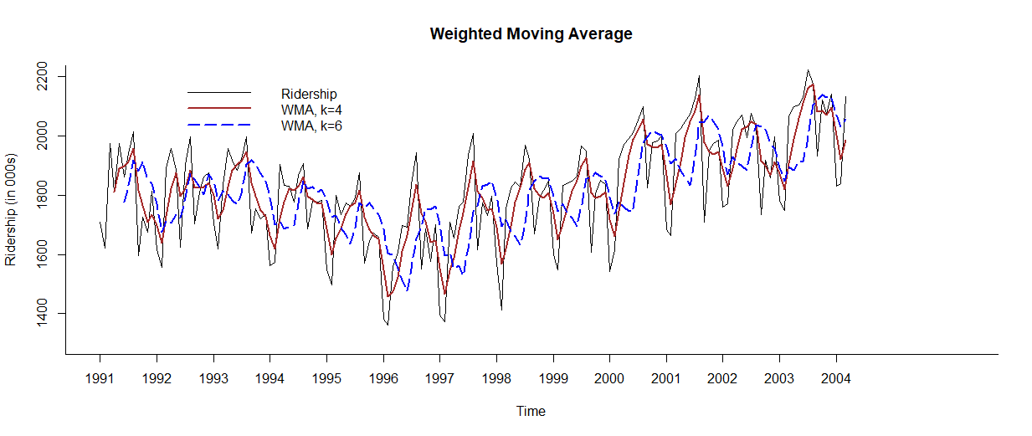
Visualizing Amtrak Ridership Data with Weighted Moving Average (WMA) in R

