Slide 1

California State University, East Bay College of Business and Economics BAN 673 Time Series Analytics
Smoothing Methods: Exponential Smoothing
Lecture Materials
Dr. Z. Radovilsky
Notes:
1
1
Developed by Dr. Zinovy Radovilsky, Professor of Management
California State University, East Bay
@All rights reserved

Slide 2
Lecture Objectives
Define simple exponential smoothing (SES), its formula and smoothing constant
Apply simple exponential smoothing in forecasting, and explain how to choose smoothing constant
Identify and apply double exponential smoothing (Holt’s model) for series with additive and multiplicative trends
Apply Winter’s (Holt-Winter’s) exponential smoothing for series with additive and multiplicative trend and seasonality
Use R to develop smoothing methods for time series forecasting and for measuring forecast accuracy
Notes:
2
2

Slide 3
Types and of Exponential Smoothing
Main types of exponential smoothing
Simple exponential smoothing (SES)
Advanced exponential smoothing (AES)
Holt’s model for data with trend
Winter’s (Holt-Winter’s) model for data with trend and seasonality
Main principles of exponential smoothing
Data-driven methods – estimate time series components (level, trend, and seasonality) directly from the data without a predetermined structure
Smooth out the noise in a series in order to uncover the data patterns
Average series values over multiple time periods with various types of smoothers, i.e., applying smoothing constants for level, trend, and seasonality

Slide 4
Simple Exponential Smoothing (SES)
Simple exponential smoothing (SES) is a popular forecasting methods.
Popularity derived from the method’s
Flexibility
Ease of automation
Cheap computation
Relatively good performance
Similar to moving average in that it averages historical data periods to smooth out noise and uncover historical data patterns
Major difference of simple exponential smoothing:
Take a weighted average of all past historical data periods, so that the weights decrease exponentially into the past
Give more weight to recent historical data periods, yet not completely ignore older historical data periods
Typically, should be used to forecasting series that has no trend and seasonality

Slide 5
Simple Exponential Smoothing (SES) Forecast
Assumption:
Typically (but not always), series has only level (L_{t}) and noise
Noise is unpredictable and level will “stay put”
Historical data is available up to period t
Forecast in period t+1
F_{t+1} = αy_{t} + (1-α)F_{t}
F_{t+k} =F_{t+1}
where α = smoothing constant (0 ≤ α≤ 1)
Initialization for the first forecast: F₁ = y₁
Why is it called “exponential smoothing”?
F_{t+1} = αy_{t} + α(1-α) y_{t-1} + α(1-α)² y_{t-2} + α(1-α)³ y_{t-3} + …
Weights decrease exponentially into the past!

Slide 6
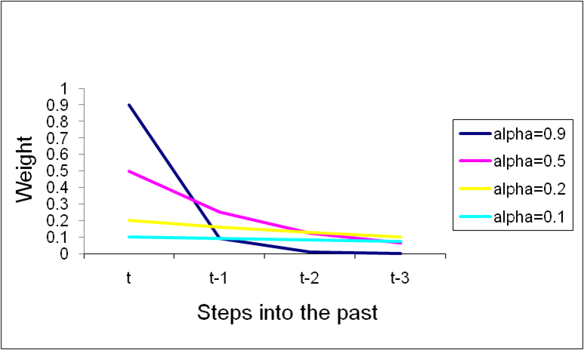
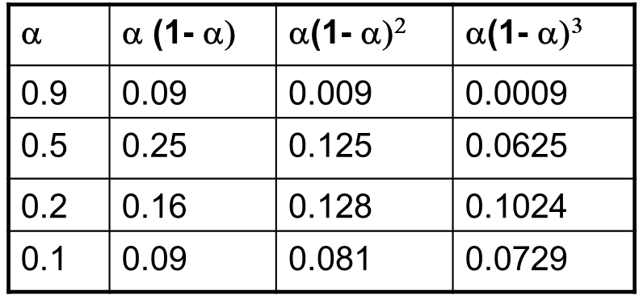
“Feeling” Effect of α
F_{t+1} = αy_{t} + α(1-α) y_{t-1} + α(1-α)² y_{t-2} + α(1-α)³ y_{t-3} + …

Slide 7
Example of SES in Excel
SES, α = 0.2, at 3/1991, t=3:
SES₃: F₃ = αy₂ + (1-α)F₂ = 0.2*1620.586 + (1-0.2)*1708.917 = 1691.251
SES, α = 0.2, at 6/1991, t=6:
SES₆: F₆ = αy₅ + (1-α)F₅ = 0.2*1974.964 + (1-0.2)*1760.368 = 1803.287

Slide 8
Choosing Smoothing Constant α
Smoothing constant determines the rate of learning and is set by user
0 ≤ α≤ 1
α→1 indicates fast learning, i.e., only the most recent values influence on the forecast – under-smoothing
α→0 indicates slow learning, i.e., past observations have large influence on the forecast – over-smoothing
Choice of α depends on the required level of smoothing and on how relevant the history is for generating forecasts
Common values α = 0.1 - 0.2
Trial and error with various α values can also help; plot and visualize various SES charts
Apply performance/accuracy measure like MAPE and RMSE to compare validation forecasts; using this just for training data can lead to model overfitting
In R, a forecast using simple exponential smoothing can be done using ets() function, which stands for error, trend, and seasonality, respectively
Utilize model = c(ANN), where A = additive error, first N = no trend, second N = no seasonality
Apply a specific α value, e.g., α = 0.2
If you choose to find the optimal value of α, then don’t apply α in the ets() function

Slide 9
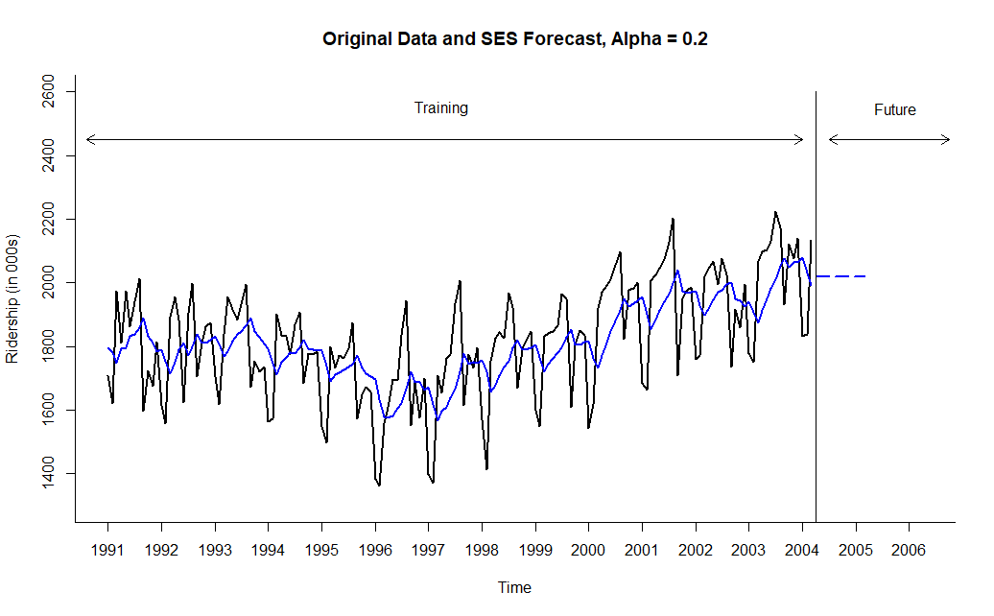
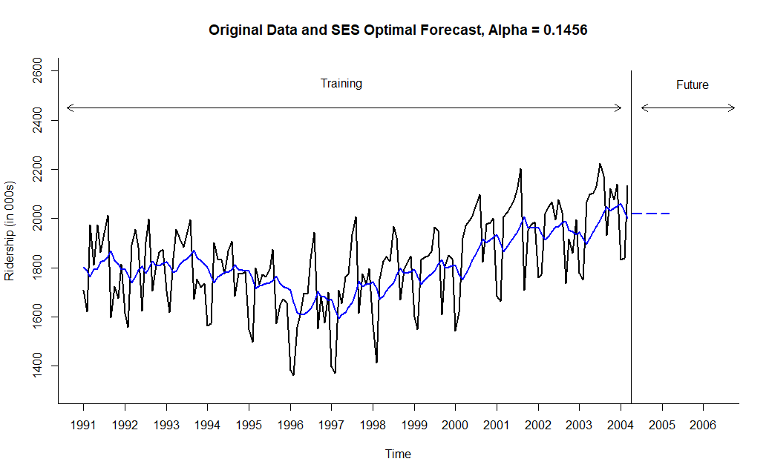
Visualizing Two SES Forecasts for Amtrak Ridership in R

Slide 10
Advanced Exponential Smoothing: Holt’s Model
Holt’s (double-exponential) smoothing is used for time series that contains trend
Idea is to augment simple exponential smoothing (SES) by capturing a trend component
Holt’s additive model: Forecast = Level (L_{t}) + Trend(T_{t})
F_{t+k} = L_{t} + k T_{t}
Level component (L_{t} ) (exponential smoothing)
L_{t} = αy_{t} + (1-α)( L_{t-1} + T_{t-1})
Trend component (T_{t}) (linear trend)
T_{t} = β (L_{t} -L_{t-1}) + (1- β) T_{t-1}
where: α = smoothing constant for exponential smoothing (0 ≤ α≤ 1)
β = smoothing constant for trend estimate (0 ≤ β ≤ 1)
k = periods to be forecasted into future
Choosing α and β
Default values, e.g., α, β = 0.1 – 0.2
Compare several Holt’s models with various α and β to identify such α and β that would minimize RMSE or MAPE for training set
Overfitting may be a problem
What to do: make sure chosen values are reasonable

Slide 11
Holt’s Model (continued)
Holt’s multiplicative model: Forecast = Level (L_{t}) × Trend(T_{t})
F_{t+k} = L_{t} × T_{t}^{k}
L_{t} = αy_{t} + (1-α)( L_{t-1} × T_{t-1})
T_{t} = β (L_{t} / L_{t-1}) + (1- β) T_{t-1}
where: α = smoothing constant for exponential smoothing (0 ≤ α≤ 1)
β = smoothing constant for trend estimate (0 ≤ β ≤ 1)
k = periods to be forecasted into future
Additive and multiplicative Holt’s models can apply two types of errors
Additive errors –assume that errors (e_{t}) have a fixed magnitude irrespective of the current level + trend of the series
F_{t+1} = L_{t} + T_{t} + e_{t}
Multiplicative errors – assume that errors (e_{t}) grow as the level of series increases (can be a more reasonable assumption)
F_{t+1} = (L_{t} + T_{t} )×(1 + e_{t})
In R, identify a specific model by using in ets() function parameter: model = c(Z, Z, Z)
First Z can be equal to A (additive) or M (multiplicative) error
Second Z can be equal to A (additive) or M (multiplicative) trend
Example: model = c(A,A,N), where A = additive error, A = additive trend, and N = no seasonality

Slide 12
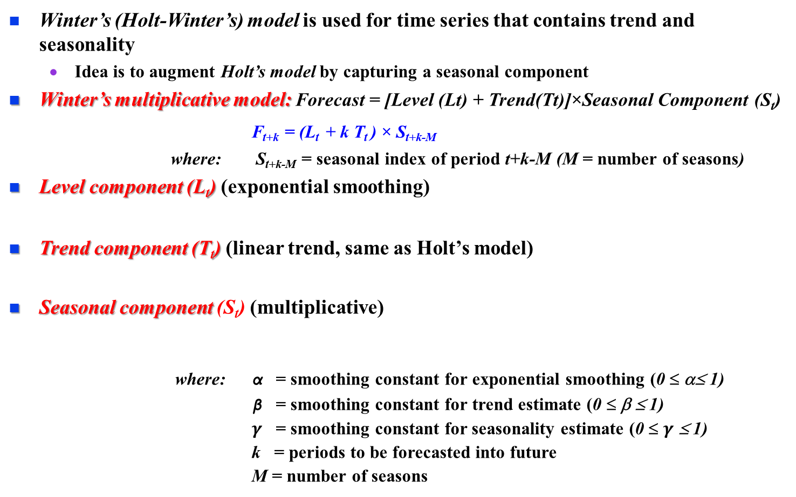


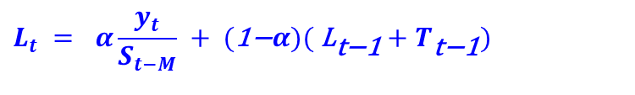
Advanced Exponential Smoothing: Winter’s Model
Winter’s (Holt-Winter’s) model is used for time series that contains trend and seasonality
Idea is to augment Holt’s model by capturing a seasonal component
Winter’s multiplicative model: Forecast = [Level (Lt) + Trend(Tt)]×Seasonal Component (S_{t})
F_{t+k} = (L_{t} + k T_{t} ) × S_{t+k-M}
where: S_{t+k-M} = seasonal index of period t+k-M (M = number of seasons)
Level component (L_{t}) (exponential smoothing)
Trend component (T_{t}) (linear trend, same as Holt’s model)
Seasonal component (S_{t}) (multiplicative)
where: α = smoothing constant for exponential smoothing (0 ≤ α≤ 1)
β = smoothing constant for trend estimate (0 ≤ β ≤ 1)
$γ$ = smoothing constant for seasonality estimate (0 ≤ $γ$ ≤ 1)
k = periods to be forecasted into future
M = number of seasons
$$L_{t} = α\frac{y_{t}}{S_{t−M}} + (\text{1−}α)( {\text{L}}_{\text{t}\text{−1}}+T_{\text{t}\text{−1}})$$
$$T_{t} = β( {\text{L}}_{t}−L_{\text{t}\text{−1}}) + (\text{1−}β) {\text{T}}_{\text{t}\text{−1}}$$
$$S_{t} = γ\frac{y_{t}}{L_{t}} + (\text{1−}γ) {\text{S}}_{\text{t}\text{−}\text{M}}$$

Slide 13
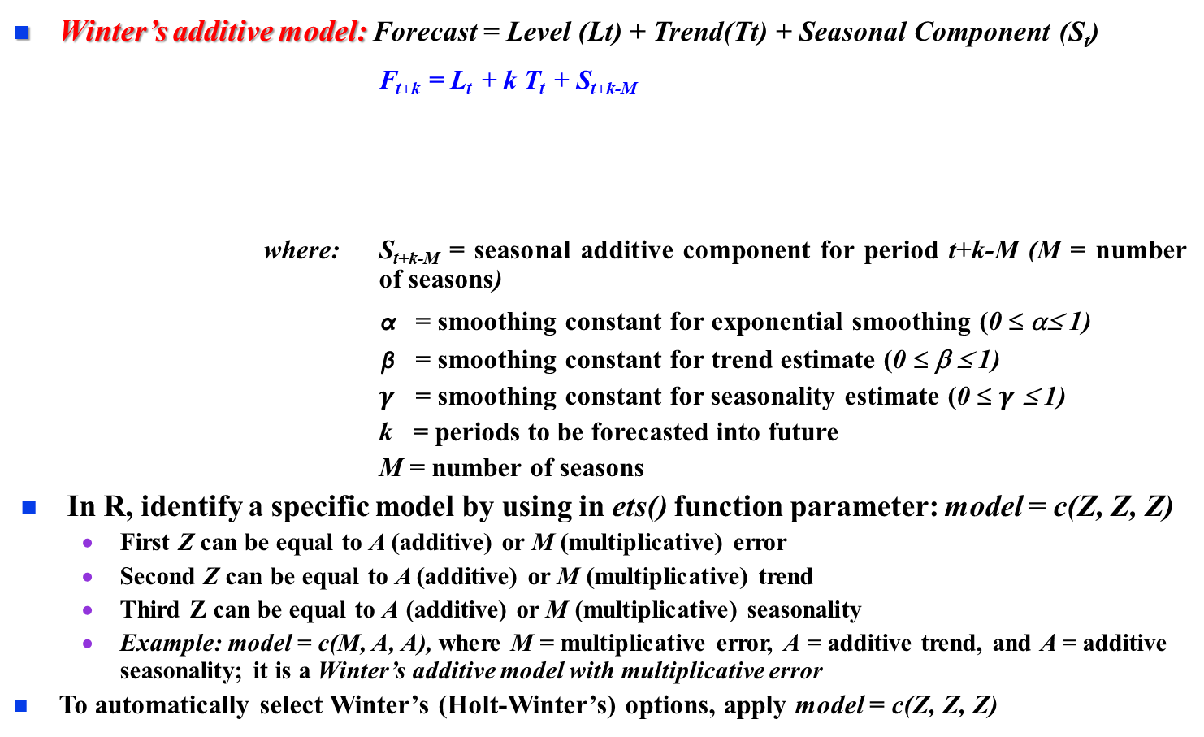


Winter’s Model (continued)
Winter’s additive model: Forecast = Level (Lt) + Trend(Tt) + Seasonal Component (S_{t})
F_{t+k} = L_{t} + k T_{t} + S_{t+k-M}
where: S_{t+k-M} = seasonal additive component for period t+k-M (M = number of seasons)
α = smoothing constant for exponential smoothing (0 ≤ α≤ 1)
β = smoothing constant for trend estimate (0 ≤ β ≤ 1)
$γ$ = smoothing constant for seasonality estimate (0 ≤ $γ$ ≤ 1)
k = periods to be forecasted into future
M = number of seasons
In R, identify a specific model by using in ets() function parameter: model = c(Z, Z, Z)
First Z can be equal to A (additive) or M (multiplicative) error
Second Z can be equal to A (additive) or M (multiplicative) trend
Third Z can be equal to A (additive) or M (multiplicative) seasonality
Example: model = c(M, A, A), where M = multiplicative error, A = additive trend, and A = additive seasonality; it is a Winter’s additive model with multiplicative error
To automatically select Winter’s (Holt-Winter’s) options, apply model = c(Z, Z, Z)
$$L_{t} = α(y_{t}−S_{t−M})+ (\text{1−}α)( {\text{L}}_{\text{t}\text{−1}}+T_{\text{t}\text{−1}})$$
$$T_{t} = β( {\text{L}}_{t}−L_{\text{t}\text{−1}}) + (\text{1−}β) {\text{T}}_{\text{t}\text{−1}}$$
$$S_{t} = γ(y_{t}−L_{t})+ (\text{1−}γ) {\text{S}}_{\text{t}\text{−}\text{M}}$$

Slide 14
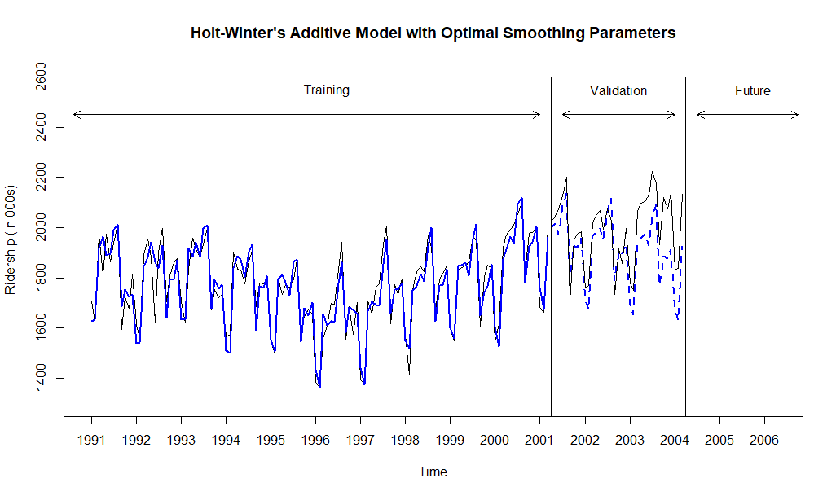
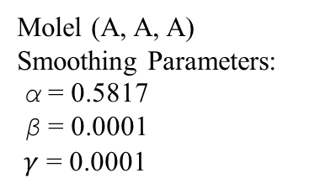
Visualizing Ridership Data with Holt-Winter’s Additive Model and Optimal Smoothing in R
Molel (A, A, A)
Smoothing Parameters:
α = 0.5817
β = 0.0001
$γ$ = 0.0001

Slide 15
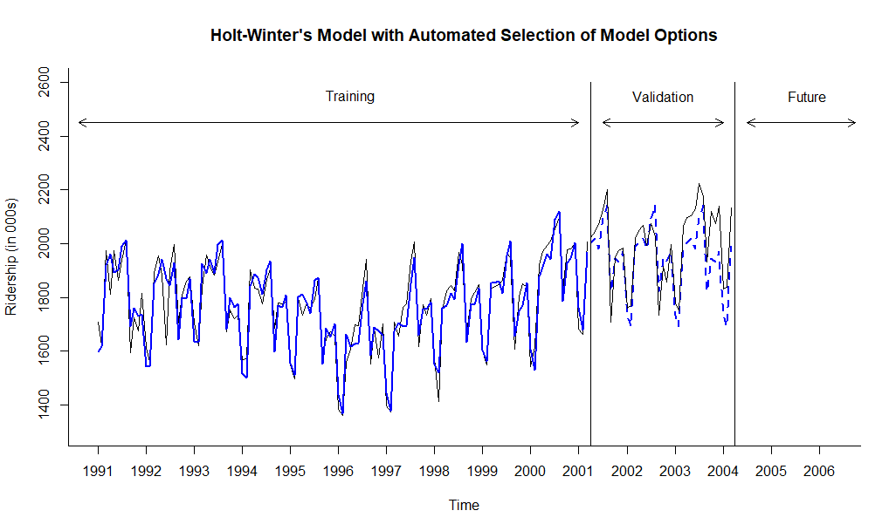
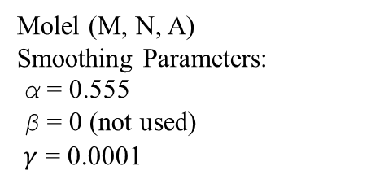
Visualizing Ridership Data with Holt-Winter’s Model - Automated Selection of Model Options
Molel (M, N, A)
Smoothing Parameters:
α = 0.555
β = 0 (not used)
$γ$ = 0.0001

Slide 16
Performance Measures of SES and Holt-Winter’s Models Using Accuracy Function in R
SES, α = 0.2
ME RMSE MAE MPE MAPE MASE ACF1 Theil's U
Test Set 108.531 178.721 160.457 4.941 7.896 1.945 0.276 1.014
HW Additive Model with Optimal Parameters
ME RMSE MAE MPE MAPE MASE ACF1 Theil's U
Test Set 82.393 118.670 98.337 4.031 4.906 1.192 0.720 0.690
HW Model with Automated Selection of Model Options
ME RMSE MAE MPE MAPE MASE ACF1 Theil's U
Test Set 49.727 88.628 73.964 2.391 3.707 0.897 0.654 0.514

Slide 17
Forecasting for Future Periods
Before attempting to forecast future values of the series, the training and validation periods must be recombined into one (entire) time series dataset
The chosen model, e.g., Holt-Winter’s (HW) model with automated selection of model options, needs to be rerun on the entire (complete) dataset
Measure model performance vs. original data using accuracy measure like MAPE, RMSE and others
The new forecasting model, based on the entire dataset, can be now used for forecasting future periods

Slide 18
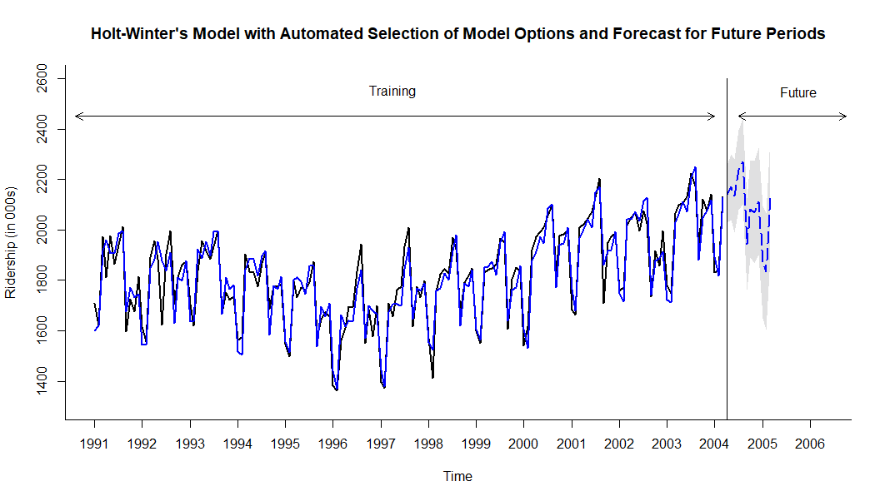
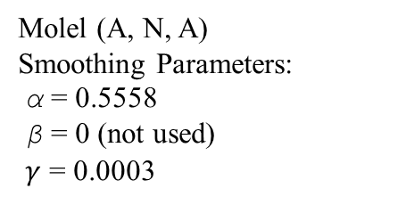
Holt-Winter’s Model with Automated Selection of Model Options and Forecast for Future Periods
Molel (A, N, A)
Smoothing Parameters:
α = 0.5558
β = 0 (not used)
$γ$ = 0.0003

Slide 19
Performance Measures of Holt-Winter’s Model with Entire Dataset Using Accuracy Function in R
HW Model with Automated Selection of Model Options for Entire Dataset
ME RMSE MAE MPE MAPE ACF1 Theil's U
Test Set 3.081 55.645 43.609 0.090 2.436 0.050 0.320

