Slide 1

California State University, East Bay College of Business and Economics BAN 673 Time Series Analytics
Regression-Based Models
Lecture Materials
Dr. Z. Radovilsky
Notes:
1
1
Developed by Dr. Zinovy Radovilsky, Professor of Management
California State University, East Bay
@All rights reserved

Slide 2
Lecture Objectives
Define regression-based methods in time-series forecasting and their benefits
Capture linear and non-linear trend with regression-based models
Apply regression models with seasonality in time series forecasting
Utilize regression models with both trend and seasonality in time series forecasting
Use R to develop regression methods for time series forecasting
Notes:
2
2

Slide 3
Define Smoothing Methods
Regression-based methods is a family of time series models based on mostly simple and multiple linear regression models as well as non-linear regression models
Regression-based models can be used for:
Fitting a trend component – linear, exponential, polynomial, etc.
Fitting a seasonal component – additive or multiplicative
Fitting trend + seasonal components
Capturing special events – e.g., holidays, energy demand spikes, etc.
Capturing period-to-period correlation – autoregressive models
Regression methods are useful for
Data visualization
Multi-period forecasting

Slide 4
Model 1: Regression Model with Linear Trend
Linear trend – used to fit a global trend that applies to the entire time series and will apply in the forecasting period
Means that values of series increase or decrease linearly over time
Output variable y_{t} is set a time series measurement, e.g., Amtrak ridership number
Predictor x is set as time period index t, t = 1, 2, 3, …
y_{t} = β₀ + β₁ t + ε
Multiple R-squared: 0.006125, Adjusted R-squared: -0.002089
F-statistic: 0.7456 on 1 and 121 DF, p-value: 0.3896
y_{t} = 1750.36 + 0.35 t
The regression equation is not statistically significant
Indicate that the trend is not linear
tslm(formula = train.ts ~ trend)
Coefficients:
Estimate Std. Error t value Pr(>|t|)
(Intercept) 1750.3595 29.0729 60.206 <2e-16 ***
trend 0.3514 0.4069 0.864 0.39

Slide 5
Regression with Linear Trend in Excel

Slide 6
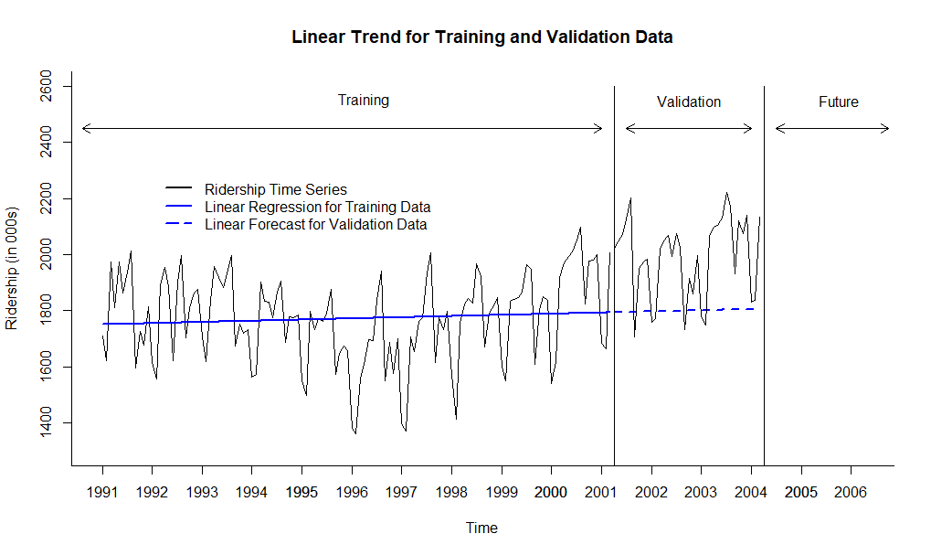
Visualizing Amtrak Ridership Data with Linear Trend in R

Slide 7
Model 2: Regression Model with Exponential Trend
0
Exponential trend implies multiplicative increase/decrease of the series over time; also means a percentage of growth from period to period (e.g., month)
y_{t} = α e ^{β t +} ^{ε}
To fit exponential trend, replace the output variable with log(y) (in this case, natural logarithm of y) and fit a linear regression:
log(y_{t} ) = β₀ + β₁ t + ε (β₀ = log(α); β₁ = β)
log(y_{t} ) = 7.46 + 0.00018 t
y_{t} = 1737.15 e ^{0.00018 t}
The exponential model has a very slow growth (small percentage of monthly growth)
tslm(formula = train.ts ~ trend, lambda = 0)
Coefficients:
Estimate Std. Error t value Pr(>|t|)
(Intercept) 7.4646979 0.0168680 442.535 <2e-16 ***
trend 0.0001783 0.0002361 0.755 0.451
Multiple R-squared: 0.004694, Adjusted R-squared: -0.003532
F-statistic: 0.5707 on 1 and 121 DF, p-value: 0.4515

Slide 8
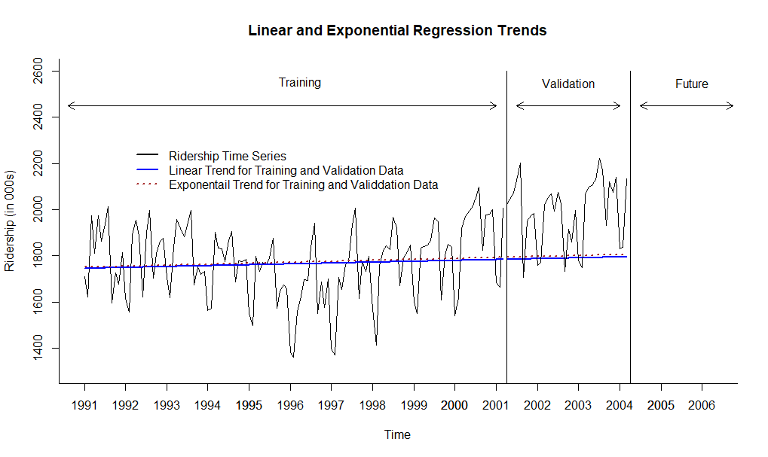
Visualizing Amtrak Ridership Data with Linear and Exponential Trends in R

Slide 9
Model 3: Regression Model with Quadratic (Polynomial) Trend
0
Quadratic trend (order 2 polynomial trend)
Fit order 2 polynomial regression with y_{t} as output, and t and t² as predictors y_{t} = β₀ + β₁ t + β₂ t² + ε
tslm(formula = train.ts ~ trend + I(trend^2))
Coefficients:
Estimate Std. Error t value Pr(>|t|)
(Intercept) 1888.88401 40.91521 46.166 < 2e-16 ***
trend -6.29780 1.52327 -4.134 6.63e-05 ***
I(trend^2) 0.05362 0.01190 4.506 1.55e-05 ***
Multiple R-squared: 0.1499, Adjusted R-squared: 0.1358
F-statistic: 10.58 on 2 and 120 DF, p-value: 5.844e-05
y_{t} = 1888.88 – 6.30 t + 0.05 t²
Hard to interpret coefficients of polynomial trend
Try to apply a polynomial trend with least order

Slide 10
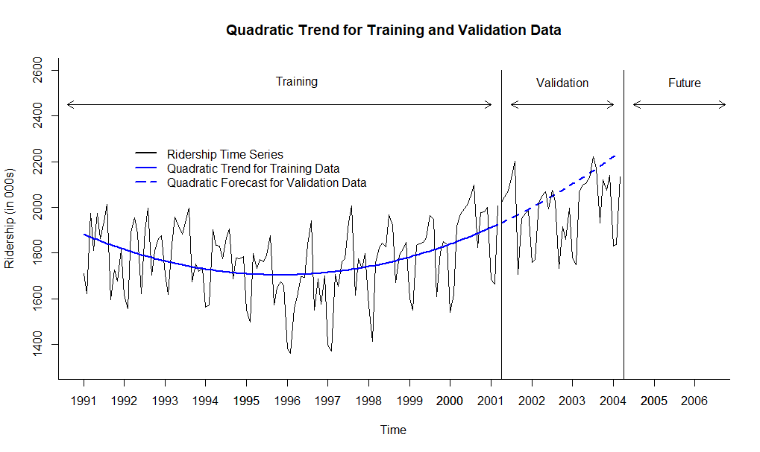
Visualizing Amtrak Ridership Data with Quadratic Trend in R

Slide 11
Model 4: Regression Model with Seasonality
0
Regression model with seasonality fits a series that falls into some seasonal pattern
The most common way to capture seasonality in a regression model is to create a new categorical variable that describes season for each observation, e.g., Jan, Feb, Mar, etc. for monthly data
In R, to define these categorical variables numerically, apply binary (dummy) variables starting from February :
D₂ =
D₃ =
………………………………..
D₁₂ =
If all D_{i} = 0 (i = 2, 3, …, 12), then it is January
For K seasons, need maximum of K -1 dummy variables
y_{t} = β₀ + β₁ D₂ + β₂ D₃+… + β₁₁ D₁₂ + ε

Slide 12
Model 4 with Seasonality: Output in R
tslm(formula = train.ts ~ season)
Coefficients:
Estimate Std. Error t value Pr(>|t|)
(Intercept) 1573.97 30.58 51.475 < 2e-16 ***
season2 -42.93 43.24 -0.993 0.3230
season3 260.77 43.24 6.030 2.19e-08 ***
season4 245.09 44.31 5.531 2.14e-07 ***
season5 278.22 44.31 6.279 6.81e-09 ***
season6 233.46 44.31 5.269 6.82e-07 ***
season7 345.33 44.31 7.793 3.79e-12 ***
season8 396.66 44.31 8.952 9.19e-15 ***
season9 75.76 44.31 1.710 0.0901 .
season10 200.61 44.31 4.527 1.51e-05 ***
season11 192.36 44.31 4.341 3.14e-05 ***
season12 230.42 44.31 5.200 9.18e-07 ***
Multiple R-squared: 0.6348, Adjusted R-squared: 0.5986
F-statistic: 17.54 on 11 and 111 DF, p-value: < 2.2e-16
y_{t} = 1573.97 - 42.93 D₂ + 260.77 D₃ +… + 230.42 D₁₂

Slide 13
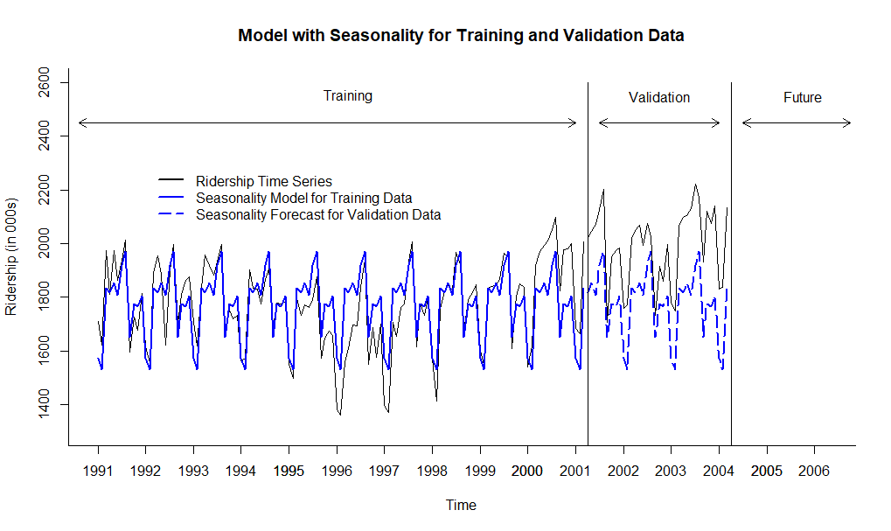
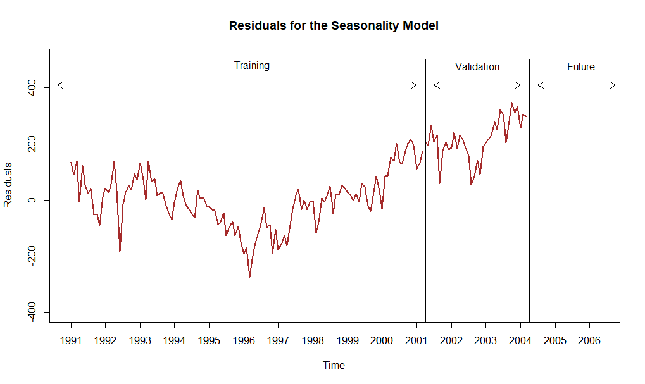
Visualizing Amtrak Ridership Data with Seasonality Model and Residuals in R

Slide 14
Model 5: Regression Model with Quadratic Trend and Seasonality
Assuming that the historical data has a non-linear trend (some form of a quadratic trend) and monthly seasonality, we can combine both patterns in one forecasting model
y_{t} = β₀+ β₁ t +β₂ t² + β₃ D₂ + β₄ D₃ + … + β₁₃ D₁₂+ ε
Additive model with quadratic trend and monthly seasonality

Slide 15
Model 5 with Quadratic Trend and Seasonality: Output in R
tslm(formula = train.ts ~ trend + I(trend^2) + season)
Coefficients:
Estimate Std. Error t value Pr(>|t|)
(Intercept) 1.697e+03 2.768e+01 61.318 < 2e-16 ***
trend -7.156e+00 7.293e-01 -9.812 < 2e-16 ***
I(trend^2) 6.074e-02 5.698e-03 10.660 < 2e-16 ***
season2 -4.325e+01 3.024e+01 -1.430 0.15556
season3 2.600e+02 3.024e+01 8.598 6.60e-14 ***
season4 2.606e+02 3.102e+01 8.401 1.83e-13 ***
season5 2.938e+02 3.102e+01 9.471 6.89e-16 ***
season6 2.490e+02 3.102e+01 8.026 1.26e-12 ***
season7 3.606e+02 3.102e+01 11.626 < 2e-16 ***
season8 4.117e+02 3.102e+01 13.270 < 2e-16 ***
season9 9.032e+01 3.102e+01 2.911 0.00437 **
season10 2.146e+02 3.102e+01 6.917 3.29e-10 ***
season11 2.057e+02 3.103e+01 6.629 1.34e-09 ***
season12 2.429e+02 3.103e+01 7.829 3.44e-12 ***
Multiple R-squared: 0.8246, Adjusted R-squared: 0.8037
F-statistic: 39.42 on 13 and 109 DF, p-value: < 2.2e-16
y_{t} = 1697.00 − 7.16 t + 0.06 t² − 43.25 D₂ + 260.00 D₃ +… + 242.90 D₁₂

Slide 16
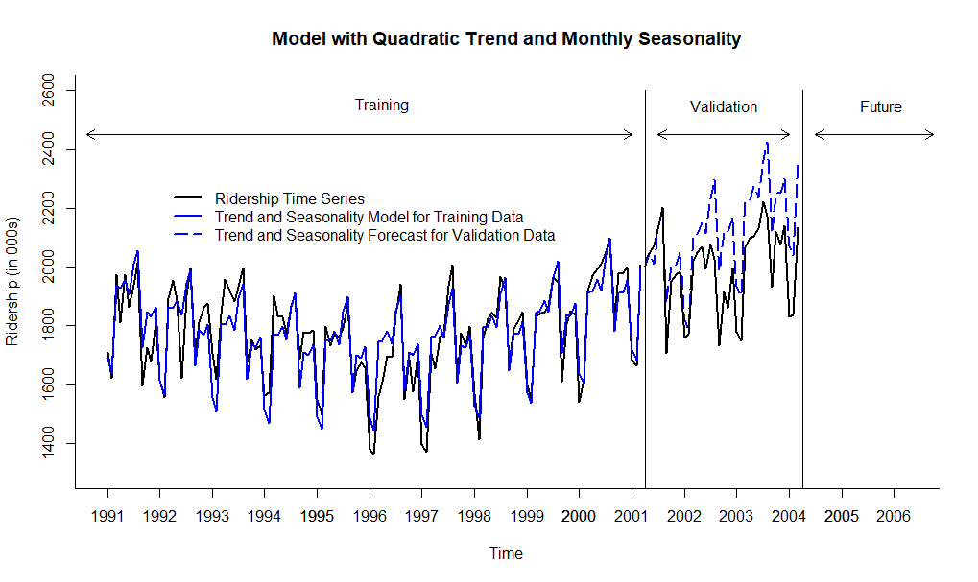
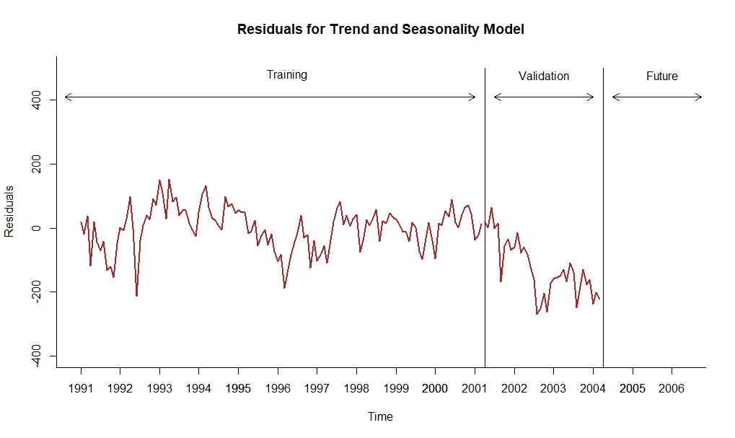
Visualizing Amtrak Ridership Data with Trend and Seasonality Model and Residuals in R

Slide 17
Performance Measures Using Accuracy Function for Validation Data in R
Model with Quadratic
Trend (Model 3)
ME RMSE MAE MPE MAPE
Test Set -83.962 179.849 133.738 -4.725 7.076
Model with Seasonality
(Model 4)
ME RMSE MAE MPE MAPE
Test Set 217.927 229.651 217.927 10.865 10.865
Model with Quadratic Trend and Seasonality (Model 5)
ME RMSE MAE MPE MAPE
Test Set -126.165 153.251 131.725 -6.431 6.669

Slide 18
Forecasting for Future Periods
Before attempting to forecast future values of the series, the training and validation periods must be recombined into one (entire) time series dataset
The chosen model, e.g., quadratic trend and monthly seasonality, needs to be rerun on the entire (complete) dataset
Measure model performance vs. original data using accuracy measure like MAPE, RMSE and others
The new forecasting model, based on the entire dataset, can be now used for forecasting future periods

Slide 19
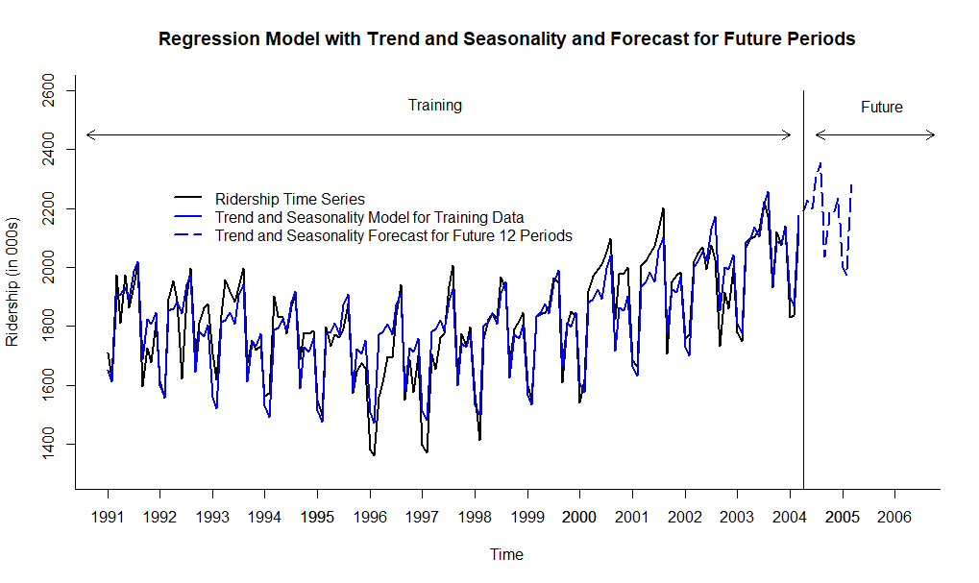
Regression Model with Quadratic Trend and Monthly Seasonality and Future Forecast
y_{t} = 1656 − 4.940 t + 0.04127 t² − 36.14 D₂ + 262.3 D₃ +… + 243.1 D₁₂

Slide 20
Performance Measures of Regression with Quadratic Trend and Seasonality Forecast vs. Naïve and Seasonal Naïve Forecasts
Regression Model with Quadratic Trend and Seasonality for Entire Data Set
ME RMSE MAE MPE MAPE
Test Set 0 69.375 54.761 -0.159 3.089
Naïve Model Forecast for Entire Data Set
ME RMSE MAE MPE MAPE
Test Set 2.681 168.381 123.96 -0.318 7.029
Seasonal Naïve Model Forecast for Entire Data Set
ME RMSE MAE MPE MAPE
Test Set 21.009 99.007 81.508 0.941 4.517

