Slide 1

California State University, East Bay College of Business and Economics BAN 673 Time Series Analytics
Autocorrelation and Autoregressive Models
Lecture Materials
Dr. Z. Radovilsky
Notes:
1
1
Developed by Dr. Zinovy Radovilsky, Professor of Management
California State University, East Bay
@All rights reserved

Slide 2
Lecture Objectives
Apply autocorrelation for time series and forecast residuals
Identify and explain autoregressive (AR) models in time series analytics
Utilize one-level and two-level autoregressive models
Apply autoregressive models to identify predictability of time series
Use R to develop autocorrelation and autoregressive models for time series forecasting
Notes:
2
2

Slide 3
Why Use Autocorrelation?
In cross-sectional data, the assumption is that a response variable and predictors don’t have correlation between successive records
In time series data, values in neighboring periods tend to be correlated
Referred to as autocorrelation
Time series regression model can account for trend and seasonal patterns
However, regression model may not account for autocorrelation
Autocorrelation is informative
Positive or negative, strong in certain lags (first lag or seasonal lags)
Contains useful information that can be used to improve forecasting

Slide 4
Autocorrelation
Autocorrelation measures how strong the values of a time series are related to their own past values
Technically: compute the correlation between the series and the lagged series (approximately)
Lag(1) autocorrelation = correlation between (y₁, y_{2,} …, y_{t-1} ) and (y₂, y₃, …, y_{t})
Lag(k) autocorrelation = correlation between (y₁, y_{2,} …, y_{t-k}) and (y_{k+1}, y_{k+2}, …, y_{t})
Use of autocorrelation
Check time series forecast residuals for independence (or dependence)
Model remaining information (residuals), in particular, if residual dependency exists
Evaluate predictability, i.e., whether the series is a “random walk” or can be predictable

Slide 5
Autocorrelation (cont.)
Autocorrelation coefficient r_{k} is a measure of autocorrelation between a variable itself and the same variable lagged k periods:
where
r_{k} = autocorrelation coefficient for a lag of k periods
= mean of the values of the series
Y_{t}= observation in time period t
Y_{t-k} = observation k time periods earlier or at time period t-k
If a time series is random, the autocorrelations for any lag are close to zero
The successive values of a time series are not related to each other

Slide 6
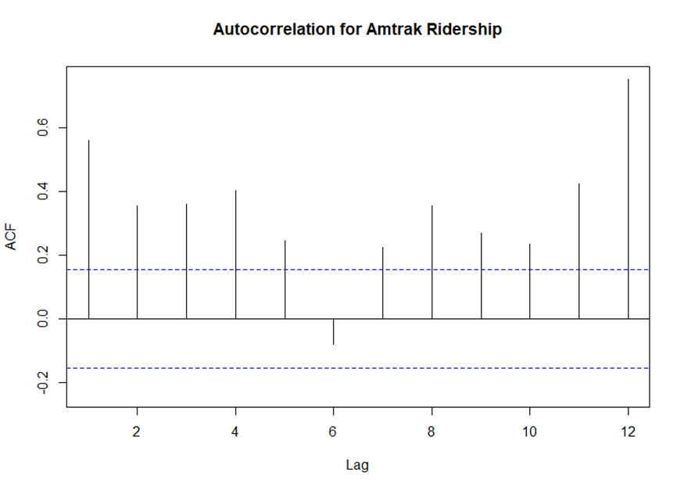
Autocorrelation Function (ACF) in R
Autocorrelation function (ACF) identifies and plots multiple autocorrelation coefficients for various lags of a time series data
It also calculates and plots interval (horizontal lines) to identify significant autocorrelation

Slide 7
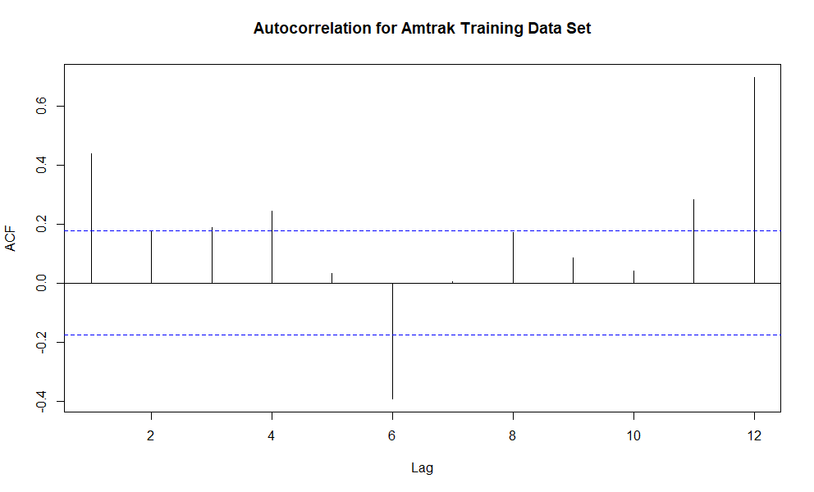
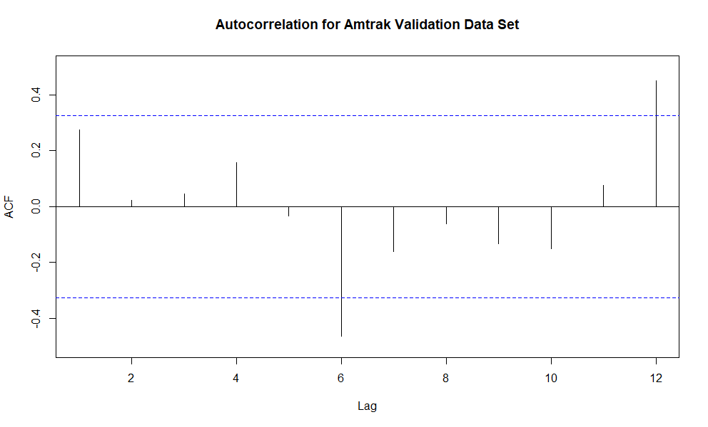
Autocorrelation for Training and Validation Data Sets

Slide 8
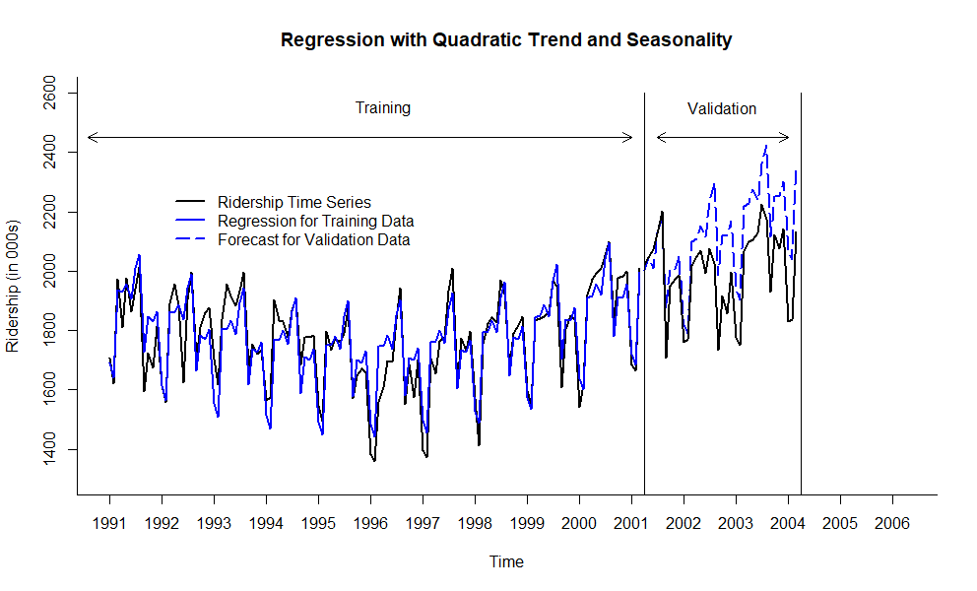
Regression with Quadratic Trend and Seasonality for Training Data Set
Call:
tslm(formula = ridership.ts ~ trend + I(trend^2) + season)
Residuals:
Min 1Q Median 3Q Max
-213.775 -39.363 9.711 42.422 152.187
Coefficients:
Estimate Std. Error t value Pr(>|t|)
(Intercept) 1.697e+03 2.768e+01 61.318 < 2e-16 ***
trend -7.156e+00 7.293e-01 -9.812 < 2e-16 ***
I(trend^2) 6.074e-02 5.698e-03 10.660 < 2e-16 ***
season2 -4.325e+01 3.024e+01 -1.430 0.15556
season3 2.600e+02 3.024e+01 8.598 6.60e-14 ***
season4 2.606e+02 3.102e+01 8.401 1.83e-13 ***
season5 2.938e+02 3.102e+01 9.471 6.89e-16 ***
season6 2.490e+02 3.102e+01 8.026 1.26e-12 ***
season7 3.606e+02 3.102e+01 11.626 < 2e-16 ***
season8 4.117e+02 3.102e+01 13.270 < 2e-16 ***
season9 9.032e+01 3.102e+01 2.911 0.00437 **
season10 2.146e+02 3.102e+01 6.917 3.29e-10 ***
season11 2.057e+02 3.103e+01 6.629 1.34e-09 ***
season12 2.429e+02 3.103e+01 7.829 3.44e-12 ***
---
Signif. codes: 0 ‘***’ 0.001 ‘**’ 0.01 ‘*’ 0.05 ‘.’ 0.1 ‘ ’ 1
Residual standard error: 70.92 on 109 degrees of freedom
Multiple R-squared: 0.8246, Adjusted R-squared: 0.8037
F-statistic: 39.42 on 13 and 109 DF, p-value: < 2.2e-16

Slide 9
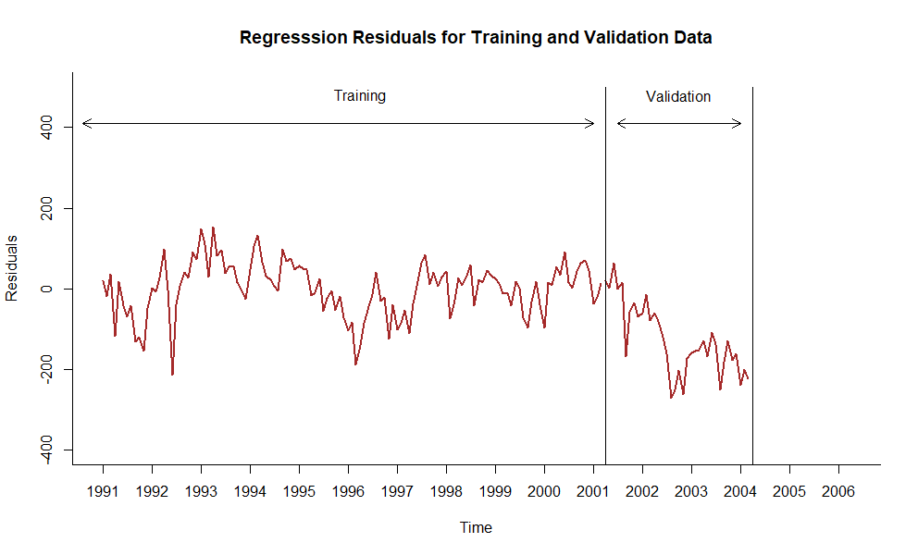
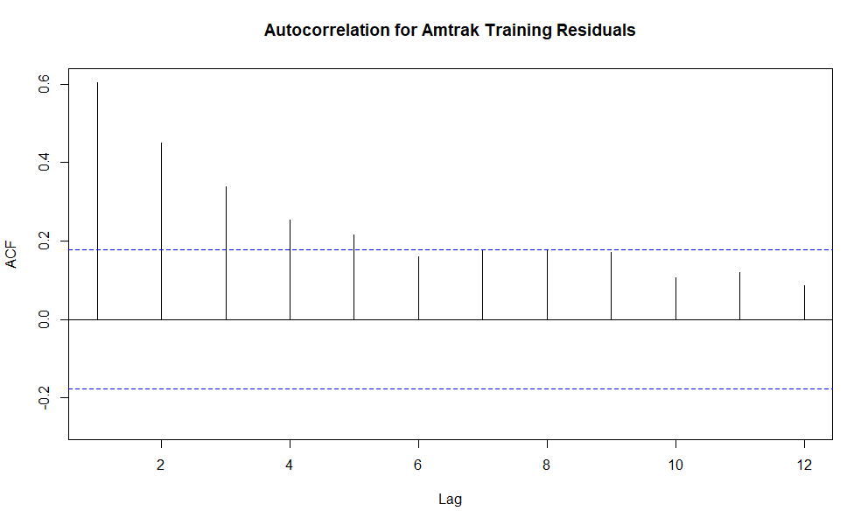
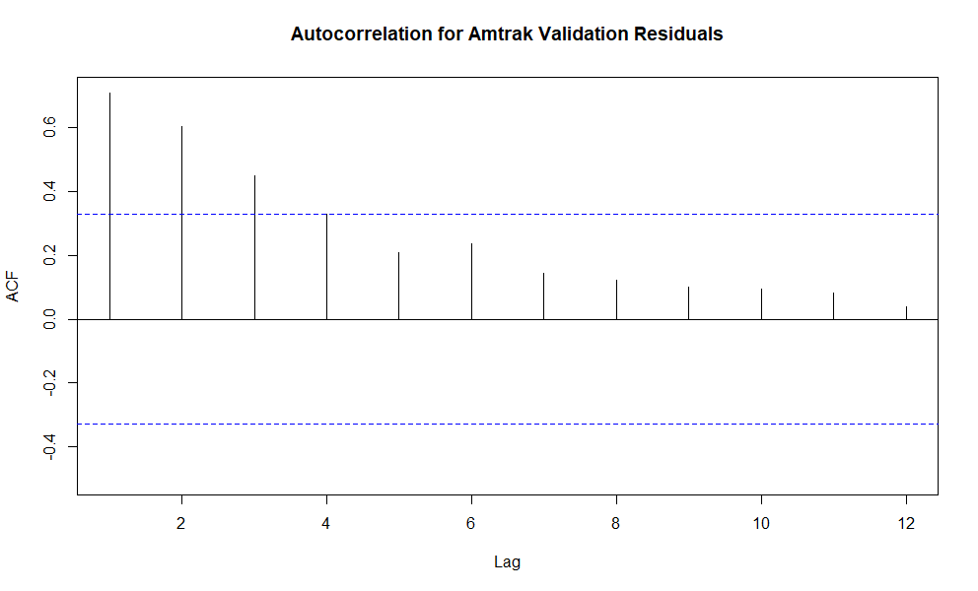
Examine Residuals of Regression Model

Slide 10
Model Relationships Identified by Autocorrelation: Autoregressive (AR) Model
Autoregressive model (AR) idea: model the autocorrelation directly in regression model, using past observations as predictors
Similar to linear regression models, except that the predictors are the past values of the series
AR model of order 1:
Y_{t} = α + β₁Y_{t-1} + ε_{t}
AR model of order 2:
Y_{t} = α + β₁Y_{t-1} + β₂Y_{t-2} + ε_{t}
Two approaches in using AR models
Two-level modeling with AR model
Use any method to generate forecasts (regression, smoothing)
Examine forecast residual series for autocorrelation by utilizing time plot of forecast residuals and ACF function plot
If autocorrelation of residuals exists, fit AR model to forecast residual series
Direct AR model
Fit AR model directly into original series by using an ARIMA model

Slide 11
Two-Level Modeling with AR
Generate k-step ahead forecast of the series, F_{t+k} ,using the identified forecasting method (regression, Holt-Winter’s model, etc.)
Generate k-step ahead forecast of residual s(errors), e_{t+k} , using AR model
Typically, when autocorrelation at lag-1 exist and high, it is sufficient to fit an AR(1) model of the form:
e_{t} = α + β₁e_{t-1} + ε_{t}
Improve the initial k-step ahead forecast of the time series by adjusting it according to its forecasted residual
Improved forecast F*_{t+k} :
F*_{t+k} = F_{t+k} + e_{t+k}

Slide 12
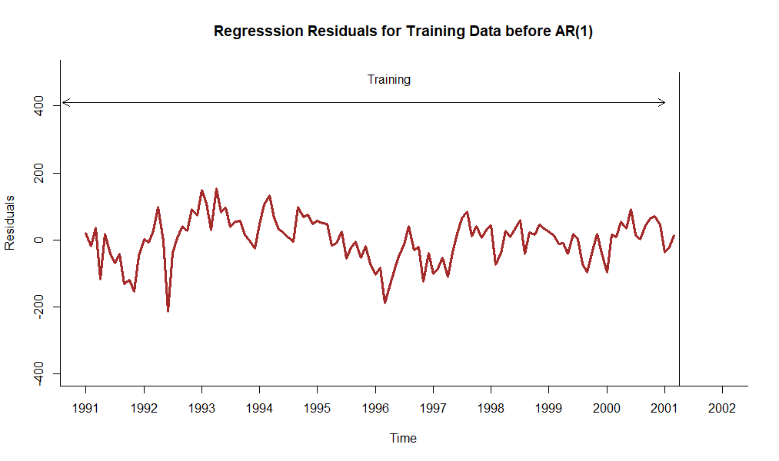
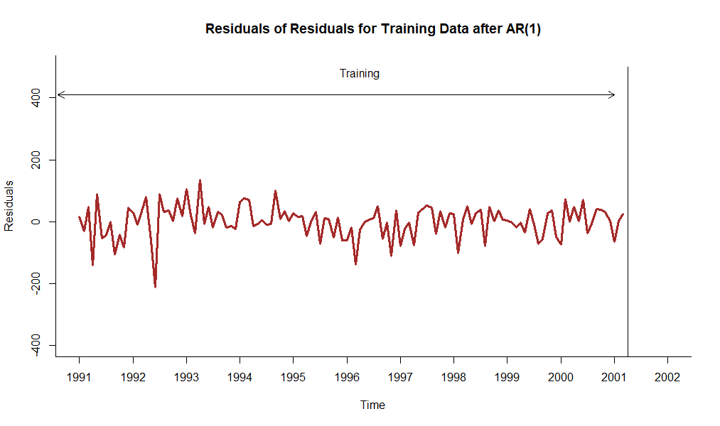
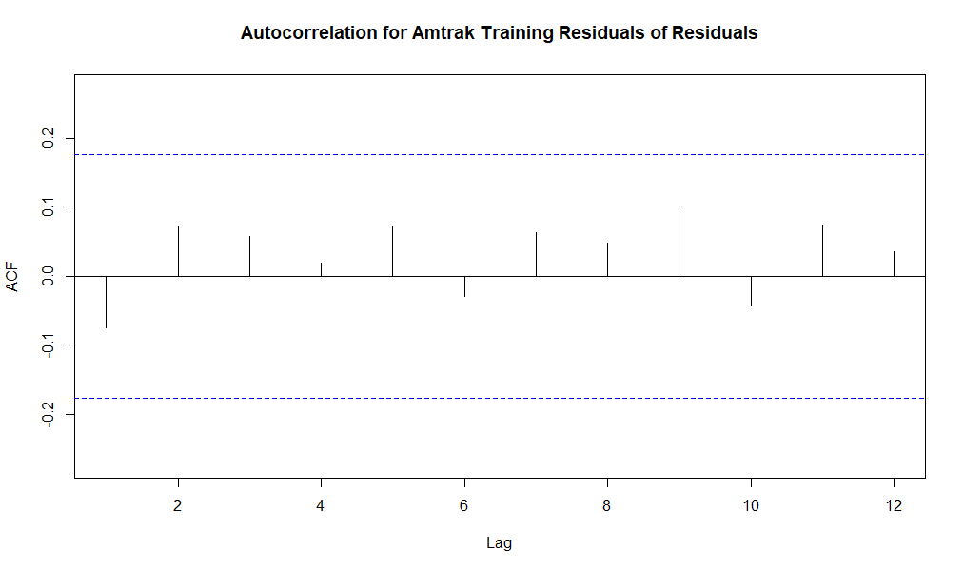
Regression Residuals and Residuals of Residuals with AR(1) Model

Slide 13
Results of Two-Level Modeling with AR(1) Model for Validation Period
First 6 validation records with historical data, regression forecast, AR(1) forecast (for residuals), and combined forecast
Regression AR(1) Combined
Ridership Forecast Forecast Forecast
1 2023.792 2004.271 7.4111098 2011.682
2 2047.008 2045.419 4.5942671 2050.014
3 2072.913 2008.675 2.9047772 2011.580
4 2126.717 2128.560 1.8914526 2130.452
5 2202.638 2187.911 1.2836792 2189.195
6 1707.693 1875.032 0.9191481 1875.951

Slide 14
Forecasting for Future Periods
Before attempting to forecast future values of the series, the training and validation periods must be recombined into one (entire) time series dataset
The chosen model, two-level model (regression model with trend and seasonality + AR(1) model), needs to be rerun on the entire (complete) dataset
Measure model performance vs. original data using accuracy measure like MAPE, RMSE and others
The new forecasting model, based on the entire dataset, can be now used for forecasting future periods

Slide 15
Results of Two-Level Modeling in 12 Futures Periods
Forecast for 12 future periods using quadratic trend with seasonality forecast, AR(1) forecast for residuals, and combined forecast
Regression AR(1) Combined
Forecast Forecast Forecast
1 2193.895 -27.96589223 2165.929
2 2230.128 -17.76999761 2212.358
3 2200.795 -11.27206835 2189.523
4 2311.354 -7.13088346 2304.223
5 2356.100 -4.49167155 2351.608
6 2036.934 -2.80967964 2034.124
7 2187.264 -1.73773206 2185.526
8 2181.622 -1.05457087 2180.568
9 2234.274 -0.61918651 2233.655
10 2000.112 -0.34171240 1999.771
11 1973.018 -0.16487582 1972.853
12 2280.547 -0.05217638 2280.495

Slide 16
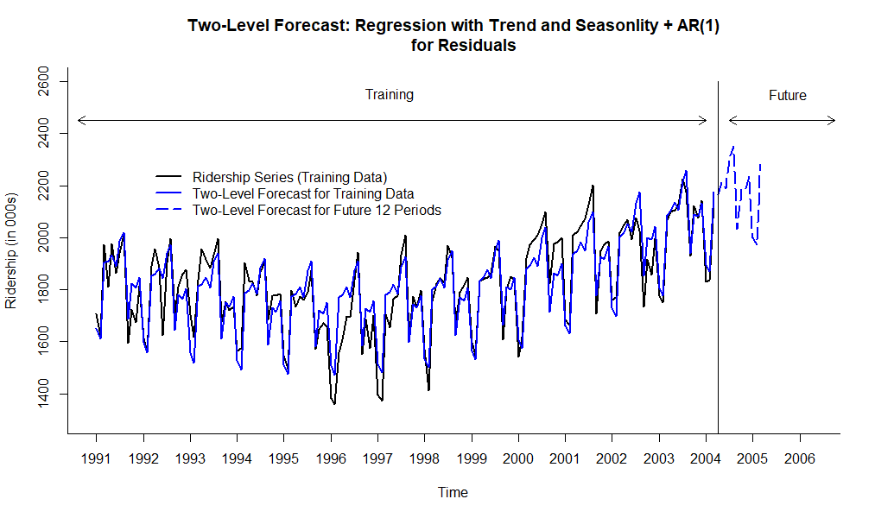
Two-Level Model: Regression Forecast with Trend and Seasonality + AR(1) Forecast for Training and Future Periods

Slide 17
Performance Measures of Two-Level Model with AR(1) vs. Regression and Seasonal Naïve Models
Two-Level Model: Quadratic Trend and Seasonal Model + AR(1) Model
ME RMSE MAE MPE MAPE ACF1 Theil's U
Test Set -0.312 53.357 41.019 -0.111 2.301 -0.108 0.313
Quadratic Trend and Seasonal Model
ME RMSE MAE MPE MAPE ACF1 Theil's U
Test Set 0 69.375 54.761 -0.159 3.089 0.637 0.419
Seasonal Naïve Model
ME RMSE MAE MPE MAPE ACF1 Theil's U
Test Set 21.009 99.007 81.508 0.941 4.517 0.645 0.557

Slide 18
Evaluating Predictability
Predictability
Means that time series is predictable, i.e., its historical data and patterns can be used to apply for non-trivial (non-naïve forecast) type prediction with forecasting methods
Figuring out if forecasting effort may be useful
Main question: should we go beyond naïve forecast?
Random walk
Time series in which changes from one time period to the next are random
The random walk hypothesis in finance means that stock market prices evolve according to a random walk (so price changes are random) and thus cannot be predicted.
Random walk series is considered non-predictable
Random walk is a special case of AR(1) model
If in AR(1) model, Y_{t} = α + β₁Y_{t-1} + ε_{t} , β₁ = 1, then the model becomes:
Y_{t} = α + Y_{t-1} + ε_{t}
This model is random walk, the difference between period t and t-1 is random
Forecast becomes a naïve forecast + parameter α
α = drift parameter

Slide 19
Predictability Test: How to Check if Time Series is Random Walk
Approach 1
Fit an AR(1) model to time series and test the hypothesis that the slope coefficient β₁ =1 (H_{o}: β₁ =1 vs. H₁: β₁ ≠1)
If the H_{o} hypothesis is rejected (p-value is small, below 0.05 or 0.01 confidence), then the series is not random walk
Otherwise, if H_{o} cannot not be rejected, this may indicate that a series is random walk
Approach 2
Mathematically an equivalent of approach 1
Examine differenced series: Y₂-Y₁, Y₃-Y₂, … , Y_{t} -Y_{t-1}
If original series is random walk, the differenced series behaves like random walk
Hence, to test whether the series is random walk:
Compute differenced series
Examine ACF for differenced series
If ACF plot indicates that the autocorrelation coefficients at lags 1, 2, 3, etc. are within horizontal thresholds, that it can be inferred that time series is random walk.

Slide 20
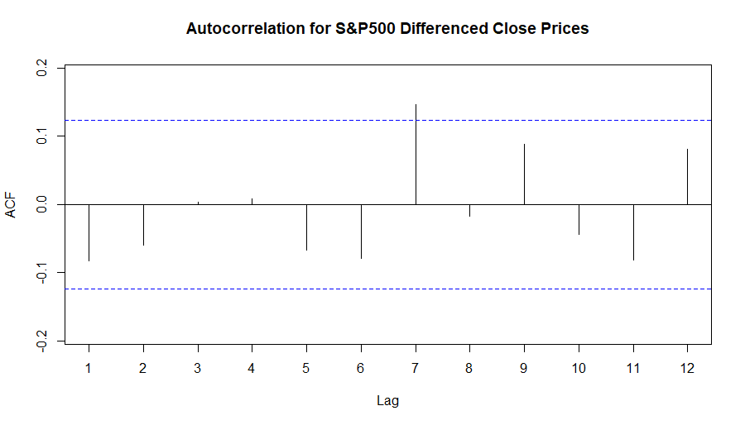
Predictability Test for S&P 500 Close Prices in 2019
Approach 1: Fit AR(1) model into S&P 500 Close Prices data in (https://in.finance.yahoo.com/quote/%5EGSPC/history)
Approach 2: Apply ACF for differenced Close Prices data
Conclusion: S&P 500 Close Prices in 2019 data may be random walk, can be hard to predict
Series: close.price.ts
ARIMA(1,0,0) with non-zero mean
Coefficients:
ar1 mean
0.9970 2882.7598
s.e. 0.0039 246.8988

Slide 21
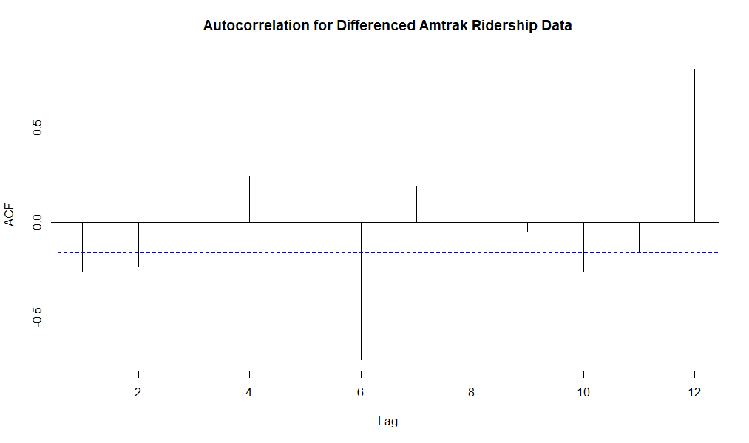
Predictability Test for Amtrak Ridership Data
Approach 1: Fit AR(1) model into Amtrak Ridership data
Approach 2: Apply ACF for differenced Amtrak Ridership data
Conclusion: Amtrak Ridership data is not random walk, can be predicted
Series: ridership.ts
ARIMA(1,0,0) with non-zero mean
Coefficients:
ar1 intercept
0.5682 1823.7972
s.e. 0.0656 27.1978

