Slide 1

California State University, East Bay College of Business and Economics BAN 673 Time Series Analytics
Autoregressive Integrated Moving Average (ARIMA) Models
Lecture Materials
Dr. Z. Radovilsky
Notes:
1
1
Developed by Dr. Zinovy Radovilsky, Professor of Management
California State University, East Bay
@All rights reserved

Slide 2
Lecture Objectives
Present and explain general concept of Autoregressive Integrated Moving Average (ARIMA) models
Define and apply Autoregressive (AR) model as a part of ARIMA
Utilize Moving Average (MA) model as a part of ARIMA
Define Autoregressive Moving Average (ARMA) models and their components
Recognize and explain ARIMA model parameters for non-seasonal and seasonal ARIMA models
Apply auto ARIMA models with optimal model parameters
Use R to develop ARIMA models for time series forecasting
Notes:
2
2

Slide 3
What is ARIMA?
Autoregressive Integrated Moving Average (ARIMA) is a class of popular models in time series forecasting
Also referred to as Box-Jenkins methodology or Box-Jenkins approach
Capable of presenting any time series component – level (stationary), trend, and seasonality – or a combination of these components
Flexible to forecast any time series
Complex structure, may include up to 6 parameters to be identified for each model (unless using an automated option)
Less understandable among practitioners
In general, an ARIMA model includes three parts
Autoregressive (AR) model with various order of lags – number of autocorrelation lags equal to p (p = 0, 1, 2, …)
Moving average (MA) model of order q (q = 0, 1, 2, ….) of the model residuals
Differencing of AR model with order of d (d = 0, 1, 2, …) lag-1 differences, typically to remove trend and/or seasonality

Slide 4
AR Model
Autoregressive models AR(p)
y_{t} = β₀ + β₁y_{t-1} + β₂y_{t-2} … + β_{p}y_{t-p} + ε_{t}
Autoregressive model of order p (p = 0, 1, 2, …) – number of autocorrelation lags
Predictors are lagged values (y_{t-1} , y_{t-2} , …, y_{t-p}) of the response variable (y_{t})
Used to identify relationships between time series lags and apply them in forecasting
Does not include possible relationships between autocorrelation terms of forecast residuals
Typically, appropriate for level (stationary) time series without trend and/or seasonality
For example, AR(2) model
y_{t} = β₀ + β₁y_{t-1} + β₂y_{t-2} + ε_{t}
In R, AR(p) model of order p is defined by Arima() function as order = c(p, 0, 0)

Slide 5
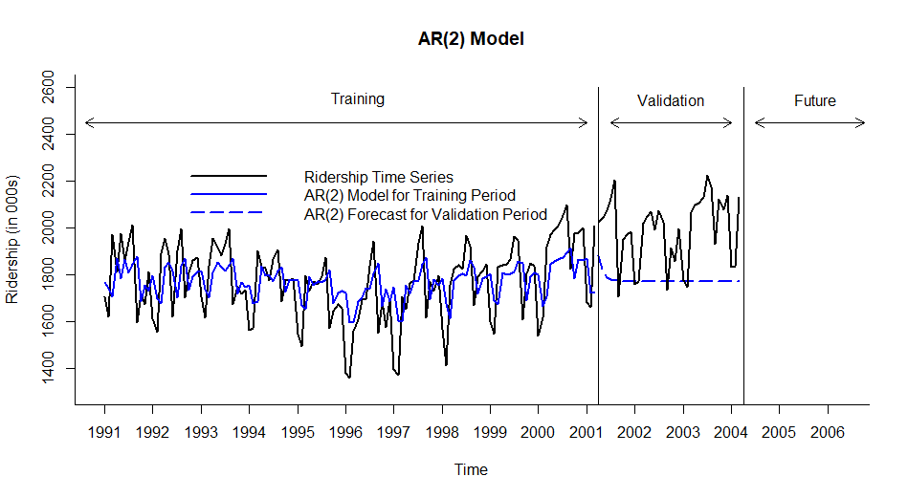
Visualizing AR(2) Model in R for Training and Validation Periods
Series: train.ts
ARIMA(2,0,0) with non-zero mean
Coefficients:
ar1 ar2 mean
0.4577 -0.0308 1773.2916
s.e. 0.0912 0.0914 22.3512
sigma^2 estimated as 20918: log likelihood=-784.95
AIC=1577.89 AICc=1578.23 BIC=1589.14
Training set error measures:
ME RMSE MAE MPE MAPE MASE ACF1
Training set 0.2323437 142.855 117.5968 -0.6772484 6.829772 1.425555 0.007953338
y_{t} = 1773.29 + 0.458 y_{t-1} - 0.031 y_{t-2}

Slide 6
MA Model
Moving Average MA(q) model uses past forecast residuals (errors) of q autocorrelation lags in a regression-like model
y_{t} = c + ε_{t} + θ₁ ε_{t-1} + θ₂ ε_{t-2} …+θ_{q} ε_{t-q}
where
c = constant mean of the MA model, also referred to as drift
ε_{t} = error term similar to those by the standard regression model (unexplained portion
of the response variable)
ε_{t-1} ,ε_{t-2} , …, ε_{t-q} = errors in previous (lagged) time periods used to identify y_{t}
θ₁ , θ₂ ,…, θ_{q} = coefficients of the variables to be estimated
The term “moving average” for the model is historical and not to be confused with trailing MA
Typically, appropriate for level (stationary) time series without trend and/or seasonality
For example, MA(2) model
y_{t} = c + ε_{t} + θ₁ ε_{t-1} + θ₂ ε_{t-2}
In R, MA(q) model of order q is defined by Arima() function as order = c(0, 0, q)

Slide 7
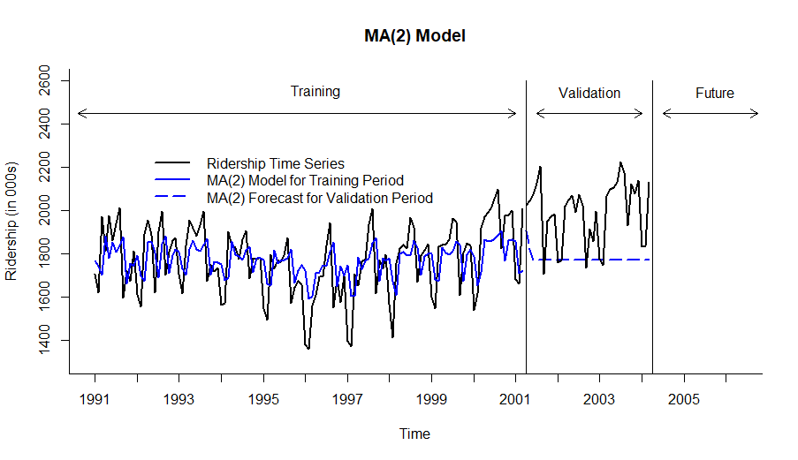
Visualizing MA(2) Model in R for Training and Validation Periods
Series: train.ts
ARIMA(0,0,2) with non-zero mean
Coefficients:
ma1 ma2 mean
0.4864 0.1634 1773.3812
s.e. 0.1030 0.1334 21.1733
sigma^2 estimated as 20922: log likelihood=-784.97
AIC=1577.94 AICc=1578.28 BIC=1589.19
y_{t} = 1773.38 + 0.486 ε_{t-1} + 0.163 ε_{t-2}
Training set error measures:
ME RMSE MAE MPE MAPE MASE ACF1
Training set 0.1680475 142.8695 117.6684 -0.6762222 6.832639 1.426423 -0.005735862

Slide 8
ARMA Model
Autoregressive Moving Average (ARMA) model incorporates time series lags (“Autoregressive” part) and lags of forecast residuals ( “Moving Average” part) to capture all forms of autocorrelation
y_{t} = β₀ + β₁y_{t-1} + β₂y_{t-2} … + β_{p}y_{t-p} + ε_{t} + θ₁ ε_{t-1} + θ₂ ε_{t-2} …+θ_{q} ε_{t-q}
ARMA(p, q) contains two parameters:
p = order of autoregressive AR(p) model or a number of autocorrelation lags included
q = order of moving average MA(q) model or a number of residuals’ autocorrelation lags included
ARMA(p, q) model as well as AR(p) and MA(q) model are useful for forecasting data without trend and/or seasonality
Example of ARMA(2, 2) model
y_{t} = β₀ + β₁y_{t-1} + β₂y_{t-2} + ε_{t} + θ₁ ε_{t-1} + θ₂ ε_{t-2}
In R, ARMA(p, q) model of order (p, q) is defined by Arima() function as order = c(p, 0, q)

Slide 9
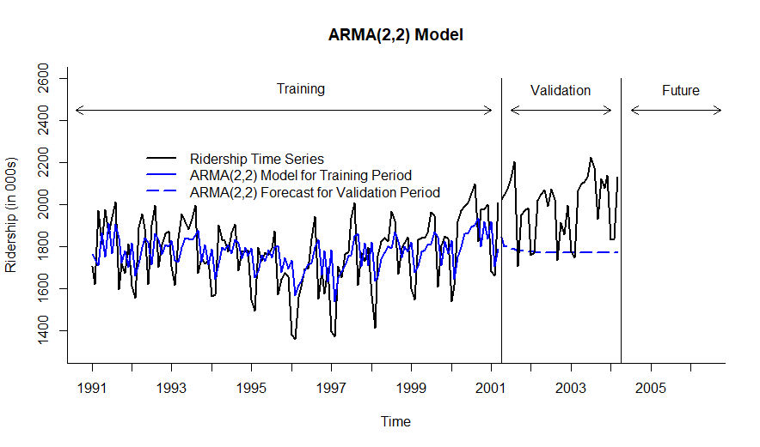
Visualizing ARMA(2, 2) Model for Training and Validation Periods
ARIMA(2,0,2) with non-zero mean
Coefficients:
ar1 ar2 ma1 ma2 mean
0.0503 0.4166 0.4241 -0.3331 1773.5397
s.e. 0.2649 0.1247 0.2727 0.1973 25.5736
sigma^2 estimated as 20467: log likelihood=-782.66
AIC=1577.32 AICc=1578.05 BIC=1594.2
y_{t} = 1773.54 + 0.050 y_{t-1} + 0.417 y_{t-2}
+ 0.424 ε_{t-1} – 0.333 ε_{t-2}
Training set error measures:
ME RMSE MAE MPE MAPE MASE ACF1
Training set 0.1202918 140.1259 115.6086 -0.657805 6.707788 1.401453 0.003782767

Slide 10
ARIMA Models
Autoregressive Integrated Moving Average (ARIMA) is the same model as ARMA but incorporates a preliminary step of differencing, which removes trend
Term I (“Integrated”) represents the differencing operation in ARIMA
Flexible model to forecast any time series including series with level, trend, and seasonality
ARIMA (p, d, q) model is used to forecast data with level and trend components – non-seasonal ARIMA model
p = order of autoregressive model AR(p) – number of autocorrelation lags included
d = order of differencing in AR model – indicates how many rounds of lag-1 differencing are performed to remove certain trend
d = 0: no differencing (series does not have a trend), y_{t}
d = 1: difference the series once which can remove linear trend, y_{t} - y_{t -1} , e.g., y₂ - y₁, y₃ – y₂, …
d = 2: difference the series twice, each time of lag-1 (first difference of the first difference), (y_{t} - y_{t -1}) - (y_{t -1} - y_{t -2}) = y_{t} – 2 y_{t -1} + y_{t -2}, e.g., y₃ – 2 y₂+ y₁ , y₄– 2 y₃ + y₂, …
q = order of moving average MA(q) – number of residuals’ autocorrelation lags included
ARIMA (2, 1, 2) means the following:
p = 2: order 2 autoregressive model AR(2)
d = 1, order 1 differencing to remove linear trend
q = 2, order 2 moving average MA(2) for error lags
y_{t} - y_{t-1} = β₀ + β₁(y_{t-1} - y_{t-2}) + β₂(y_{t-2} - y_{t-3}) + ε_{t} + θ₁ ε_{t-1} + θ₂ ε_{t-2}

Slide 11
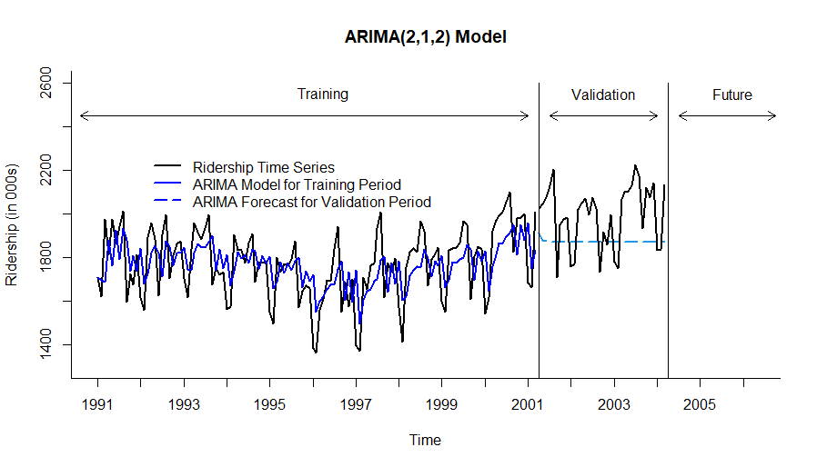
Visualizing ARIMA(2, 1, 2) Model for Training and Validation Periods
Series: train.ts
ARIMA(2,1,2)
Coefficients:
ar1 ar2 ma1 ma2
-0.4198 0.1744 -0.0836 -0.7677
s.e. 0.1304 0.1128 0.0895 0.0849
sigma^2 estimated as 20594: log likelihood=-777.69
AIC=1565.38 AICc=1565.9 BIC=1579.4
y_{t} - y_{t-1} = − 0.420 (y_{t-1} -y_{t-2}) + 0.174 (y_{t-2} -y_{t-3}) − 0.084 ε_{t-1}
– 0.768 ε_{t-2}
Training set error measures:
ME RMSE MAE MPE MAPE MASE ACF1
Training set 5.913171 140.5602 117.5478 -0.2962527 6.795819 1.42496 -0.006682137

Slide 12
Seasonal ARIMA Models
Seasonal ARIMA model is formed by including additional seasonal terms in the ARIMA(p d, q) model
ARIMA (p, d, q) (P, D, Q)_{m} model is used to forecast data with level, trend, and seasonality components. In addition to the (p, d, q) parameters, it includes seasonal parameters:
P = order of autoregressive seasonal model AR(P) – number of autocorrelation lags included
D = order of differencing in AR seasonal model – indicates how many rounds of lag-1 differencing the are performed to remove certain trend
Q = order of moving average MA(Q) – number of residuals’ autocorrelation lags included
m = number of seasons
ARIMA (2, 1, 2) (1, 1, 2)₁₂ means the following:
p = 2, order 2 autoregressive model AR(2)
d = 1, order 1 differencing to remove linear trend
q = 2, order 2 moving average MA(2) for error lags
P = 1, order 1 autoregressive model AR(1) for seasonality
D = 1, order 1 differencing to remove linear trend
Q = 2, order 2 moving average MA(2) for error lags
m = 12, for monthly seasonality
In R, ARIMA(p, d, q)(P, D, Q) model is defined by Arima() function as order = c(p, d, q), seasonal = c(P, D, Q). Seasonality m is identified by the type of time series data used

Slide 13
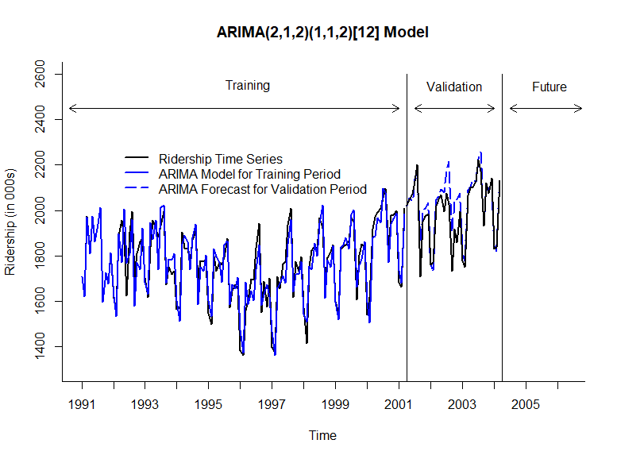
Visualizing ARIMA(2, 1, 2)(1, 1, 2) Model for Training and Validation Periods
Series: train.ts
ARIMA(2,1,2)(1,1,2)[12]
Coefficients:
ar1 ar2 ma1 ma2 sar1 sma1 sma2
-0.6044 0.2711 0.2061 -0.6921 -0.2104 -0.4363 -0.2329
s.e. 0.1914 0.1793 0.1533 0.1415 0.8787 0.8799 0.6036
sigma^2 estimated as 4124: log likelihood=-614.93
AIC=1245.86 AICc=1247.29 BIC=1267.46
y_{t} - y_{t-1} = − 0.604 (y_{t-1} -y_{t-2}) + 0.271 (y_{t-2} -y_{t-3}) + 0.206 ε_{t-1}
– 0.692 ε_{t-2} − 0.210 (y_{t-1} -y_{t-13}) − 0.436 ρ_{t-1} – 0.233 ρ_{t-2}
Training set error measures:
ME RMSE MAE MPE MAPE MASE ACF1
Training set 6.785703 58.76519 45.07997 0.2991491 2.568609 0.5464771 -0.03877231

Slide 14
Auto ARIMA Models
ARIMA models are rather complex with a number of parameters involved and complex relationships between the model parts
It is hard (but not impossible) to clearly identify what specific parameters should be used in the model
Visualize historical data
Apply ACF and PACF (partial autocorrelation function) charts
However, may not produce optimal results
auto.arima() function in R is used to identify optimal ARIMA model and its respective (p, d, q)(P, D, Q) parameters.
Does not require to input any of these parameters into the function

Slide 15
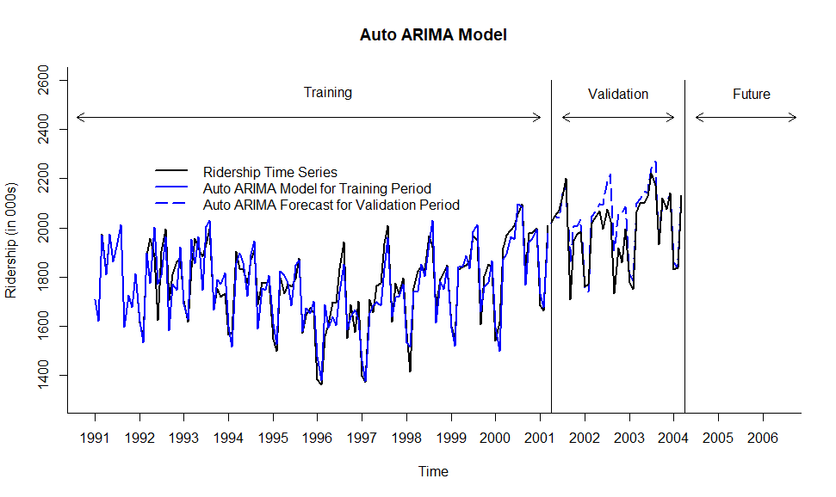
Visualizing Auto ARIMA Model for Training and Validation Periods
Series: train.ts
ARIMA(1,1,1)(0,1,1)[12]
Coefficients:
ar1 ma1 sma1
0.3221 -0.7446 -0.7017
s.e. 0.1644 0.1185 0.1021
sigma^2 estimated as 4032: log likelihood=-615.44
AIC=1238.88 AICc=1239.26 BIC=1249.68
y_{t} - y_{t-1} = 0.322 (y_{t-1} -y_{t-2}) − 0.745 ε_{t-1}− 0.702 ρ_{t-1}
Training set error measures:
ME RMSE MAE MPE MAPE MASE ACF1
Training set 6.754576 59.22559 45.54802 0.297054 2.593327 0.552151 -0.03298123

Slide 16
Forecasting for Future Periods
Before attempting to forecast future values of the series, the training and validation periods must be recombined into one (entire) time series dataset
The chosen model, auto ARIMA model, needs to be rerun on the entire (complete) dataset
Measure model performance vs. original data using accuracy measures like MAPE, RMSE and others
The new forecasting model, based on the entire dataset, can be now used for forecasting future periods

Slide 17
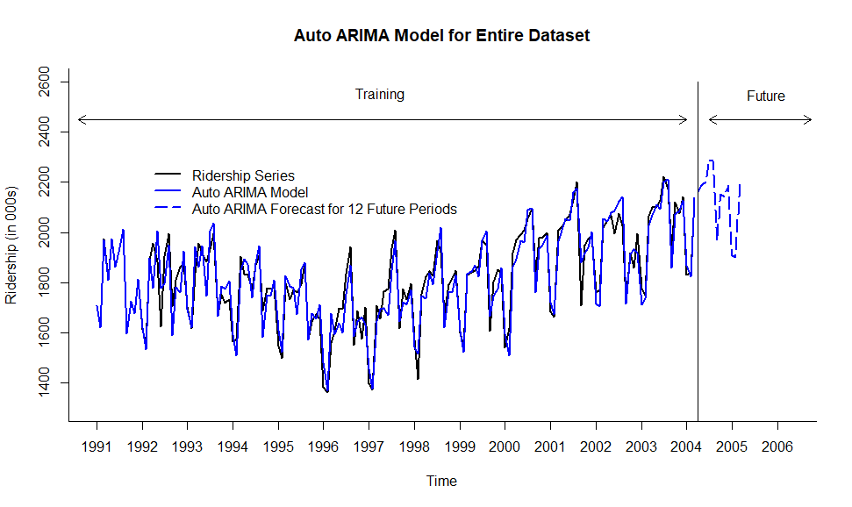
Visualizing Auto ARIMA Model for Amtrak Ridership for Entire Dataset
Series: ridership.ts
ARIMA(2,1,1)(2,1,2)[12]
Coefficients:
ar1 ar2 ma1 sar1 sar2 sma1 sma2
0.4364 0.1098 -0.8426 0.6814 -0.1719 -1.3928 0.5558
s.e. 0.1360 0.1161 0.1003 1.4698 0.1604 1.4873 1.1010
sigma^2 estimated as 3714: log likelihood=-808.93
AIC=1633.86 AICc=1634.91 BIC=1657.73
y_{t} - y_{t-1} = 0.436 (y_{t-1} -y_{t-2}) + 0.110 (y_{t-2} -y_{t-3}) − 0.843 ε_{t-1}
+ 0.681 (y_{t-1} -y_{t-13}) − 0.172 (y_{t-2} -y_{t-14}) − 1.393 ρ_{t-1} + 0.556 ρ_{t-2}
Training set error measures:
ME RMSE MAE MPE MAPE MASE ACF1
Training set 6.022299 56.98239 43.42804 0.2691214 2.425856 0.5328092 -0.01489883

Slide 18
Performance Measures of ARIMA Models vs. Naïve Forecasts for Entire Data Set
Seasonal ARIMA Model (2,1,2)(1,1,2)₁₂
ME RMSE MAE MPE MAPE ACF1 Theil's U
Test set 5.799 57.332 43.647 0.252 2.436 -0.037 0.336
Auto ARIMA Model
ME RMSE MAE MPE MAPE ACF1 Theil's U
Test set 6.022 56.982 43.428 0.269 2.426 -0.015 0.335
Seasonal Naïve Forecast
ME RMSE MAE MPE MAPE ACF1 Theil's U
Test set 21.009 99.007 81.508 0.941 4.517 0.645 0.557
Naïve Forecast
ME RMSE MAE MPE MAPE ACF1 Theil's U
Test set 2.681 168.381 123.96 -0.318 7.029 -0.256 1

Slide 19
Compare Performance Measures of Forecasting Models for Amtrak Ridership
Auto ARIMA Model
ME RMSE MAE MPE MAPE ACF1 Theil's U
Test set 6.022 56.982 43.428 0.269 2.426 -0.015 0.335
Two-Level Model (Regression with Quadratic Trend and Seasonality
+ AR(1) for Residuals)
ME RMSE MAE MPE MAPE ACF1 Theil's U
Test set -0.312 53.357 41.019 -0.111 2.301 -0.108 0.313
Regression with Quadratic Trend and Seasonality
ME RMSE MAE MPE MAPE ACF1 Theil's U
Test set 0.690 69.375 54.761 -0.159 3.089 0.637 0.419
Holt-Winter’s Model with Automated Selection of Model Options
ME RMSE MAE MPE MAPE ACF1 Theil's U
Test set 3.081 55.645 43.609 0.090 2.436 0.050 0.320
Two-Level Model (Regression with Quadratic Trend and Seasonality
+ Trailing MA for Residuals)
ME RMSE MAE MPE MAPE ACF1 Theil's U
Test set 1.235 56.880 45.501 -0.018 2.536 0.543 0.336

