Slide 1

Basic Details of the team and Problem Statement
Cybersecurity awareness and protection for SMEs
Team Name: Falcon 4.0
Team Leader: Roonaak Agasti
Theme: Cybersecurity & Digital Safety

Slide 2

Team Member Details
Team Leader : Roonaak Agasti Branch – C.S.E Year 3rd
Team Member 1: Nishanta Kumar Das Branch – C.S.E Year 3rd
Team Member 2: Shubhankar Dikshit Branch – C.S.E Year 3rd
Team Member 3: Sanjay Kumar Biswal Branch – C.S.E Year 3rd
Team Member 4: Sabyasachi Kundoo Branch – C.S.E Year 3rd
Team Member 5: Jyoti Prakash Mallik Branch – C.S.E Year 3rd

Slide 3
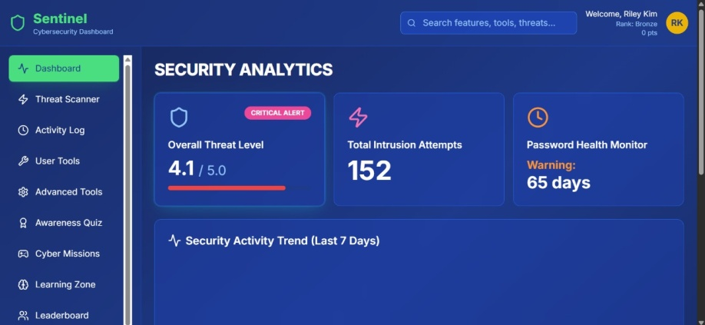
Idea/Approach Details
SMEs and MSMEs are increasingly vulnerable to phishing, deepfake, and malicious URL scams due to limited cybersecurity infrastructure and awareness.
Sentinel provides a unified dashboard that empowers small businesses with real-time threat detection, phishing simulation, and actionable insights; all without needing a dedicated security team.
Using a lightweight ML model and simple rule based logic, our product scans e-mails, URLs and uploaded files for fraud and phishing content. The results are instant and concise.
Beyond protection, Sentinel aims to provide a gamified learning experience using quizzes, mission based training and small tasks
Sentinel is designed for minimal infrastructure and supports API-based integration with existing tools.
A 24*7 chatbot helps users triage alerts and access information about the threats and risks.
Fig: Snapshot of dashboard from Sentinel
Commercial Model:
Advertisement
Collaborations with security vendors
Promotions (via Cybersecurity campaigns)
Subscription plans for premium features
API monetization for third party integrations

Slide 4







Idea/Approach Details
Our prototype and solutions
Dashboard: A single place to access all security tools such as scan results, alerts, and learning modules; in one easy-to-use interface.
Threat Scanner: Scans URLs, emails, and files to detect phishing links and suspicious content; fast, accurate, and built for everyday use.
Activity Logs: Keeps a record of all scans, alerts, and user actions , so nothing goes unnoticed.
Awareness(quizzes and leaderboards): Boosts cybersecurity knowledge through interactive quizzes and leaderboards; making learning fun and competitive.
Senty: Offers 24×7 support for both technical and non-technical users — guiding them through scans, alerts, and safety tips in plain language.
Project Dependencies and Tech Stack
Languages & Libraries Used:
APIs used
Virus Total API
Mailcheck.ai API
OpenAI API
Pwned API
Hosting & Database

Slide 5
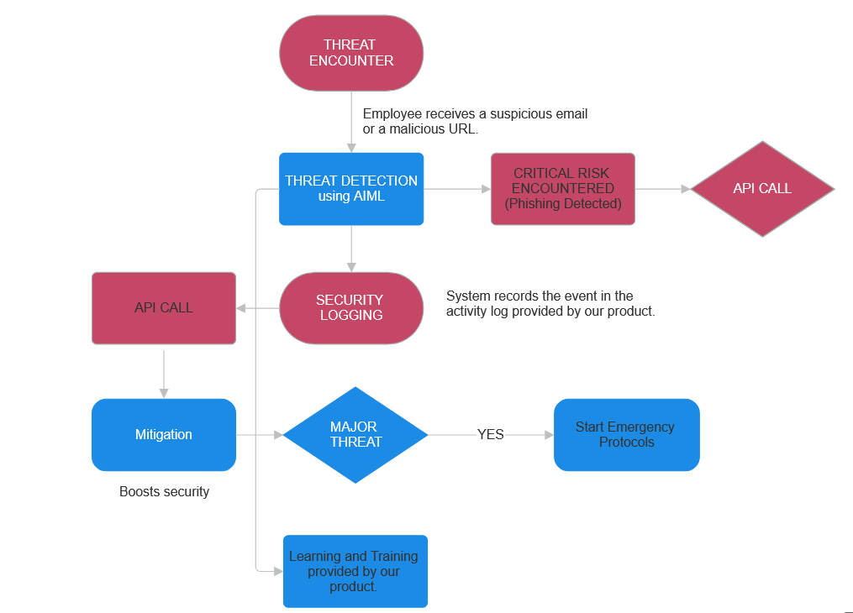
Flow

Slide 6
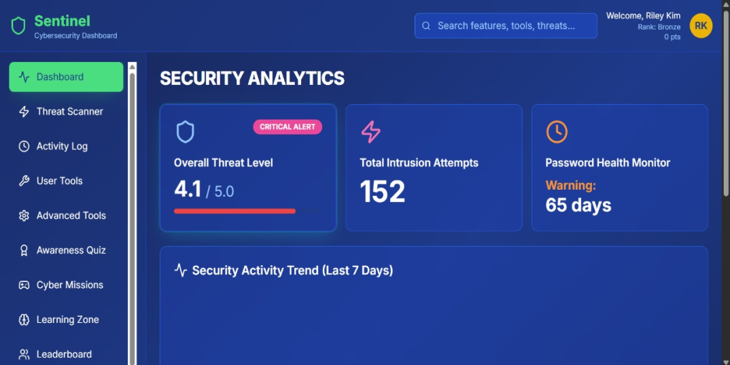
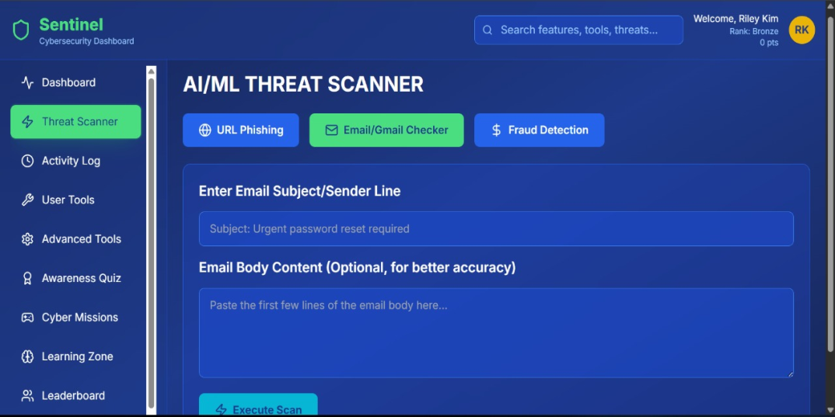
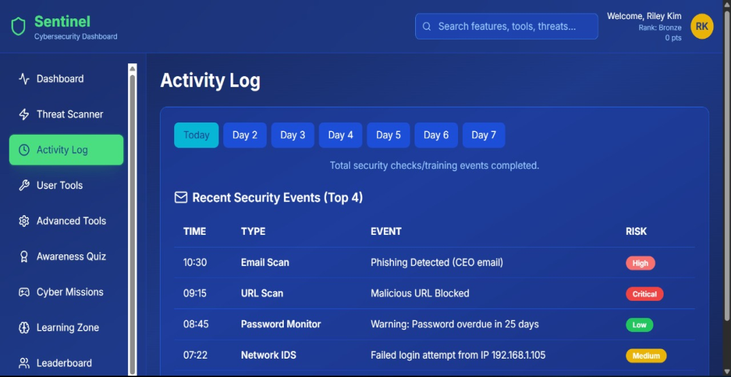
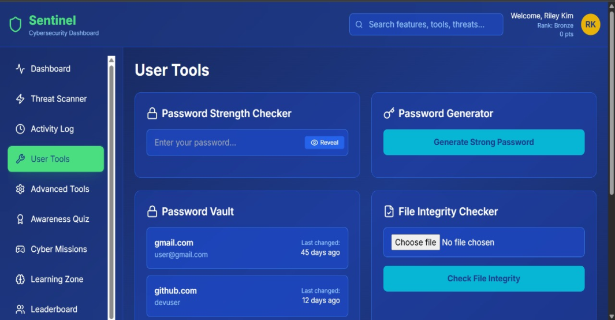
WireFrame
Fig: Dashboard
Fig: Built-in Threat Scanner
Fig: Activity Logs
Fig: User accessible tools

Slide 7
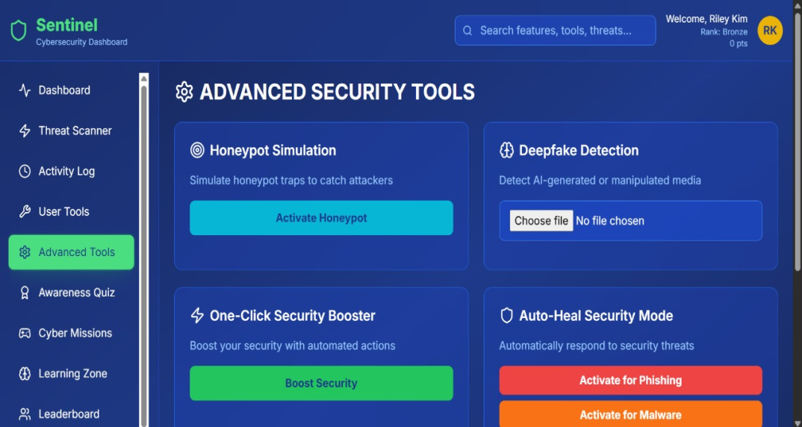
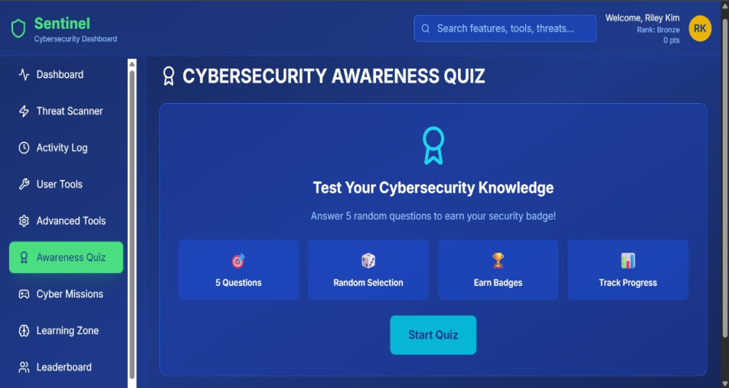
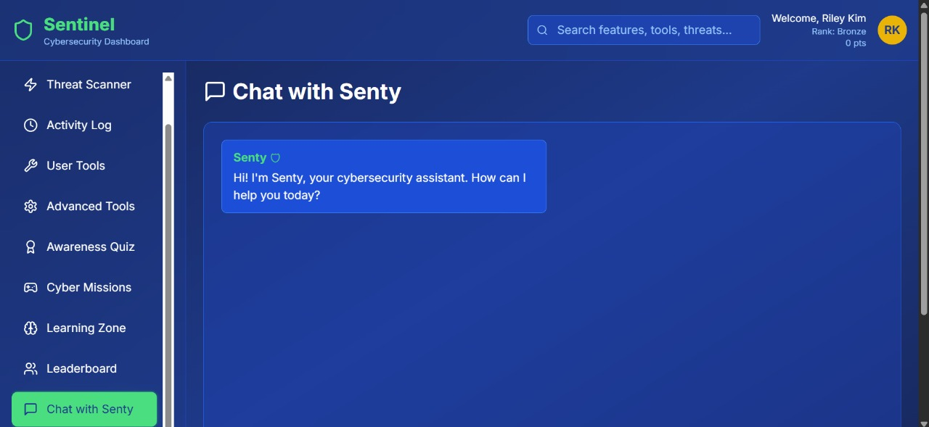
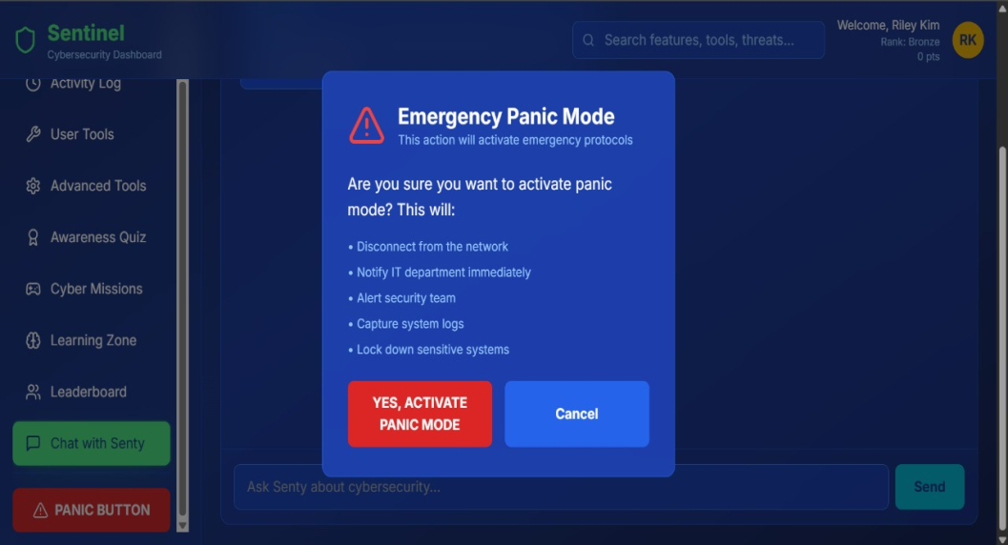
Fig: Advanced Tools
Fig: Awareness Quiz
Fig: Senty the Chatbot
Fig: Panic Mode (for emergencies)

