Slide 1

Basic Details of the team and Problem Statement
Cybersecurity awareness and protection for SMEs
Team Name: Falcon 4.0
Team Leader: Roonaak Agasti
Theme: Cybersecurity & Digital Safety

Slide 2
Team Member Details
Team Leader Name: Roonaak Agasti Branch – B.Tech Year III
Team Member 1: Nishanta Kumar Das Branch – B.Tech Year III
Team Member 2: Shubhankar Dikshit Branch – B.Tech Year III
Team Member 3: Sanjay Kumar Biswal Branch – B.Tech Year III
Team Member 4: Sabyasachi Kundoo Branch – B.Tech Year III
Team Member 5: Jyoti Branch – B.Tech Year III

Slide 3
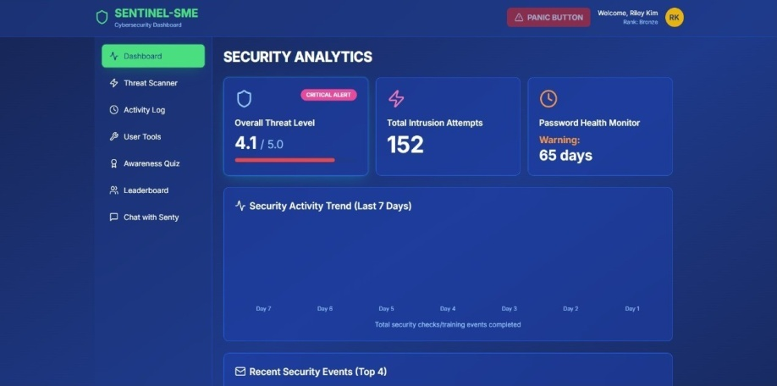
Idea/Approach Details
SMEs and MSMEs are increasingly vulnerable to phishing, deepfake, and malicious URL scams due to limited cybersecurity infrastructure and awareness.
Sentinel provides a unified dashboard that empowers small businesses with real-time threat detection, phishing simulation, and actionable insights; all without needing a dedicated security team.
Using a lightweight ML model and simple rule based logic, our product scans e-mails, URLs and uploaded files for fraud and phishing content. The results are instant and concise.
Beyond protection, Sentinel aims to provide a gamified learning experience using quizzes, mission based training and small tasks
Sentinel is designed for minimal infrastructure and supports API-based intgration with existing tools.
A 24*7 chatbot helps users triage alerts and access information about the threats and risks.
Fig: Snapshot of dashboard from Sentinel
Commercial Model:
Advertisement
Collaborations with security vendors
Promotions (via Cybersecurity campaigns)
Subscription plans for premium features
API monetization for third party integrations

