Slide 1
AUSTIN RHUG · 2026
From NVIDIA NGC to Red Hat OpenShift AI
Evaluate hosted models, then promote your app onto your own GPU with a single GitOps configuration change.
17 short videos · click each thumbnail to watch on YouTube
github.com/dkypuros/austin_rhug_2016 · issues #1 (chat) and #2 (RAG)

Slide 2
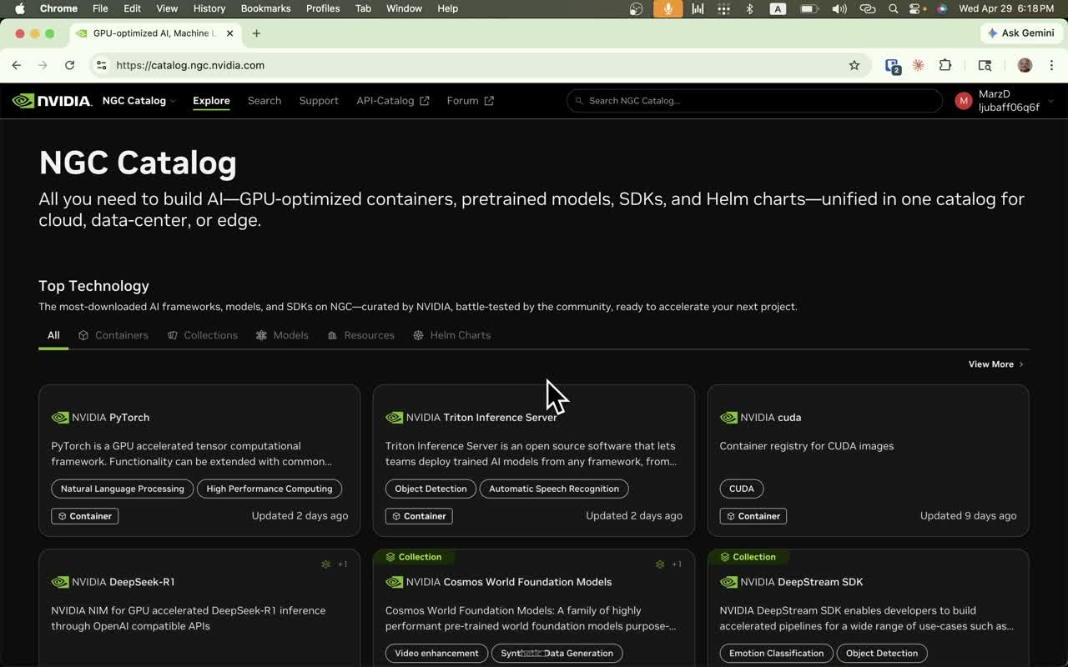
1
Step 1 — Browse NVIDIA NGC
1_ngc-catalog-browse.mp4
WHAT YOU'RE WATCHING
Open catalog.ngc.nvidia.com to evaluate hosted models. The same client we'll build talks OpenAI-compatible JSON to either NGC or our own cluster.
▶ YouTube link
(paste URL here after upload)
Austin RHUG · 2026 — Step 1 of 17
github.com/dkypuros/austin_rhug_2016

Slide 3
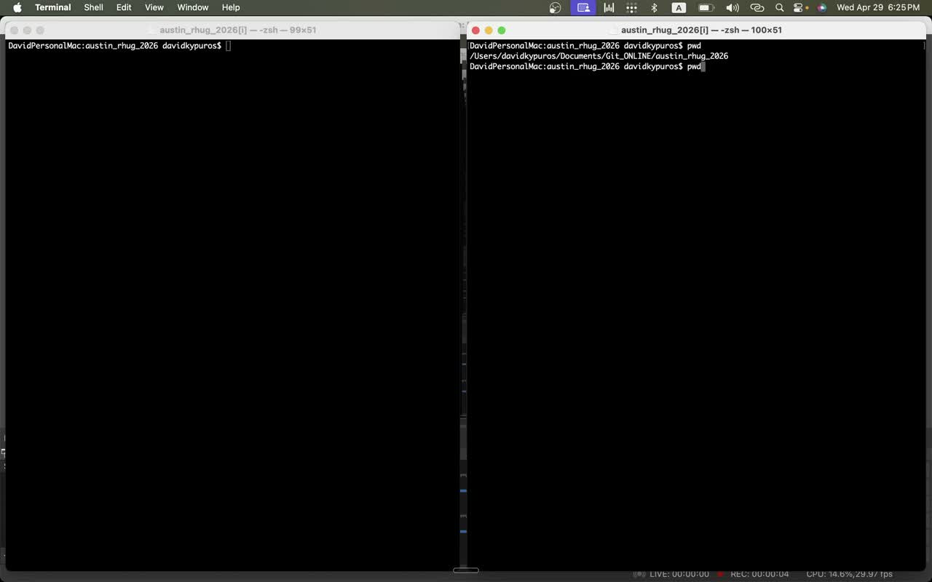
2
Step 2 — Workspace setup
2_terminal-pwd-setup.mp4
WHAT YOU'RE WATCHING
Fresh terminal, working directory at austin_rhug_2026. Nothing in the harness yet — clean slate.
▶ YouTube link
(paste URL here after upload)
Austin RHUG · 2026 — Step 2 of 17
github.com/dkypuros/austin_rhug_2016

Slide 4
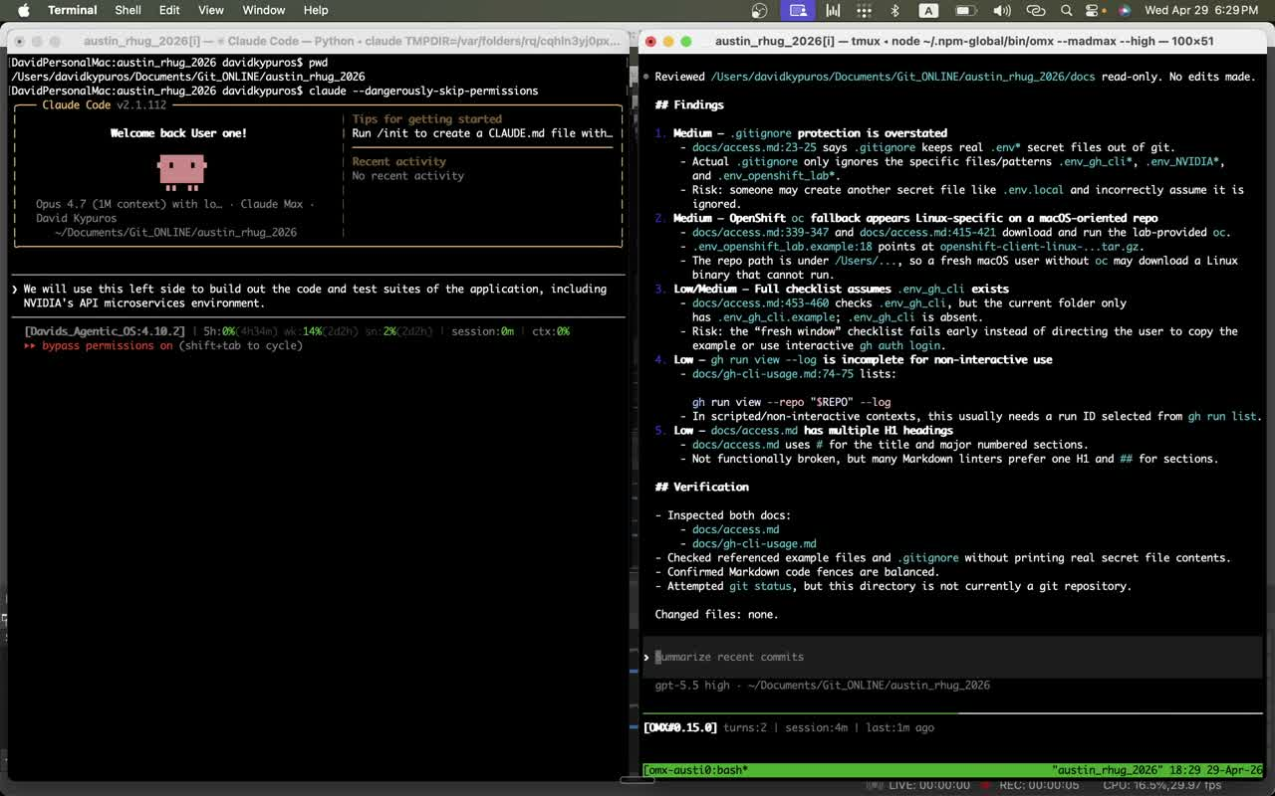
3
Step 3 — Security review of the harness
3_harness-security-review.mp4
WHAT YOU'RE WATCHING
Claude reviews docs/access.md and .gitignore for secret-handling risk before any code lands. Sets the bar: no .env_* in git, ever.
▶ YouTube link
(paste URL here after upload)
Austin RHUG · 2026 — Step 3 of 17
github.com/dkypuros/austin_rhug_2016

Slide 5
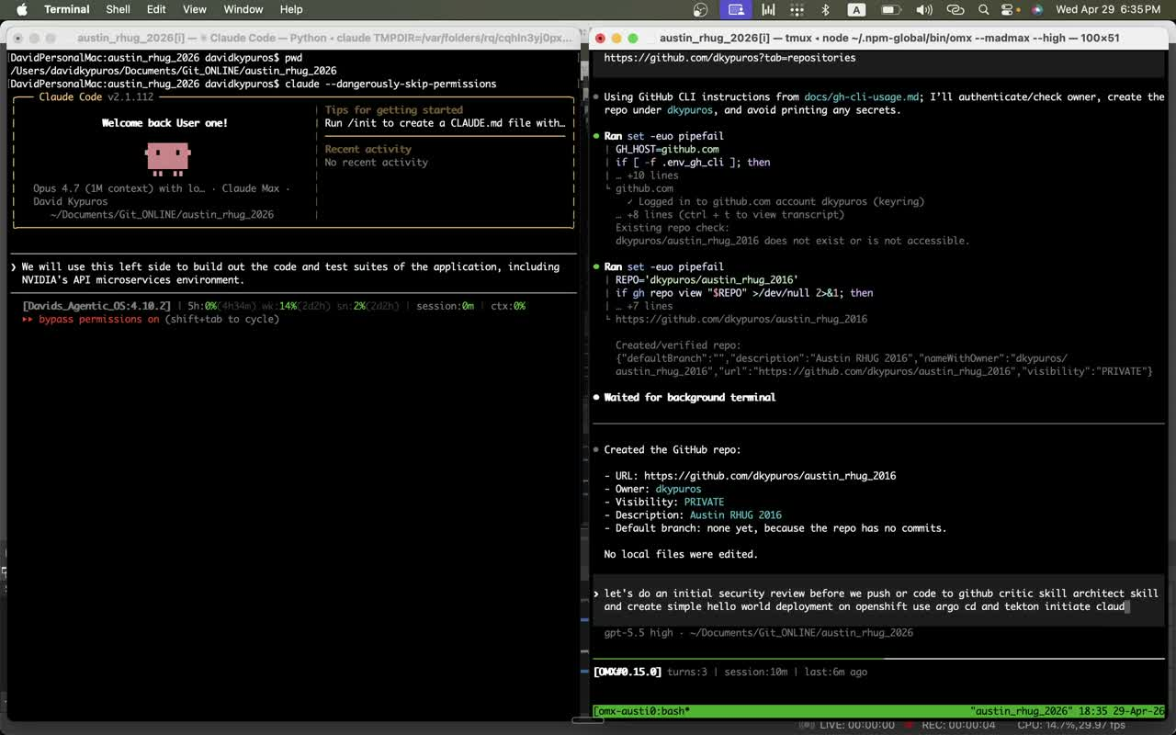
4
Step 4 — Claude Code launches
4_claude-code-launch.mp4
WHAT YOU'RE WATCHING
Bring up Claude Code (Opus 4.7) inside the project. Plan: build app + tests + manifests against a real RHOAI cluster.
▶ YouTube link
(paste URL here after upload)
Austin RHUG · 2026 — Step 4 of 17
github.com/dkypuros/austin_rhug_2016

Slide 6
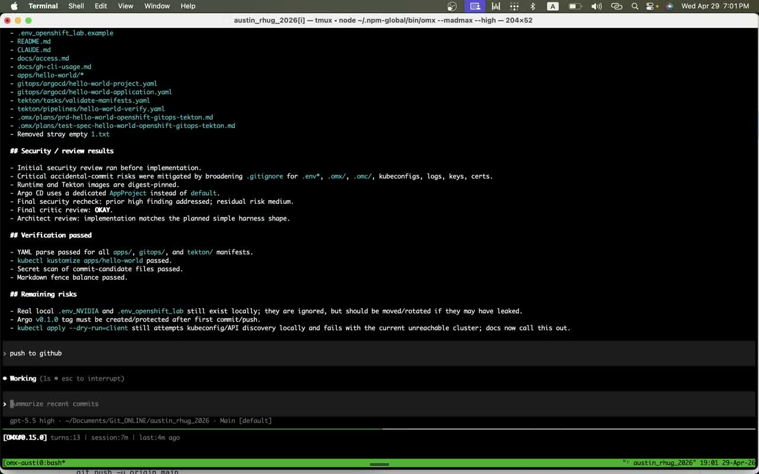
5
Step 5 — First push to GitHub
5_initial-push-to-github.mp4
WHAT YOU'RE WATCHING
Architect/critic review pass, secret-scan green, kustomize/YAML validated. Small initial harness gets committed and pushed.
▶ YouTube link
(paste URL here after upload)
Austin RHUG · 2026 — Step 5 of 17
github.com/dkypuros/austin_rhug_2016

Slide 7
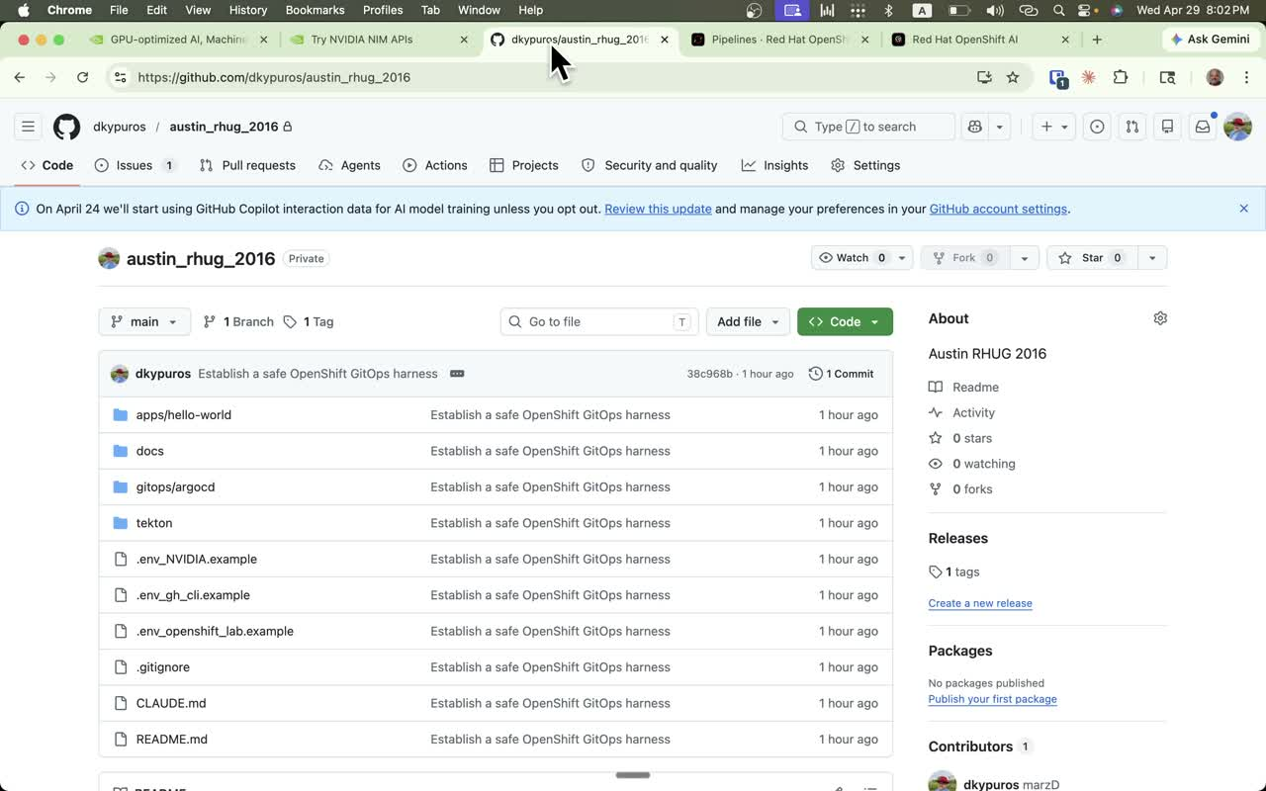
6
Step 6 — Repo overview
6_github-repo-overview.mp4
WHAT YOU'RE WATCHING
github.com/dkypuros/austin_rhug_2016 — apps/, docs/, gitops/argocd/, tekton/, .env_*.example, harness CLAUDE.md. The skeleton the demo will grow into.
▶ YouTube link
(paste URL here after upload)
Austin RHUG · 2026 — Step 6 of 17
github.com/dkypuros/austin_rhug_2016

Slide 8
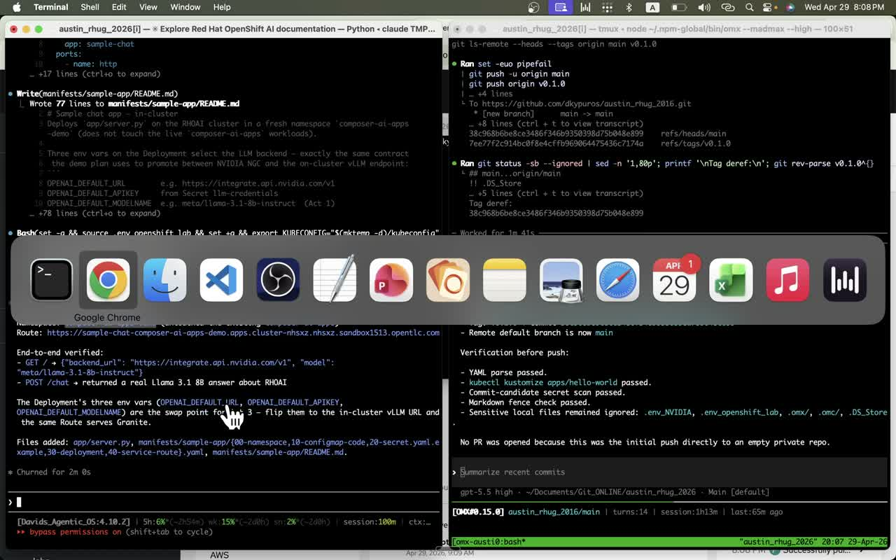
7
Step 7 — Tag v0.1.0 and push
7_tag-and-push-v0.1.0.mp4
WHAT YOU'RE WATCHING
Cut the first release tag and push README + manifests for the sample app. Establishes the GitOps source of truth.
▶ YouTube link
(paste URL here after upload)
Austin RHUG · 2026 — Step 7 of 17
github.com/dkypuros/austin_rhug_2016

Slide 9
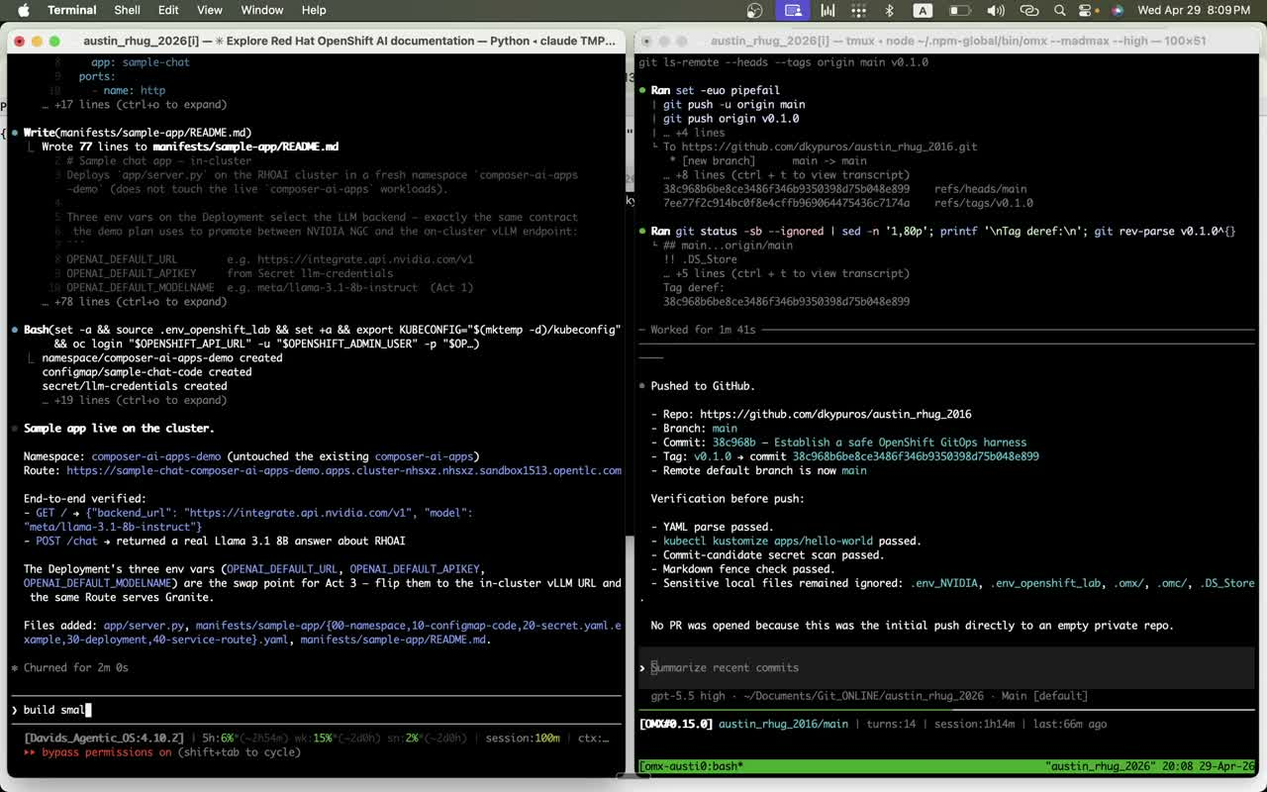
8
Step 8 — Sample app live on the cluster
8_sample-app-deployed.mp4
WHAT YOU'RE WATCHING
Namespace composer-ai-apps-demo, ConfigMap + Secret + Deployment + Route created. End-to-end smoke test returns a real Llama-3.1-8B answer.
▶ YouTube link
(paste URL here after upload)
Austin RHUG · 2026 — Step 8 of 17
github.com/dkypuros/austin_rhug_2016

Slide 10
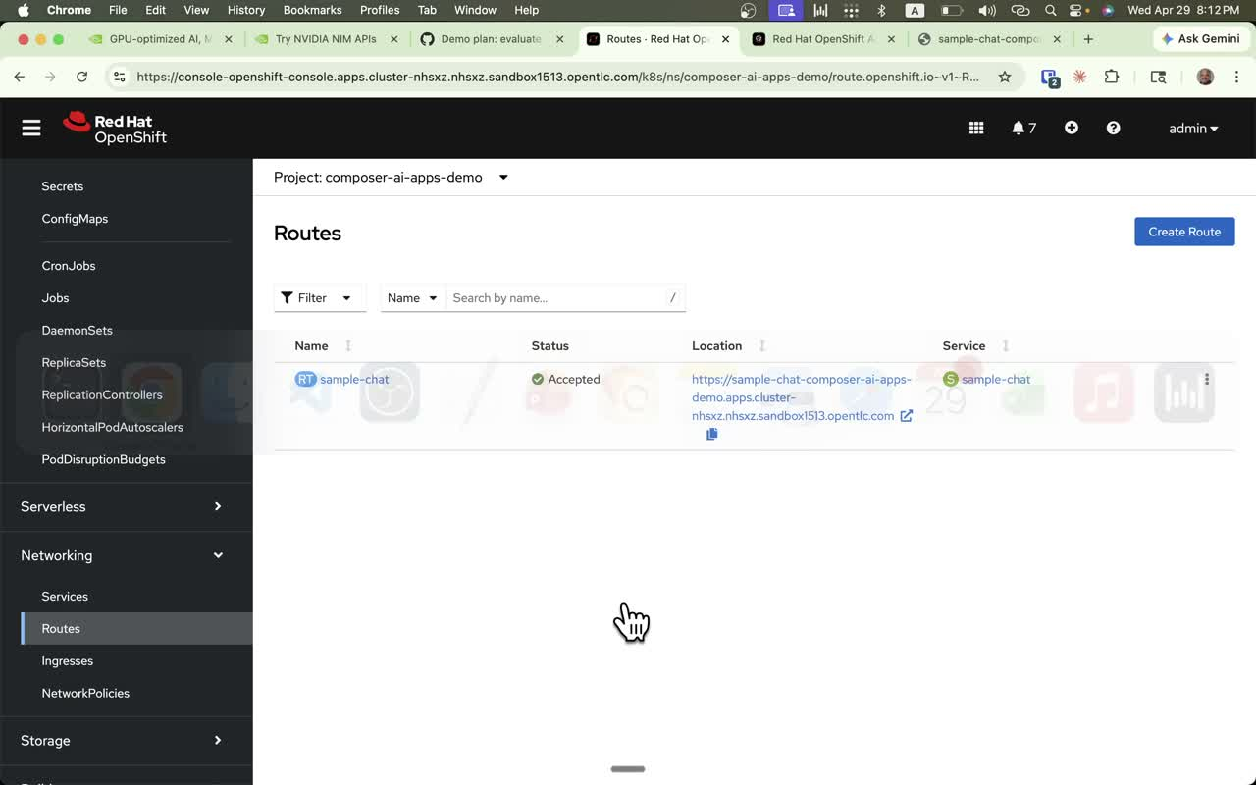
9
Step 9 — OpenShift Route accepted
9_openshift-route-accepted.mp4
WHAT YOU'RE WATCHING
Verify in the OCP console: Routes → sample-chat → Accepted. The browser-facing URL we'll demo against is live.
▶ YouTube link
(paste URL here after upload)
Austin RHUG · 2026 — Step 9 of 17
github.com/dkypuros/austin_rhug_2016

Slide 11
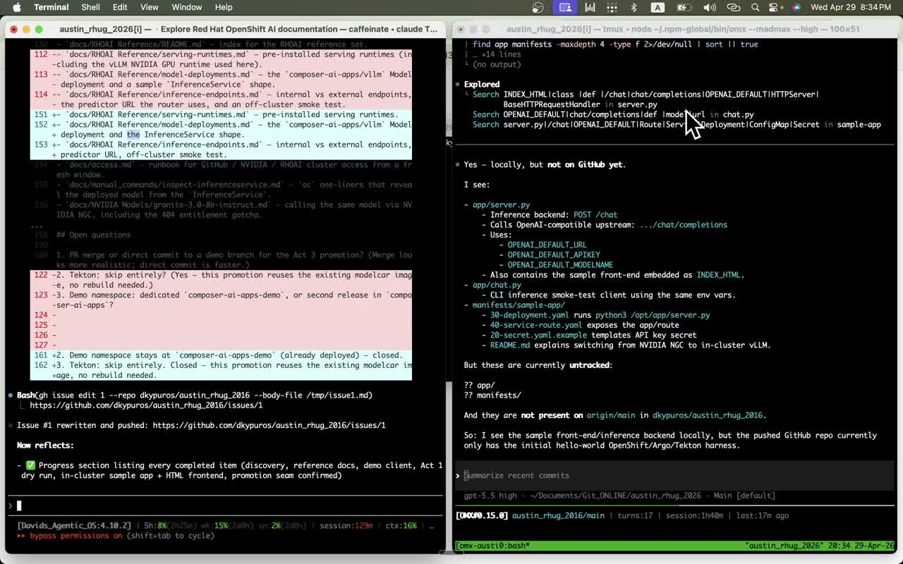
10
Step 10 — Local vs origin diff
10_local-vs-origin-diff.mp4
WHAT YOU'RE WATCHING
RHOAI Reference docs and the sample app exist locally but aren't on origin/main yet. Surfaces the need to push so the demo is reproducible.
▶ YouTube link
(paste URL here after upload)
Austin RHUG · 2026 — Step 10 of 17
github.com/dkypuros/austin_rhug_2016

Slide 12
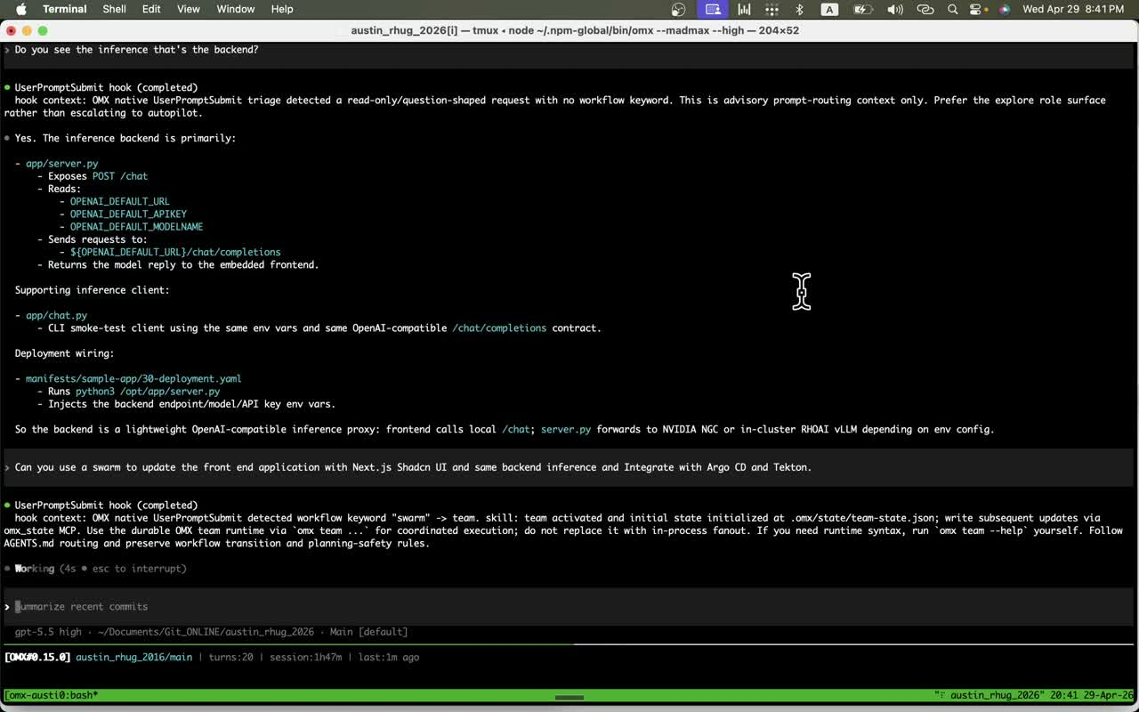
11
Step 11 — Backend architecture Q&A
11_backend-architecture-qa.mp4
WHAT YOU'RE WATCHING
Walk through app/server.py: POST /chat, three env vars (URL/APIKEY/MODELNAME), forwards to /chat/completions upstream. The swap surface.
▶ YouTube link
(paste URL here after upload)
Austin RHUG · 2026 — Step 11 of 17
github.com/dkypuros/austin_rhug_2016

Slide 13
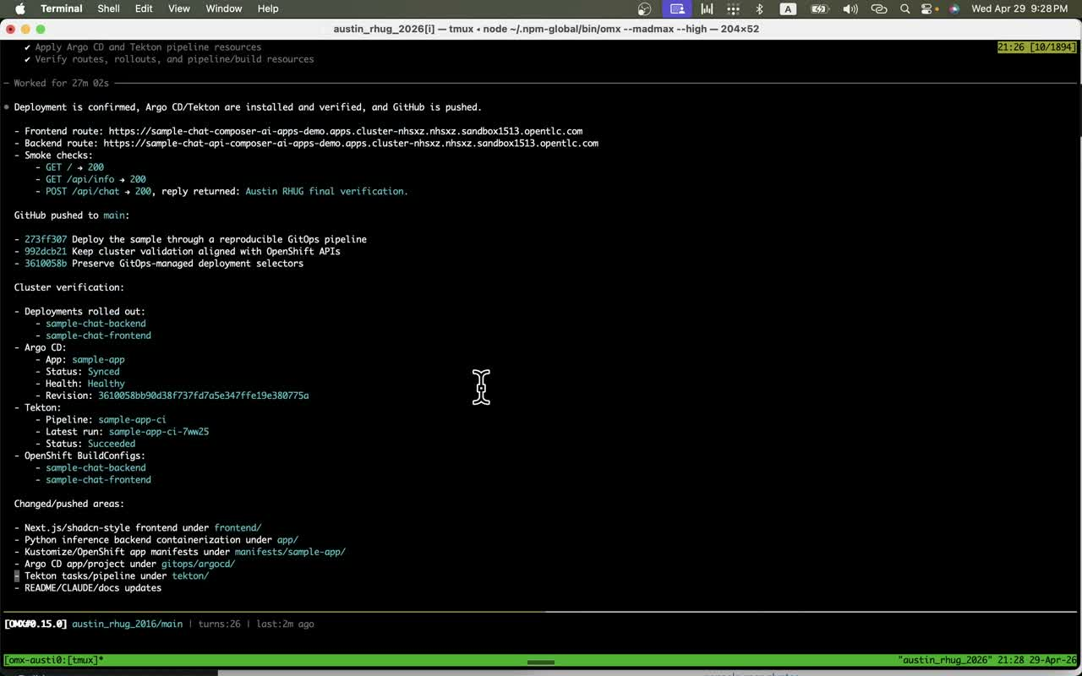
12
Step 12 — Argo CD + Tekton verified
12_gitops-tekton-verified.mp4
WHAT YOU'RE WATCHING
Argo CD Application Synced/Healthy, Tekton PipelineRun Succeeded, Deployments rolled out. The pipeline that owns the demo app from now on.
▶ YouTube link
(paste URL here after upload)
Austin RHUG · 2026 — Step 12 of 17
github.com/dkypuros/austin_rhug_2016

Slide 14
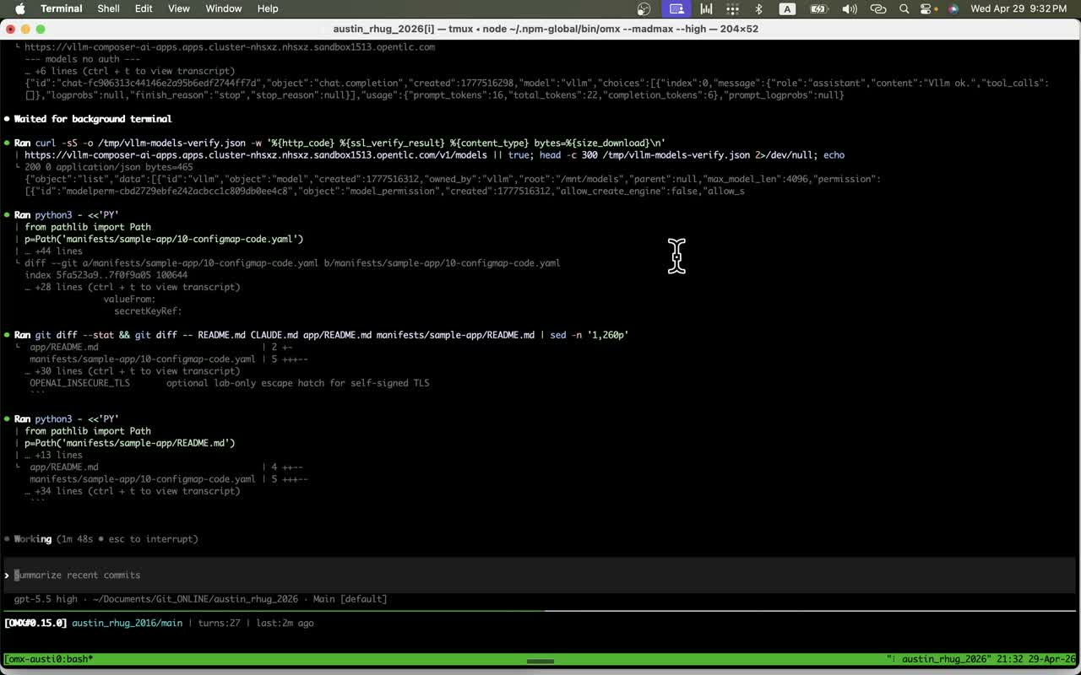
13
Step 13 — curl the in-cluster vLLM
13_curl-vllm-verification.mp4
WHAT YOU'RE WATCHING
HTTP 200 from /v1/chat/completions on vllm-composer-ai-apps. Granite 3.0 8B Instruct, served from the GPU node, OpenAI-compatible.
▶ YouTube link
(paste URL here after upload)
Austin RHUG · 2026 — Step 13 of 17
github.com/dkypuros/austin_rhug_2016

Slide 15
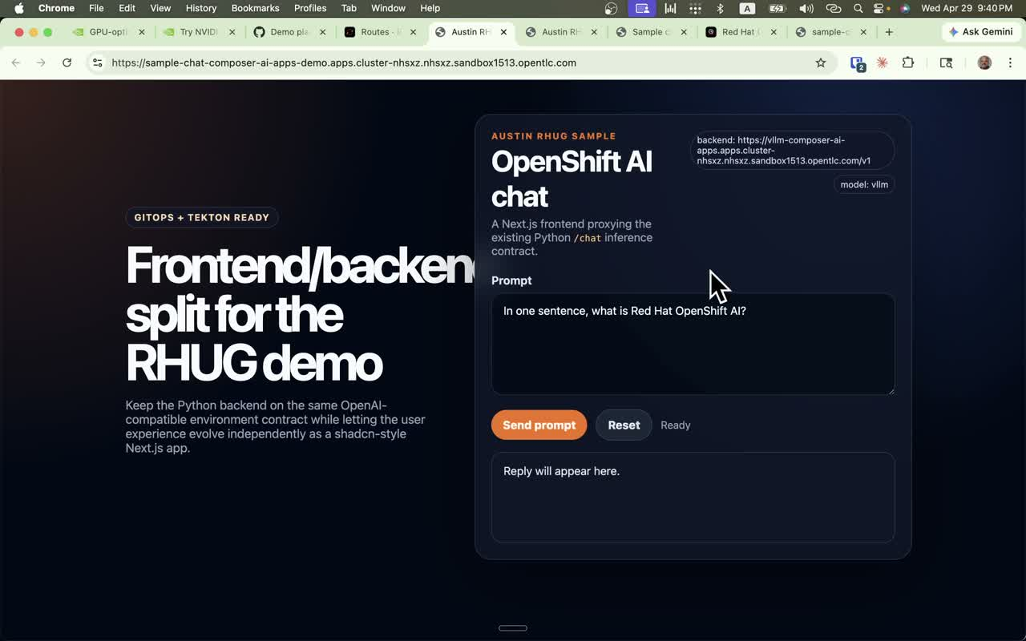
14
Step 14 — Frontend now on the on-cluster model
14_live-frontend-vllm-swap.mp4
WHAT YOU'RE WATCHING
Same Next.js page, no code change — backend pill flips to vllm-composer-ai-apps and model: vllm. The promotion moment.
▶ YouTube link
(paste URL here after upload)
Austin RHUG · 2026 — Step 14 of 17
github.com/dkypuros/austin_rhug_2016

Slide 16
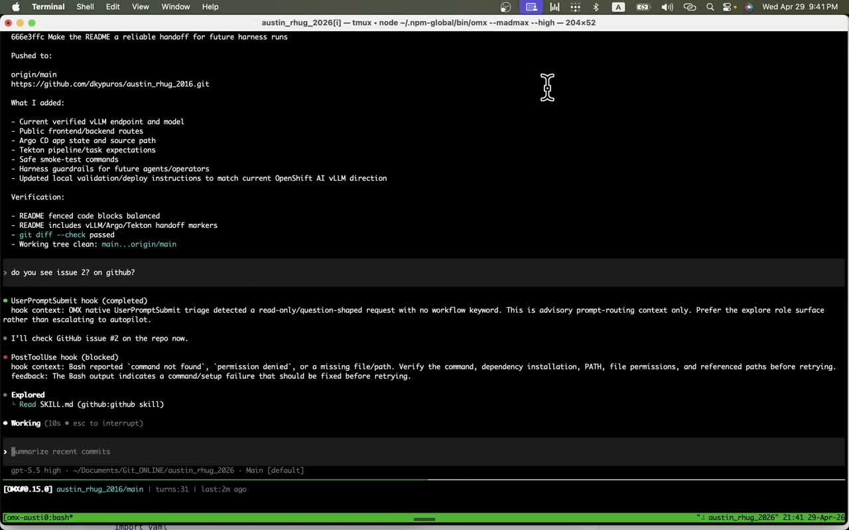
15
Step 15 — Issue #2 follow-up
15_issue-2-followup-prompt.mp4
WHAT YOU'RE WATCHING
Plan the next beat: add embeddings + reranking on the same env-var seam. Tracked in GitHub issue #2.
▶ YouTube link
(paste URL here after upload)
Austin RHUG · 2026 — Step 15 of 17
github.com/dkypuros/austin_rhug_2016

Slide 17
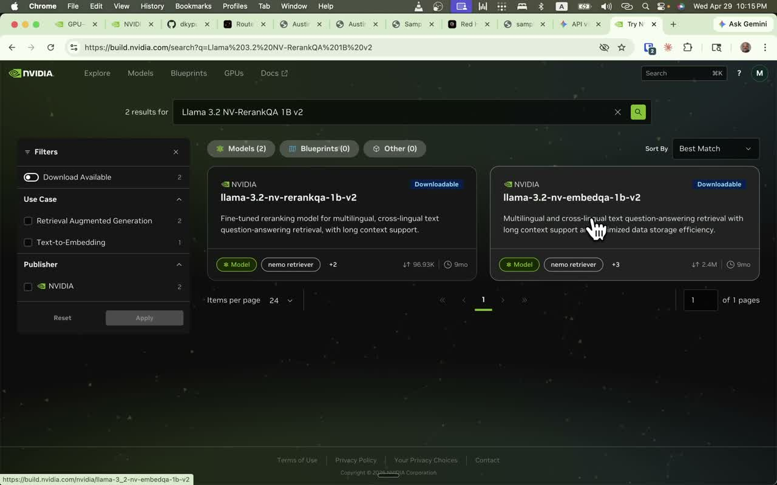
16
Step 16 — RAG walkthrough
16_rag-walkthrough-pills.mp4
WHAT YOU'RE WATCHING
Three pills appear: chat (vllm), embed (nv-embedqa-e5-v5), rerank (llama-3.2-nv-rerankqa-1b-v2). Same backend, retrieval lane added.
▶ YouTube link
(paste URL here after upload)
Austin RHUG · 2026 — Step 16 of 17
github.com/dkypuros/austin_rhug_2016

Slide 18
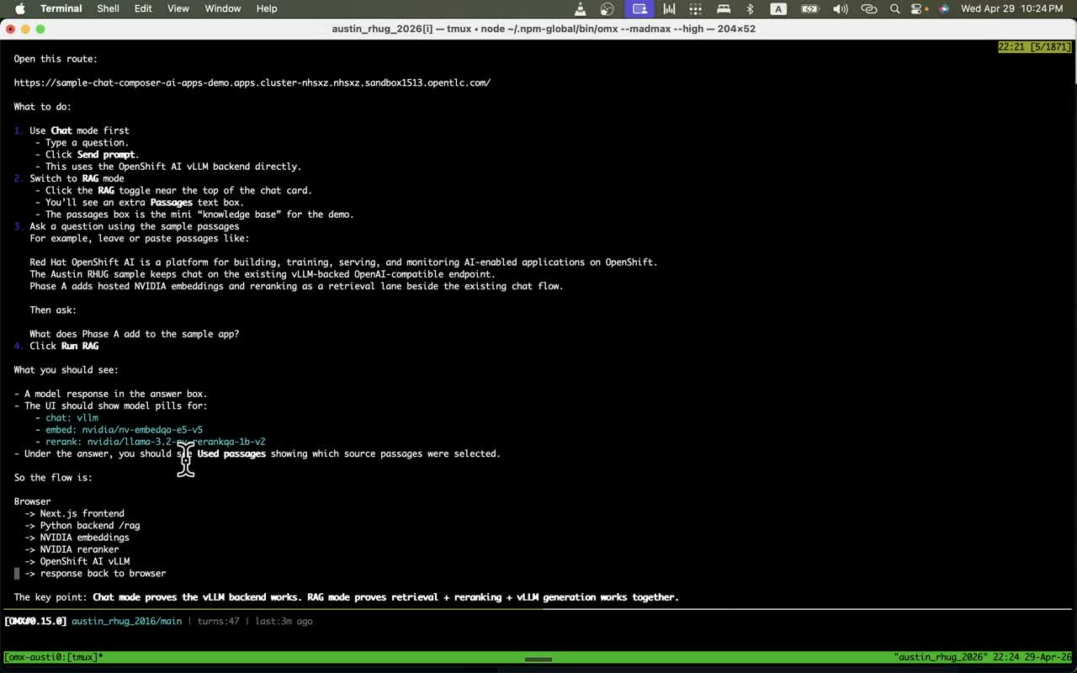
17
Step 17 — Discover the reranker on build.nvidia.com
17_nvidia-rerank-search.mp4
WHAT YOU'RE WATCHING
Two NIM hits for Llama 3.2 NV-RerankQA — the reranker and the embedder. Closes the loop: hosted NIMs available, ready to promote on-cluster too.
▶ YouTube link
(paste URL here after upload)
Austin RHUG · 2026 — Step 17 of 17
github.com/dkypuros/austin_rhug_2016

Slide 19
WHAT WE BUILT
One client. Two backends. One commit between them.
• Same OpenAI-compatible client — three env vars choose the backend.
• NVIDIA NGC for evaluation; in-cluster vLLM (Granite on RHOAI) for production.
• Argo CD owns the swap; same Route, same UI, no code change.
• Issue #2 extends the same seam to embeddings + reranking for full RAG.
github.com/dkypuros/austin_rhug_2016 · issues #1 and #2

