Slide 1

The many values
of one tree
An ordinary pine. Several economic possibilities.
Notes:
Picture an ordinary pine tree. Someone might offer twenty dollars for it standing in the woods. Someone else could turn its wood into several hundred dollars of lumber. And a person with the right building system might use it to replace thousands of dollars of purchased framing. How can all of those descriptions be true? This presentation follows one tree through different uses, then examines a proposed two-tree dome. The central idea is simple. The value depends on the work you add, the function you create, and the costs you avoid. Each number answers a different economic question.
On-screen qualification:
Sources: User-provided tree-value essay, adapted for a general audience.
Forest background: built-in ImageGen conceptual illustration, generated for this presentation.

Slide 2
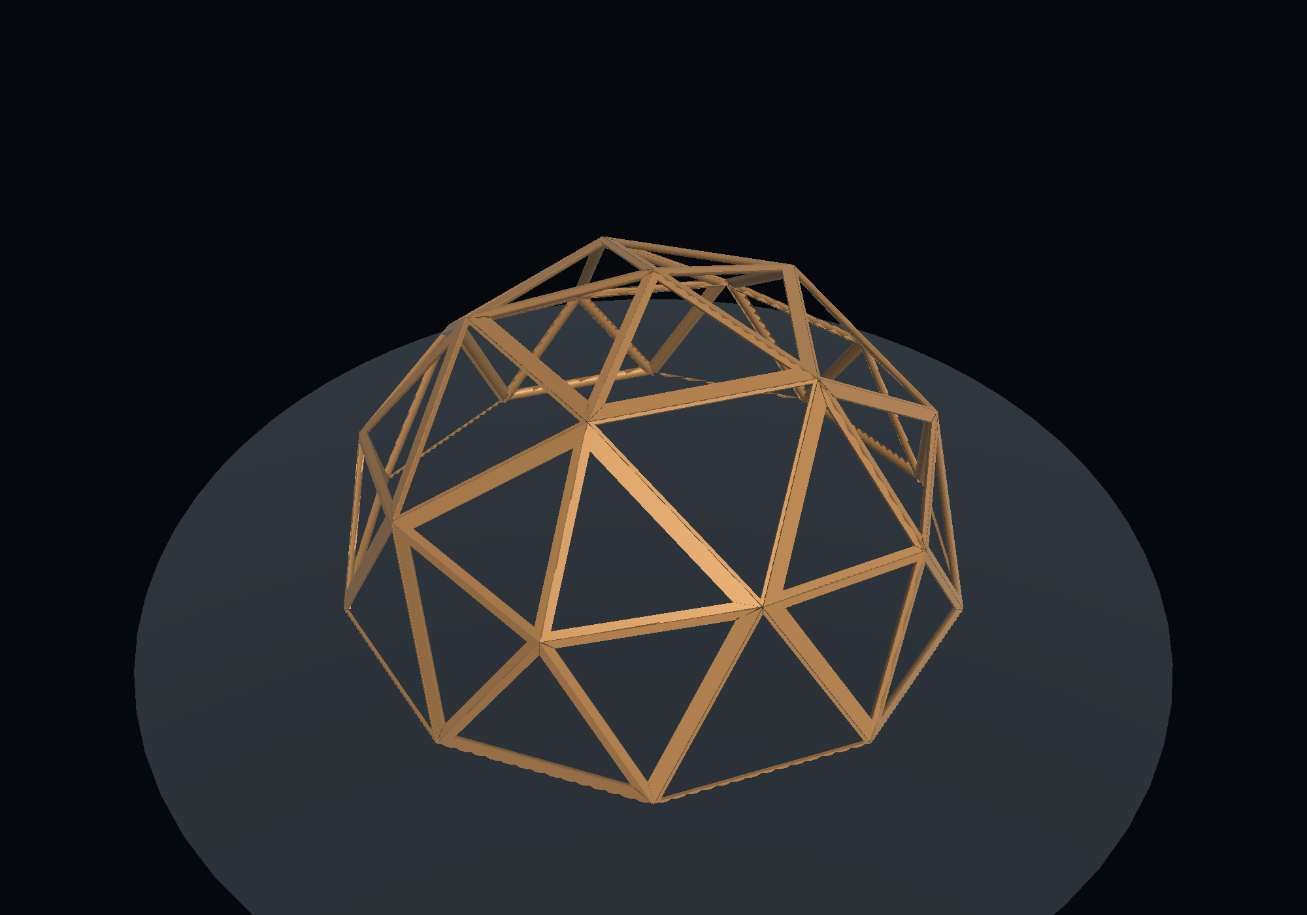
The working example
15-inch trunk diameter
60 feet of useful stem
Two suitable trees for a 300
ft² shell
Project assumptions. Actual yield and equivalent framing cost require measurement.
02
Notes:
Our example starts with a pine about fifteen inches in diameter at breast height, the standard reference height for measuring a trunk. The source assumes roughly sixty feet of useful stem and around thirty-seven cubic feet of solid wood. Trees taper, so this is a yield assumption, not the volume of a perfect cylinder. The dome scenario uses two suitable trees, approximately one hundred twenty frame members, and a three-hundred-square-foot structural shell. It assigns forty-eight hundred dollars to the commercial framing function those members could replace. That figure is a working comparison supplied with the project. It is not a contractor quote or the cost of a completed home.
On-screen qualification: Project assumptions. Actual yield and equivalent framing cost require measurement.
Sources: User-provided tree-value essay, adapted for a general audience.
Illustration: C:/Users/Don/Desktop/DomeSim/two_trees_codex/workspace/expanded-art/tools-20260912T064848369517Z-cc4b2b/forge-double-frame.png

Slide 3
Standing timber and stumpage
$10–$35
Illustrative standing value per tree
$23.34/ton
South-wide pine sawtimber, Q2 2026
$5.40/ton
South-wide pine pulpwood, Q2 2026
Regional prices are dated benchmarks. Two isolated trees may have little commercial harvest appeal.
03
Notes:
Stumpage means the price paid for standing timber before harvesting and transport. A buyer still has to fell the tree, pull it to a loading area, haul it, mill it, dry the boards, hold inventory, and find customers. Builders must then turn those boards into a structure. The source cites Alabama pine sawtimber at roughly seventeen to twenty-one dollars per ton in the fourth quarter of twenty twenty-five. TimberMart-South confirms a South-wide average of twenty-three dollars and thirty-four cents per ton for the second quarter of twenty twenty-six. The source's roughly six-dollar pulpwood comparison is close to that quarter's five dollars and forty cents. These are prices per ton, not prices per tree. The example's ten-to-thirty-five-dollar tree range also depends on its merchantable weight, quality, access, and local buyers.
On-screen qualification: Regional prices are dated benchmarks. Two isolated trees may have little commercial harvest appeal.
Sources: https://timbermart-south.com/wp-content/uploads/2026/07/2Q2026_bulletin.pdf ; Alabama Q4 range retained from supplied essay, corroborated by https://thetimberlandinvestor.com/alabama-stumpage-timber-prices/

Slide 4
One tree on the value ladder
State or use | Approximate value | Meaning
Standing timber | $10–$35 | Raw timber sale
Retail-equivalent firewood | $95–$135 | Processed fuel
Rough-sawn lumber | $330–$415 | Processed boards
About 80 wedge blanks | $250–$400 | Lumber substitution
Dome contribution | $2,400–$3,200 | Gross framing substitution
With assumed financing | $5,500–$7,300 | Nominal payments over 30 years
Gross comparisons before processing costs and labor. System use and loan payments are different measures.
04
Notes:
Here is the complete ladder from the source. Standing timber might bring ten to thirty-five dollars. Retail-equivalent firewood might represent about one hundred to one hundred thirty-five dollars. Rough pine boards could represent three hundred thirty to four hundred fifteen dollars. About eighty wedge blanks carry an estimated two-hundred-fifty-to-four-hundred-dollar lumber replacement value. In a useful dome assembly, the proposed contribution rises to twenty-four hundred to thirty-two hundred dollars per tree. Including the assumed financing, the source rounds the corresponding lifetime payments to fifty-five hundred through seventy-three hundred dollars. The upper figures depend on more favorable system assumptions. We will use the conservative two-tree allocation of twenty-four hundred dollars for the rest of the explanation. These are alternative valuations. Adding the rows together would count the same material repeatedly.
On-screen qualification: Gross comparisons before processing costs and labor. System use and loan payments are different measures.
Sources: User-provided tree-value essay, adapted for a general audience.

Slide 5
A cord measures a stack
4 ft × 4 ft × 8 ft = 128 ft³
The stack includes air spaces
Working conversion: about 90 ft³ of solid wood per cord
90 ft³ is a working solid-wood conversion. The 60-foot and 80-foot yield examples come from the source essay.
05
Notes:
Before pricing firewood, we need to understand a cord. A standard cord occupies one hundred twenty-eight cubic feet when stacked, commonly four feet high, four feet deep, and eight feet long. That stack includes empty spaces between pieces. Solid wood volume is smaller. Our model uses about ninety cubic feet of solid wood per cord. Forestry references show that the actual amount varies with piece size and stacking, so ninety is a conversion assumption rather than a universal physical constant. The supplied yield examples place a fifteen-inch pine near point three five cord at sixty feet and point four seven cord at eighty feet, depending on species and usable top diameter. For the representative stem, we use point three five to point four five cord.
On-screen qualification: 90 ft³ is a working solid-wood conversion. The 60-foot and 80-foot yield examples come from the source essay.
Sources: https://extension.psu.edu/valuing-standing-timber ; https://extension.okstate.edu/fact-sheets/measuring-woodland-timber ; supplied essay for tree-specific yield examples. The essay attributes 90 ft³ to Alabama Extension; that exact attribution was not independently verified.

Slide 6
The firewood comparison
0.35–0.45 cord
One representative stem
$95–$135
Retail-equivalent fuel value
$190–$270
Two stems, about 0.7–0.9 cord
Rounded model values. Local listing does not establish a species-matched pine sale price.
06
Notes:
A Tuscaloosa-area seller, North River Firewood, lists a full cord at two hundred seventy-five dollars for pickup and three hundred dollars delivered, with stacking charges and delivery terms to check. The source also gives a broader Southeast comparison of two hundred to three hundred twenty-five dollars per cord. Using the local two-hundred-seventy-five-to-three-hundred-dollar benchmark, point three five to point four five cord works out to roughly ninety-five to one hundred thirty-five dollars for one tree. Two equivalent trees represent about point seven to point nine cord, or one hundred ninety to two hundred seventy dollars. This is a retail-equivalent comparison. Species, seasoning, and delivery affect actual sale value. Felling, cutting, splitting, seasoning, and stacking also consume time and money. The selling price is not the seller's profit.
On-screen qualification: Rounded model values. Local listing does not establish a species-matched pine sale price.
Sources: https://north-river-firewood.ueniweb.com/price-list ; broader Southeast range retained as an unverified comparison range from the supplied essay.

Slide 7
Firewood and structural function
$190–$270
Two trees as retail-equivalent firewood
$4,800
Modeled framing function from those trees
About 18–25× gross use-value comparison. It is not a resale-price multiplier.
07
Notes:
Now compare those same two trees with the proposed dome. The model assigns them forty-eight hundred dollars of framing substitution. Divide that by the firewood comparison and the ratio is roughly eighteen to twenty-five. Using two hundred fifty dollars as a simple midpoint gives forty-eight hundred divided by two hundred fifty, or nineteen point two. The amount of wood has not increased. The design gives the wood a different purpose. The comparison also changes economic categories. Firewood is a processed product you might sell. The dome number is a purchased structural function you might avoid paying for. It becomes a real advantage only if the substitute actually does the required job at an acceptable total cost.
On-screen qualification: About 18–25× gross use-value comparison. It is not a resale-price multiplier.
Sources: User-provided tree-value essay, adapted for a general audience.

Slide 8
Conventional lumber recovery
37 ft³ × 7.5 BF/ft³ ≈ 275 BF
275 BF × $1.20–$1.50/BF
≈ $330–$413 per tree
7.5 BF/ft³ and $1.20–$1.50/BF are scenario inputs. 275 BF uses coarse rounding.
08
Notes:
Milling creates another useful product: boards. A board foot is a volume unit equivalent to a board one inch thick, twelve inches wide, and twelve inches long. You cannot turn every cubic inch of a log into standard lumber. The saw blade removes a strip called the kerf. Outer slabs, edging, defects, and dimensional requirements reduce recovery. The source gives a southern-pine recovery range of seven point five to eight point four board feet per cubic foot of log. We use seven point five as the working factor. Thirty-seven times seven point five is two hundred seventy-seven point five, rounded here to about two hundred seventy-five board feet. At the assumed dollar twenty to dollar fifty per board foot, the result is roughly three hundred thirty to four hundred thirteen dollars. Mill configuration, grade, and local prices can change the result.
On-screen qualification: 7.5 BF/ft³ and $1.20–$1.50/BF are scenario inputs. 275 BF uses coarse rounding.
Sources: https://www.fpl.fs.usda.gov/documnts/fplrp/fplrp285.pdf supports a historical average around 7.5, not the complete claimed modern southern-pine 7.5–8.4 range. That range is retained as a source input. https://potato-pepper-ggcl.squarespace.com/lumberprices lists common 1x pine at $1.50/BF.

Slide 9
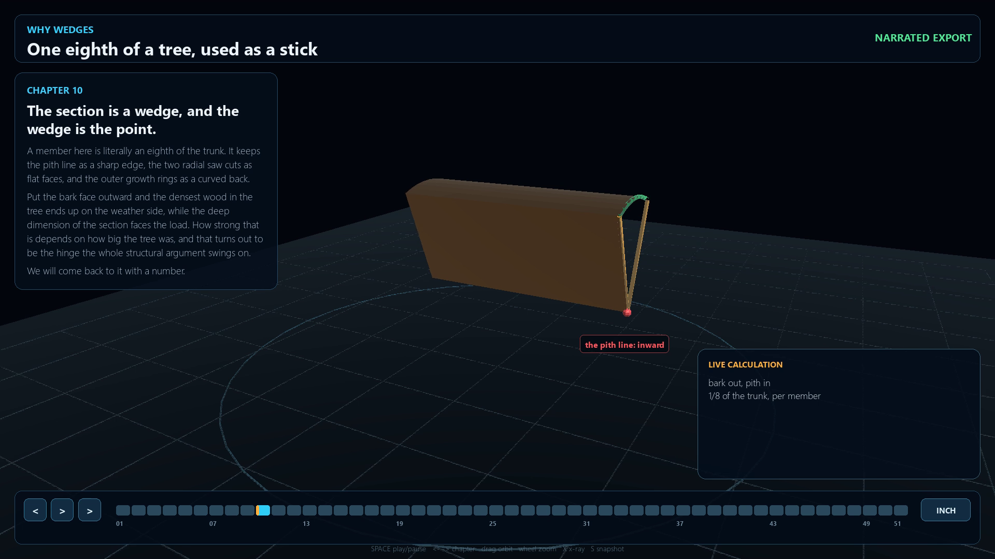
Radial wedge processing
One log becomes 2, then 4,
then 8 sectors
Eight longitudinal sectors
retain the curved outer form
Useful members still depend
on sound wood and usable
dimensions
Radial processing concept. Usable structural yield remains a project assumption.
09
Notes:
The wedge proposal changes the shape of the desired product. A conventional sawmill aims to recover standard rectangular boards. This method divides the log lengthwise into two halves, then four quarters, then eight sectors. Each sector has a wedge-shaped cross-section. Because the structural design can use that shape, less wood may need to be removed simply to make rectangular stock. That is the proposed material advantage. It does not eliminate losses from cutting, defects, taper, trimming, or drying. The meaningful question becomes how much usable building structure you can recover from the tree. To answer it, the resulting pieces must meet the design's length, cross-section, connection, and material requirements.
On-screen qualification: Radial processing concept. Usable structural yield remains a project assumption.
Sources: User-provided tree-value essay, adapted for a general audience.
Illustration: C:/Users/Don/Desktop/DomeSim/two_trees_codex/workspace/expanded-art/video-20260912T103813587203Z-f337b60b/01-why-wedges-no-sawmill-v2-000333.000s.png

Slide 10
The theoretical member count
8 sectors × 60 ft = 480 linear ft
480 ft ÷ 6 ft = 80 blanks per tree
2 trees = 160 theoretical blanks
Idealized count before actual cutting losses and material acceptance.
10
Notes:
The source's member-count arithmetic is straightforward. Eight longitudinal sectors over sixty useful feet give four hundred eighty linear feet of wedge stock. Divide by six feet per blank and you get eighty blanks from one tree. Two comparable trees therefore offer a theoretical one hundred sixty six-foot blanks. This is an inventory calculation, not a measured production result. It assumes the useful stem can supply all eight acceptable sectors at each needed section and that the length allowance covers the actual cutting plan. Real trunks taper. Knots, splits, saw kerf, end trimming, and drying can turn a theoretical blank into a shorter piece or a reject. Those effects determine whether the proposed inventory holds up in practice.
On-screen qualification: Idealized count before actual cutting losses and material acceptance.
Sources: User-provided tree-value essay, adapted for a general audience.

Slide 11
The allowance for other pieces
160
Theoretical six-foot blanks
120
Modeled dome frame members
40
Potential spare or secondary pieces
The 40-piece balance is an allowance, not guaranteed additional construction material.
11
Notes:
Against a requirement of about one hundred twenty members, one hundred sixty theoretical blanks leave forty potential pieces. The source identifies several uses for that allowance: rejects, shorter members, flooring or support material, bracing, door framing, test pieces, and replacement stock. Those forty pieces cannot all be promised as useful extras. Some may be consumed by the losses needed to obtain the main frame. Still, the allowance makes the planning question concrete. A sawmill asks how much standardized lumber a log can produce. This building method asks how much of the proposed structure the available stock can supply. A measured cut list and an inventory of accepted pieces connect those two questions to reality.
On-screen qualification: The 40-piece balance is an allowance, not guaranteed additional construction material.
Sources: User-provided tree-value essay, adapted for a general audience.

Slide 12

Geometry and the jig add function
A repeatable jig organizes
the work
Members become triangular
assemblies
Assemblies contribute to a
structural shell
Existing DomeSim jig illustration. The image explains the concept, not a certified construction detail.
12
Notes:
A pile of wedge blanks has a material substitution value, estimated in the source at two hundred fifty to four hundred dollars per tree. The larger economic claim appears when geometry, a jig, assembly work, and a suitable structural design turn those pieces into a functioning shell. A jig is a fixture that holds parts in a repeatable position while you work. It can reduce repeated measuring and help produce consistent assemblies. The transformation therefore belongs to a system: tree, tools, labor, knowledge, organization, and verified performance. Assigning all of the resulting value to the raw tree would hide most of the inputs that made the result possible.
On-screen qualification: Existing DomeSim jig illustration. The image explains the concept, not a certified construction detail.
Sources: User-provided tree-value essay, adapted for a general audience.
Illustration: C:/Users/Don/Desktop/DomeSim/two_trees_codex/workspace/expanded-art/tools-20260912T064848369517Z-cc4b2b/forge-jig-loaded.png

Slide 13
Who performs the next process?
Conventional route
Tree / logger / truck / sawmill / kiln
Wholesaler / retailer / framer / house
Proposed local route
Tree / radial processing / drying
Jig / triangular assembly / dome
Alternative production routes. Self-building internalizes work and costs.
13
Notes:
Imagine the conventional route: tree, logger, truck, sawmill, kiln, wholesaler, retailer, framer, and finally a house. Now imagine the proposed local route: tree, radial processing, drying, jig, triangular assembly, and dome. Each commercial step normally carries someone's labor, equipment, overhead, transportation, inventory, profit, and financing. Performing more of the chain yourself may reduce some of those purchased services and margins. The physical work remains. You take responsibility for the parts of the process you can perform effectively. The savings come from organizing that work well, using the available wood efficiently, and avoiding costs that your particular situation does not require. Commercial operations also have efficiencies, so a shorter route alone does not prove that your total cost will be lower.
On-screen qualification: Alternative production routes. Self-building internalizes work and costs.
Sources: User-provided tree-value essay, adapted for a general audience.

Slide 14
Different owners quote different values
Landowner: standing timber
Firewood seller and sawmill: processed material
Lumberyard: drying, grading, stocking and retail
Framer: installed structural function
Lender: the payment stream that funds the work
14
Notes:
The landowner might describe a twenty-dollar tree. The firewood seller sees roughly one hundred dollars of prepared fuel. The sawmill sees several hundred dollars of boards. The lumberyard adds drying, grading, stocking, and retail service. The framer turns those boards into an installed structure that represents thousands of dollars of completed work. If a customer borrows for that work, the lender receives payments that include interest over time. All of these descriptions begin with the same cellulose. Processing, knowledge, organization, and usefulness change what the next person can offer. The numbers become understandable once you identify who owns the next process and what that person's price actually includes.
On-screen qualification:
Sources: User-provided tree-value essay, adapted for a general audience.

Slide 15
The two-tree comparison
Use or measure | Two-tree quantity | Approximate amount
Standing timber | Two suitable trees | $20–$70
Retail-equivalent firewood | 0.7–0.9 cord | $190–$270
Rough pine lumber | About 550 BF | $660–$825
Framing substitution | 300 ft² shell scenario | $4,800
Financed payments avoided | 6.5%, 30 years | $10,922 nominal
Illustrative gross comparisons. The shell figure excludes the other costs of a completed home.
15
Notes:
With two trees, the complete comparison becomes easier to see. Selling them standing might bring twenty to seventy dollars combined, although a buyer may not want to harvest only two trees. Processing them as firewood gives a retail-equivalent one hundred ninety to two hundred seventy dollars. Milling them yields about five hundred fifty board feet in the example, worth six hundred sixty to eight hundred twenty-five dollars at the assumed rough-pine price. Using them in the dome is modeled to replace forty-eight hundred dollars of framing. If that entire amount would otherwise have been financed under the stated mortgage assumptions, its lifetime principal-and-interest payments total about ten thousand nine hundred twenty-two dollars. These rows measure different alternatives, not cumulative income.
On-screen qualification: Illustrative gross comparisons. The shell figure excludes the other costs of a completed home.
Sources: User-provided tree-value essay, adapted for a general audience.

Slide 16
Principal and future payments
$4,800
Assumed principal avoided
$30.34/month
Principal and interest at 6.5% for 30 years
$10,922
360 nominal payments in total
Illustrative fixed-rate loan calculation. $10,922 is a future nominal total, not present value.
16
Notes:
Here is what financing adds to the comparison. Assume forty-eight hundred dollars would have been borrowed at a fixed annual rate of six point five percent for thirty years, with monthly payments. The standard amortization calculation gives about thirty dollars and thirty-four cents each month. Across three hundred sixty payments, the unrounded calculation totals ten thousand nine hundred twenty-two dollars. About six thousand one hundred twenty-two dollars of that total is interest. This scenario assumes the balance stays in place for the full term, with no early repayment or refinancing. It excludes taxes, insurance, and fees. Nominal means we add future dollars without adjusting for inflation or the time value of money. The forty-eight hundred dollars is already included in the payment total. Adding it again would double count the principal.
On-screen qualification: Illustrative fixed-rate loan calculation. $10,922 is a future nominal total, not present value.
Sources: User-provided tree-value essay, adapted for a general audience.

Slide 17
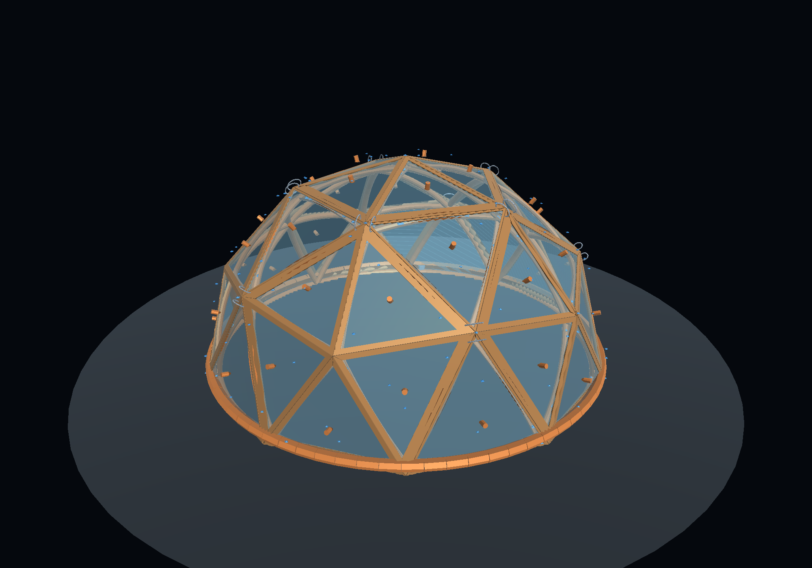
Fuel and durable capital
$250 of illustrative fuel
value used once
$4,800 of modeled framing
substitution
A useful structure can
provide service over time
Concept illustration of a building shell. Durability and property value depend on the completed project.
17
Notes:
Firewood converts wood into heat and consumes the material in the process. Construction can keep that wood in service as part of a durable asset. Using the two-hundred-fifty-dollar firewood illustration, the forty-eight-hundred-dollar framing comparison is nineteen point two times as large. But the deeper distinction is the continuing function. A completed, useful building can provide shelter and enclosed space, and may contribute to property value and owner equity. Appreciation is possible, not guaranteed. Framing by itself does not establish a finished building's market value. Connections, weather protection, foundations, services, maintenance, and the rest of the project still matter. The economic opportunity is to preserve wood in a useful capital asset whose service lasts beyond a single use.
On-screen qualification: Concept illustration of a building shell. Durability and property value depend on the completed project.
Sources: User-provided tree-value essay, adapted for a general audience.
Illustration: C:/Users/Don/Desktop/DomeSim/two_trees_codex/workspace/expanded-art/tools-20260912T064848369517Z-cc4b2b/forge-split-log-shell.png

Slide 18
A highest-use index
Use or measure | Source’s approximate index
Standing timber | 1×
Firewood | About 5×
Rough lumber | About 15–20×
Dome structural contribution | About 100× or more
Including nominal financing | About 250× or more
Economic-use indices, not resale-price multipliers. Categories and time horizons differ.
18
Notes:
You can summarize the ladder with a rough index. Set a representative standing value to one. The source describes firewood near five times that value, lumber near fifteen to twenty times, the dome contribution around one hundred times or more, and nominal financed payments around two hundred fifty times or more. These are broad economic-use comparisons. For example, an exact twenty-dollar baseline makes a twenty-four-hundred-dollar structural contribution one hundred twenty times as large. Changing the starting tree value changes the ratio. The financing row also spans thirty years, while the material rows describe value at one point in time. An index makes the scale memorable, but it should always travel with its assumptions and the name of the quantity being compared.
On-screen qualification: Economic-use indices, not resale-price multipliers. Categories and time horizons differ.
Sources: User-provided tree-value essay, adapted for a general audience.

Slide 19
Timber value and labor productivity
96:1
Gross framing function per dollar of standing timber
$60/hour
Gross framing substitution per work hour
Source assumptions: $50 combined timber value and 80 work hours. Both ratios are gross.
19
Notes:
Suppose the two standing trees together have a timber value of fifty dollars. Forty-eight hundred divided by fifty is ninety-six. That gives a gross raw-material ratio of ninety-six dollars of framing function for each dollar of standing timber value. Now include the work. If the transformation takes eighty hours, forty-eight hundred divided by eighty is sixty dollars per hour. This is gross framing substitution per work hour. It is not a take-home wage or a profit rate, because it has not deducted cash expenses or the value of the timber. Both measures can be useful at once. One describes the relationship to the raw material. The other describes output relative to time. Neither justifies treating the other inputs as free.
On-screen qualification: Source assumptions: $50 combined timber value and 80 work hours. Both ratios are gross.
Sources: User-provided tree-value essay, adapted for a general audience.

Slide 20
Each tree’s share of the system
$2,400
Half of the modeled $4,800 framing function
$5,461
Half of the $10,922 nominal payment stream
$20 / $100 / $350
Rounded standing / firewood / lumber examples
Per-tree allocations under the conservative two-tree case. Each larger value depends on successful substitution.
20
Notes:
Under the two-tree assumption, divide the forty-eight-hundred-dollar framing value by two. Each tree contributes twenty-four hundred dollars of gross structural substitution. Divide the lifetime payment stream by two and each tree accounts for about fifty-four hundred sixty-one dollars of nominal payments. You can therefore describe the same tree as twenty-dollar standing timber, roughly one-hundred-dollar firewood, roughly three-hundred-fifty-dollar lumber, a twenty-four-hundred-dollar framing contribution, or a fifty-four-hundred-sixty-one-dollar share of financed payments. There is no contradiction once you name the measurement. There is also no new market in which someone automatically pays those larger amounts for a raw tree. The larger values belong to a successful use of the complete system.
On-screen qualification: Per-tree allocations under the conservative two-tree case. Each larger value depends on successful substitution.
Sources: User-provided tree-value essay, adapted for a general audience.

Slide 21
Personal use value
The highest net value
you can realistically create
21
Notes:
Market sale value is what another person is willing to pay you for the resource. Personal use value asks what you can accomplish by keeping it. Suppose someone offers twenty-five dollars for a standing pine. If you can realistically turn it into the equivalent of twenty-four hundred dollars of purchased framing, keeping it may be the better choice. That conclusion depends on having the time, ability, suitable equipment, and legal and structural means to complete the work. It also depends on what you give up by choosing this project. The meaningful opportunity is the highest net value you can realistically create, after paying the processing costs and allowing for the value of your time. A large gross replacement number alone does not settle the choice.
On-screen qualification:
Sources: User-provided tree-value essay, adapted for a general audience.

Slide 22
The net-use formula
Commercial function displaced
− Cash processing costs
− Opportunity cost of labor
= Net personal use value
This calculation requires equivalent finished function and a complete accounting of project costs.
22
Notes:
The formula is the commercial function displaced, minus cash processing costs, minus the opportunity cost of labor. Cash costs can include harvesting, transport, consumables, tool wear, drying, and the other expenses required for the substitute. Count each cost once and compare equivalent scopes. Opportunity cost means the value of the best realistic alternative you give up. If forty hours on the tree replace forty hours of available paid work, your after-tax earnings from that work are a useful benchmark. If the alternative is different, choose a value that reflects your circumstances. Finally, compare the resulting net use value with the amount you could receive by selling the tree and with any other realistic use.
On-screen qualification: This calculation requires equivalent finished function and a complete accounting of project costs.
Sources: User-provided tree-value essay, adapted for a general audience.

Slide 23
A worked net-value example
$2,400 − $300 − (40 × $25)
= $1,100 net personal use value
$1,100 − $25 sale alternative = $1,075 advantage
Illustrative example. $1,100 before the forgone tree sale; $1,075 relative to selling for $25.
23
Notes:
Let one tree contribute twenty-four hundred dollars of equivalent framing. Suppose direct expenses are three hundred dollars, the work takes forty hours, and your alternative after-tax wage is twenty-five dollars per hour. Forty times twenty-five assigns one thousand dollars to your time. Subtract that and the three hundred dollars of cash costs from twenty-four hundred. The result is eleven hundred dollars of net personal use value. This is the source's worked example, with your labor fully counted at the assumed rate. To choose between keeping the tree and accepting a twenty-five-dollar sale offer, subtract that forgone sale value as well. The advantage of processing rather than selling is then one thousand seventy-five dollars. That final comparison makes the opportunity cost of the tree explicit.
On-screen qualification: Illustrative example. $1,100 before the forgone tree sale; $1,075 relative to selling for $25.
Sources: User-provided tree-value essay, adapted for a general audience.

Slide 24
What changes the result?
Accepted members recovered from the actual trees
Equivalent framing price and full processing costs
Hours of work and the value of that time
Actual borrowing amount, rate and repayment period
Sensitivity follows the worked example. $2,100 ÷ 40 = $52.50/hour before the sale alternative.
24
Notes:
The model is most useful when you know which inputs can change the answer. A lower accepted yield may require more trees. Higher tool or drying costs reduce the advantage. More hours, or a more valuable alternative use of your time, also reduce it. A lower commercial framing price reduces what you avoid buying. In the worked example, twenty-four hundred minus three hundred leaves twenty-one hundred dollars available to compensate forty hours of work. That is fifty-two dollars and fifty cents per hour before counting the forgone sale. Above that opportunity cost, the stated net use value becomes negative. Financing benefits also fall if you borrow less, repay early, or would not have borrowed at all. Measuring these inputs turns the idea into an economic decision.
On-screen qualification: Sensitivity follows the worked example. $2,100 ÷ 40 = $52.50/hour before the sale alternative.
Sources: User-provided tree-value essay, adapted for a general audience.

Slide 25
A clear public explanation
“A $20 standing tree could contribute
about $2,400 of avoided framing cost
in this model.”
Conditional claim based on the supplied model. Processing expenses and labor still count.
25
Notes:
A clear public explanation names both the raw input and the function. You could say: In this model, a twenty-dollar standing tree could contribute about twenty-four hundred dollars of avoided commercial framing cost, before processing expenses and the value of my labor. That wording is stronger than calling it a five-thousand-dollar tree, because it tells the audience where the value actually comes from. Geometry and a repeatable method let ordinary material perform a valuable job. The labor, tools, knowledge, and design deserve their share of the explanation. Any financed-payment comparison should appear separately, with the interest rate and time period attached.
On-screen qualification: Conditional claim based on the supplied model. Processing expenses and labor still count.
Sources: User-provided tree-value essay, adapted for a general audience.

Slide 26
The value is in the useful result
The same wood can serve different purposes
The process creates the function
The best choice depends on realistic net value
Notes:
We began with an ordinary pine and followed several possibilities. Standing timber, firewood, and lumber have different processed-material values. A successful dome system could use that material to avoid buying a more expensive structural function. Avoiding a loan for that function could also reduce future payments. Those claims can coexist because each measures something different. The decisive number for the builder is the highest realistic net use value after expenses, the value of time, and the alternatives given up. That is why the two-tree idea deserves a careful trial. Its promise is to make structural shelter a valuable use of ordinary wood. Measured yield, repeatable work, and an equivalent functioning structure are what would turn that promise into a demonstrated result.
On-screen qualification:
Sources: User-provided tree-value essay, adapted for a general audience.
Forest background: built-in ImageGen conceptual illustration, generated for this presentation.

