Slide 1
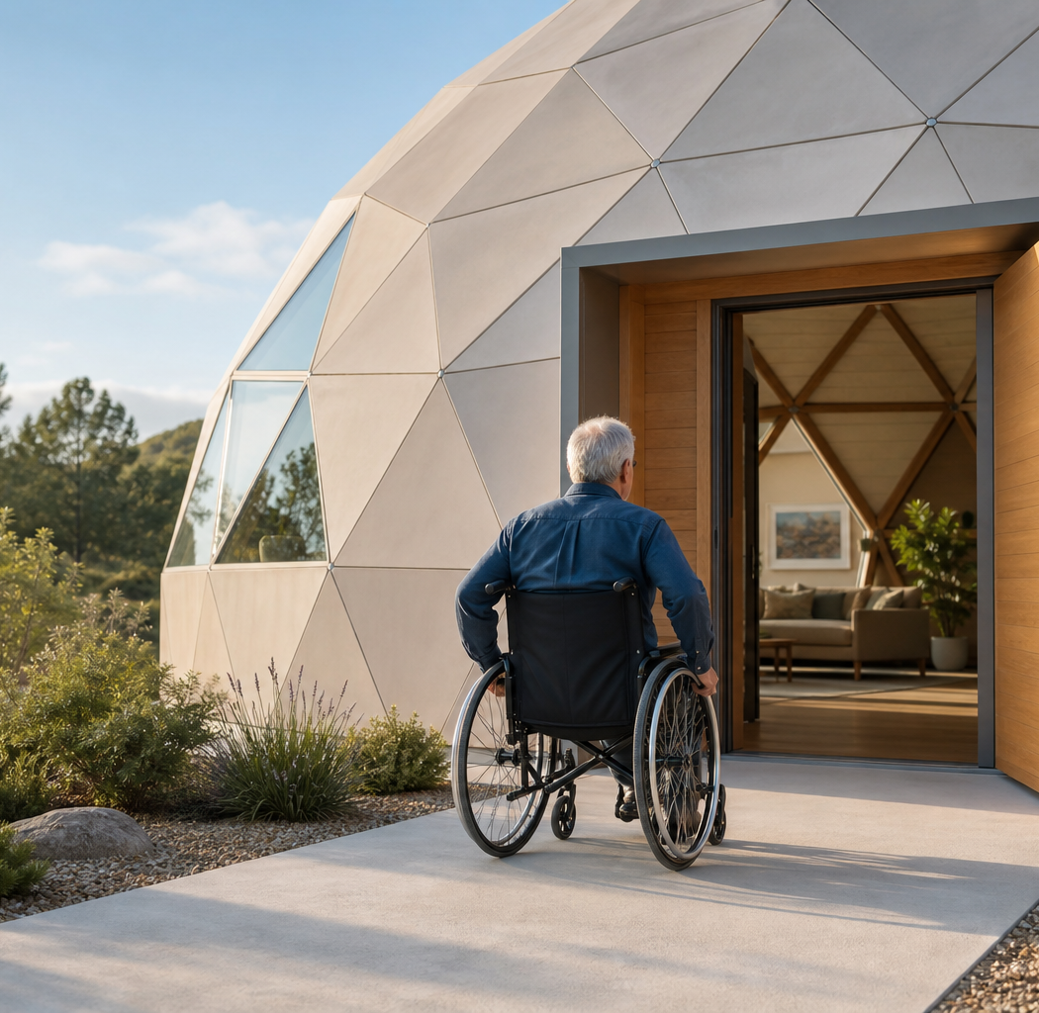
WHEELCHAIR-FIRST DOME LIVING
A home that
moves with you
Why a purpose-built, single-level dome can turn accessibility from an add-on into the organizing idea.
For wheelchair users, older adults, and anyone whose movement changes over time
ACCESSIBLE HOUSING CONCEPT • 2026
Notes:
Narration
The strongest accessible home is not a conventional plan with a ramp added later. It begins with the person, the chair, and the path. A single-level dome can make that path the center of the architecture—if every threshold, turn, and reach is designed honestly.
[Sources]
- Visual: original AI-generated image created for this deck with OpenAI ImageGen; prompt retained in the presentation metadata and companion manifest.
[/Sources]

Slide 2
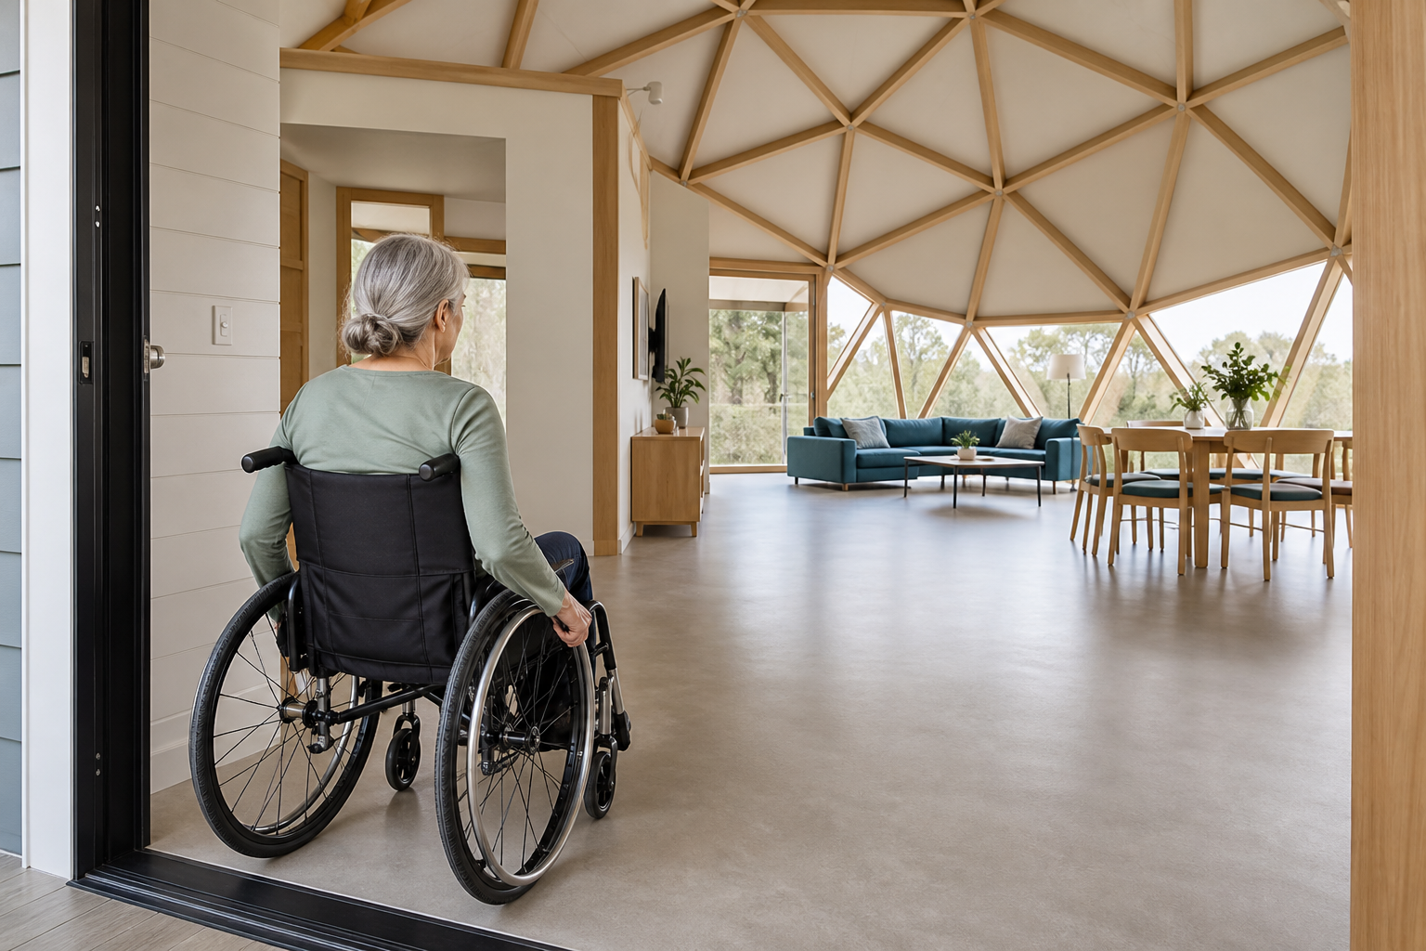
WHEELCHAIR-FIRST DOME LIVING
WHEELCHAIR-FIRST DOME LIVING
One level changes the whole day
One level changes the whole day
The daily win
No stairs or lift dependency. The primary life of the house happens on one continuous floor.
No corridor maze. Rooms open from a legible central space instead of a chain of tight turns.
No special route. The accessible path is the same welcoming path everyone uses.
Accessibility becomes invisible—in the best possible way.
02
Notes:
Narration
Independence is usually lost in small moments: one step at the entrance, one tight turn at the bedroom, one threshold at the shower. Put daily life on one continuous floor and those moments stop demanding help. The accessible route becomes simply the route.
[Sources]
- National Institute on Aging, “Aging in Place: Growing Older at Home”: https://www.nia.nih.gov/health/aging-place-growing-older-home
- Visual: original AI-generated image created for this deck with OpenAI ImageGen.
[/Sources]

Slide 3
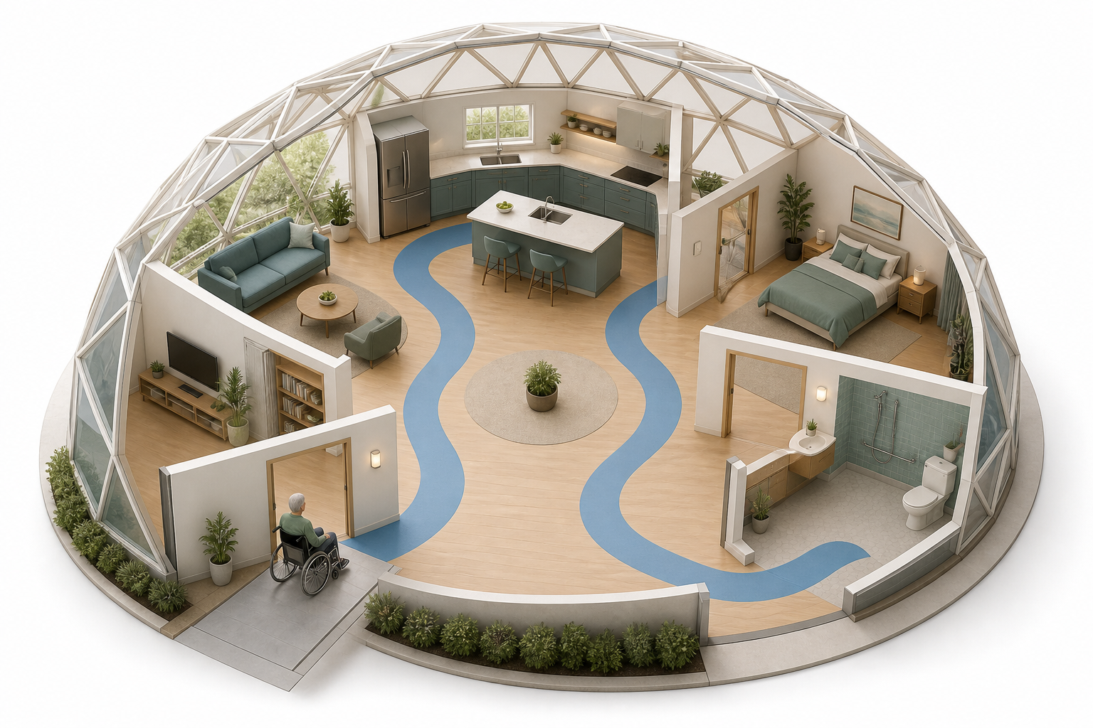
WHEELCHAIR-FIRST DOME LIVING
WHEELCHAIR-FIRST DOME LIVING
Start with a turning circle, then place the rooms
Start with a turning circle, then place the rooms
The dome works best when the open center becomes a mobility commons—not leftover space.
01
ENTER
A flush doorway lands directly in the shared center.
02
TURN
Generous clear floor space absorbs direction changes.
03
REACH
Short radial routes connect kitchen, bed, and bath.
03
Notes:
Narration
A good accessible floor plan is a movement map. Enter without a level change. Turn without reversing through a narrow hall. Reach the kitchen, bedroom, and bathroom on short, obvious routes. The dome earns its value when its central volume is reserved for that movement.
[Sources]
- ADA 2010 Standards, Sections 304–305, used here as best-practice dimensional references: https://www.ada.gov/law-and-regs/design-standards/2010-stds/
- Visual: original AI-generated image created for this deck with OpenAI ImageGen; conceptual, not a construction drawing.
[/Sources]

Slide 4
WHEELCHAIR-FIRST DOME LIVING
WHEELCHAIR-FIRST DOME LIVING
Every extra barrier becomes a daily tax
Every extra barrier becomes a daily tax
A plan can look generous on paper and still demand dozens of avoidable maneuvers every day.
01
02
03
04
THRESHOLD
TURN
REACH
TRANSFER
A wheel catches. Momentum stops.
A sharp corner forces backing and correction.
A control sits beyond safe range.
A tight fixture turns privacy into assistance.
The persuasive case for the dome is simple: spend the floor area on movement before spending it on walls.
04
Notes:
Narration
Accessibility is cumulative. A threshold, a tight turn, a long reach, and a crowded transfer zone may each seem minor. Repeated across a day, they drain time, strength, and privacy. The plan should remove those taxes before the first wall is built.
[Sources]
- No external factual claim on this slide. Visuals are original AI-generated assets created for this deck.
[/Sources]

Slide 5
WHEELCHAIR-FIRST DOME LIVING
WHEELCHAIR-FIRST DOME LIVING
The shell can organize space around movement
The shell can organize space around movement
The dome is valuable here not because it is round, but because it can hold a broad central volume with fewer interior structural interruptions.
CENTER
EDGE
ROUTES
Reserve it for turning, passing, gathering, and changing direction.
Place storage, utilities, and built-ins where movement does not need to be.
Use short, straight radial connections—never a curved ramp as a design gesture.
Curve the envelope. Keep the accessible route level, direct, and predictable.
05
Notes:
Narration
The dome’s structural shell can free the interior from the bearing walls that often chop a plan into corridors. But the curved exterior does not excuse curved circulation. Put the turning zone in the center, service functions at the edge, and connect rooms with short, level, straight routes.
[Sources]
- ADA 2010 Standards, Advisory 405.7, cautions that tight curvilinear ramps can create compound cross slopes: https://www.ada.gov/law-and-regs/design-standards/2010-stds/
[/Sources]

Slide 6
WHEELCHAIR-FIRST DOME LIVING
WHEELCHAIR-FIRST DOME LIVING
The entrance is the first independence test
The entrance is the first independence test
A beautiful house that requires help at the door is not accessible.
32 in
Flush threshold. Eliminate the small lip that stops casters and creates a trip edge.
Level landing. Give the user room to stop, reach hardware, and operate the door.
Straight, gentle approach. Use the least slope practical; if it is a ramp, design to the applicable standard.
Simple hardware. Lever handles, low force, and powered opening where appropriate.
minimum clear door opening
Benchmark from the ADA Standards; local residential requirements and individual needs may differ.
A shared, dignified front door—not a side-door accommodation.
06
Notes:
Narration
The entrance should pass four tests: a flush threshold, enough clear opening, enough landing space to operate the door, and the gentlest practical approach. The 32-inch number is a useful design benchmark, but the principle matters more: the front door must work independently.
[Sources]
- ADA 2010 Standards, Sections 404.2.3 and 405: https://www.ada.gov/law-and-regs/design-standards/2010-stds/
[/Sources]

Slide 7
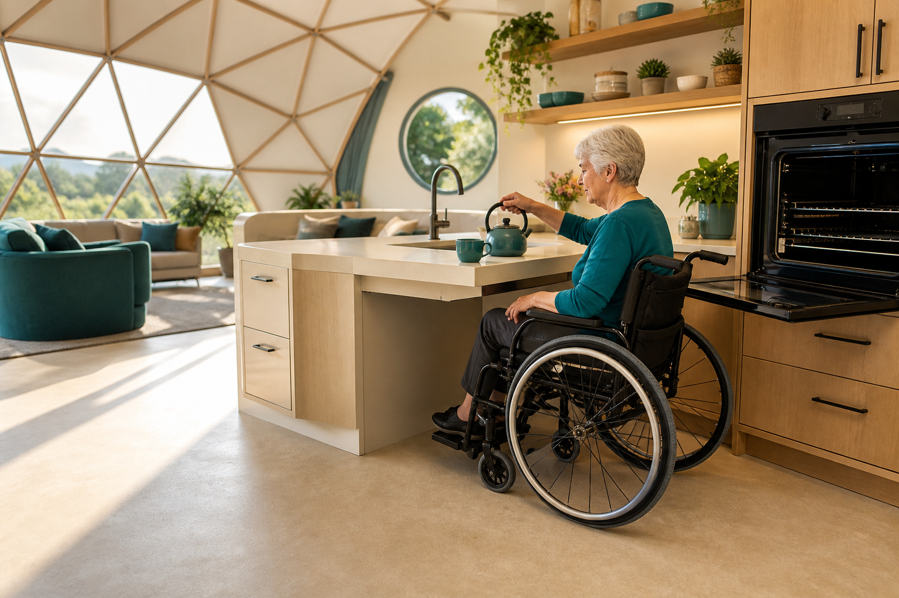
WHEELCHAIR-FIRST DOME LIVING
WHEELCHAIR-FIRST DOME LIVING
The kitchen stays part of life
The kitchen stays part of life
Design for reach, not adaptation
Pull under. Provide knee and toe clearance at a true work surface.
Bring storage down. Use drawers, pull-outs, and reachable pantry zones.
Open the turning area. Keep the chair clear of appliance doors and traffic.
Share the room. An open kitchen keeps cooking social, visible, and connected.
07
Notes:
Narration
The kitchen is where accessible design becomes quality of life. Knee clearance, reachable storage, side-opening appliances, and room to turn keep a wheelchair user participating instead of watching. The dome’s open center can give the kitchen generous circulation without isolating it.
[Sources]
- ADA 2010 Standards, Sections 305–306, used as best-practice clear floor, knee, and toe clearance references: https://www.ada.gov/law-and-regs/design-standards/2010-stds/
- Visual: original AI-generated image created for this deck with OpenAI ImageGen; features are illustrative and require project-specific verification.
[/Sources]

Slide 8
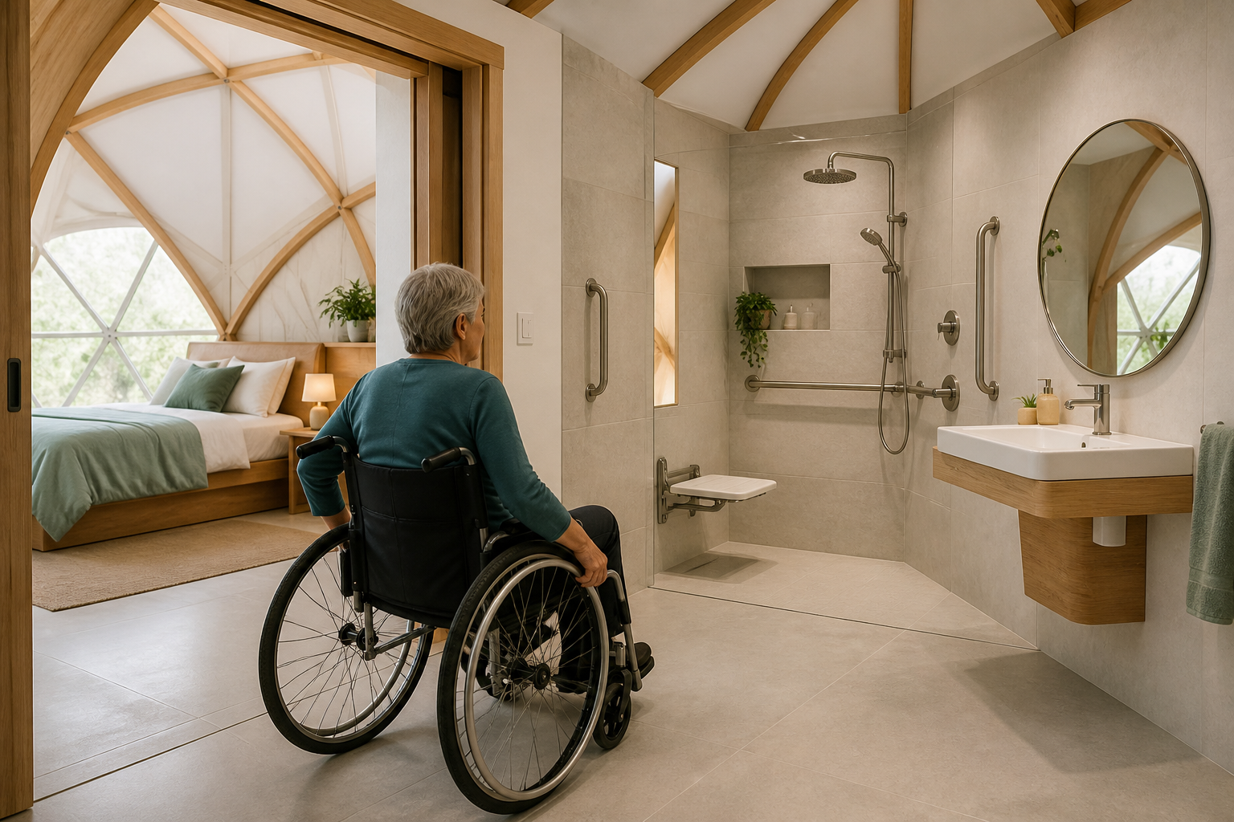
WHEELCHAIR-FIRST DOME LIVING
WHEELCHAIR-FIRST DOME LIVING
Privacy depends on space to move
Privacy depends on space to move
The bedroom and bathroom should reduce transfers, not create new ones.
Wide sliding opening. Avoid a door swing that steals maneuvering room.
Roll-in shower. Use a flush floor, seat, controls within reach, and correctly placed grab bars.
Clear side approach. Leave transfer space beside the bed and fixtures.
Reinforced straight walls. Give rails and cabinetry solid mounting surfaces inside the curved shell.
08
Notes:
Narration
Bathroom space protects more than safety; it protects privacy. A wide sliding opening, a zero-threshold shower, a reachable seat and controls, and clear transfer zones let more routines remain independent. Straight reinforced service walls solve the practical mounting problem inside a curved shell.
[Sources]
- ADA 2010 Standards, Sections 603–610, used as best-practice bathroom fixture and transfer references: https://www.ada.gov/law-and-regs/design-standards/2010-stds/
- Visual: original AI-generated image created for this deck with OpenAI ImageGen; conceptual, not a code-compliance drawing.
[/Sources]

Slide 9
WHEELCHAIR-FIRST DOME LIVING
WHEELCHAIR-FIRST DOME LIVING
Small dimensions produce enormous freedom
Small dimensions produce enormous freedom
Use these as early design checks. They are not a substitute for local residential code, an architect, or the user’s own chair and reach.
60 in
32 in
1:12
TURNING SPACE
CLEAR OPENING
MAXIMUM RAMP SLOPE
A clear circular benchmark for changing direction.
Minimum benchmark through a doorway opened to 90 degrees.
Where a ramp is required; gentler is better whenever practical.
09
Notes:
Narration
Three numbers catch many plan failures early: sixty inches for a circular turning space, thirty-two inches of clear doorway opening, and no steeper than one in twelve where a ramp is required. In a private home, treat them as disciplined starting benchmarks and verify every project locally.
[Sources]
- ADA 2010 Standards, Sections 304.3.1, 404.2.3, and 405.2: https://www.ada.gov/law-and-regs/design-standards/2010-stds/
[/Sources]

Slide 10
WHEELCHAIR-FIRST DOME LIVING
WHEELCHAIR-FIRST DOME LIVING
Wheelchair flow also protects aging bodies
Wheelchair flow also protects aging bodies
Designing out level changes, cluttered routes, and forced transfers helps more people than wheelchair users alone.
1 in 4
37%
ONE FLOOR
U.S. adults age 65+ report falling each year
of people who fall report injury needing medical treatment or restricting activity
A design goal that benefits wheelchair users, people with walkers, anyone with fatigue, and future caregivers.
Aging in place works best when the house can change before the person has to leave.
10
Notes:
Narration
Accessible circulation is not a niche feature. Falls are the leading cause of injury for older adults, and more than fourteen million older Americans report falling each year. A level, legible, uncluttered home cannot prevent every fall, but it can remove avoidable environmental demands and support aging in place.
[Sources]
- CDC, Older Adult Falls Data: https://www.cdc.gov/falls/data-research/index.html
- National Institute on Aging, “Aging in Place: Growing Older at Home”: https://www.nia.nih.gov/health/aging-place-growing-older-home
[/Sources]

Slide 11
WHEELCHAIR-FIRST DOME LIVING
WHEELCHAIR-FIRST DOME LIVING
A wheelchair-first dome spends space differently
A wheelchair-first dome spends space differently
TYPICAL CONVENTIONAL RETROFIT
PURPOSE-BUILT ACCESSIBLE DOME
Circulation is leftover. Hallways and corners are inherited from the existing plan.
Access is appended. A ramp, widened door, or lift solves one barrier at a time.
Doors consume maneuvering room. Multiple swings compete in small spaces.
Future change is expensive. Structure, plumbing, and floor levels limit adaptation.
Movement is the organizing grid. The open center is reserved for turning and passing.
Access is the front door. The shared route is level, direct, and dignified.
Short radial routes replace long halls. Key rooms remain visually and physically close.
Straight service walls make adaptation easier. Cabinetry, rails, and utilities stay practical.
The advantage is not novelty. It is fewer barriers per day.
11
Notes:
Narration
The comparison is not dome versus every conventional house. A well-designed rectangular house can be excellent. The argument is about design priorities: typical retrofits inherit barriers, while a purpose-built dome can reserve its central volume for movement from the beginning.
[Sources]
- This slide is a qualitative design comparison, not a universal claim about all conventional or dome homes.
[/Sources]

Slide 12
THE HONEST STANDARD
A dome is perfect only when the details are
built around a real body.
Curve the shell—not the wheelchair path. Routes remain level, straight, and predictable.
Use straight interior service walls. They simplify cabinetry, plumbing, reinforcement, and grab bars.
Keep every essential room on the main floor. Lofts may exist, but daily life cannot depend on them.
Test the plan with the actual user. Chair size, reach, transfer method, fatigue, vision, and caregiver needs vary.
NEXT STEP
Map one real user’s day—entry, turn, reach, transfer—before pricing the shell.
Build a home that preserves choice, privacy, and belonging as movement changes.
12
Notes:
Narration
The dome is not a shortcut around good accessibility practice. It is a promising shell for doing that practice well. Start with a real person’s movement map, protect the central turning space, put essential rooms on one floor, and verify every detail with the user and qualified local professionals.
[Sources]
- ADA 2010 Standards are referenced as design benchmarks; applicability to private residential construction varies by project and jurisdiction: https://www.ada.gov/law-and-regs/design-standards/2010-stds/
- National Institute on Aging, aging-in-place guidance: https://www.nia.nih.gov/health/aging-place-growing-older-home
[/Sources]

