Slide 1
Healthcare Expenditures for Diabetics in the United States
Dominic Garcia

Slide 2
Agenda
Business Problem
Data
Visualizations & Insights
Conclusions
Future Work

Slide 3
Business Problem
Beyond Type I is a nonprofit with a focus on education, advocacy & a path to cure Type I Diabetes.
A primary focus of their advocacy is the added cost of living for those diagnosed with the condition.
Recently, they’ve aimed to put together a comprehensive report on the factors that determine how much income diabetic & non-diabetic citizens spend on healthcare. Specifically, they’d like to answer the following question:
Are the demographic factors (race, sex, education level, income level, age) most important to determining money spent on healthcare the same for diabetics & non-diabetics?

Slide 4
Data
Data in this project is sourced from the Medical Expenditure Panel Survey (MEPS), a nationally representative survey of the civilian noninstitutionalized population administered by the Agency for Healthcare Research and Quality.
Specifically, this project's data is pulled from MEPS's annual Household Full Year Consolidated Data Files.

Slide 5
Data
Input data for modeling includes a survey subject’s:
US geographic region
Age
Sex
Race/ethnicity
Education level
Degree of annual income
The target data is the subject’s annual healthcare expenses.

Slide 6
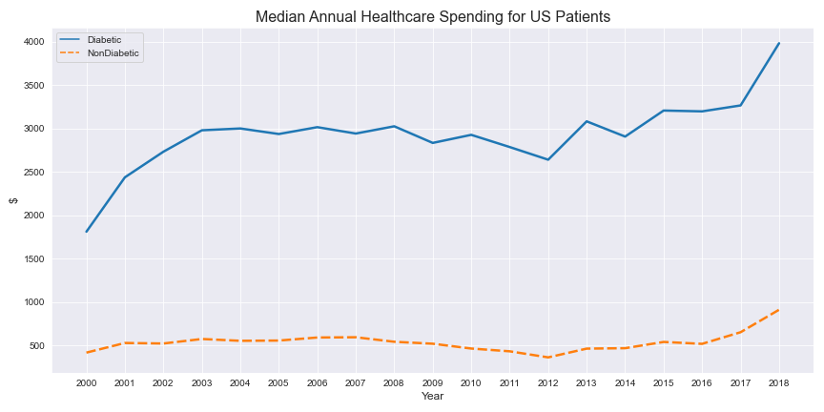
Visualizations & Insights

Slide 7
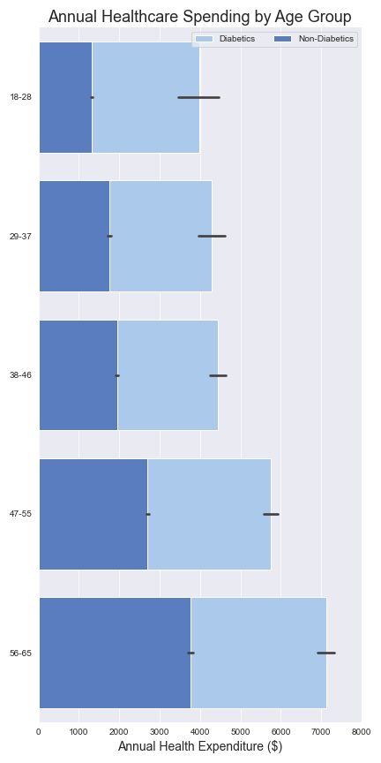
Visualizations & Insights
For both groups, healthcare spending seems to increase as a person ages
For diabetics, though, the increase in spending becomes more significant – especially for ages 38-46 and beyond
Compare differences between light blue boxes to differences between dark blue boxes

Slide 8
Visualizations & Insights
Further insights were provided by classification, which was performed on 3 different groups:
General: Included data on both diabetics & non-diabetics. This model's purpose was to let me know how important having diabetes is in determining which healthcare expenditure tier a subject is part of.
Diabetics: Only included data on diabetic survey subjects. This model's purpose was to let me know which demographic features are most important in determining which healthcare expenditure tier a diabetic subject is part of.
Non-Diabetics: Only included data on non-diabetic survey subjects. This model's purpose was to let me know which demographic features are most important in determining which healthcare expenditure tier a non-diabetic subject is part of.

Slide 9
Visualizations & Insights
Ultimately, these were the results for each:
General: whether a subject had diabetes was the 3rd most important variable in determining which healthcare expenditure tier they were in.
Diabetics: demographic variables that were significant in determining healthcare expenditure tier– subject's age
Non-Diabetics: demographic variables that were significant in determining healthcare expenditure tier – subject's age, sex, income

Slide 10
Conclusions
To answer the business problem’s central question, the most impactful factor on healthcare spending for both groups is a person's age.
As seen in visualizations, though, healthcare spending increases more rapidly over time for diabetics.
This is likely due to the increased likelihood of medical issues as a person ages.
What might be a normal aging-related issue could be exacerbated for someone with an existing condition, like diabetes.

Slide 11
Conclusions
Based on this conclusion, I recommend that Beyond Type I:
Direct fundraising efforts toward poorer middle-age diabetics, whose income might not keep up with rising healthcare costs over time.
Make an organization-wide push to recruit more middle-age diabetics into their advocacy efforts.
Create education programs for older citizens that ensure they maintain healthy habits & keep them up to date on the latest diabetes management technology.

Slide 12
Future Work
Given more time with the job, I would:
Obtain similar data that has a more thorough time component in order to perform time series based speculation about future healthcare costs.
Obtain healthcare spending data for US residents with other specific conditions to observe how much they spend compared to diabetics.
Make comparison of diabetes healthcare costs for US residents vs residents of other nations around the world.

Slide 13
Questions?
Github: https://github.com/dl-gd
Email: dlgarcia.017@gmail.com

