Slide 1
convolutional neural networkS
Informationsverarbeitung II:
Informationsextraktion mit Neuronalen Netzwerken
Eduard Saller
Notes:
NOTE:
To change the image on this slide, select the picture and delete it. Then click the Pictures icon in the placeholder to insert your own image.

Slide 2
Overview
History
CNN Topology Overview
Example with step by step introduction of important terms
CNNs for NLP
Discussion

Slide 3


History
Yann LeCun
New York University
Facebook Artificial Intelligence Research
Yoshua Bengio
Université de Montréal
In 1995, Yann LeCun and Yoshua Bengio introduced the concept of convolutional neural networks.

Slide 4
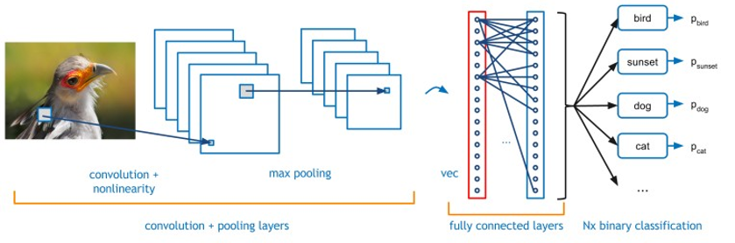
CNN Topology
http://www.nallatech.com/fpga-acceleration-convolutional-neural-networks/

Slide 5
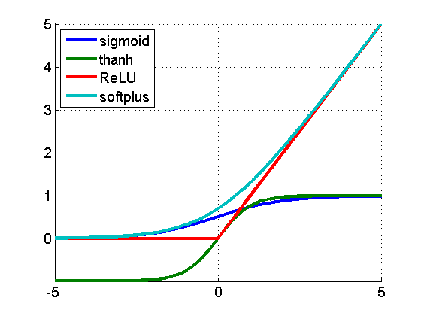
Recap: Non-Linearity?
A neural network is only non-linear if you squash the output signal from the nodes with a non-linear activation function.
=> arbitrary function approximator
Interpreting the squashed output signal could very well be interpreted as the strength of this signal (biologically speaking)

Slide 6
Toy Example
A two-dimensional
array of pixels
CNN
X or O

Slide 7
Toy Example
CNN
X
CNN
O

Slide 8
Harder to solve problem
CNN
X
translation
scaling
rotation
weight
CNN
O

Slide 9
How to compare?
?
=

Slide 10
Compare smaller areas
=
=
=

Slide 11
Term: Filter

Slide 12
Term: Filter

Slide 13
Term: Convolution
Used fitlers to create a filter layer based on the input
- Yellow area: counts all ones that are part of ist diagonal
- Green area: input features
http://deeplearning.stanford.edu/wiki/index.php/Feature_extraction_using_convolution

Slide 14
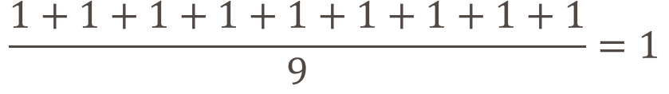
Building the filter layer
$$\frac{1+1+1+1+1+1+1+1+1}{9}=1$$

Slide 15
=
=
=

Slide 16
Recap: CNN Topology
http://www.nallatech.com/fpga-acceleration-convolutional-neural-networks/

Slide 17
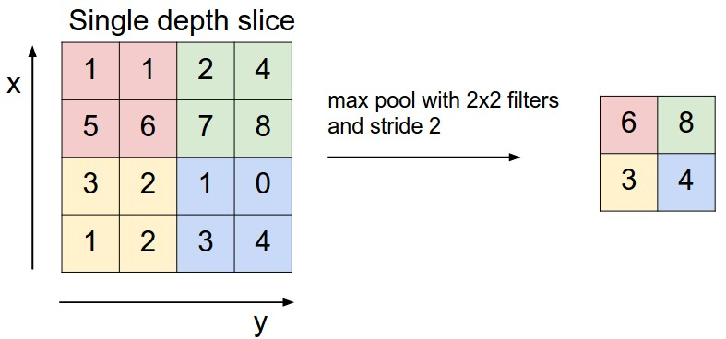
Term: Pooling Layers
http://cs231n.github.io/convolutional-networks/#pool

Slide 18
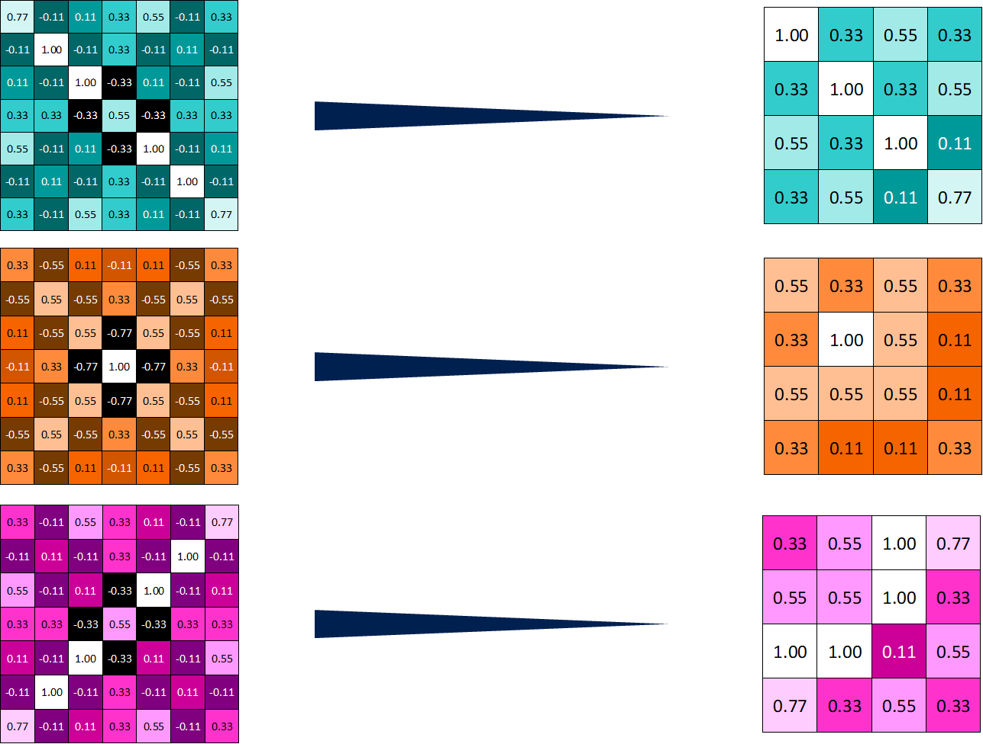

Slide 19
Stacking
Convolution
Non-linear
Pooling

Slide 20
Stacking
Convolution
Non-linear
Convolution
Non-linear
Pooling
Convolution
Non-linear
Pooling

Slide 21
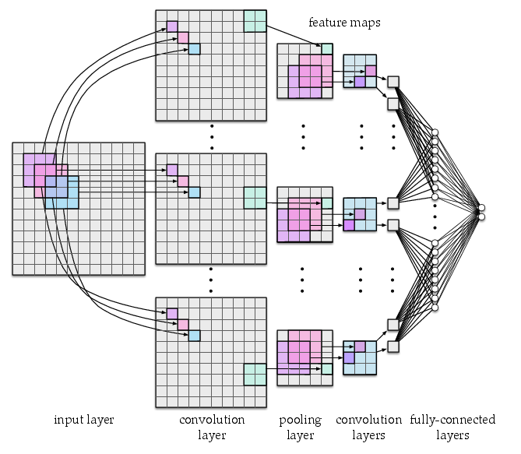
Term: fully-connected layer
takes an input volume and outputs an N dimensional vector

Slide 22
Toy example: fully-connected layer

Slide 23
fully-connected layer => Voting on an answer
X
O

Slide 24
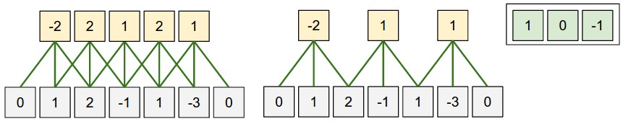
Term: Strides
http://cs231n.github.io/convolutional-networks/

Slide 25
Term: Strides
without strides
with strides

Slide 26
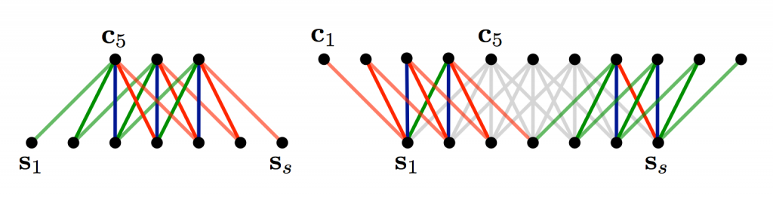
Term: Padding
A Convolutional Neural Network for Modelling Sentences (2014)

Slide 27
Term: Padding

Slide 28
NLP: What area would be good fits
classifications tasks, such as:
Sentiment Analysis
Spam Detection
Topic Categorization

Slide 29
NLP: What area would be bad fits
Convolutions and pooling operations lose information about the local order of words
PoS Tagging
Entity Extraction
=> sequence tagging is a harder to fit into a pure CNN architecture

Slide 30
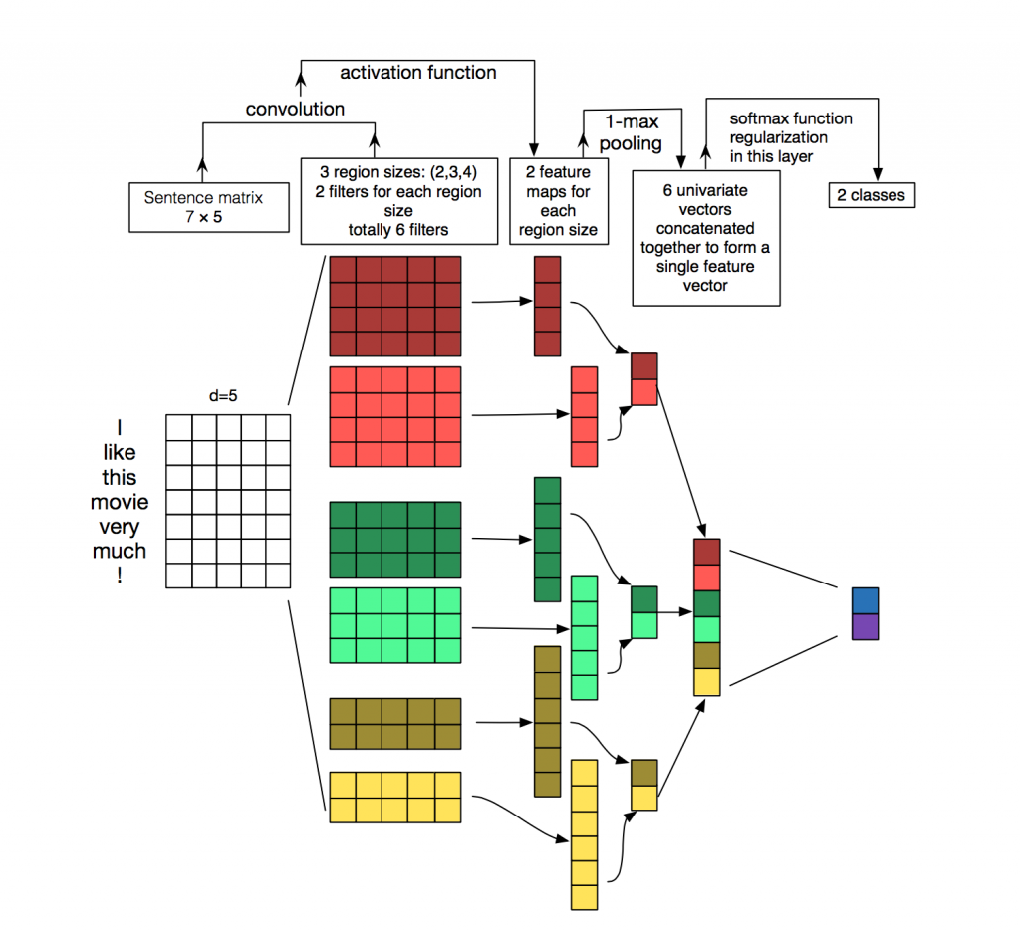
NLP
Source: Zhang, Y., & Wallace, B. (2015). A Sensitivity Analysis of (and Practitioners’ Guide to) Convolutional Neural Networks for Sentence Classification

Slide 31
References
[1] Kim, Y. (2014). Convolutional Neural Networks for Sentence Classification. Proceedings of the 2014 Conference on Empirical Methods in Natural Language Processing (EMNLP 2014), 1746–1751.
[2] Kalchbrenner, N., Grefenstette, E., & Blunsom, P. (2014). A Convolutional Neural Network for Modelling Sentences. Acl, 655–665.
[3] Santos, C. N. dos, & Gatti, M. (2014). Deep Convolutional Neural Networks for Sentiment Analysis of Short Texts. In COLING-2014 (pp. 69–78).
[4] Johnson, R., & Zhang, T. (2015). Effective Use of Word Order for Text Categorization with Convolutional Neural Networks. To Appear: NAACL-2015, (2011).
[5] Johnson, R., & Zhang, T. (2015). Semi-supervised Convolutional Neural Networks for Text Categorization via Region Embedding.
[6] Wang, P., Xu, J., Xu, B., Liu, C., Zhang, H., Wang, F., & Hao, H. (2015). Semantic Clustering and Convolutional Neural Network for Short Text Categorization. Proceedings ACL 2015, 352–357.
[7] Zhang, Y., & Wallace, B. (2015). A Sensitivity Analysis of (and Practitioners’ Guide to) Convolutional Neural Networks for Sentence Classification,
[8] Nguyen, T. H., & Grishman, R. (2015). Relation Extraction: Perspective from Convolutional Neural Networks. Workshop on Vector Modeling for NLP, 39–48.
[9] Sun, Y., Lin, L., Tang, D., Yang, N., Ji, Z., & Wang, X. (2015). Modeling Mention , Context and Entity with Neural Networks for Entity Disambiguation, (Ijcai), 1333–1339.

Slide 32
References
[10] Zeng, D., Liu, K., Lai, S., Zhou, G., & Zhao, J. (2014). Relation Classification via Convolutional Deep Neural Network. Coling, (2011), 2335–2344.
[11] Gao, J., Pantel, P., Gamon, M., He, X., & Deng, L. (2014). Modeling Interestingness with Deep Neural Networks.
[12] Shen, Y., He, X., Gao, J., Deng, L., & Mesnil, G. (2014). A Latent Semantic Model with Convolutional-Pooling Structure for Information Retrieval. Proceedings of the 23rd ACM International Conference on Conference on Information and Knowledge Management – CIKM ’14, 101–110.
[13] Weston, J., & Adams, K. (2014). # T AG S PACE : Semantic Embeddings from Hashtags, 1822–1827.
[14] Brandon Roher, Toy example
[15] Santos, C., & Zadrozny, B. (2014). Learning Character-level Representations for Part-of-Speech Tagging. Proceedings of the 31st International Conference on Machine Learning, ICML-14(2011), 1818–1826.
[16] Zhang, X., Zhao, J., & LeCun, Y. (2015). Character-level Convolutional Networks for Text Classification, 1–9.
[17] Zhang, X., & LeCun, Y. (2015). Text Understanding from Scratch. arXiv E-Prints, 3, 011102.
[18] Kim, Y., Jernite, Y., Sontag, D., & Rush, A. M. (2015). Character-Aware Neural Language Models.

