Slide 1
DL deployment instruments and challenges
Iliya Slavutin

Slide 2
Agenda
Discuss key challenges and goals
Overview of existing products
Overview of few key techniques
Contest

Slide 3
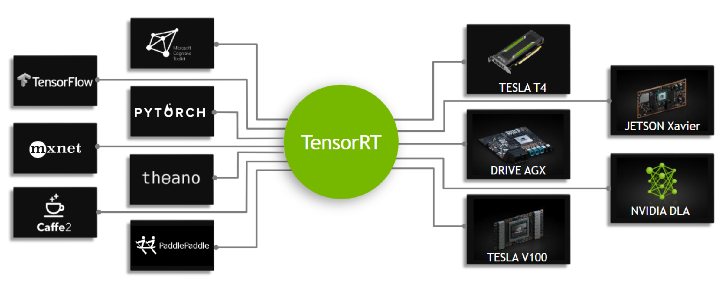
World of Inference Engines
Key players are:
HW vendors – NVidia, Intel and others
OS vendors – Goolge, Microsoft, Apple
Deep Learning Framework Vendors – Facebook, Alibaba, Baidu
What are the key benefits?
Typical flow to illustrate the benefits of certain Inference Engine (based on NVidia TensorRT example)
Ease of deployment
Performance
Optimal latency and throughput
Platform capabilities and features utilization
Graph level optimizations to leverage inference nature
Efficient memory usage
Bonus question: What are the business goals?
Stickiness to vendor ecosystem
Something else?

Slide 4
World of Inference Engines: some details
Framework | Vendor | Open Source | Key comments | Target OSes | Target platforms
TensorRT | Nvidia | No | Unified and powerful toolkit for NVidia ecosystem | Linux, Windows | NVidia GPUs
OpenVINO | Intel | Yes | Unified and powerful toolkit for Intel/x86 ecosystem | Linux, Windows, MacOS | x86, i/dGPU, VPU
ONNXRuntime | Microsoft | Yes | Vendor agnostic API. Convinient if you do not want to depend on HW vendor API. Mostly just a wrapper on top of HW vendors IEs | Linux, Windows, MacOS | NVidia GPUs, x86, i/dGPU, VPU, Xilinx FPGA, etc
TensorFlow Lite | Google |  | Great tool for Android ecosystem to deploy modern solutions on Android targets (and not only) | Android, iOS | ARM, Mali GPU, TPU
Pytorch mobile | Facebook | Yes | Way to deploy Torch models to mobile devices (Android and iOS ) without need to use other serialization formats and APIs Limited capabilities. Implemented through Torch.jit but a lot of ops and modern topolgoies are not supported yet | Android, iOS | ARM, Mali GPU
MNN | Alibaba | Yes | Blazing fast (according to authors and some people who tried :)) | Android, iOS | ARM, Mali GPU
CoreML | Apple | No | Unified and powerful toolkit for Apple ecosystem | MacOS, iOS | ARM, GPU, NPU

Slide 5
Graph compilation techniques
Target independent optimizations (typically done as offline model compilation / conversion stage). For example:
Constant folding
Batch Norm fusion
etc
Pattern matching techniques
Map certain subgraph to high level ops (e.g. recognize Conv pattern in low level TF graph) and rely on low level optimization libraries (e.g. cuDNN, oneDNN, ACL) to speedup inference

Slide 6
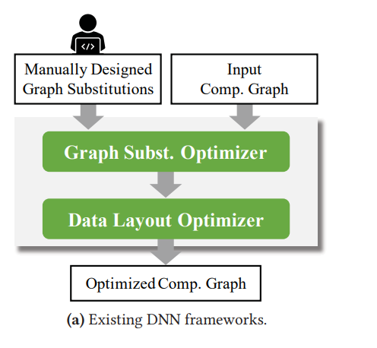
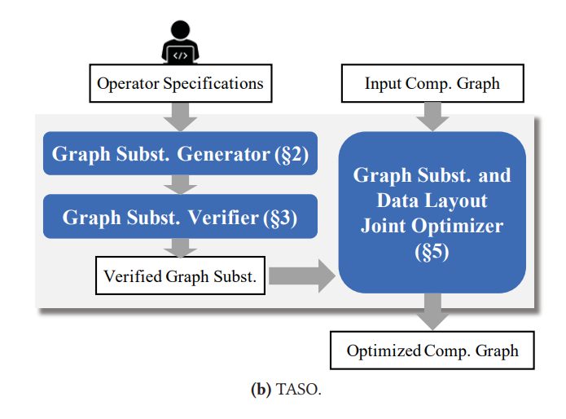
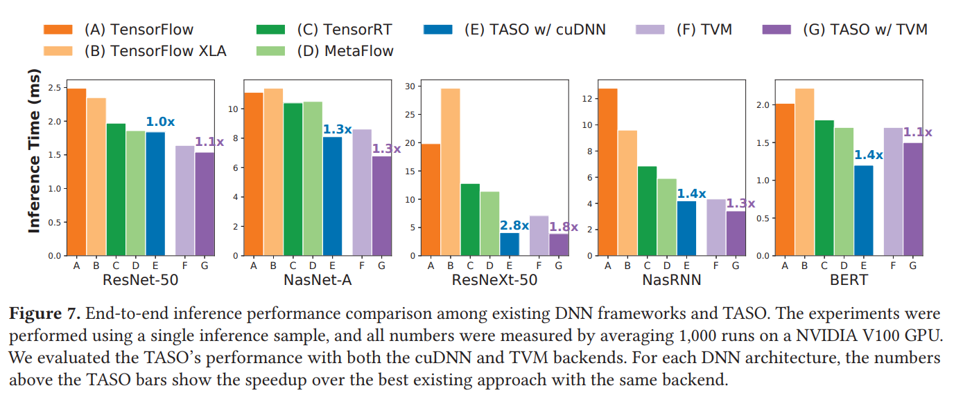
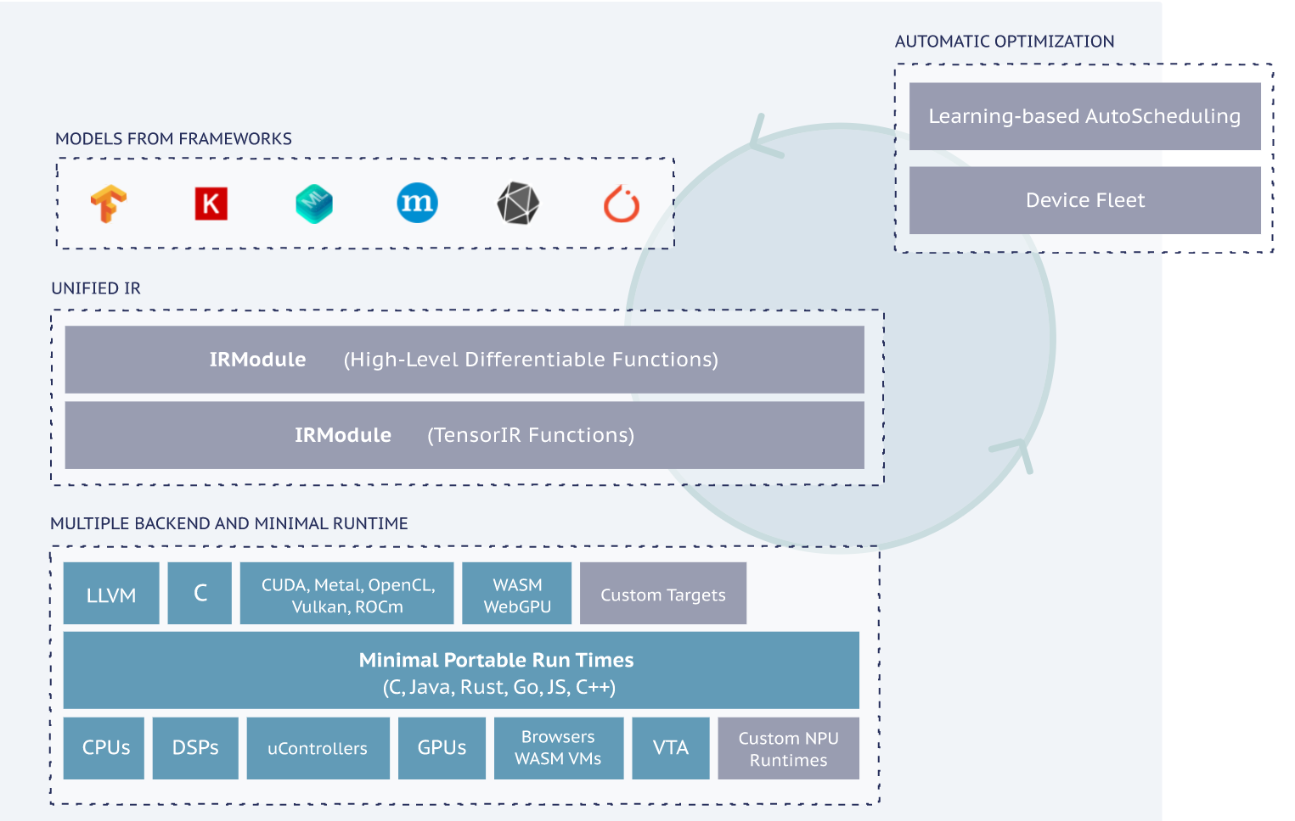
Graph compilation techniques (alternative /enhanced ideas)
TASO: Tensor Algebra SuperOptimizer
(source: https://cs.stanford.edu/~padon/taso-sosp19.pdf)
VS.
Apache TVM
Rely on compiler based stack of technologies (from graph compilation/lowering down to code generation)
Compilation of deep learning models into minimum deployable modules
Infrastructure to automatic generate and optimize models on more backend with better performance

Slide 7
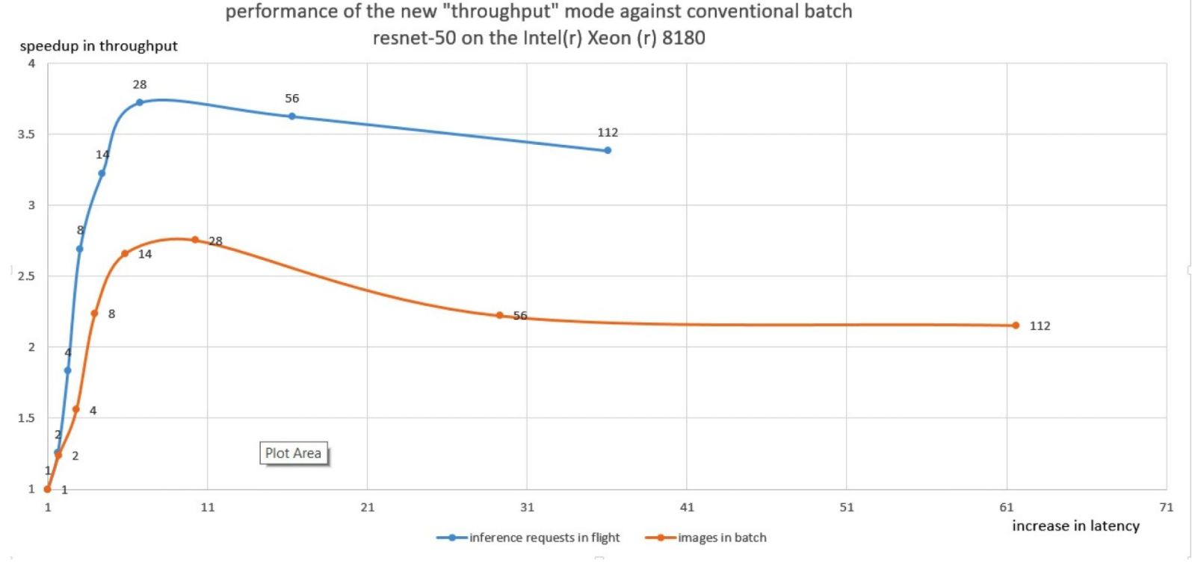
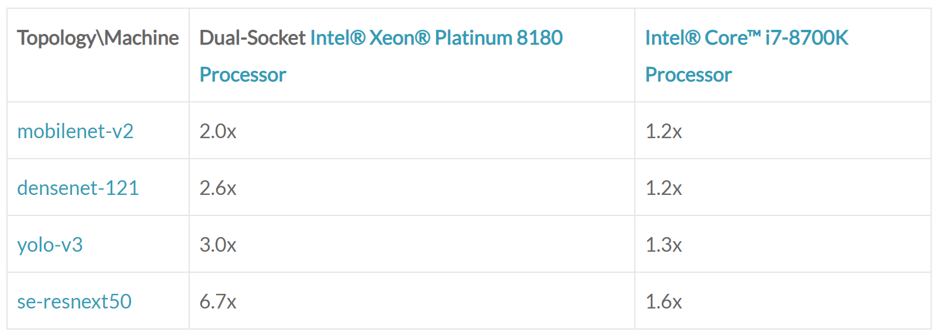
Performance and latency: Batches, streams
What we have?
Powerful multi-core systems are everywhere from edge to cloud
Latency and performance expectations from customers are high
How to address?
Batching:
(+) leverage per layer data parallelism
(+) increase utilizations of the system
(-) reduce latency
Can we do better? … yes, with streams
Efficient parallelization of multiple requests (can be combined with batches)
Reduces the amount of scheduling/synchronization compared to a latency-oriented approach when every CNN operation is made parallelized internally over the full number of CPU cores
Improved cache utilization
Example speedup of the “throughput” mode over best performance with batch
source: https://www.intel.com/content/www/us/en/artificial-intelligence/posts/cpu-inference-performance-boost-openvino.html

Slide 8
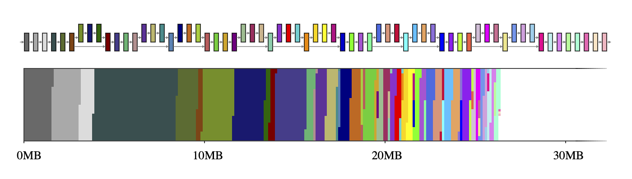
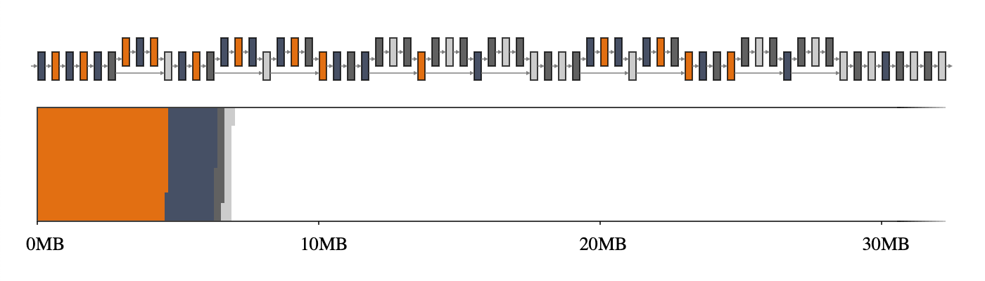
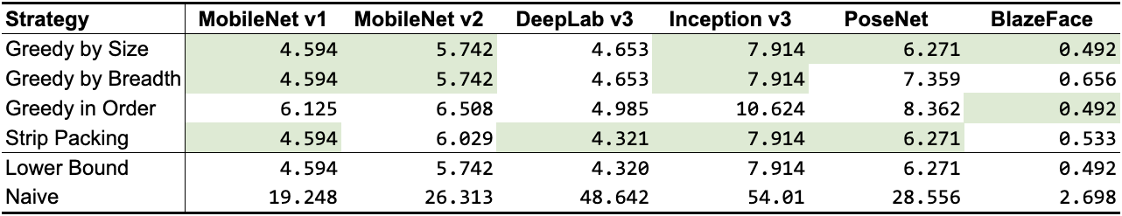
Memory usage
Running inference on mobile and embedded devices is challenging due to tight resource constraint
Same challenge is equally valid for super large modern models used for NLP and recommendation system tasks in the cloud
Intermediate tensors don't have to co-exist in memory thanks to data dependency analysis
Reuse the memory buffers of the intermediate tensors and reduce the total memory footprint of the inference engine. Arbitrary networks forming complicated graphs, this NP-complete resource allocation problem requires a good approximation algorithm
Tensor usage record of an intermediate tensor is an auxiliary data structure that contains information about how big the tensor is and when it is used for the first and the last time in a given execution plan of the network
Memory manager is able to compute the intermediate tensor usages at any moment in the network's execution and optimize its runtime memory for the smallest footprint possible
5 different algorithms are implemented In TensorFlow lite. Except for Min-Cost Flow, they are greedy algorithms, each using a different heuristic, but still reaching or getting very close to the theoretical lower bound
Naïve allocation on mobilenet v2
GREEDY_BY_BREADTH on mobilenet v2
Up to 10x less memory usage compare to naïve allocation
source: https://blog.tensorflow.org/2020/10/optimizing-tensorflow-lite-runtime.html

Slide 9
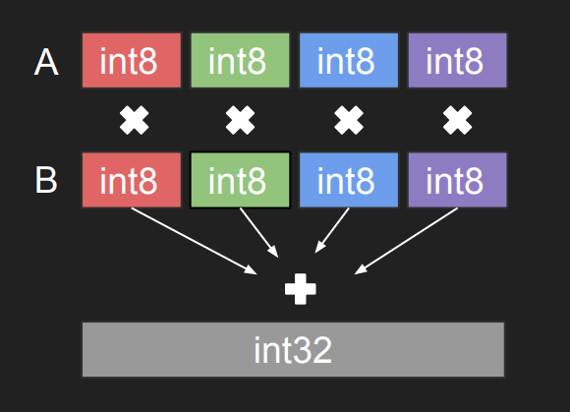
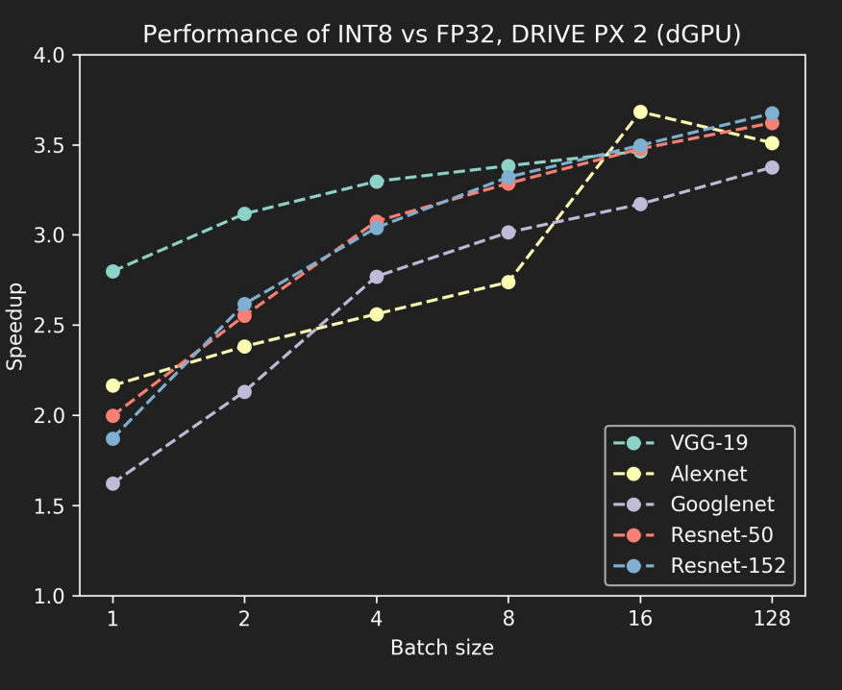
Quantization technique(s)
Quantization is the process of transforming deep learning models to use parameters and computations at a lower precision to achieve improvements in performance and footprint
Most modern CPUs and AI accelerators have ISA for fast int8 precision MAC for vectors or even matrixes
Leveraging this instructions leads to significant perf boost, but may impact accuracy. So it is typically a trade-off decision
INT8 has significantly lower precision and dynamic range compared to FP32 so simple conversion from fp32 into int8 is not enough to keep the accuracy
Finding the optimal quantization schemes and algorithms is a very active research area
Two main approaches exist:
Quantization Aware Training emulates inference-time quantization, creating a model that downstream tools will use to produce actually quantized models. The quantized models use lower-precision (e.g. 8-bit instead of 32-bit float), leading to benefits during deployment. Technique is supported by all popular Deep Learning FW
(example from TF https://www.tensorflow.org/model_optimization/guide/quantization/training)
Post Training Quantization techniques algorithm that can quantize model with little degradation in model accuracy without need to fine-tune or train model

Slide 10
Algo map (simplified picture)
Algorithm | Complexity for user | Pro | Cons
Data free | Very Low | * Easy of use (no any data required to run) * Can be incorporated into model conversion process | * May heart accuracy significantly if modern techniques are not applied
Quantization on unlabeled data | Medium | * Fast to run Typically the best performance | * Require representative data May impact accuracy, requires implementation of modern technique to keep it higher
Accuracy aware post training quant. | High | * “Mid point” of performance benefits and accuracy * May cover below int8 / mixed precision | * Require knowledge about loss function / metric Require representative set of data Might be time consuming
Domain specific (NLP, etc) | High | * Address accuracy problems which could not be handled by generic algos (mostly CNN oriented) | * Dedicated effort to implement and explain customers when to be used
Fine tuning (Quantization aware traiing | Very High | * Way to achieve the best accuracy | * Requires knowledge / expertise in training (but might be mitigated if incorporated into transfer learning tools) Time consuming step Not always optimal from performance perspective
Accuracy
(higher is better)
Original fp32 model
Fine-tuning
fp16 model
Accuracy aware post training
quantization & Domain specific (e.g. NLP, Recommendation Systems)
Quantitation on unlabeled data
Edge of accuracy drop acceptance by customer
Data free quantitation
Performance
(higher is better)

Slide 11
Some useful articles on quantization topic (might be a great topic for PhD)
Krishnamoorthi R. (2018). Quantizing deep convolutional networks for efficient inference: A whitepaper. arXiv:1806.08342.
Nagel M., Baalen M., Blankvoort T. and Welling M. (2019). Data-Free Quantization Through Weight Equalization and Bias Correction. arXiv:1906.04721.
Banner R., Nashan Y., Hoffer E. and Soundry D. (2018). ACIQ: Analytical Clipping for Integer Quantization of neural networks. ICLR 2019 Conference.
Finkelstein A., Almog U. and Grobman M. (2019). Fighting Quantization Bias With Bias.
Hubara I. (2020). Improving Post Training Neural Quantization: Layer-wise Calibration and Integer Programming. arXiv:1906.03193.
Gennari M., Fawcett R. and Prisacariu V. (2019). DsConv: Efficient Convolution Operator. arXiv:1901.01928.
He X. and Cheng J. (2018). Learning Compression from Limited Unlabeled Data. ECCV 2018. arXiv:1901.01928.
Nashan Y., Chmiel B., Baskin C., Zheltonozhskii E., Banner R., Bronstein A. and Mendelson A. (2019). Loss aware Post-training quantization. arXiv:1911.07190.
Park E., Yoo S. and Vajda P. (2018). Value-aware quantization for training and inference of neural networks. arXiv:1804.07802.
Zadex A., Edo I., Awad O. and Moshovos A. (2020). GOBO: Quantizing Attention-Based NLP Models for Low Latency and Energy Efficient Inference. arXiv:2005.03842.
Shen S., Dong Z., Ye J., Ma L., Yao Z., Gholami A., Mahoney M. and Keutzer K. (2019). Q-BERT: Hessian Based Ultra Low Precision Quantization of BERT. arXiv:1909.05840.
Zafrir O., Boudoukh G., Izsak P. and Wasserblat M. (2019). Q8BERT: Quantized 8bit BERT. arXiv:1910.06188.
Bhandare A., Sripathi V., Karkada D., Menon V., Choi S., Datta K. and Saletore V. (2019). Efficient 8-Bit Quantization of Transformer Neural Machine Language Translation Model. arXiv:1906.00532.
Prato G., Charlaix E. and Rezagholizadeh M. (2019). Fully Quantized Transformer for Improved Translation. ICLR 2020 Conference.
Prato G., Charlaix E. and Rezagholizadeh M. (2020). Fully Quantized Transformer for Machine Translation. arXiv:1910.10485.

Slide 12
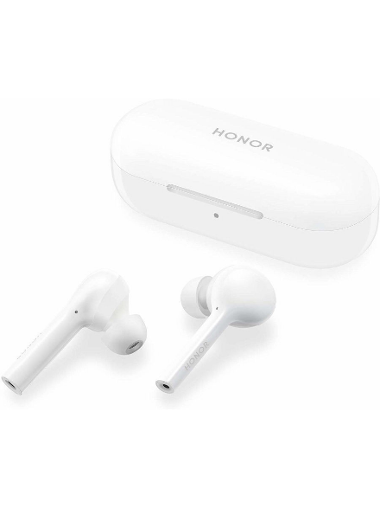
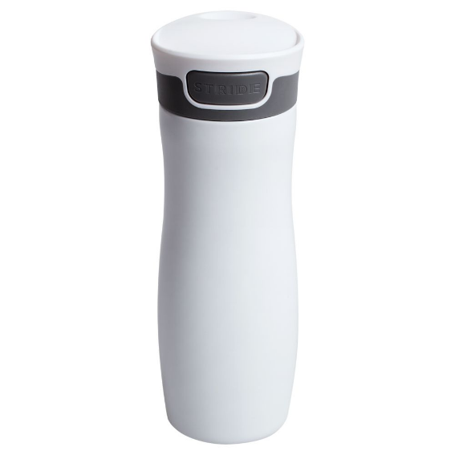
Contest from Huawei
Task
Take any modern object/keypoint detection model
Deploy to the target device by using any IE discussed in the lecture
Document and describe all the steps and challenges (if you faced any)
Use all the possible selected IE knobs to get the best performance (for latency or throughput scenarios, or both if applicable)
Document your performance findings
Share your notes and code over github repo
Small app demonstrating some use case is a plus
Deadline: Jan, 31st 2021
Send your results to Alexey Sidnev and Iliya Slavutin
Prizes:
1st place - Honor fly pods (3 pieces)
2nd place –Cool thermal mugs (3 pieces)
3rd place – Some useful stuff (10 pieces)

Slide 13
Q&A

Slide 14
Contacts
E-mal: iliya.slavutin@gmail.com

