Slide 1
Points
Lines
Polygons
(x_{1b}, y_{1b})
(x₄, y₄)
(x_{1d}, y_{1d})
(x_{1a}, y_{1a})
(x₁, y₁)
(x_{1c}, y_{1c})
(x_{2b}, y_{2b})
(x₃, y₃)
(x₂, y₂)
(x_{2a}, y_{2a})

Slide 2
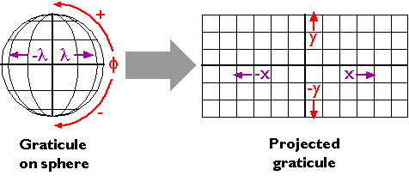

Slide 3
+deg
+y
- deg
+ deg
-x
+x
-y
-deg

Slide 4
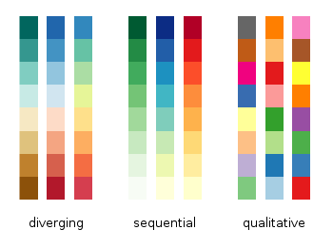

Slide 5
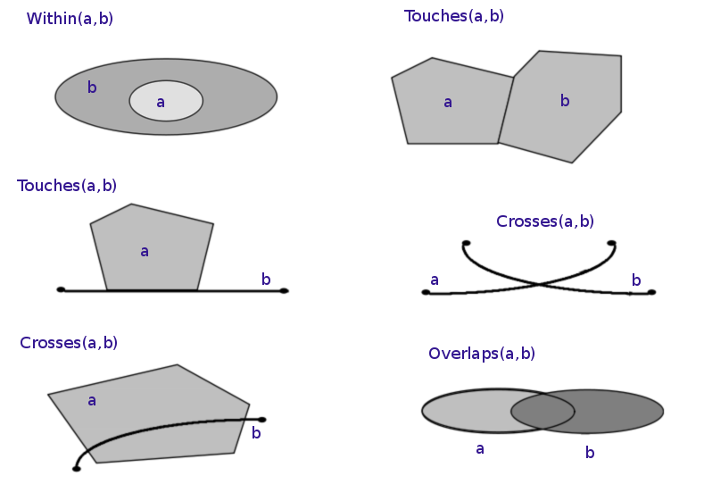

Slide 6
Within/Contains
Touches
A
B
B
A contains B
B within A
B
A
A
Intersects
Disjoint
A
A
B
B
B
A
B
A

Slide 7
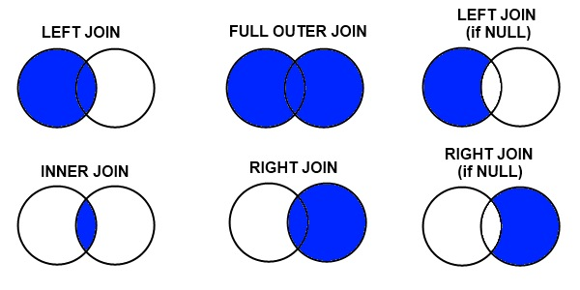

Slide 8
Left Join
Outer Join
Inner Join
Right Join

Slide 9
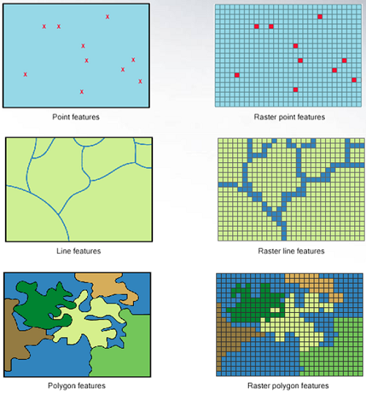

Slide 10
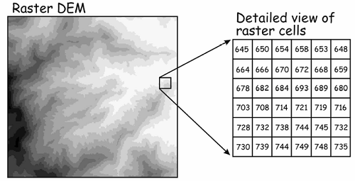

Slide 12
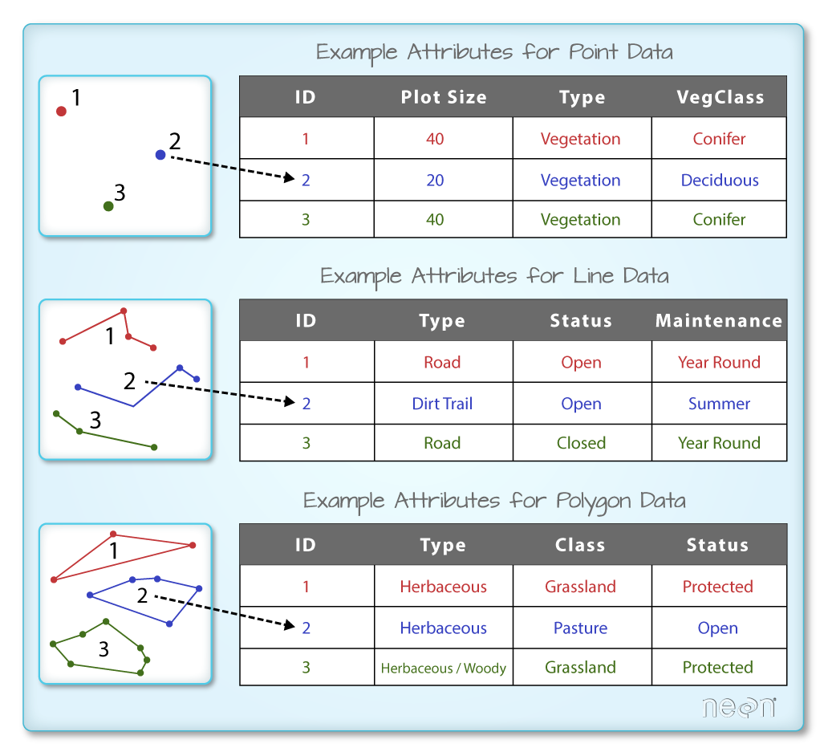

Slide 13
Points
Lines
Polygons
(x_{1b}, y_{1b})
(x_{2b}, y_{2b})
(x₄, y₄)
3
(x₁, y₁)
(x_{1d}, y_{1d})
(x₃, y₃)
(x_{1a}, y_{1a})
1
(x₂, y₂)
(x_{1c}, y_{1c})
2
(x_{2a}, y_{2a})
ID | School | # of Students
1 | Berkeley High School | 1392
2 | MLK Middle School | 421
3 | Walkerville Elementary | 130
ID | Bridge | Toll Amount
1 | Golden Gate Bridge | $7
2 | Bay Bridge | $6
3 | Rainbow Bridge | Free
ID | City | Mayor
1 | Berkeley | Jesse Arreguín
2 | Oakland | Libby Schaaf
3 | Narnia | The White Witch

