Slide 1
D-Lab Presents:
RStudio Project Management
Evan Muzzall
Digital Humanities Working Group Presentation 03/07/2019

Slide 2
Data science projects consist of:
Themes
Domain expertise
Teams
Many components to a project!
Tools
Data importation and preprocessing
Timelines
Assign roles/responsibilities for each part (or, how will you manage them all by yourself?)
Documentation, presentation
Research question/hypotheses, framework
Data
Visualization and analysis
Staying organized (.Rproj files)
Documentation (Rmarkdown)
Collaboration (Bash + GitHub)

Slide 3

How to manage your project
Store the constituent parts of your project inside of a .Rproj file as a sort of self-contained “repository”. Manage it using RStudio!
Include in the main directory: Readme, license, software requirements, coding scripts, subdirectories
Subdirectories for: Inbound data, output, documentation, figures, images, text, version info

Slide 4
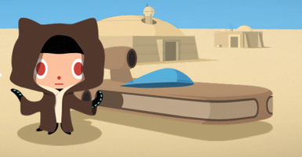
Repository organization and learning more about GitHub

Slide 5
Example: 2012-2013 SAT test takers
Let’s walkthrough the files in the repository to check out an example about SAT test takers from the 2012-2013 school year.
Import data from here: https://catalog.data.gov/dataset/sat-school-participation-and-performance-2012-2013

Slide 6

Tutorials to get started (see README.md file)

