Slide 1
Codename: Save the world

Slide 2

B
Changyong
Pacific
(Tutorial)

Slide 3
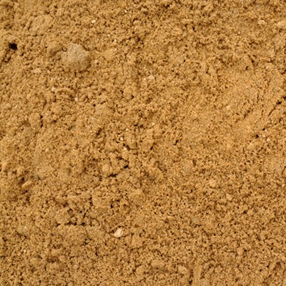

8948

Slide 4


State of
Libya
B

Slide 5

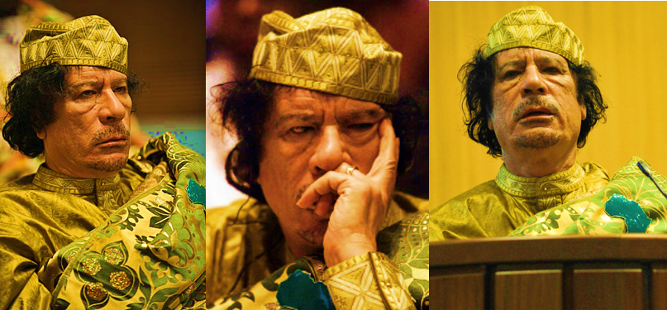
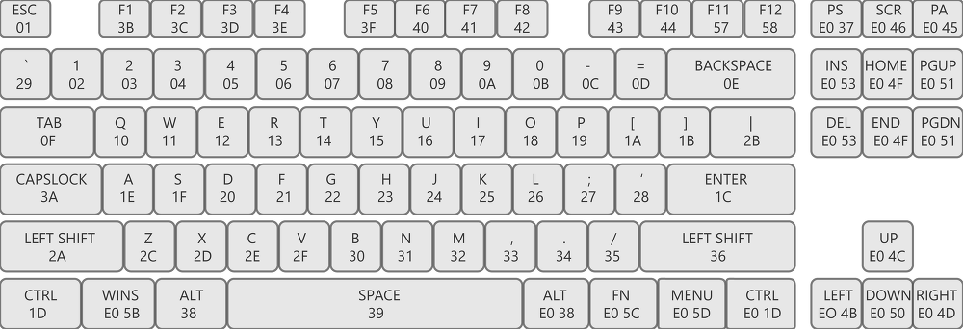
��101101101��u�H��H��HE dd�E3�H��fD��zQ\ 3�����H�\$WH�� H�wZ H��H���H��Z H�AH E3�H�|$0E3��D$(? �|

Slide 6
B
Federal
Rep. of
Somalia
State of
Libya

Slide 7


ISO 3166-1 Alpha-3

Slide 8

B
Rep. of
Yemen
State of
Libya

Slide 9

print(ord(‘Y’)+ord(‘E’)+ord(‘M’))
while True:
for i in range(1, 10):
if i > 105:
print(ord(‘E’)+ord(‘N’))
else:
None

Slide 10

Syrian Arab
Rep.
B

Slide 11
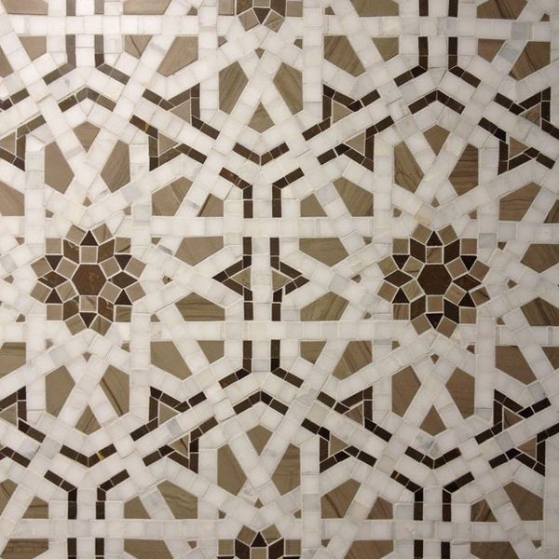
15168489879845213849844561649l887784546512138

Slide 12

B
Rep. of
Iraq

Slide 13

#567ACE

Slide 14

B
People’s
Rep. of
China

Slide 15

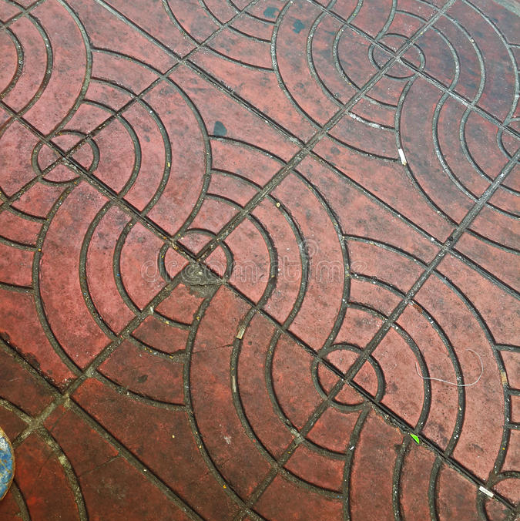
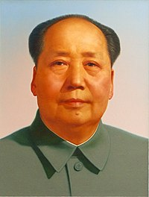
1 + 1 = ?

Slide 16
Bomb Over.
Made by dlacked

Slide 17
Thanks to you,
the world has regained peace.
Made by dlacked

Slide 18
Let’s save the world!
Changyong
Pacific
(Tutorial)
Changyong
Pacific
(Tutorial)
GO

