Slide 1
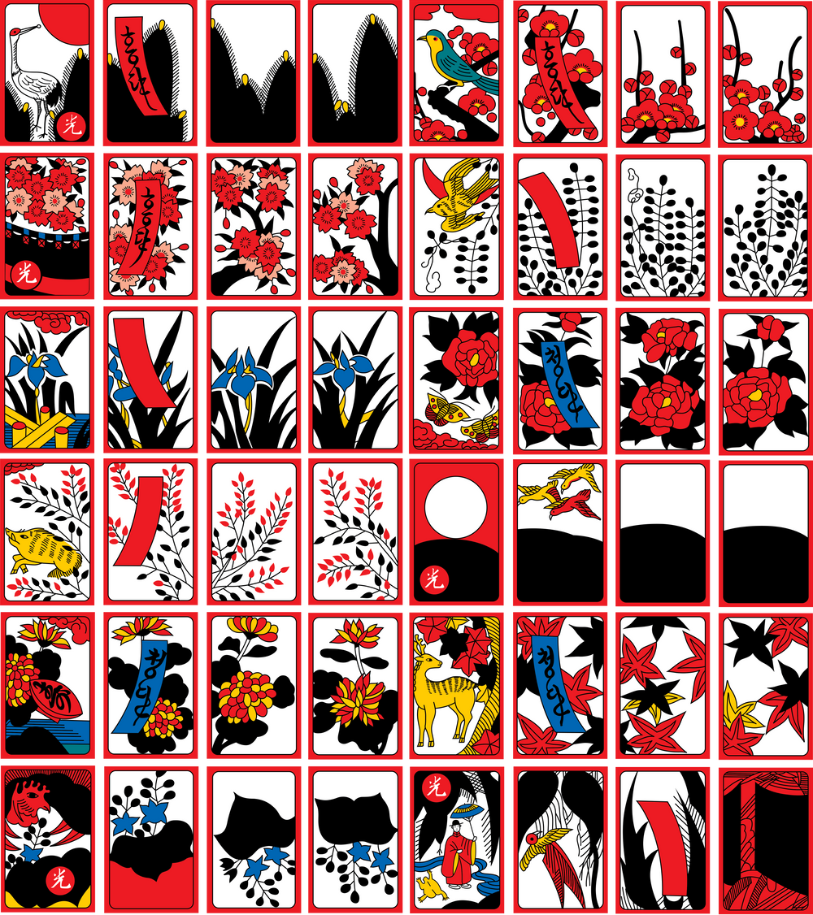


Slide 2
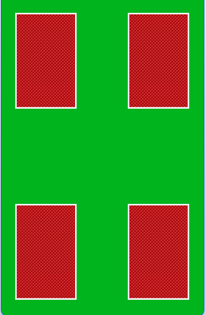
DRAW
RE

Slide 3

LOSE
RE

