Slide 1
Introduction to Neural Networks
Machine Perception and Cognitive Robotics Lab
Daniel C. LaCombe, Jr.

Slide 2
Outline
Motivation
The Basics
Types of Learning
Go Deeper
Coding
Resources

Slide 3

Disclaimer
I am not an expert on artificial neural networks
I am becoming an expert on a certain subset of this broader class
Take everything I say with a grain of salt

Slide 4
Motivation
Why should we be interested in artificial neural networks?
Allows for the computer to program itself through learning
If our goal is to have a robot learn to behave, neural networks are a great candidate to get the job done
This general class of models are state of the art in many important domains

Slide 5
The Basics
The goal of neural networks:
Given some input, produce an output that is as close as possible to the desired output
Make the output closer to desired output by learning the optimal weight values iteratively
INPUT
NEURAL NETWORK
OUTPUT
GOAL:
Network Output ≈ Desired Output

Slide 6
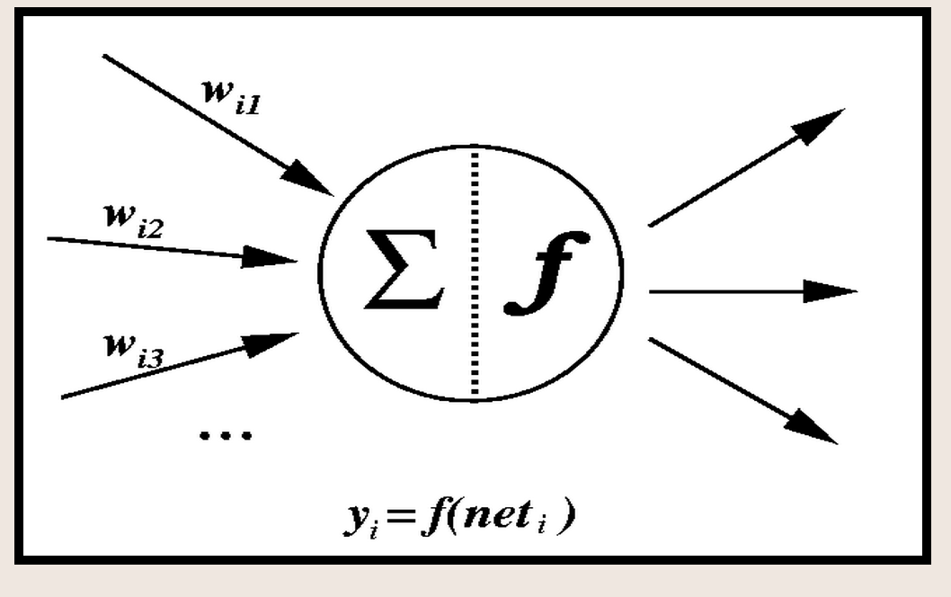
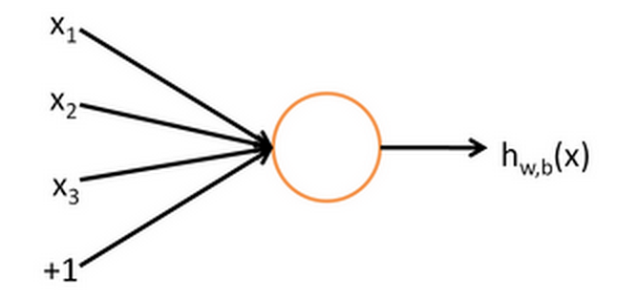
Single Neuron

Slide 7
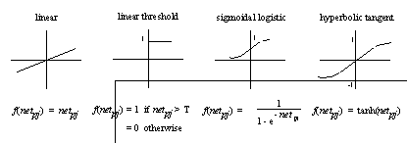
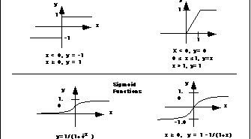
Output (Transfer) Function

Slide 8
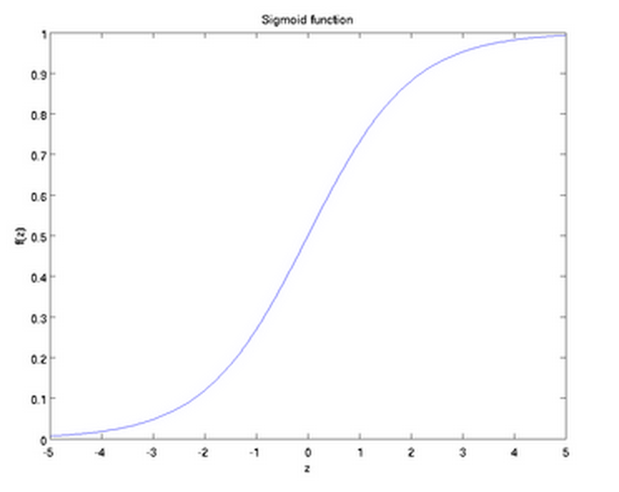
Sigmoid Function

Slide 9
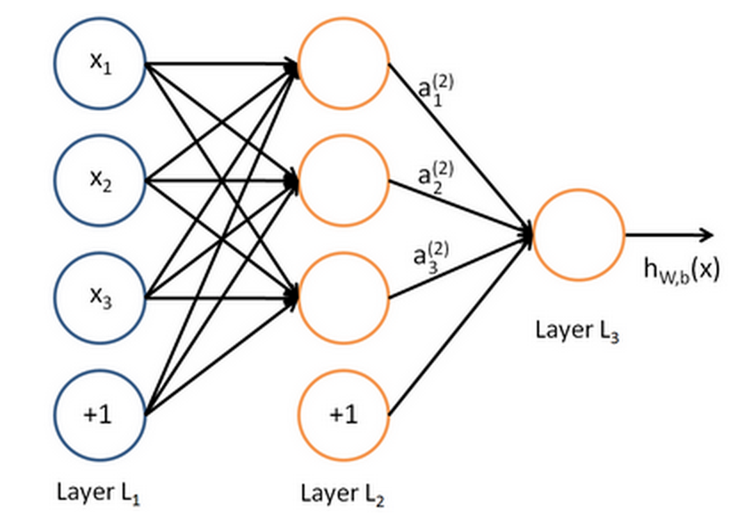
Architecture
(output layer)
- Only one output node for two classes; otherwise # of output nodes = # of classes
(input)
(hidden layer)

Slide 10

Architecture to <code/>
= f(output)
Inputs
Neurons
Classes
Hidden
Weights
Output
Weights
Data
Inputs
Examples
Neurons

Slide 11
Feed Forward
Hidden Layer Activation
Inputs
Neurons
Hidden
Weights
Data
X
Inputs
Examples
Neurons
=
Hidden
Activation
Remember that the sigmoid function (or some other output function) is then applied before passing to next layer
Examples

Slide 12
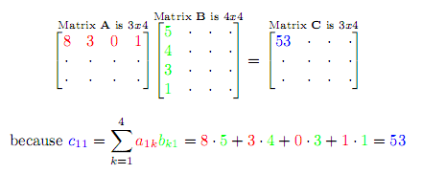
Matrix Multiplication

Slide 13
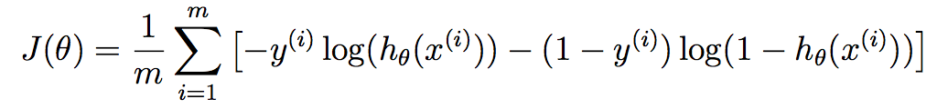
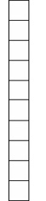
Cost Function
Cost functions come in many different forms
Logistic regression cost function
Output of Network
Correct answer

Slide 14
Example: MNIST
How well did it predict the right category?
How poorly did it predict the wrong category?
-- Logistic Regression Spreadsheet Here --

Slide 15

Backpropagation
Calculation derivatives of weights with respect to the cost (this is how it learns)
Math heavy!!!
I side-step this by using automatic differentiation in Theano
http://deeplearning.net/software/theano/

Slide 16
Types of Learning
Supervised Learning for Classification
The goal of this type of network is to have the output of the final layer accurately classify a given input
Cost function in this case is the difference between the output neuron label and the actual label assigned to a given instance
--MNIST Neural Network Demo Here--

Slide 17
Types of Learning
Unsupervised Feature Learning
The goal of this type of network is to learn a good representation (or prior) of the world with unlabeled data
Cost function here could be the difference between input and reconstructed input
--Sparse Filtering Demo Here--

Slide 18
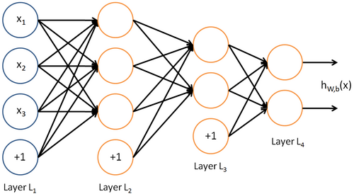
Deep Neural Networks
Neural Networks with more than one hidden layer

Slide 19
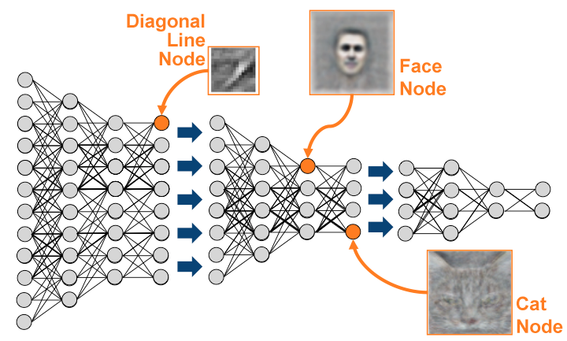
Deep Neural Networks

Slide 20
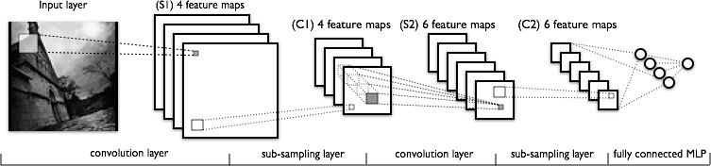
Deep Convolutional Neural Networks
For when images become too large for standard neural networks (way too many weights to train) or shift invariance is desired (which in most cases it is)

Slide 21
Coding
MATLAB
Python
Scipy
PyBrain
Scikit-Learn
Theano
Deepy
Torch7

Slide 22
Resources
Coursera: Machine Learning (Andrew Ng)
http://deeplearning.net/
http://deeplearning.net/tutorial/

