Slide 1
Introduction to Neural Networks
Machine Perception and Cognitive Robotics Lab
Daniel C. LaCombe, Jr.

Slide 2
Outline
Motivation
The Basics
Types of Learning
Nitty-gritty
Demonstrations
Going Deeper
Coding
Resources

Slide 3

Disclaimer
I am not an expert on artificial neural networks
I am becoming an expert on a certain subset of this broader class
Take everything I say with a grain of salt

Slide 4
Motivation
Why should we be interested in artificial neural networks?
Allows for the computer to program itself through learning
If our goal is to have a robot learn to behave, neural networks are a great candidate to get the job done
This general class of models are state of the art in many important domains

Slide 5
The Basics: Goals
The goal of neural networks:
Given some input, produce an output that is as close as possible to the desired output
Make the output closer to desired output by learning the optimal weight values iteratively
INPUT
NEURAL NETWORK
OUTPUT
GOAL:
Network Output ≈ Desired Output

Slide 6
The Basics: Workflow
Pseudocode:
Read in and preprocess data (e.g., scaling)
Randomly initialize network
for i = 1:maximum_iterations
Feed forward inputs to get output activation
Calculate cost (discrepancy with desired output)
Backpropagate errors by adjusting weights
Repeat until convergence or maximum iterations

Slide 7
Terms
Scaling
Adjust data so that it falls within some range
Feed forward
Propagate the input through the network by calculating the activation of each layer successively with an output at the final layer
Cost function
A function that returns a scalar value indicating how well the network performed
Back propagation
An algorithm for propagating the error derivatives back through the network so that weights can be adjusted

Slide 8
Types of Learning: Supervised
Supervised Learning for Classification
The goal of this type of network is to have the output of the final layer accurately classify a given input
Cost function in this case is some quantification of the difference between the output neuron label and the actual label assigned to a given instance
Examples:
-ALVINN
-Deep Neural Networks for Image Recognition

Slide 9
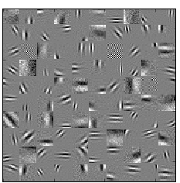
Types of Learning: Unsupervised
Unsupervised Feature Learning
The goal of this type of network is to learn a good representation (or prior) of the world with unlabeled data
Cost function here could be the difference between input and reconstructed input
Examples:
-Sparse Filtering
-(Sparse) Autoencoders
-Restricted Boltzman Machines

Slide 10
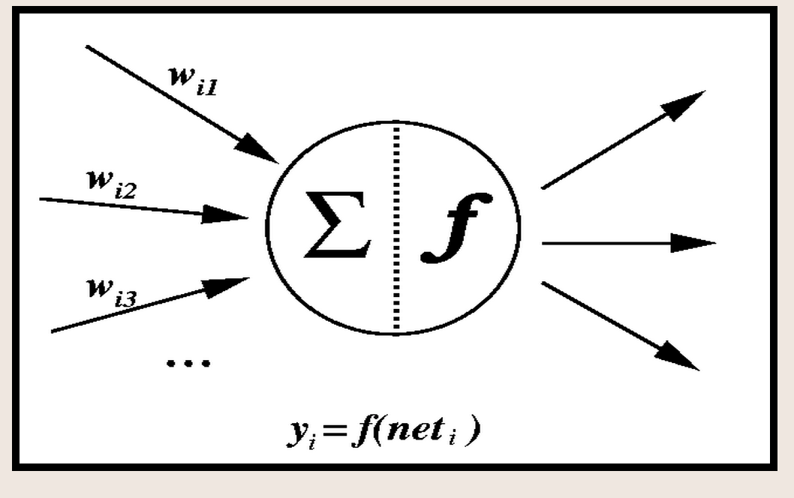
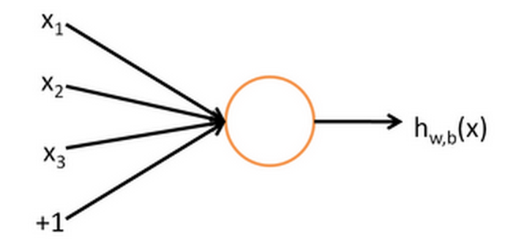
Single Neuron

Slide 11
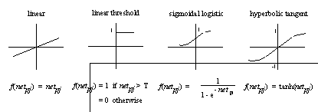
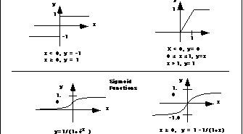
Output (Transfer) Function

Slide 12
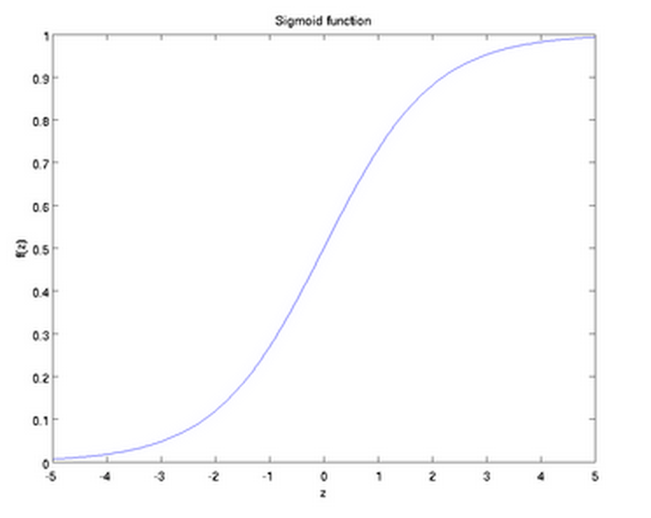
Sigmoid Function

Slide 13
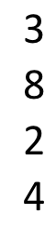
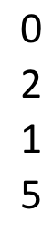
Simple Neuron Example
Input
Weights
Activation
Output
38
.9
Internal activation of neuron is weighted sum of inputs:
(3*0) + (8*2) + (2*1) + (4*5) = 38
0 + 16 + 2 + 20 = 38
Output of neuron is that value subject to a transfer function:
f(38) = .9

Slide 14
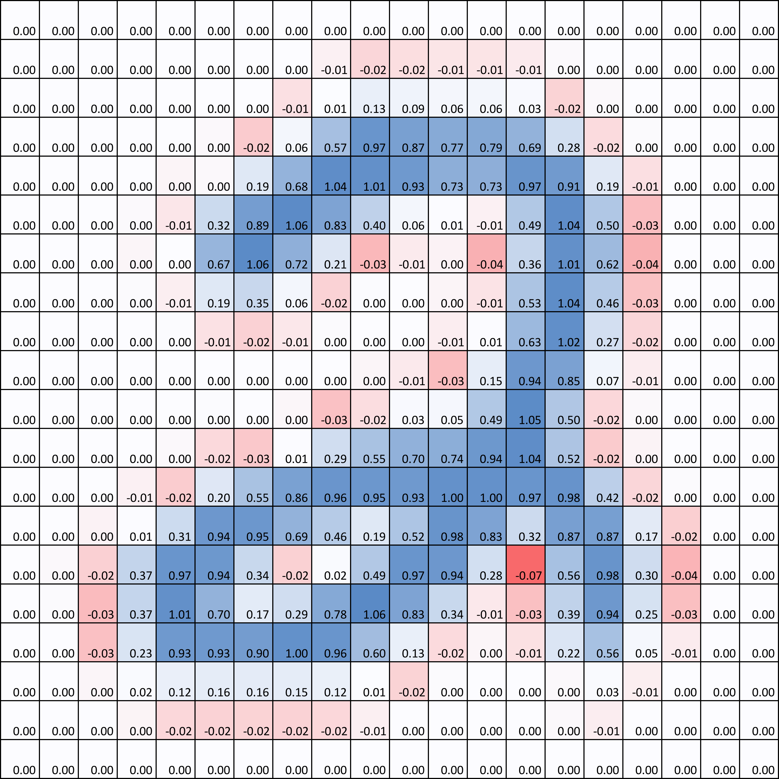
Neuron Weights to Input
…

Slide 15
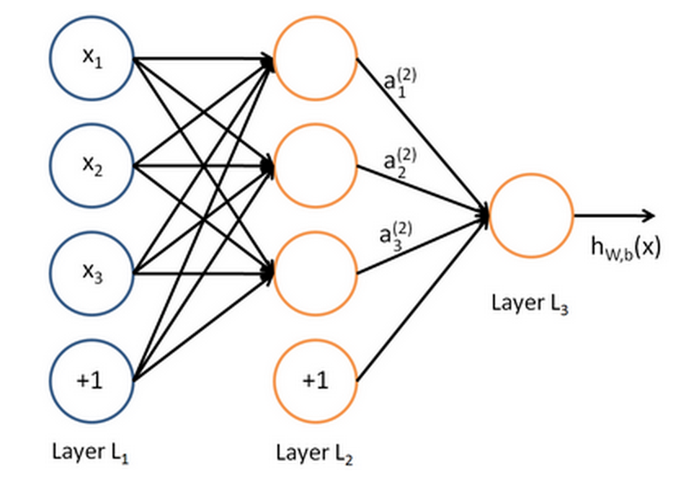
Architecture
(output layer)
*Only one output node for two classes; otherwise # of output nodes = # of classes
(input)
(hidden layer)

Slide 16
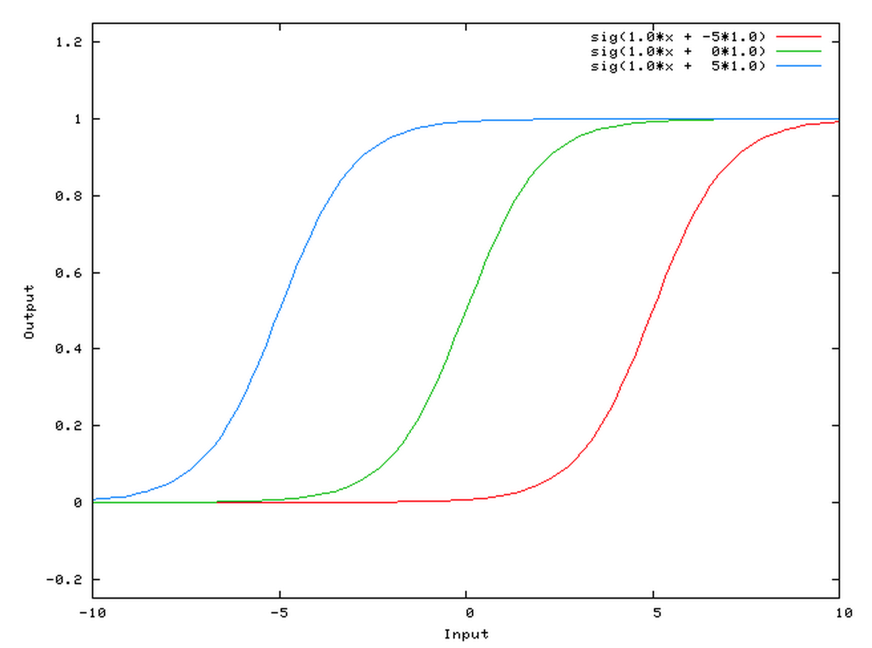
Bias Node
Allows for a neuron to output zero given some values of the input
http://stackoverflow.com/questions/2480650/role-of-bias-in-neural-networks

Slide 17
Question:
Where are all of the nodes and edges in the neural network code?
Answer: There aren’t really any. Nodes are just indexed as rows or columns in a matrix and there are only connections between nodes by virtue of the operations that are performed!

Slide 18

Architecture to <code/>
= f(activation)
Inputs
Neurons
Classes
Hidden
Weights
Output
Weights
Data
Inputs
Examples
Neurons

Slide 19

Input
Example: Images (can be anything, basically)
20 pixels
…
20 pixels
End product after vectorization
400 pixels
1 example

Slide 20
Feed Forward
Hidden Layer Activation
Hidden Layer Output
Inputs
Neurons
Neurons
Hidden
Weights
Hidden
Activation
Examples
Data
X
=
Inputs
Examples
Neurons
Neurons
f
Hidden
Activation
Hidden
Output
=
Examples
Examples

Slide 21
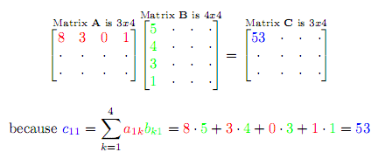
Matrix Multiplication

Slide 22
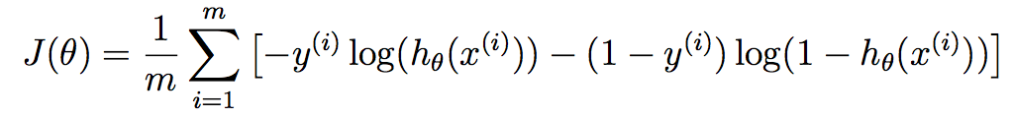
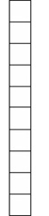
Cost Function
Cost functions come in many different forms
Logistic regression cost function
Output of Network
Correct answer

Slide 23

Vector Representation of Class
In order to compare output of neural network to correct class when classes > 2, we use vector representation of class

Slide 24
Example: MNIST
How likely did the network think the input belonged to the right category?
How likely did the network thing the input belonged to the wrong categories?
-- Logistic Regression Spreadsheet Here --

Slide 25


Backpropagation
Calculation derivatives of weights with respect to the cost (this is how it learns)
Math heavy!!!
I side-step this by using automatic differentiation in Theano (python library)
http://deeplearning.net/software/theano/

Slide 26
Supervised Artificial Neural Network Demonstration
https://github.com/dlacombe2013/MPCR_demo
Download the entire subdirectory
All of the code is in demo_code/
aNN.m (main script)
get_cost_grads.m (function calculating cost/grads)
predict.m (predicts class of test data)
sigmoid.m (activation function applied)
fmincg.m (optimization algorithm)
displayData.m (displays inputs and hidden layer)
MNIST.mat (data used to train network)

Slide 27
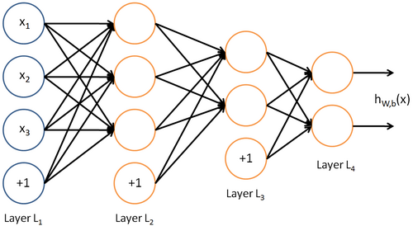
Deep Neural Networks
Neural Networks with more than one hidden layer

Slide 28
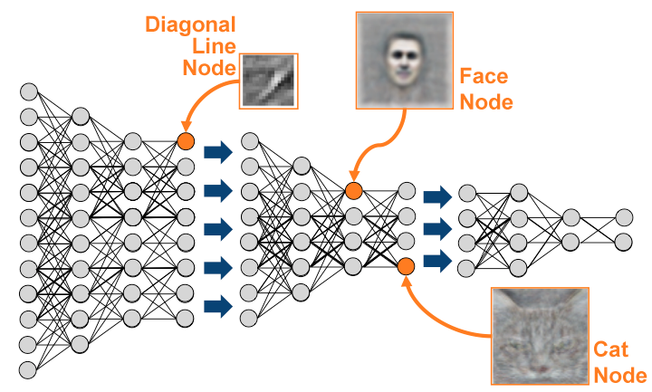
Deep Neural Networks

Slide 29
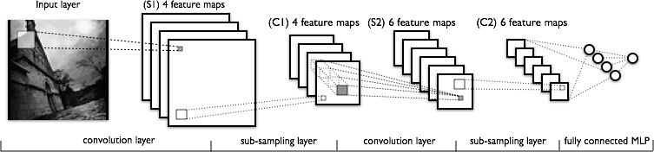
Deep Convolutional Neural Networks
For when images become too large for standard neural networks (way too many weights to train) or shift invariance is desired (which in most cases it is)

Slide 30





Coding
MATLAB
Python
Scipy
Scikit-Learn
Theano
Torch7

Slide 31
Resources
Coursera: Machine Learning (Andrew Ng)
http://deeplearning.net/
http://deeplearning.net/tutorial/
http://cs231n.stanford.edu/
And so many more…

