Slide 1
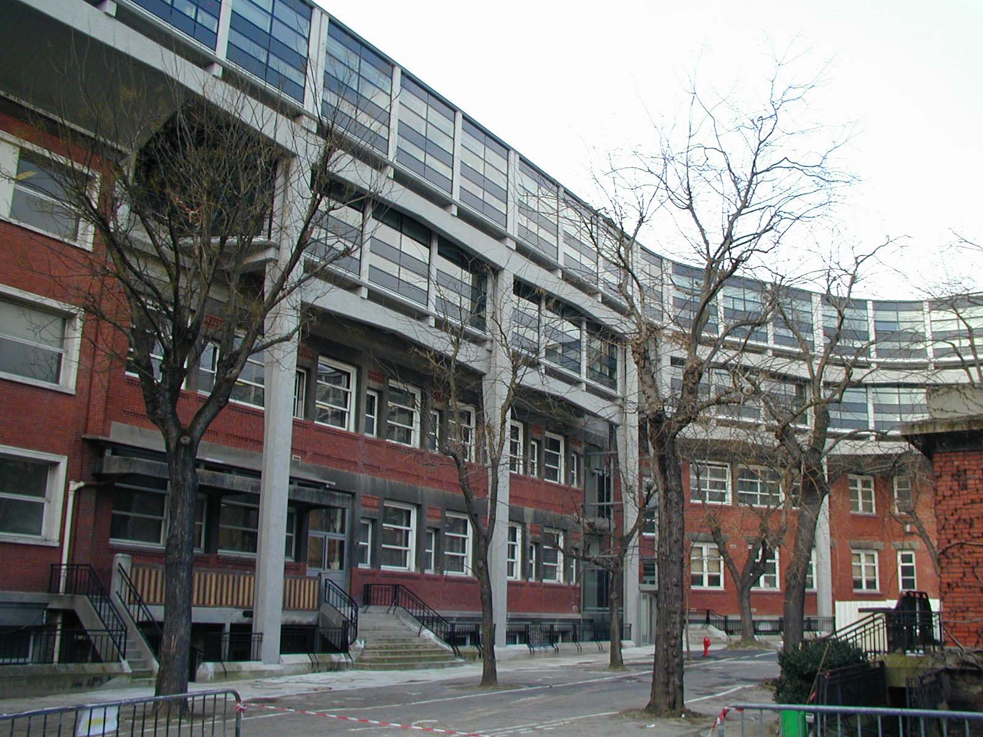

Depolarization of backscattered light
D. LACOSTE
Physico-Chimie Théorique (PCT),
ESPCI, Bat F, 3ème étage
PCT

Slide 2
Outline of the talk
Introduction: polarization in multiple light scattering
Patterns formed by linearly polarized backscattered light
T. Maggs, V. Rossetto (PCT, ESPCI),
M. Cloître, R. Barkatis (Matière molle et Chimie, ESPCI),
F. Jaillon, H. Saint-Jalmes
(Université Claude Bernard, Lyon)
V. Loriette (Laboratoire d’Optique, ESPCI)
Measuring light depolarization in backscattering with DWS:
F. Scheffold, L. Rojas (Université de Friburg).

Slide 3

Simple facts about multiple light scattering
ℓ*
Mesoscopic regime
λ << ℓ* << L << L_{abs}
L
Anisotropy in scattering
in most cases g>0
ℓ
θ
ℓ*
Length scales for memory of polarization
linear polarization: ℓ_{p} ≈ ℓ*
circular polarization: ℓ_{c} ≈ ℓ*

Slide 4
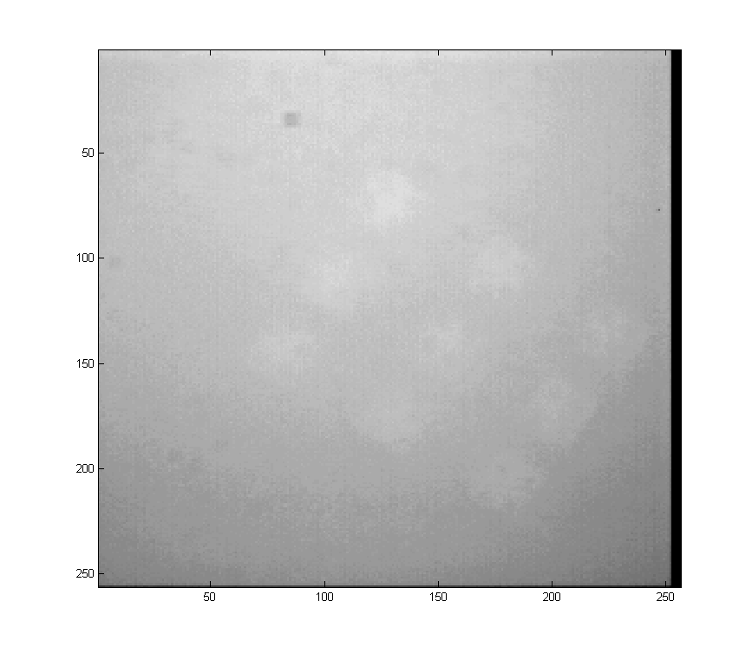
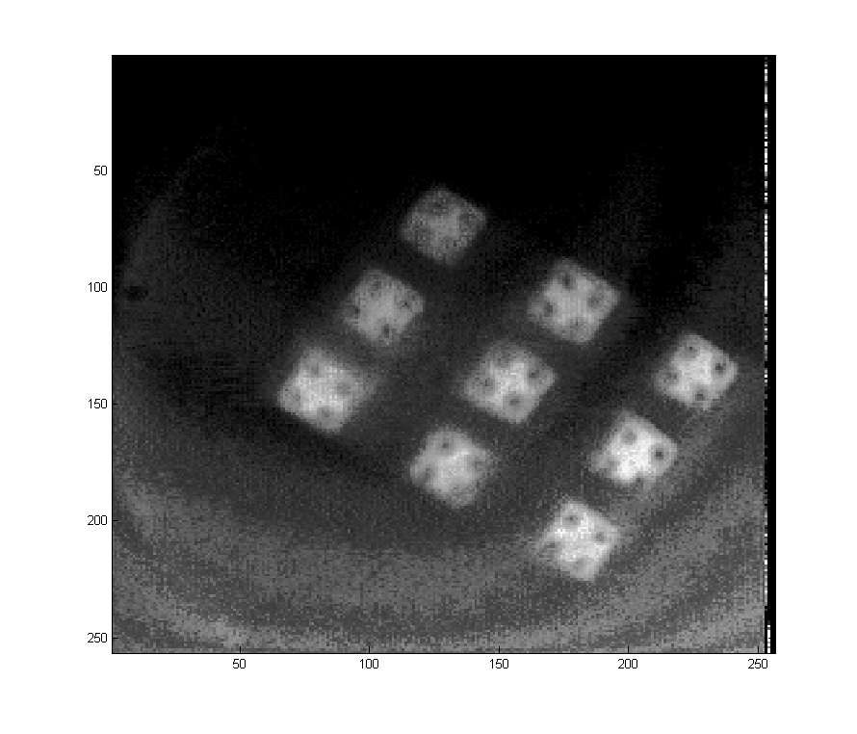
Images of 9 laser diodes through a diffuse medium of ℓ*=1.27μm, L=1cm
Image with non-polarized light
Image with polarized light
(pictures taken by Vincent Loriette, Laboratoire d’Optique ESPCI)

Slide 5
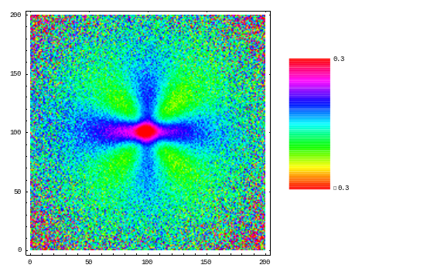
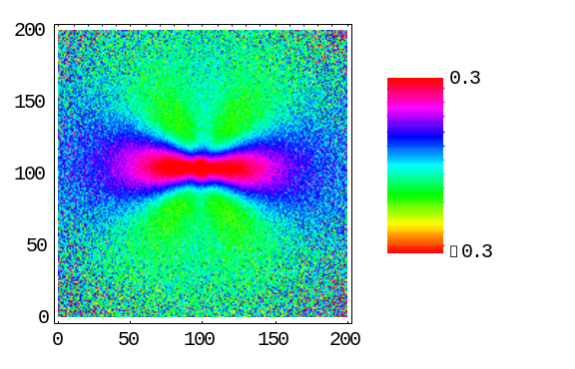
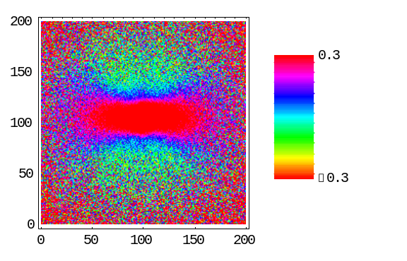
camera
polarizers
Experimental set-up :
a local analysis of the medium
colloïds
laser
g=0.91
g=0.71
g=0.55
(Patterns with crossed polarizers from F. Jaillon, Lyon).
Standard approach : Stokes parameters
Müller matrix depends on scattering properties of medium and on geometry. It contains contributions from different scattering orders.

Slide 6
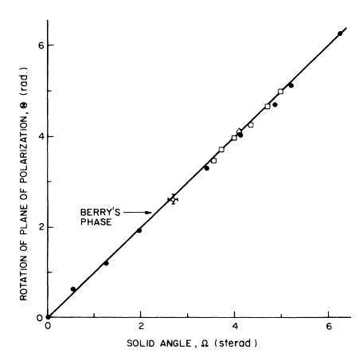
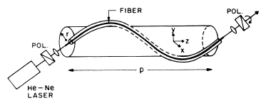
Geometrical phase
Adiabatic evolution of a system described by
an hamiltonian H(R(t)) with R(T)=R(0) (Berry 1984).
Dynamical phase (depends on R(t))
Geometrical phase (independent of R(t))
Example: a spin which turns around a magnetic field B(t) in a direction which is slowly varying : analogous to light polarization when the wave vector k(t) is slowly varying.
Experimental evidence: Tomita (1986)
Changing the pitch of the helix modifies Ω
A wavelength independent effect

Slide 7
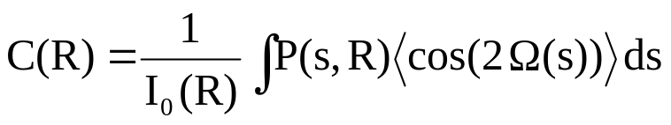
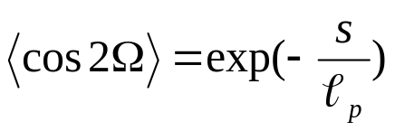
Application to multiple light scattering
Case of forward-peaked scattering
R
u
u
n
n
b
φ
b
φ+Ω
E
E
We have obtained cross shaped patterns with a contrast :
Distribution of geometrical phase is gaussian for s>> ℓ*
Linear polarization decays on a length scale ℓ_{p} analogous to absorption length scale

Slide 8
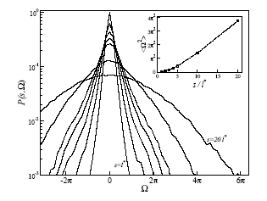
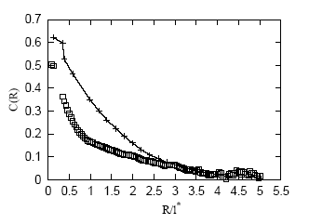
Distribution of geometrical phase Ω
(Monte Carlo simulations)
Experiment: colloïdal suspension (g=0.91)
Single
scattering
Multiple
scattering
D. L., V. Rossetto,
F. Jaillon, H. Saint-Jalmes
Optics Letters,
29 2040 (2004).

Slide 9

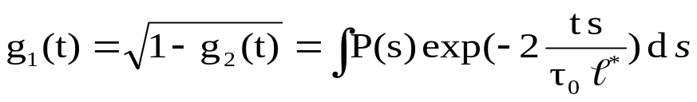
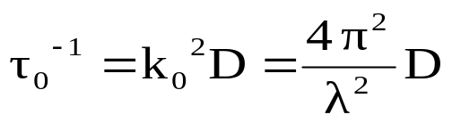
Polarization resolved diffuse wave spectroscopy (DWS)
Analysis of fluctuations of speckle intensity
Correlation function of electromagnetic field
Short paths -> long decay time of correlation function
For colloids in brownian motion:
Many other applications of DWS: micro-rheology of soft matter, granular media or biological tissues…
Polarization memory of multiply scattered light probed by DWS
MacKintosh et al. PRB 40, 9342 (1989)

Slide 10
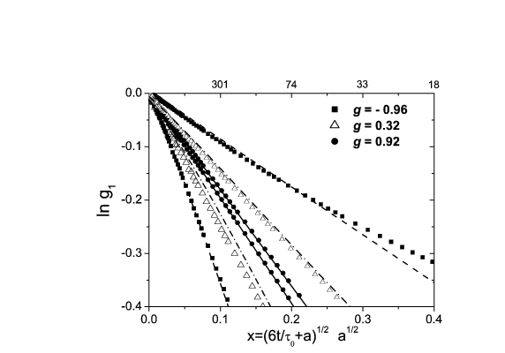
Linearly polarized light in backscattering
LF Rochas-Ochoa, D. L.,
R. Lenke, P. Schurtenberger,
F. Scheffold,
JOSA, 21, 1799 (2004).
Parallel polarizers : short paths contribute more -> slower decay of g
Predominant forward scattering -> longer characteristic path length
Depolarization length ℓ_{p} is unique adjustable parameter

Slide 11
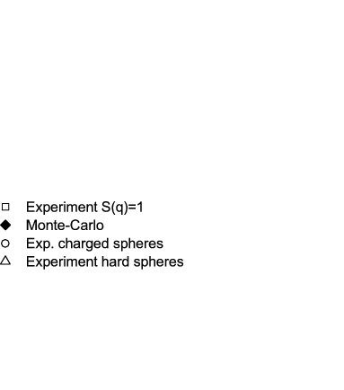
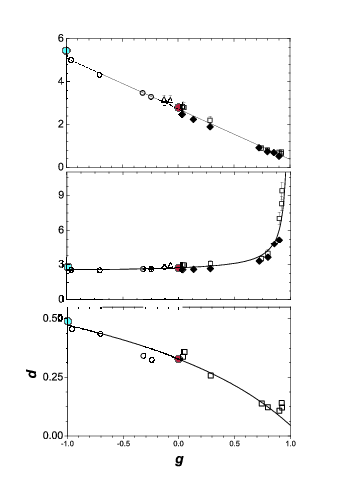
Measurement of ℓ_{p} and polarization degree d
as function of anisotropy parameter g
ℓ_{p}/ℓ*
ℓ_{p}/ℓ
g=0, Rayleigh scattering (Akkermans 1988)
g->1, forward-peaked scattering,
g->-1, backward peaked scattering

Slide 12
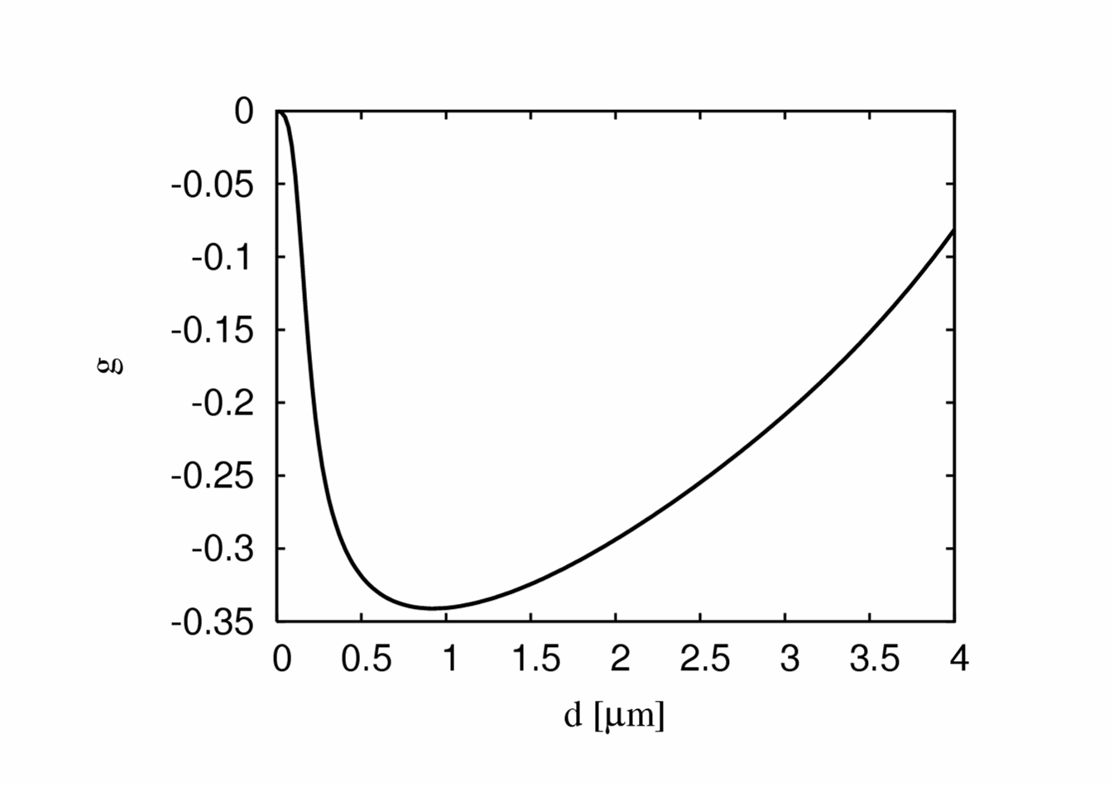
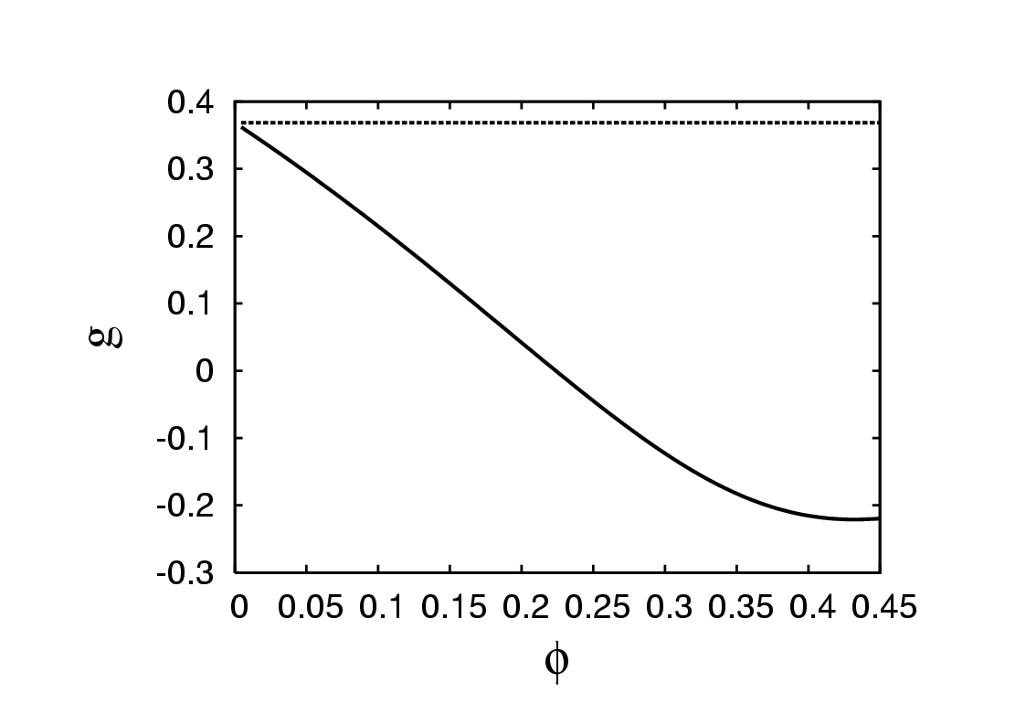
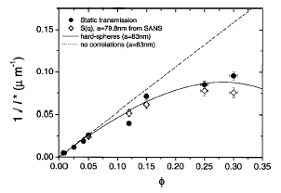
How to create a medium with negative g<0 ?
With metallic spheres :
Example: Mie scattering with Platinum
spheres in infrared at λ=10μm,
index of refraction m=37-41i
In a medium with density correlations :
By tuning these correlations through particle interactions,
any value of g (with -1<g<1) is accessible.
For hard spheres
From F. Scheffold et al., PRE 65, 051403 (2002); PRL 93, 073903 (2004)

Slide 13
Conclusion
Geometric mechanism for the loss of memory
of linear polarization in multiple scattering
-> geometric depolarization
Applications to complex fluids (or biological tissues)
which scatter light predominantly in forward direction.
Polarization resolved DWS in correlated media.
Determination of a characteristic depolarization length ℓ_{p}

