Slide 1



The Significance of Conversational Agents
Conversational Agents (Chatbots/Virtual Assistants) : Enhancing Interactions
Key Points:
"24/7 Support": the round-the-clock availability and responsiveness of conversational agents.
"Cost Efficiency": cost savings through automation.
"Personalization": the ability to provide tailored experiences.
"Data Insights": conversational agents collect valuable data.
"Scalability": the ease of scaling support and services.
"Multilingual Support": ability to assist in multiple languages.
"Accessibility": Note how they can make services more accessible.
"Consistency": Emphasize the reliability of responses.
"Various Applications": healthcare, education, and marketing.
"Human-Machine Interaction": improved natural interaction with technology.

Slide 2
The Evolution of GPT Models
Year | Model released | Parameters | Train data
2018 | GPT-1 | 117 million parameters | dataset of approximately 8 million web pages
2019 | GPT-2 | 1.5 billion parameters | approximately 40 GB of text
2020 | GPT-3 | 175 billion parameters | approximately 570 GB of text
2021 | OpenAI’s Codex | 6 billion parameters | trained on code 800 million lines of code powers GitHub Copilot, an AI-powered code completion tool
2022 | ChatGPT | an updated version of GPT-3, referred to as GPT-3.5
Mar-23 | GPT-3.5-Turbo model API to the public | available to everyone for use in services like ChatGPT
Mar-23 | OpenAI announced the release of GPT-4 | OpenAI is slowly giving developers access to the GPT-4 API. They're starting with a waitlist, and people who help OpenAI evaluate the model get access first.
Sep-23 | New voice and image capabilities in ChatGPT

Slide 3
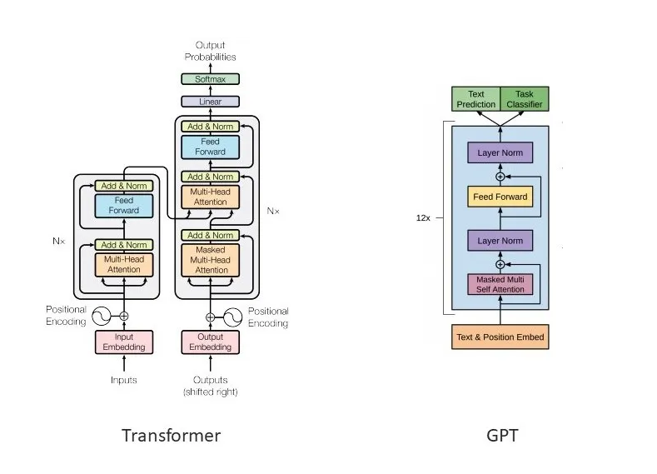

Slide 4
Transparency:
Clearly communicate that the user is interacting with a chatbot and not a human.
Disclose the bot's capabilities and limitations to users.
Avoid misleading users about the chatbot's purpose or intentions
Privacy and Data Protection:
Implement secure data handling practices to protect user information.
Create a privacy policy that explains data collection, storage, and usage.
Obtain user consent for data collection and ensure the ability to delete user data upon request.
Bias and Fairness:
Eliminate bias in chatbot responses to ensure fair and equal treatment of all users.
Regularly review and audit the chatbot's data and algorithms for bias.
Be cautious about using biased training data, which can perpetuate stereotypes.
User Consent and Control:
Design user-friendly interfaces for opting in or out of interactions with the chatbot.
Allow users to customize the type and frequency of interactions.
Implement account deletion and data management features.
Accountability:
Clearly define roles and responsibilities within your development team.
Establish protocols for addressing user complaints, issues, or harmful interactions.
Continuously monitor chatbot interactions for performance and ethical issues.
User Well-being:
Ensure that the chatbot provides reliable and accurate information.
Implement content moderation for sensitive topics.
Provide resources and helplines for users in distress.
Avoiding Harm:
Prevent the chatbot from engaging in harmful, malicious, or illegal activities.
Use robust content filtering to avoid promoting hate speech, violence, or discrimination.
Monitor for any harmful or inappropriate content generated by the chatbot.
Continuous Improvement:
Act on user feedback to enhance the chatbot's performance and ethical behavior.
Stay up to date with ethical AI guidelines and best practices.
Cultural Sensitivity:
Adapt the chatbot's responses and behavior to respect cultural norms and sensitivities.
Consult experts or users from various cultural backgrounds to ensure appropriateness.
Ethical Considerations

Slide 5

THANK YOU!
ANY QUESTIONS?

