Slide 1


Zero Overhead Interface Between the D Language and the C++ Standard Library
Alexandru Razvan Caciulescu
University POLITEHNICA of Bucharest
alexandru.razvan.c@gmail.com
DConf 2017
Berlin, May 4-7, 2017

Slide 2
Motivation
D
C++
STL
Efficient
Widely used
Powerful
Optimized
Awesome
Well tested

Slide 3
The Idea
D
import core.stdcpp.stl_vector;
int main() {
auto v = vector!int();
…
v.push_back(x);
…
}
C++
…
std::vector<int> v;
…
v.push_back(x);
…

Slide 4
Simple Example
extern(C++, std)
{ int foo(char a, char b); // _ZSt3foocc
}

Slide 5
Challenges
Name mangling
Rvalue ref
Operator Overloading
Value vs ref type
C++ ctors
Portability
Const issue
__Exceptions__

Slide 6
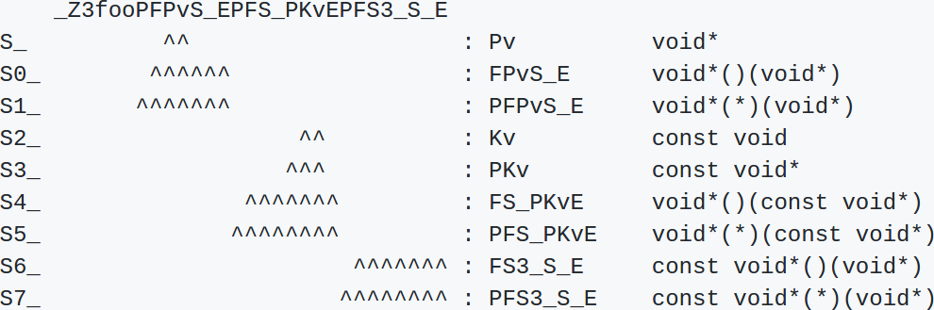
Not so Simple Example
void foo(void*(*)(void*),void*(*)(const void*),const void*(*)(void*))

Slide 7
Not so Simple Example
_ZN11QMouseEvent24createExtendedMouseEventEN6QEvent4TypeERK7QPointFRK6QPointN2Qt11MouseButtonE6QFlagsIS9_ESA_INS8_16KeyboardModifierEE
QMouseEvent::createExtendedMouseEvent(QEvent::Type, QPointF const&, QPoint const&, Qt::MouseButton, QFlags<Qt::MouseButton>, QFlags<Qt::KeyboardModifier>)

Slide 8
Name Mangling: Issues
Mangling discrepancies discovered
Unsupported keywords
  __decay_and_strip
First idea: rewrite the mangler?
  Non trivial

Slide 9
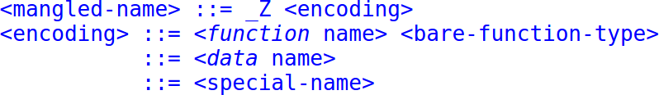
Name Mangling: Grammar

Slide 10
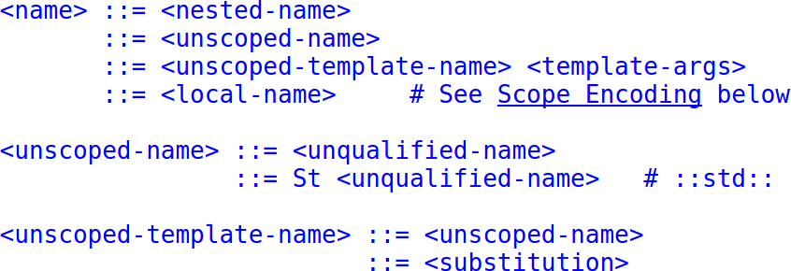
Name Mangling: Grammar

Slide 11
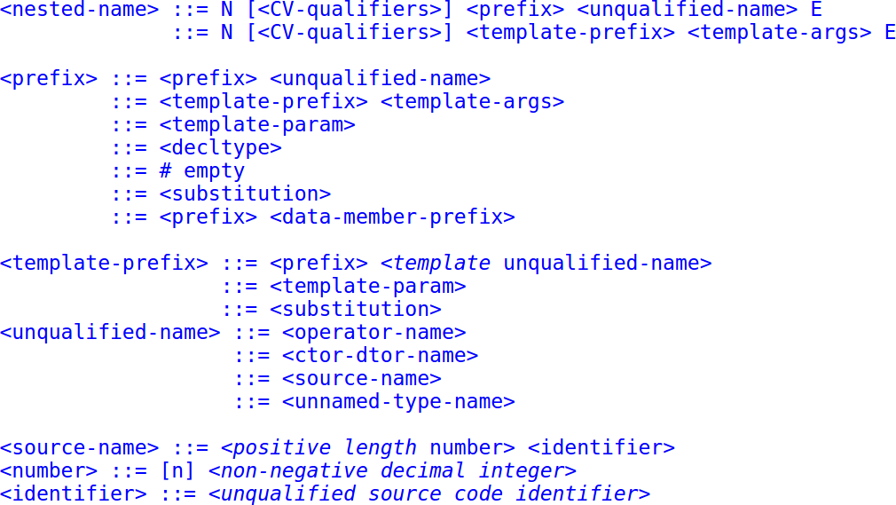
Name Mangling: Grammar

Slide 12
Name Mangling: Ideas
Second idea: Hack the mangler
  Works, efficient, not elegant
Better solution?
  Mangling as library code

Slide 13
Name Mangling: Workaround
pragma(mangle, “_myFoo”)
int foo(char a, char b)
mangleof!(int(char,char))(“foo”)

Slide 14
Rvalue Ref
Hot debate topic
It’s just a mangling issue! (in this case)
One solution: use UDA (User Defined Attributes)
  push_back(@rvalue ref int);

Slide 15
Operator Overloading
Different approach
Implement it on the D side

Slide 16
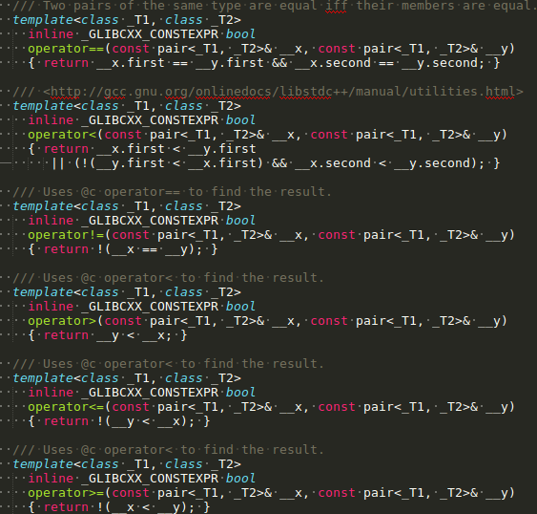
Operator Overloading

Slide 17
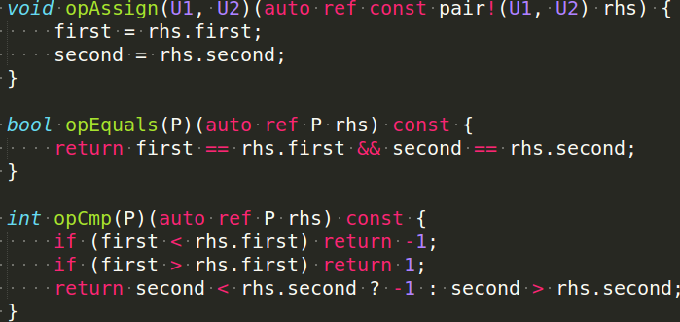
Operator Overloading

Slide 18
Pass by Value
Implies copy constructors
Incompatible between C++ and D

Slide 19
Current State
std::pair
std::allocator
std::vector
std::string

Slide 20
Benchmark

Slide 21
Inline Optimization
void push_back(const ref T x);
void push_back_opt(const ref T x) {
    if (finish == end_of_storage)
      push_back(x);
    else
      *finish++ = x;
}

Slide 22
Inline Optimization
LDC LTO (Link Time Optimization)

Slide 23
Future Work
Elegant solution for name mangling
Mangling as library code
Portability
Exceptions

Slide 24
Conclusions
Have zero overhead between D and STL
Took first steps towards full STL support
Minor STL subset interfaced
Incremental approach
Long road ahead

