Slide 1
LLMs in the Standard Library
Notes:
Comment on how it’s impossible to follow someone like Walter.
Family medical emergency.
Thank staff for their work and help with last years last-minute emergency work.

Slide 2
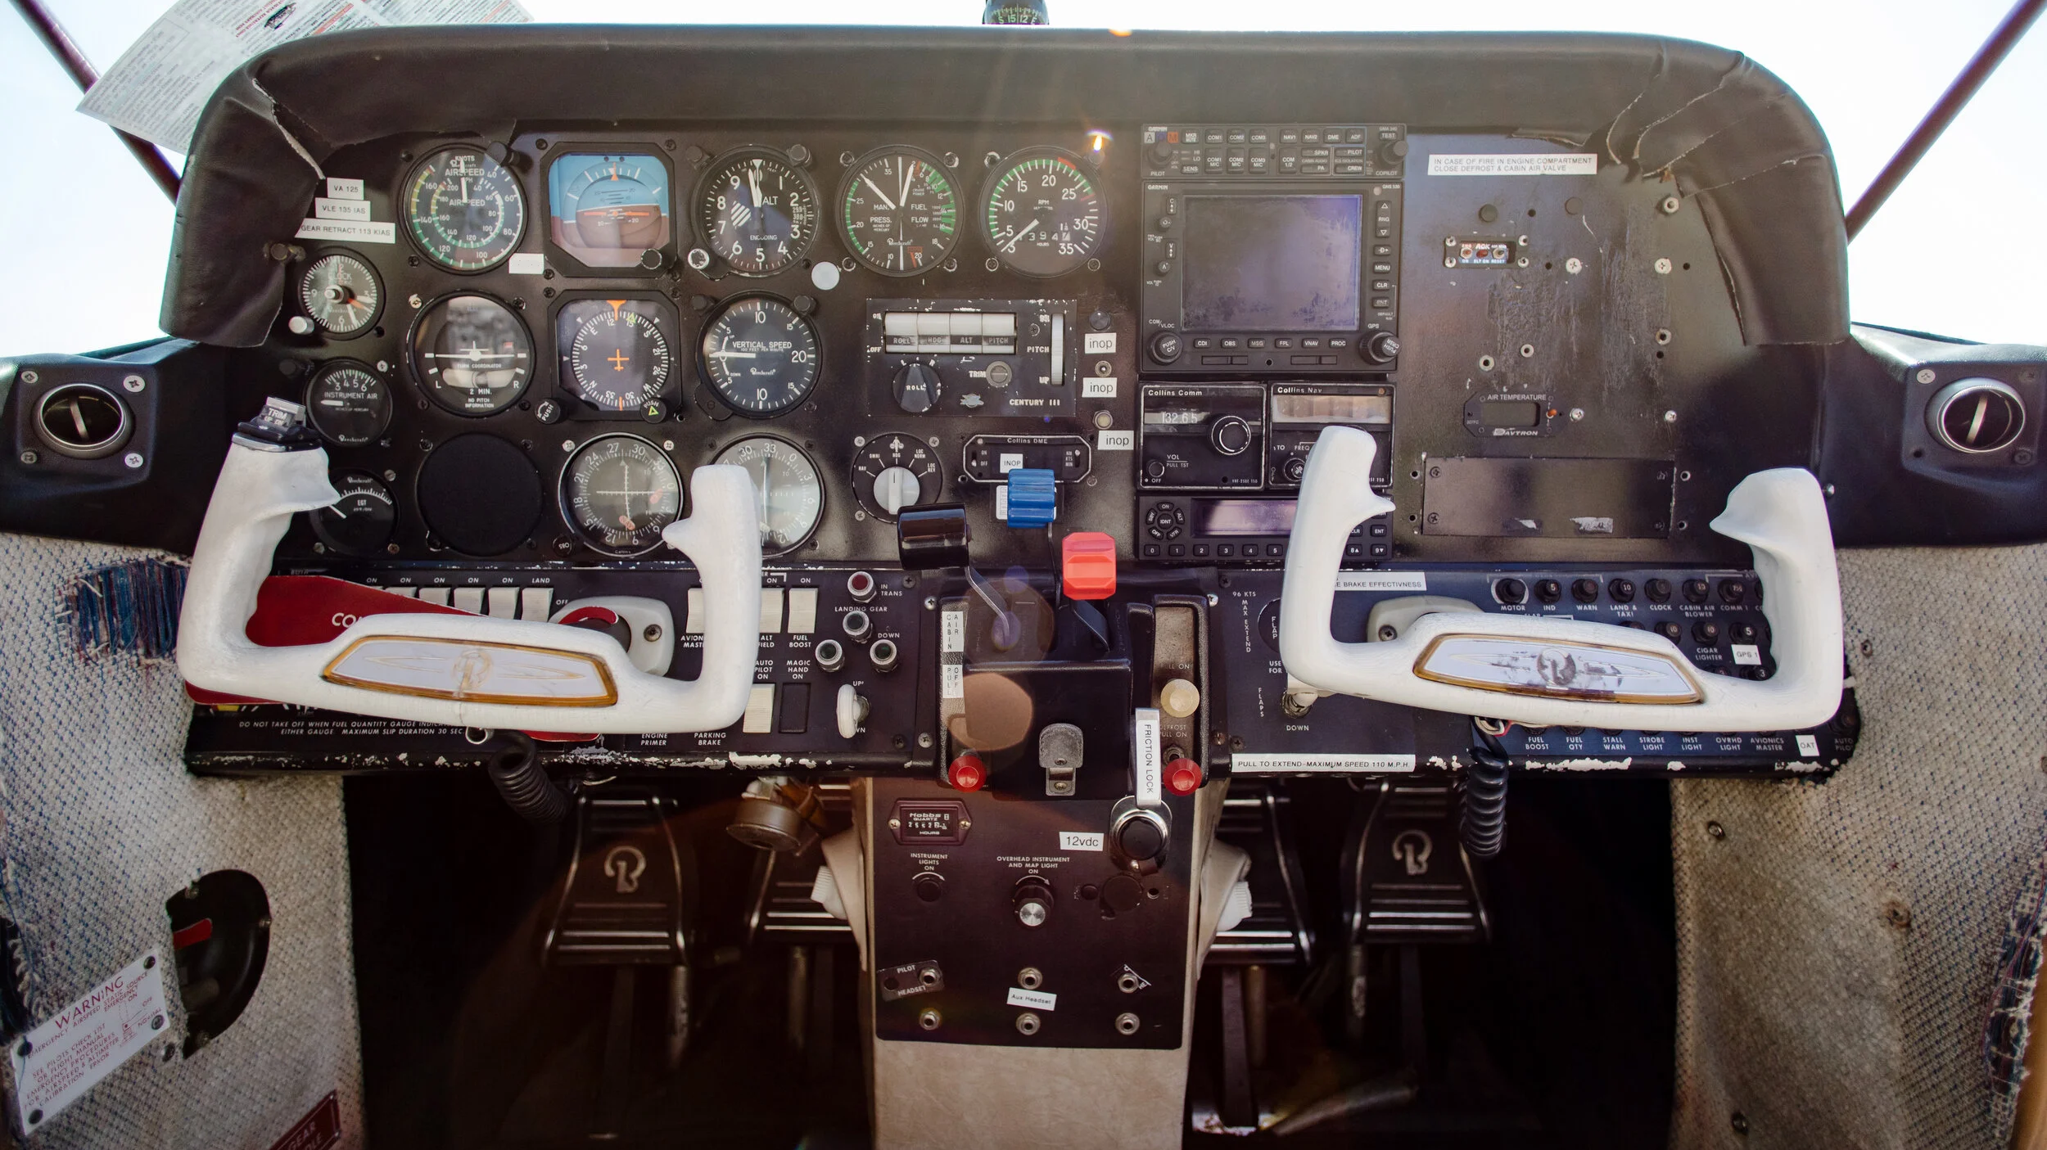

Slide 3
Why Phobos 3?

Slide 4
Walter’s Original Goals
Remove Autodecoding
  No wchar or dchar.
Reduce Template Usage
No Exceptions
  Unicode throws on invalid characters, use replacement char instead.
No GC
std.stdio Rebuild

Slide 5
Walter’s Goals Today
Remove Autodecoding ✅
  No wchar or dchar. ✅
Reduce Template Usage ✅
No Exceptions 🚫- BaseD
  Unicode throws on invalid characters, use replacement char instead. ✅
No GC 🚫- BaseD
Rebuild std.stdio ✅

Slide 6
Why Phobos 3?
These changes require a system wide code audit.
  These audits are difficult to get 100% correct.
These changes will break every user of Phobos 2 in some way.
We can now change other long-standing design choices.
  Banning Attributes avoids “encasing the code in concrete”.
    Once an attribute is added, it can never be removed.
  Fix naming inconsistencies.
  Improve error handling.

Slide 7
Where is BaseD?
It remains the proposed resolution to the lack of nogc/nothrow attributes in Phobs 3.
  No active work submitted to date.
It is currently unresourced.
  We don’t have enough people to tackle Phobos 3.
  Outside High-Performance use cases it has seen little interest.
  Volunteers needed!

Slide 8
Status Update

Slide 9
Where Are We Today?
Usable Today
  phobos.sys
    compiler
    system
    meta
    traits
Not Considered Stable
Symbols May Change!
Available in 2.114

Slide 10
Where Are We Today?
In Progress
  phobos.sys.range
  phobos.sys.decimal
    See: phobos.sys.exttypes
    Repo also contains SemVer and Network Address types.
    GitHub: https://github.com/LightBender/phobos.sys.exttypes
  phobos.sys.optional
    Rebuild of Nullable(T).
    Drops range support.
None are merged into the main repo yet.

Slide 11
Progress is an Issue
Ranges are used everywhere in Phobos.
  Not much can be done without them.
  One person is working on ranges in their spare time.
  Walter and I both agree that LLM’s are not suited to this work.
    There is very little public material for LLM’s to use when considering Ranges.

Slide 12
Candidate Libraries

Slide 13
Candidate Libraries
When not all required Phobos 3 modules are available.
Develop Phobos 3 modules before dependent modules are built.
Focus on API design and implementation.
Competing libraries encouraged.
  Libraries to be hosted on the DLang GitHub account.
  Competitors are subpackages named by original name or GH username.
    Original Name: phobos.data.json.jsoniopie.
    Username : phobos.data.json.lightbender (My GH username)
Library user may user either or both.

Slide 14
Candidate Libraries
Must use the phobos top-level package.
May use Phobos 2 in implementation and unittests.
Must not use Phobos 2 types in the public API surface.
Must not trigger auto-decoding.
Must follow the Phobos 2/3 Style Guides.
Must promptly replace Phobos 2 modules with Phobos 3 modules as they become available.

Slide 15
Candidate Libraries
Maintainer must be willing to support library during development.
Library cannot be included in Phobos 3 until all dependencies are available in Phobos 3.
The implementation must pass community review prior to inclusion in Phobos 3.
In the case of multiple implementations, the community will vote on which library will be included in Phobos 3.
  Other implementations will be removed and the winner rolled up to the primary package name. Ex: phobos.data.json

Slide 16
Candidate Libraries
APIs are considered unstable until formal inclusion in Phobos 3.
No backwards compatibility with older D versions.
  Assume the latest compiler is required.
Your testing and feedback is greatly appreciated.
Please contact me if you want to submit a candidate library.

Slide 17
phobos.sys.exttypes
phobos.sys.decimal: IEEE 754-2008 compliant decimal type.
  Implments Decimal32/Decimal64/Decimal128.
  Aliases ‘decimal’ to Decimal128.
  Extensive unittests drawing from multiple public test libraries.
phobos.sys.network: Network address types
  Can represent the following address types
    IPv4/6 Address/CIDR
    MACAddress and EUI64Address
phobos.sys.semver: SemVer 2.0 Compliant type
GitHub: https://github.com/LightBender/phobos.sys.exttypes

Slide 18
phobos.text.stringbuilder
Replicates .NET’s StringBuilder functionality in D.
Utilizes D’s Interpolated Expression Syntax.
Can improve performance in heavy append/allocation scenarios.
GitHub: https://github.com/LightBender/phobos.text.stringbuilder

Slide 19
phobos.data.compression
Usage: Buffers, Streaming, and Archiving
Codecs: Store, Deflate, ZLib, GZip, and ZStandard
Archives: TAR, GZIP, ZIP, ZIP64
GitHub: https://github.com/LightBender/phobos.data.compression

Slide 20
phobos.database.sql
API similar to JDBC or ADO.NET.
Uses D’s IES to guard against SQL injection attacks.
Leverages phobos.sys.decimal for the DECIMAL, NUMERIC, and MONEY SQL types.
Uses ODBC to interface with any ODBC compliant SQL database.
GitHub: https://github.com/LightBender/phobos.database.sql

Slide 21
Enter LLMs
Notes:
Note that I appear to have not yet talked about LLMs in the standard library.
Note that the prior libraries discussed where all built with LLMs.

Slide 22
LLMs are Controversial
Potential Copyright Issues.
  These are going to be specific to your jurisdiction.
  Seek local counsel.
Concerns over “Slop” code.
  If it is detectable “slop” then it would never have passed our pre-LLM review process.
  If it is not detectable “slop” then it would have passed.
Attribution Enforcement
  If it’s not detectable “slop” then a contributor can lie about LLM usage and we wouldn’t know.
  The honor system prevails.

Slide 23
Why Allow LLMs?
LLMs compress the time to implement features.
We don’t have the contributor numbers that other languages do.
Unlike other OSS projects, reviews are not our bottleneck.
We are already behind other major languages/ecosystems.
  Without LLMs we can only fall further behind.

Slide 24
DLF LLM Contribution Guidelines
Contributors are responsible for what they submit, including ensuring that copyright standards are met.
Contributors must understand the code they submit well enough to answer review questions without LLM assistance.
Engineering and review standards are unchanged.
If a reviewer suspects infringement, they may request more information or reject the submission.
DLF will investigate credible claims of infringement.
Phobos 3 is a DLF project and will follow these rules.

Slide 25
LLM Guidelines for Phobos 3
PR must note that an LLM was used.
Bug Fixes: Must include the prompt used to fix the bug in the PR.
New Features/Modules: Must include the plans that the LLM generates to complete the project, in addition to the initial prompt/s.
  Plans are considered part of the codebase and stored in the Repo.
  Example Plan Path: /phobos/llm-plans/path/to/module/plan-name.md
Using LLM’s for pure research, no code generated, does not require any annotation or prompt/plan logging.

Slide 26
Candidate Libraries
Candidate libraries can be developed faster with LLMs.
LLMs have no trouble mixing Phobos 2 and 3.
  Need to watch them carefully for Phobos 2 pollution of the API.
Allows us to quickly generate multiple competing designs.
  Which means we can get to the correct design much quicker.
  Prior to LLMs such design competitions would’ve been expensive.

Slide 27
Candidate Libraries
The four libraries mentioned earlier were created with LLMs.
All four libraries are used in production code.
They serve as a test for the candidate library concept.

Slide 28
Library Scope Expansion
If we accept that LLMs compress implementation times.
  We can choose to expand the scope of Phobos.
  We have already determined that we wanted to expand scope to include:
    Data Formats, Cryptography, and HTTP Clients.
  But there is a critical capability missing from this expanded scope.

Slide 29
Event Loops
Provides unified event loop system for all platforms.
Gives library authors a single interface to build on.
Enables Stackless Coroutines.
Enables UI message loops.

Slide 30
Phobos 3 Technology Stack
Phobos 3
D Runtime | Event Loop
BaseD | Async Primitives
Platform API

Slide 31
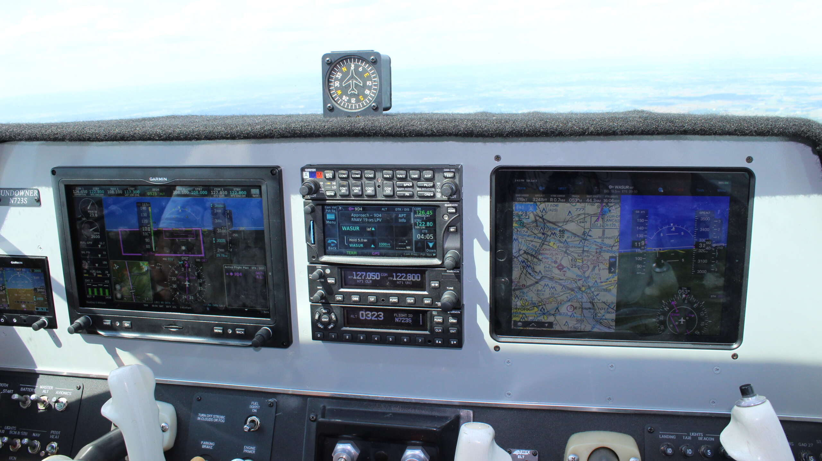

Slide 32

Thank You!

Slide 33
Questions?
GitHub: https://github.com/lightbender
Email: adamdjwilson@gmail.com
Discord: @Adam Wilson

