Slide 1
Bit packing like a mad man
Amaury SECHET
@deadalnix

Slide 2
Memory is slow
About 300 cycles to hit memory
Bandwidth still increasing
Latency only marginally increasing

Slide 3
Memory is slow - Caching
Add faster memory on CPU.
Various size and speed
Signal needs time to travel
L1: 3-4 cycles, 32kb
Instruction
Data
L2: 8-14 cycles, 256kb
L3: tens of cycles, few Mb, often shared
Cache line: 64 bytes

Slide 4
But first a small story…

Slide 5

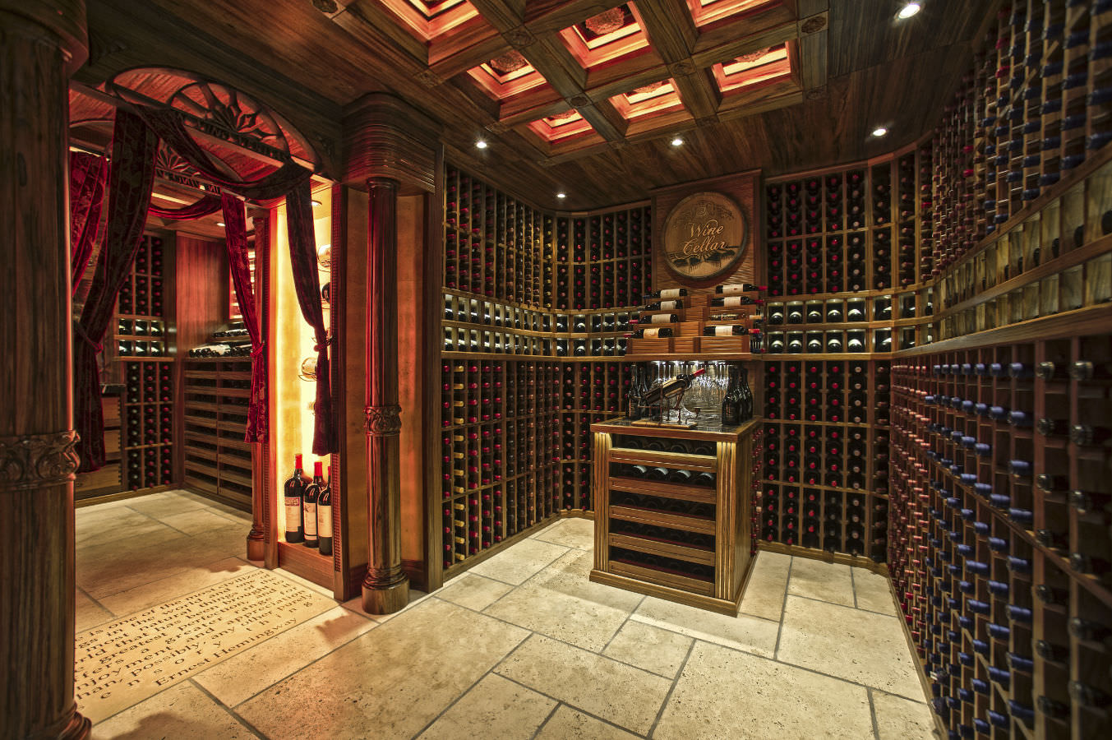
The king is throwing a party
He has 1000 bottles in his cellar

Slide 6
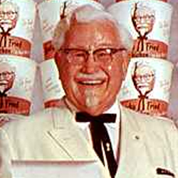
The poison will kill anyone even in small doses.
It takes several hours for someone to die from poisoning.
The King has 1000 servants and 20 prisoners.
He would like to avoid killing servants if possible, but killing prisoners is fine.
What should the king do ?
An evil man poisoned a bottle with his secret recipe with 11 herbs and spices !

Slide 7
The answer
The king can use 10 prisoners.
Number each bottle in binary
Each prisoner will drink from multiple bottles
Prisoner n will drink bottle where the nth digit is 1
The prisoner ding will give the result in binary.

Slide 8
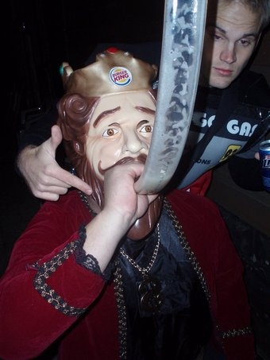
The king’s party was a real success !

Slide 9
Bit packing
Reduce memory waste
Increase cache utilization
Minimal CPU cost
Not a replacement for better algorithms
Instantiating less objects saves a lot of memory !

Slide 10
Alignment
Ensure that load/store do not
Cross cache line
Cross pages boundaries
Unaligned access: severe penalties
Bad performances on some CPU, loss of atomicity
Hardware is doing 2 accesses
Hard error on others (SIGBUS or alike)
Defined by ABI

Slide 11
Alignment – Rule of thumb
Integral types smaller than size_t
T.sizeof
Integral types bigger than size_t
size_t.sizeof
Compiler will decompose memory accesses
Structs
Max(alignment of each field)
Add padding to respect alignment

Slide 12
Struct padding
struct S {
bool f1;
uint f2;
bool f3;
}
f1
pad
f2
f3
pad
12 bytes, 6 wasted

Slide 13
Struct padding
struct S {
uint f2; bool f1;
bool f3;
}
f2
f1
f3
pad
8 bytes, 2 wasted

Slide 14
Padding tips
Start with fields with high alignment
Know where pads are
Enforce assumptions using static assert
alignof
sizeof
Classes, like structs, but
Implicit fields
Vtable
Monitor
At least pointer size alignment

Slide 15
Information density
How much actual information ?
Bool
1 bit of information
8 bits of storage
Object
45 bits of information
64 bits of storage
Dump memory and zip it
Aim for that size

Slide 16
Bit packing
Trade memory consumption for CPU
Usually a good deal
Use one integral as storage
Store several elements in that integral
Use bitwise operations to manipulate elements
std.bitmanip can help

Slide 17
Struct packing
import std.bitmanip;
struct S {
mixin(bitfield!(
uint, "f1", 30,
bool, "f2", 1,
bool, "f3", 1,
));
}
f1
f2
f3
4 bytes, 0 wasted
f1 is now 30 bits instead of 32 bits
Now about 1B max
Fields aren’t atomic anymore
bitfield does all the magic

Slide 18
Bit packing intergals
Data:
enum ReadMask = (1 << S) – 1;
enum WriteMask = ReadMask << N;
@property uint entry() {
return (data >> N) & ReadMask;
}
@property void entry(uint val) in {
assert(val & ReadMask == val);
} body {
data = (data & ~WriteMask) | ((val << N) & WriteMask);
}
entry
32
N + S
N
0

Slide 19
Bit packing bools
enum Mask = 1 << N;
@property bool entry() {
return (data & Mask) != 0;
}
@property entry(bool val) {
if (val) {
data = data | Mask;
} else {
data = data & ~Mask;
}
}
Data:
entry
32
N + 1
N
0
Note: data ^ Mask will flip the bit
It is sometime faster than to set it.

Slide 20
Bitfield layout
2 special spots
Rightmost : mask only
Leftmost : shift only
Large elements require large mask
Put them on the left most
Bools always use masks
Can be checked in leftmost with signed < 0
Don’t put them in special spots unless very hot

Slide 21
Bitfield layout
We want :
One flag
One 2 bits enum E
A 29 bits integral
What is the best layout ?

Slide 22
Bitfield layout
enum E { E0, E1, E2, E3 }
struct S {
import std.bitmanip;
mixin(bitfield!(
E, "e", 2,
bool, "flag", 1,
uint, "integral", 29,
));
}
Codegen :
e = cast(E) (data & 0x03);
flag = (data & 0x04) != 0;
integral = data >> 3;

Slide 23
Unused bits
Sometime, the whole bitfield is not needed
Create a nameless field
uint, "", 29
Make it usable for out struct/subclasses
uint, ”_derived", 29
Ideally make it private/protected
Or use in private struct elements
Need to implement the remaining fields manually
Feature request: bitfield with explicit storage

Slide 24
Unused bits - example
class Symbol : Node {
Name name;
Name mangle;
import std.bitmanip;
mixin(bitfields!(
Step, "step", 2,
Linkage, "linkage", 3,
Visibility, "visibility", 3,
InTemplate, "inTemplate", 1,
bool, "hasThis", 1,
bool, "hasContext", 1,
bool, "isPoisoned", 1,
bool, "isAbstract", 1,
bool, "isProperty", 1,
uint, "derived", 18,
));
}
class Field : Symbol { // ...
this(..., uint index, ... ) {
// ...
this.derived = index;
// Always true for fields.
this.hasThis = true;
}
@property index() const { // Only 262 143 fields possible !
return derived;
}
}

Slide 25
Tagging pointers - @trusted
Least significant bits are known to be 0
How many depends on alignment
Log2(T.alignof)
At least 3 bits on Objects (2 on 32 bits systems)
Once again, std.bitmanip can help
taggedPointer/taggedClassRef
Checks alignment constraints at compiler time
Misaligned pointers are not safe

Slide 26
Tagging pointers - @trusted
enum Color { Black, Red }
struct Link(T) {
import std.bitmanip;
mixin(taggedPointer!(
T*, "child",
Color, "color", 1,
));
}
struct Node(T) {
Link!T left;
Link!T right;
}
pointed
child
Actual pointer points at the object
Tagged pointer point within the object
GC knows about interior pointers

Slide 27
Tagging pointers - @system
Allocate in the lower 32bits of address space
Truncate pointer to 32 bits
Limited to 4Gb
Jemalloc can do that for you
Used by HHVM for codegen
On X86 most significant 16bits are zeros
Hijack them !
Confuse the GC !
Try to not SEGFAULT

Slide 28

Intermission – Germany loves D !
They even put stickers on their cars !

Slide 29
Let’s use a context
Useful for cold but often reused data
For instance, identifiers in a compiler
Usually don’t care about the actual value
Context store identifiers, provide a unique id
32 bits vs 128 bits
Equality can be tested with an int compare
Can be its own hash for hastable lookups
Make the GC happy
less pointers
More noscan !

Slide 30
Let’s use a context
struct Name {
private:
uint id;
this(uint id) {
this.id = id;
}
public:
string toString(const Context c) const {
return c.names[id]
}
immutable(char)* toStringz(const Context c) const {
auto s = toString();
assert(s.ptr[s.length] == '\0', "Expected a zero terminated string");
return s.ptr;
}
}

Slide 31
Let’s use a context
class Context {
private:
string[] names;
uint[string] lookups;
public:
auto getName(const(char)[] str) {
if (auto id = str in lookups) {
return Name(*id);
}
// As we are cloning, make sure it is 0 terminated as to pass to C.
import std.string;
auto s = str.toStringz()[0 .. str.length];
auto id = lookups[s] = cast(uint) names.length;
names ~= s;
return Name(id);
}
}

Slide 32
Context prefill
Useful to pin some id at compile time
Can be used without lookup in the context
Generated identifiers
object.d
Linkage/Version/Scope/Attribute

Slide 33
Context prefill
enum Reserved = [ "__ctor", "__dtor", "__postblit", "__vtbl", ];
enum Prefill = [
// Linkages
"C", "D", "C++", "Windows", "System",
// Generated
"init", "length", "max", "min", "ptr", "sizeof", "alignof",
// Scope
"exit", "success", "failure",
// Defined in object
"object", "size_t", "ptrdiff_t", "string",
"Object",
"TypeInfo", "ClassInfo",
"Throwable", "Exception", "Error",
// Attribute
"property", "safe", "trusted", "system", "nogc",
// ...
];
auto getNames() {
import d.lexer;
auto identifiers = [""];
foreach(k, _; getOperatorsMap()) {
identifiers ~= k;
}
foreach(k, _; getKeywordsMap()) {
identifiers ~= k;
}
return identifiers ~ Reserved ~ Prefill;
}
enum Names = getNames();

Slide 34
Context prefill
template BuiltinName( string name, ) {
private enum id = Lookups .get(name, uint.max);
static assert( id < uint.max, name ~ " is not a builtin name.", );
enum BuiltinName = Name(id);
}
auto getLookups() {
uint[string] lookups;
foreach(uint i, id; Names) {
lookups[id] = i;
}
return lookups;
}
enum Lookups = getLookups();

Slide 35
More context !
Track locations in a compiler
They are everywhere
Register file in the context
Allocate a range of value from N to N + sizeof(file)
A position for each byte in the file !
Add a flag for mixin (D) / macros (C++)
Register expansions in the context.

Slide 36
More context !
Use cases:
Emit debug infos
Error messages
Perfs do not matter for errors
Access pattern mostly predictable for debug
Find file/line from location using
One element cache
Linear search (8 elements)
Binary search

Slide 37
More context !
0
2B
File 1
File 2
File 3
Empty
Mixin 1
Mixin 2
Mixin 3
Empty
-2B
-1
Context store file boundaries and line position within files

Slide 38
More context !
A position is 31 bits number + a flag
Up to 2Gb of source code + 2 Gb of macros/mixin
A pair of positions is a location
Used for tokens/expressions/symbols/statements
Lexer only need to bump the position value for each token by the length of the token
Strategy used by clang / SDC

Slide 39

Polymorphism

Slide 40
Tagged reference
Useful to encapsulate several reference types
Can provide methods forwarding to elements
Use reflection to do so
Avoid vtable lookups/cascaded loads
No common layout in the referenced object
Number of elements limited by alignement
Easy to get up to 8 on X64
LLVM’s call/invoke

Slide 41
Tagged reference
template TagFields(uint i, U...) {
import std.conv;
static if (U.length == 0) {
enum TagFields = "\n\t" ~ T.stringof ~ " = “ ~ to!string(i) ~ ",";
} else {
enum S = U[0].stringof;
static assert(
(S[0] & 0x80) == 0,
S ~ " must not start with an unicode.",
);
static assert(
U[0].sizeof <= size_t.sizeof,
"Elements must be of pointer size or smaller.",
);
import std.ascii;
enum Name = (S == "typeof(null)")
? "Undefined"
: toUpper(S[0]) ~ S[1 .. $];
enum TagFields = "\n\t" ~ Name ~ " = "
~ to!string(i) ~ "," ~ TagFields!(i + 1, U[1 .. $]);
}
}
mixin("enum Tag {" ~ TagFields!(0, U) ~ "\n}");
import std.traits;
alias Tags = EnumMembers!Tag;
import std.typetuple;
alias TagTuple = TypeTuple!(uint, "tag", EnumSize!Tag);

Slide 42
Tagged reference
struct TaggedRef(U...) {
private:
import std.bitmanip;
mixin(taggedPointer!( void*, "ptr", TagTuple));
public:
auto get(Tag E)() in {
assert(tag == E);
} body {
static union Helper {
void* __ptr;
U u;
}
return Helper(ptr).u[E];
}
template opDispatch(string s, T...) {
auto opDispatch(A...)(A args) {
final switch(tag) {
foreach(T; Tags) {
case T:
auto r = get!T();
return mixin("r." ~ s)(args);
}
}
}
}
}

Slide 43
Value Type Polymorphism
All subtypes fit under a given size budget
A tag is used to differentiate them
The whole thing is wrapped in an nice API
Being able to hide atrocities behind a nice façade, that’s the power of D
Example: Representing D types

Slide 44
Value Type Polymorphism
template SizeOfBitField(T...) {
static if (T.length < 2) {
enum SizeOfBitField = 0;
} else {
enum SizeOfBitField = T[2] + SizeOfBitField!(T[3 .. $]);
}
}
enum EnumSize(E) = computeEnumSize!E();
size_t computeEnumSize(E)() {
size_t size = 0;
import std.traits;
foreach (m; EnumMembers!E) {
size_t ms = 0;
while ((m >> ms) != 0) {
ms++;
}
import std.algorithm;
size = max(size, ms);
}
return size;
}

Slide 45
Value Type Polymorphism
struct TypeDescriptor(K, T...) {
enum DataSize = ulong.sizeof * 8 - 3 - EnumSize!K - SizeOfBitField!T;
import std.bitmanip;
mixin(bitfields!(
K, "kind", EnumSize!K,
TypeQualifier, "qualifier", 3,
ulong, "data", DataSize,
T,
));
static assert(TypeDescriptor.sizeof == ulong.sizeof);
this(K k, TypeQualifier q, ulong d = 0) {
kind = k;
qualifier = q;
data = d;
}
}

Slide 46
Value Type Polymorphism
A type is a TypeDescriptor + an indirection field
Data depend on the kind
If it doesn’t fit, use indirection field
There are many type kind:
Builtin
Struct
Class
Alias
Function
…
Common API switch on kind to do the right thing

Slide 47
Value Type Polymorphism
data
Qualifier
Kind
Indirection
128 bits budget
Indirection is used when
The type need extra space (Function)
The type need to refers to a symbol (Aggregate, Alias)
Otherwise null
Replaced the type class hierarchy advantageously
Significant memory consumption reduction
Significantly faster runtime (about 20%)

Slide 48
Value Type Polymorphism
You can nest, effectively creating hierarcies
For instance, Identifiable is
A type
An expression
A symbol
More packing !

Slide 49
Value Type Polymorphism
Tag
data
Qualifier
Kind
Indirection/Expression/Symbol
Tag is used to discriminate between
Type
Expression
Symbol
Tag is zeroed out to find the type
Saved 70 Mb (!) of template bloat in SDC

Slide 50
Value Type Polymorphism
import d.semantic.identifier;
Identifiable i = ...;
i.apply!(delegate Expression(identified) {
alias T = typeof(identified);
static if (is(T : Expression)) {
return identified;
} else {
return getError(
identified,
location,
t.name.toString(pass.context) ~ " isn't callable",
);
}
})();

Slide 51
Value Type Polymorphism
Identifiable
Type
Expression
Symbol
Builtin
Class
Struct
Alias
Pointer
Function
…

Slide 52
Value Type - ABI
Struct up to 2 fields
Up to pointer sized
Slice !
No float/integral mixing
Common anti pattern 2 pointers + a bool
std.bigint.BigInt is a slice + a bool
Passed in memory instead of registers ☹
More than one pointer tends to use 2
Use either 1 or 2 pointer sized struct

Slide 53

Classless Polymorphism

Slide 54
Classless Polymorphism
Create a base struct
All substruct use it as first field
Contains a tag describing the type
The tag can be part of a bitfield
Use mixin in all substruct
Include static assert to check this is done right
Alias this the base

Slide 55
Classless Polymorphism
Each leaf of the hierarchy has a tag value
Each non leaf has a range of tag value
The root match all values
The hierarchy must be know at compile time
Use a bunch of mixin templates
Add the boilerplate
A ton of static asserts

Slide 56
Classless Polymorphism
struct SubStruct {
mixin GrandChilds!( Root, SubChild, );
}
struct SubChild {
mixin Parent!SubStruct;
}
struct Child {
mixin Parent!Root;
}
struct Root {
mixin Childs!(Child, SubStruct);
}

Slide 57
Classless Polymorphism
Root
Root
Child’s fields
Root
SubStruct’s fields
Root
SubStruct’s fields
SubChild’s fields

Slide 58
Classless Polymorphism
Child share the parent’s part of the layout
It is safe to upcast
Done via alias this
Downcast to a leaf: check tag’s value
Cheap
Easy pattern matching
Downcast to substruct: check tag range
Cheap
No typeid pointer chasing

Slide 59
Virtualish Dispatch
No virtual table
Get function pointer in a table
One table per method
One entry per leaf type
Using the tag as an index
Used by HHVM for PHP arrays
Creative datastructure
Is a vector/hashmap/set/tuple/whatever…

Slide 60
Regular Virtual Dispatch
f1
f2
f3
f4
g1
g2
g3
g4
Vtable pointer
T1’s data
Vtable pointer
T2’s data
One vtable per type
Vtable has one entry per method
Load vtable then load function address

Slide 61
Virtualish Dispatch
f1
g1
h1
i1
f2
g2
h2
i2
Tag
T1’s data
Tag
T2’s data
One vtable per method
Vtable has one entry per type
Load tag then use it as index in per function table

Slide 62
Virtualish Dispatch
Usually better locality
Calling the same method on objects of various types more common than calling various method on objects of the same type
Often worked around by sorting by type
Classless get most of the benefit without sorting
Still helps branch prediction
Tables can be generated using reflection in D

Slide 63
Classless visitors !
Regular class hierarchy need to know all method at compile time
Can add types dynamically
Classless hierarchy need to know all types at compile time
Can add method dynamically
Visitor can create a visit method’s table
And use the tag to dispatch
Closed extensibility one way, opened it another way

Slide 64
?

