Slide 1


Generic Lightweight Druntime
Lucia Madalina Cojocaru
University POLITEHNICA of Bucharest
lucia.mcojocaru@gmail.com

Slide 2
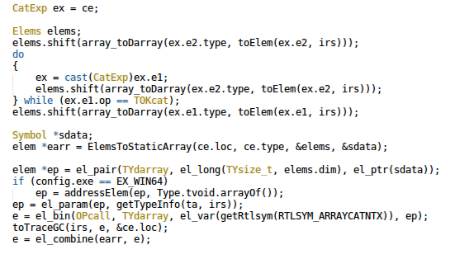

Slide 3
How?
Witch hunt: compiler dark magic
Lower to straight D code (in Druntime)
Burn them at the stake!
Refactor druntime to do their job

Slide 4
Motivation
DMD replaces certain code with calls to traditional untyped functions in the runtime library
Call created during IR code gen phase
TypeInfo inheritance chain
Dynamically dispatched calls that are slow

Slide 5
The Idea - Lowering
Lower the code to calls to templates in Druntime
Lowering happens during the semantic analysis phase
Replace complex code generation in compiler and Druntime with simple templates
Implementation focus shifts on Druntime
Less duplication! Safety! Speedup!

Slide 6
The Process
if (__cmp(a, b)){…}
int __cmp(T)(const T[] lhs,
const T[] rhs)
if (__traits(isScalar, T))
{
…
}
int[2] a = [1, 2];
int[2] b = [3, 4];
if (a > b){…}
Compiler semantic
Runtime template

Slide 7
First Steps
Identify some functions and replace them
Array operations
Compare
Equals
Assign
Evaluate performance

Slide 8
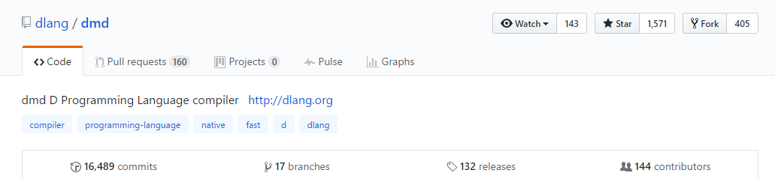
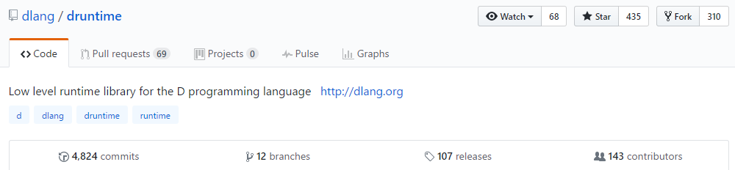
Pros – [PRs] To Be Reviewed…
Notes:
Lots of contributors, significantly fewer than on phobos
PR contrast => not enough compiler experts to understand internals and review PRs

Slide 9
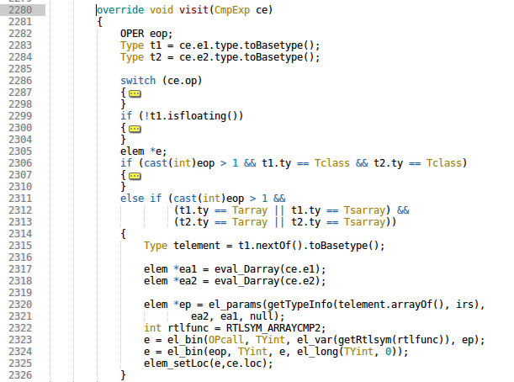
Pros – Simplify the Compiler
dmd/src/ddmd/e2ir.d
Notes:
- Bits of code with various optimizations or specifics sprinkled all over the compiler
Remove them, add straightforward implementation in druntime
AST => IR where the call to the array compare function is generate
During semantic analysis phase we are not aware that this will happen

Slide 10
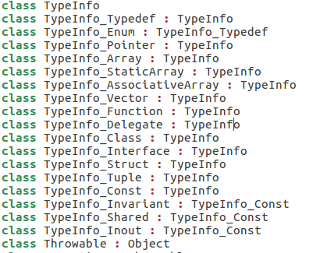
Pros – Reduce the Use of TypeInfo
druntime/src/object.d
Notes:
Typeinfo - used to generate runtime info about types
Used by the compiler
Inheritance hierarchy
Find the proper override => lots of indirections (slow at times)
Lots of duplicate code.
Lots of code that can be removed once templates are in place.

Slide 11
Pros – Templates Everywhere!
Generic
Compiled when necessary
Richer type information (@nogc, nothrow, pure)
Inlineable
Performance increase!
Notes:
We have the positive experience of C++ that has switched full bore from virtuals/indirect calls/traditional designs to template-based designs maintaining great speed and usability. Of course, we are certain we can greatly improve on that.
Primitive types (e.g. int) cannot be directly held in the container. You must write a wrapper class (such as Java's Integer) to hold such items.
The container is not typesafe. You must cast items from Object to their real type when removing them from the container. There are also no particular limits on the actual types of the items in the container, meaning a given container is capable of holding a random mix of types.
All of this up- and down-casting can have a negative impact on performance.

Slide 12
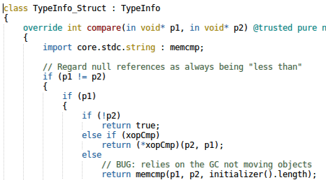
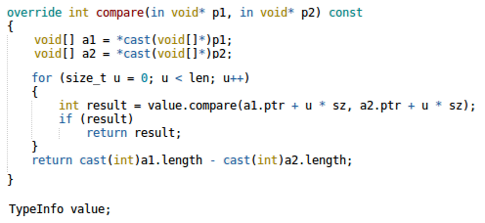

Pros – Performance! (Before)
druntime/src/object.d
struct C
{
int i;
int opCmp(C c) const
{ return i - c.i; }
}
druntime/src/adi.d
druntime/src/object.d
Notes:
Struct with opEquals
1. call to adCmp2
2. call to the appropriate compare in TypeInfo
3. call opEquals defined for that struct

Slide 13
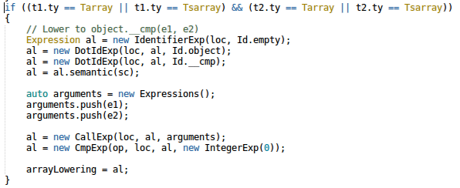

Pros – Performance! (After)
dmd/expression.d
struct C
{
int i;
int opCmp(C c) const
{ return i - c.i; }
}
druntime/src/object.d
Notes:
Struct with opEquals
1. call to template
2. call to opEquals
Less indirection, templates are inlined => faster code

Slide 14
Cons – object.d Bloating
Code from druntime/src/rt/typeinfo moves into object.d
Compare, equals, getHash
All template overloads defined in object.d
New modules in druntime: import tradeoff

Slide 15
Cons – Compilation Speed
Simple projects - no difference
Compilation speed may decrease
Compile the templates several times

Slide 16
Current State
Array compare (__cmp) integrated in dmd and druntime
Array equals in development (some dmd tests failing)
Benchmarks
Backburner: array assign, code cleanup
Notes:
Compare finish + benchmarks
Array equals finished: passes druntime and phobos unittests, fails dmd test because of issue with compile time evaluation of static variables

Slide 17
Benchmarks
bool fun(C[] array1, C[] array2) {
return array1[] < array2[];
}
void test(int size)
{
C[n] array1, array2;
// create arrays of size n
...
auto r = benchmark!({ fun(array1, array2); })(10_000);
}

Slide 18
Array Compare Speedup (1/2)

Slide 19
Array Compare Speedup (2/2)

Slide 20
Array Equals Speedup (1/2)

Slide 21
Array Equals Speedup (2/2)

Slide 22
Hot Code!
Integer and string comparisons happen often
Lots of compile time string comparisons (equality)
Several sorting algorithms in Phobos

Slide 23
Further Work
__equals, array assign
Templates for non-array types
Destructors, switch statements
Code cleanup

Slide 24
Conclusions
Refactor druntime to use lowering and templates
Simplify compiler logic and increases runtime performace
Simplify the language implementation and make it more powerful
Speedup between 1x and 30x

